Slide 1
Understanding and Utilizing the Geostationary Lightning Mappers (GLMs) for Operational Meteorology & Lightning Safety
Joseph Patton, University of Maryland-College Park/ESSIC/CISESS
20 May 2021

Slide 2
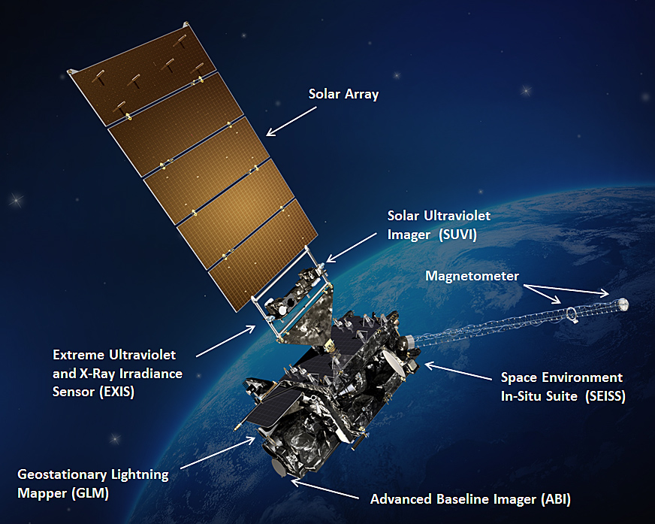
What Is the GLM?
GLM is a single-channel, near-infrared imager that monitors for short-lived sources of light emitted by lightning, both cloud-to-ground and cloud-to-cloud
Sources of light are compared to a continuously updating background image to detect lightning
Coverage is provided across most of the Western Hemisphere by GOES-16 and GOES-17
GOES satellite with GLM. Source: NASA

Slide 3
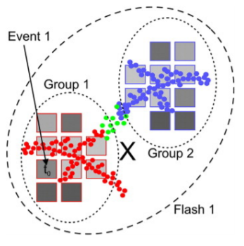
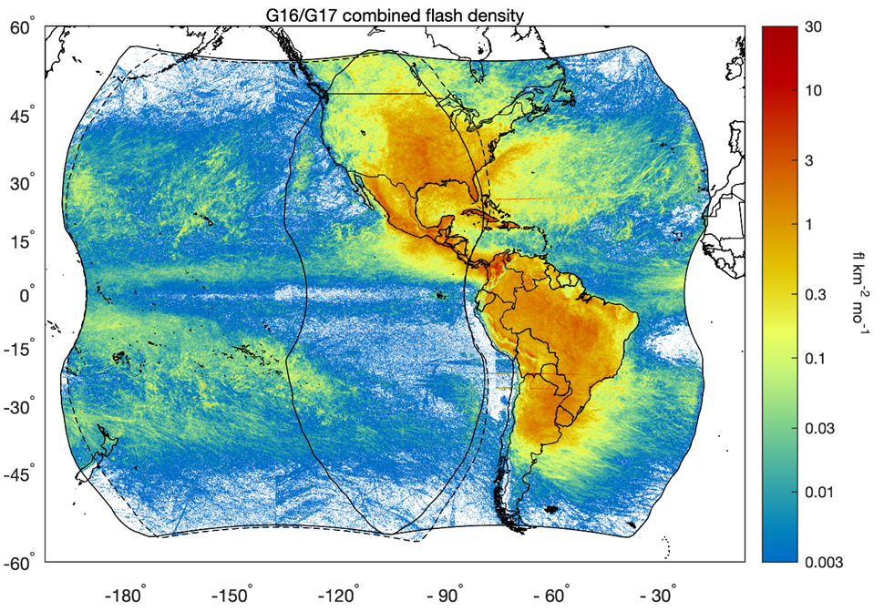
Flash Processing by the GLM
Individual point sources of lightning are collected into “flashes” when groups of point sources occur near each other in space and time
Gridded products quickly convey lightning characteristics such as the areal lightning extent and number of flashes
Source: Bruning et al. (2019)
Source: Rudlosky and Virts (2021)

Slide 4
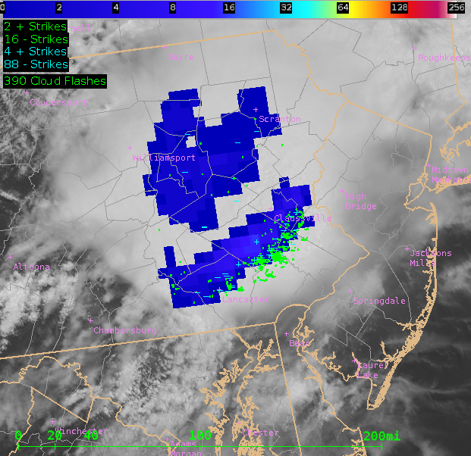
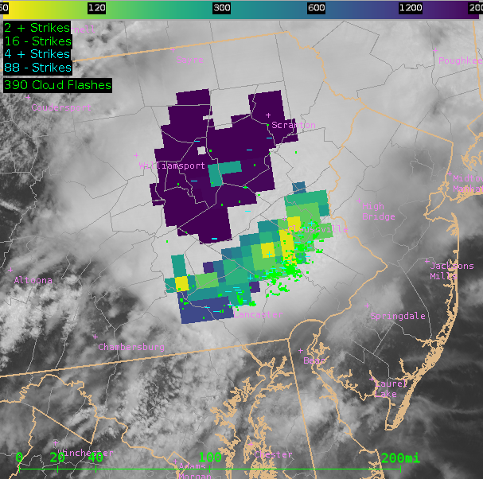
GLM Gridded Products
Flash Extent Density (FED) – total number of flashes spatially coincident with each grid cell over a given period of time. Ranges from one to hundreds of flashes
Minimum Flash Area (MFA) – smallest area of any flash observed with each grid cell in km². Smallest MFA values are less than 100 km² while the largest MFA values can be 1000s of km²
Total Optical Energy (TOE) – total amount of optical brightness observed by the GLM instrument in femtoJoules (J x 10⁻¹⁵). Ranges from 0.1 fJ to hundreds of fJ
FED, MFA, and TOE imagery from a convective complex in the Eastern United States

Slide 5
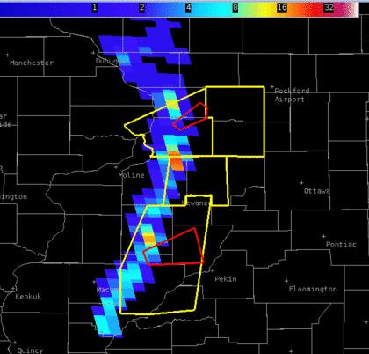
GLM Products – Flash Extent Density (FED)
Total flash counts with each grid cell over a given period of time
Cool colors indicate fewer flashes while warmer colors indicate more flashes
Large FED not necessary for severe storms, but larger FED may be indicative of strengthening convective activity which may show a greater potential for severe weather
“Jumps” in lightning activity have been correlated with a higher likelihood of the occurrence of severe weather
FED + NWS Warnings
FED Imagery from a QLCS in the Central United States

Slide 6
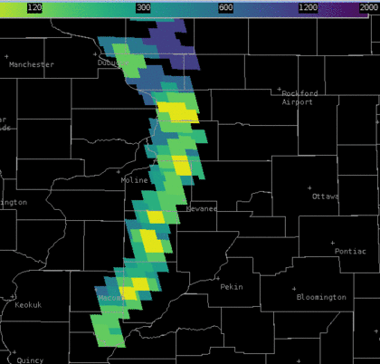
GLM Products – Minimum Flash Area (MFA)
Area of the smallest flash spatially coincident with each grid cell over a given period of time
Smaller MFA values (< 300 km²) represented by yellow/green grid cells often indicate strengthening convection and/or mature updrafts
Larger MFA values (> 900 km²) represented by dark blue/purple grid cells often indicate either weakening convection or large flashes in anvil/stratiform regions of mature storms
MFA
MFA Imagery from a QLCS in the Central United States

Slide 7
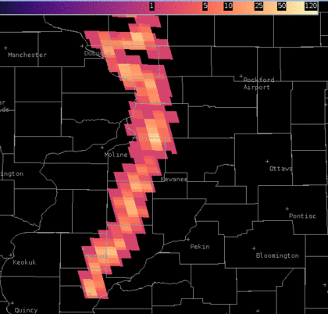
GLM Products – Total Optical Energy (TOE)
Amount of optical brightness/energy observed with each grid cell over a given period of time
More energetic lightning flashes will likely be observed by the GLM as higher TOE values
Higher TOE values may indicate brighter flashes from strengthening convection or fewer hydrometeors preventing light from reaching the GLM instruments
TOE
TOE Imagery from a QLCS in the Central United States

Slide 8
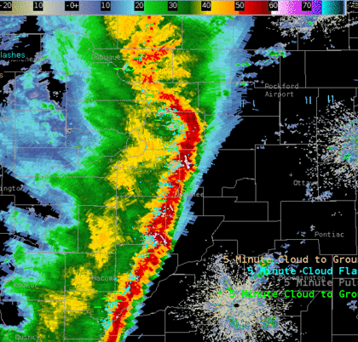
Case Study – QLCS
Consistently low MFA coupled with greater FED coincides with a bowing segment on radar
70-80 mph wind gusts observed shortly after
MFA
FED + NWS Warnings
TOE
Radar + NLDN/GLD360
1-min GLM products update more rapidly than the fastest radar scans (~5 min)

Slide 9
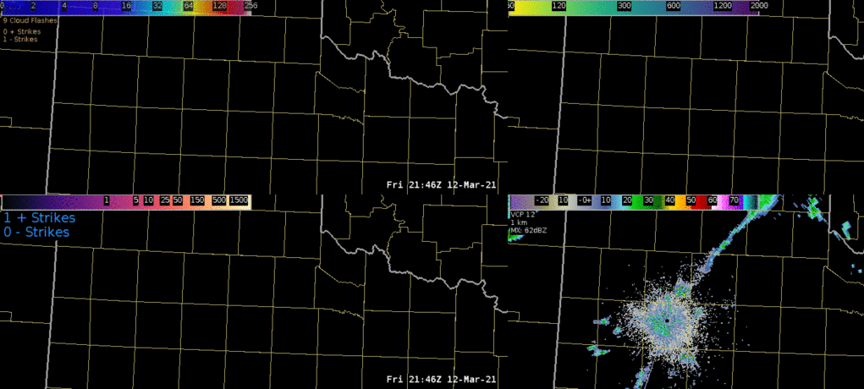
Lightning Safety
FED + NWS Warnings
MFA
Convective initiation (above) is highlighted with low MFA values as first lightning occurs
Large stratiform region flashes (left, red ovals) are clearly visible with high MFA/low FED/high TOE values; highlight a less obvious risk for cloud-to-ground flashes which threaten life and property
Radar + NLDN/GLD360
TOE

Slide 10
Operational and Training Resources
Operational GLM Product Sources
GLM Training Resources
CSPP Geo software allows forecasters to visualize GLM grids in real-time (https://cimss.ssec.wisc.edu/csppgeo/)
Software is compatible with 64-bit CentOS7 Linux platforms and is free to download and use
CSPP Geo supports all GOES-16 instruments
Some near real-time GLM imagery can also be seen in some online resources such as College of DuPage (https://weather.cod.edu/) and Weathernerds (https://www.weathernerds.org/)
Several quick guides (2-page reference materials) detailing GLM products and uses are hosted here: https://rammb.cira.colostate.edu/training/visit/quick_guides/ (just look for GLM)
Quick briefs (4 to 5 minute training videos) concerning the GLM are hosted here: https://rammb.cira.colostate.edu/training/visit/quick_briefs/
COMET provides GLM/GOES-R training here: https://www.goes-r.gov/users/training/comet.html

Slide 11
Summary & References
GLM gridded products include Flash Extent Density (flash counts), Minimum Flash Area (area of smallest flash), and Total Optical Energy (total optical brightness)
Using the GLM gridded products in addition to ground-based networks is important to fully understand the lightning and convective activity within thunderstorms
Initial flashes and stratiform flashes, both of which pose a risk to safety, are highlighted by the GLM
Several training resources are available for better understanding how to use the GLM
References
Bruning, E., Tillier, C. E., Edgington, S. F., Rudlosky, S. D., Zajic, J., Gravelle, C., et al. (2019). Meteorological imagery for the geostationary lightning mapper. Journal of Geophysical Research: Atmospheres, 2019; 124: 14285– 14309. https://doi.org/10.1029/2019JD030874
Rudlosky, S. D., and Virts, K. S. (2021). Dual Geostationary Lightning Mapper Observations. Monthly Weather Review, 2021; 149-4: 979-998. https://doi.org/10.1175/MWR-D-20-0242.1

