Slide 1

GLM Lightning Optical Energies
GLM Science Meeting, Huntsville AL
Sept. 12, 2018
William Koshak, NASA/MSFC
Koshak, NASA/MSFC

Slide 2
Overview
Analysis
Sample Daily Plots
Frequency Distribution
Spatial Variation
Diurnal Variation
Trend of Daily Mean Energy
Koshak, NASA/MSFC

Slide 3
Analysis
Koshak, NASA/MSFC

Slide 4
Analysis
Region: Entire GLM FOV
Period: 11 Jan 2018 - 11 Jun 2018
# Days: 152
# Flashes: 121,073,578
Filtration: None (so energy biased by glint, radiation dots, …)
Emphasis: On long-term trending of full flash data product as we move through s/w fixes.
Koshak, NASA/MSFC

Slide 5
Sample Daily Plots
Koshak, NASA/MSFC

Slide 6
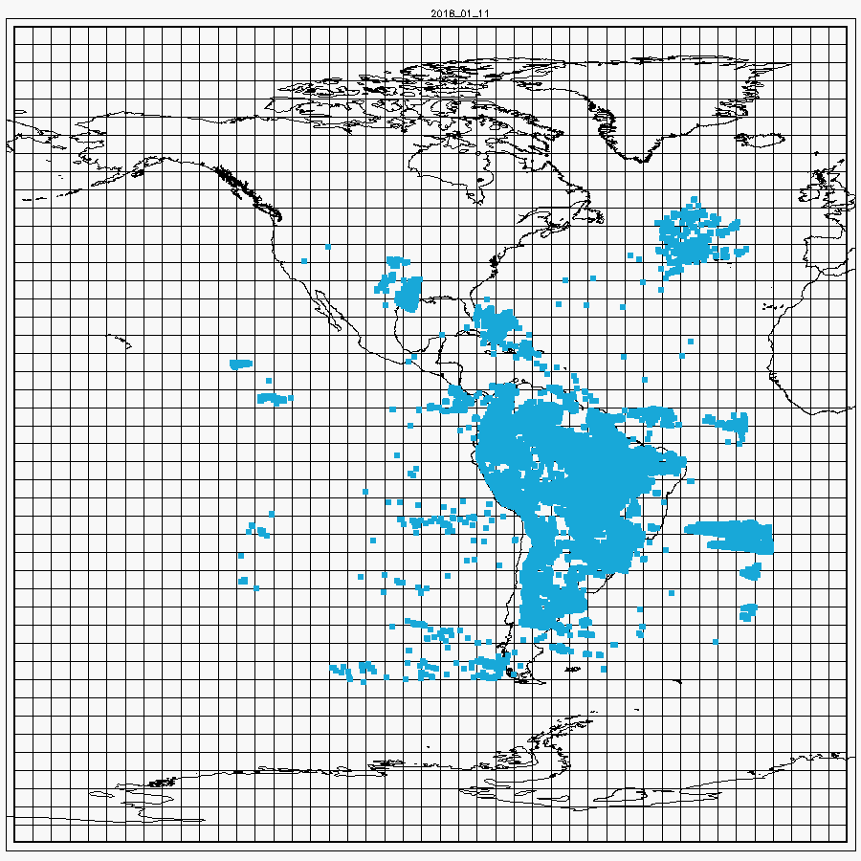
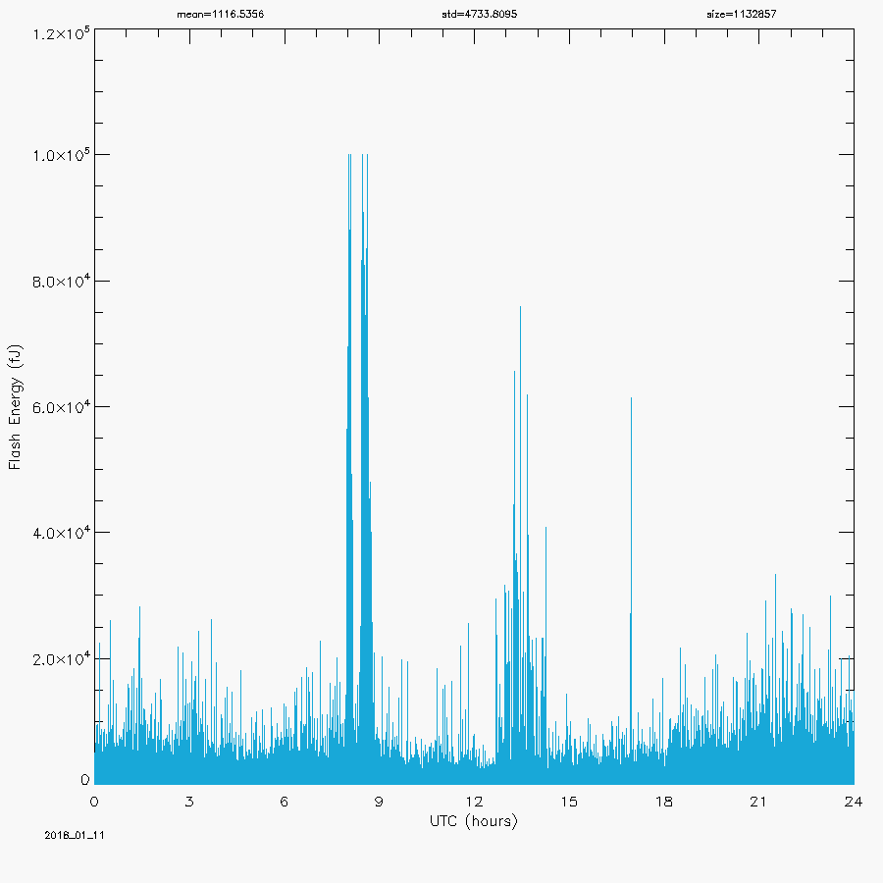
Sample Daily Plots (first 60 days)
Koshak, NASA/MSFC

Slide 7
Frequency Distribution
Koshak, NASA/MSFC

Slide 8
Summary
Heritage Flash Amplitude Baseline Computed by Koshak
Using Raw Data Results from Various Investigators
OTD: poor sensitivity, only CONUS stats done, Z estimate … not best to use.
More data in LIS Post-Boost than in Pre-boost … so Post-Boost better sample size
Buechler & Christian study has 1 more year of data than the Beirle et al. study, and more specific mean event footprints (since Beirle didn’t separate out Pre-boost from Post-boost).
So best estimate currently is 6th column above (bolded).
Koshak, NASA/MSFC

Slide 9
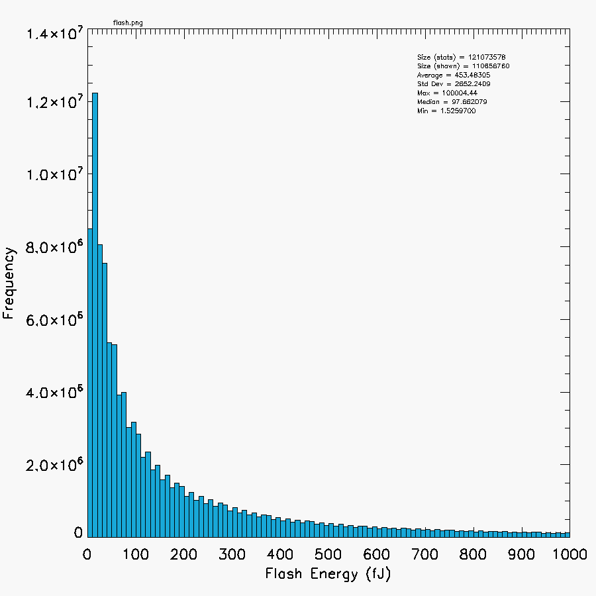
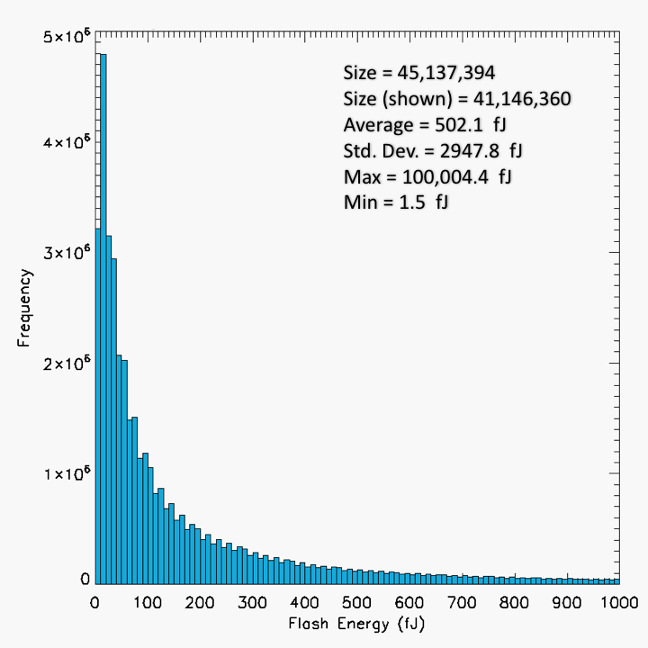
Size (stats) = 121,073,578
Size (shown) = 110,656,760
Average = 453.483 fJ
Std. Dev. = 2652.241 fJ
Max = 100,004.44 fJ
Median = 97.662 fJ
Min = 1.526 fJ
Frequency Distribution
of
Flash Energies
5 month distribution
(Jan 11 – Jun 11, 2018)
Koshak, NASA/MSFC
60-DAY DISTRIBUTION
(Jan 11 – Mar 11, 2018)

Slide 10
Spatial Variation
Koshak, NASA/MSFC

Slide 11
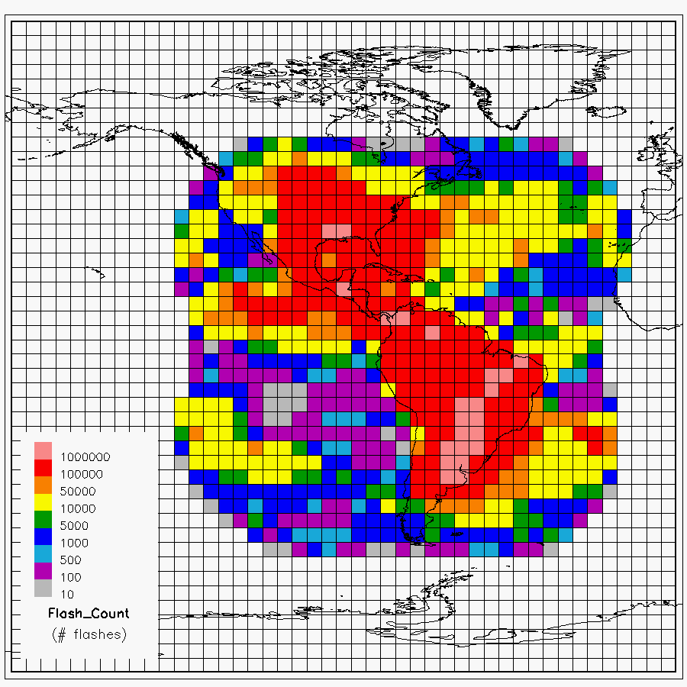
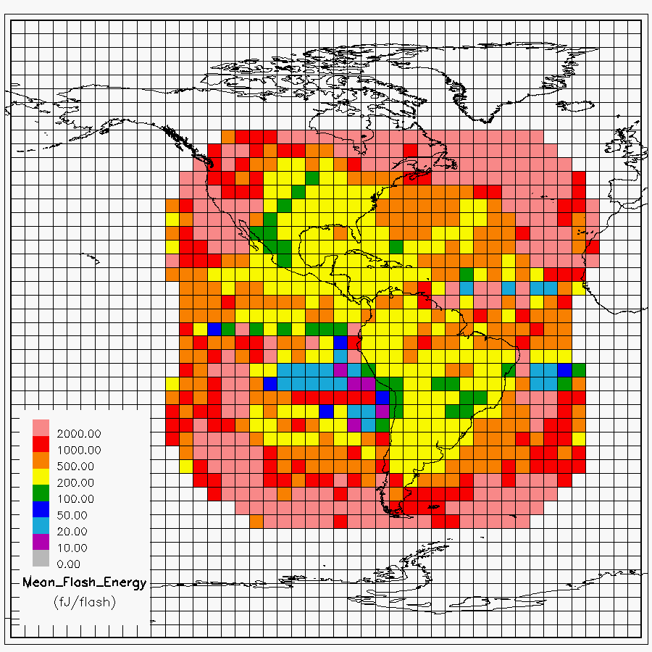
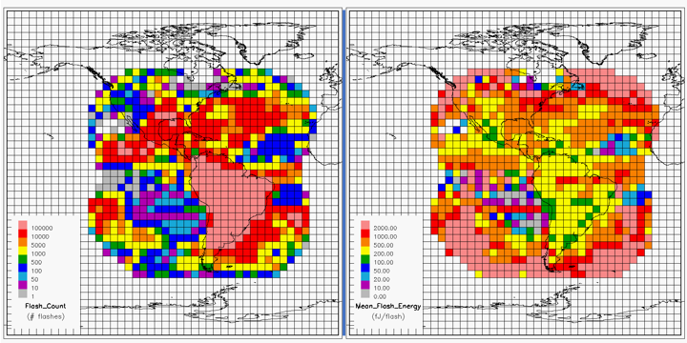
Spatial Variation
Flash Counts
Mean Flash Energy
Flashes more energetic over oceans, for sufficient sample size. Agrees with TRMM/LIS findings in Beirle et al. (2014).
Flash energy increases towards limb since:
pixel size decreases
filter roll-off
side/beneath cloud detection.
Koshak, NASA/MSFC

Slide 12
Diurnal Variation
Koshak, NASA/MSFC

Slide 13
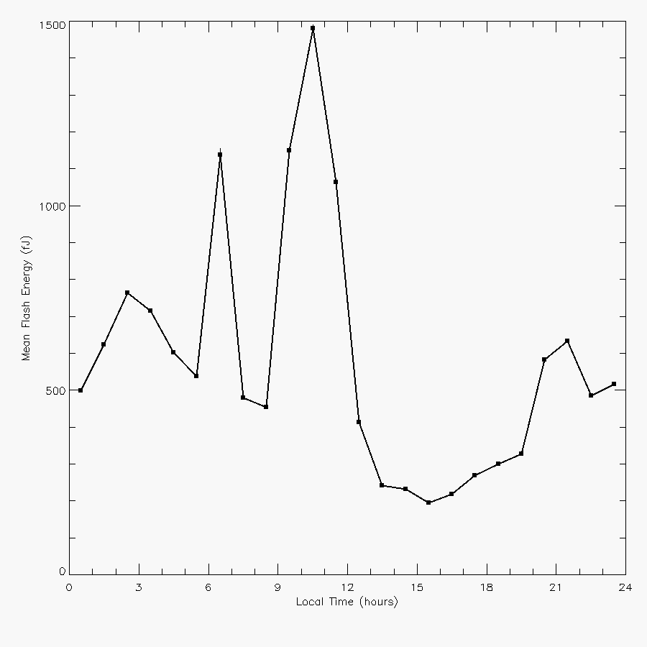
Diurnal Variation
This Study
5mo (Jan 11 – Jun 11, 2018)
no filtration
Koshak et al., 2018: XVI ICAE,
17-22, June Nara, Japan
Koshak, NASA/MSFC

Slide 14
Trend of Daily Mean Energy
Koshak, NASA/MSFC

Slide 15
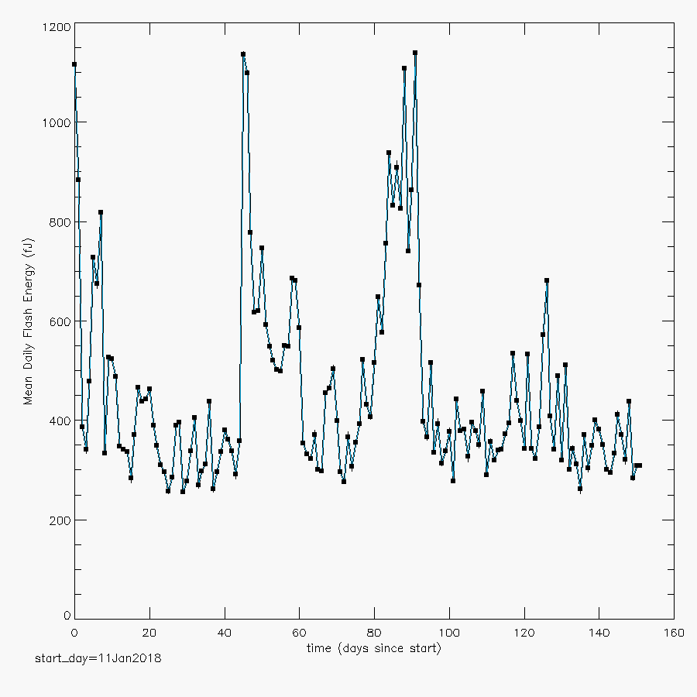
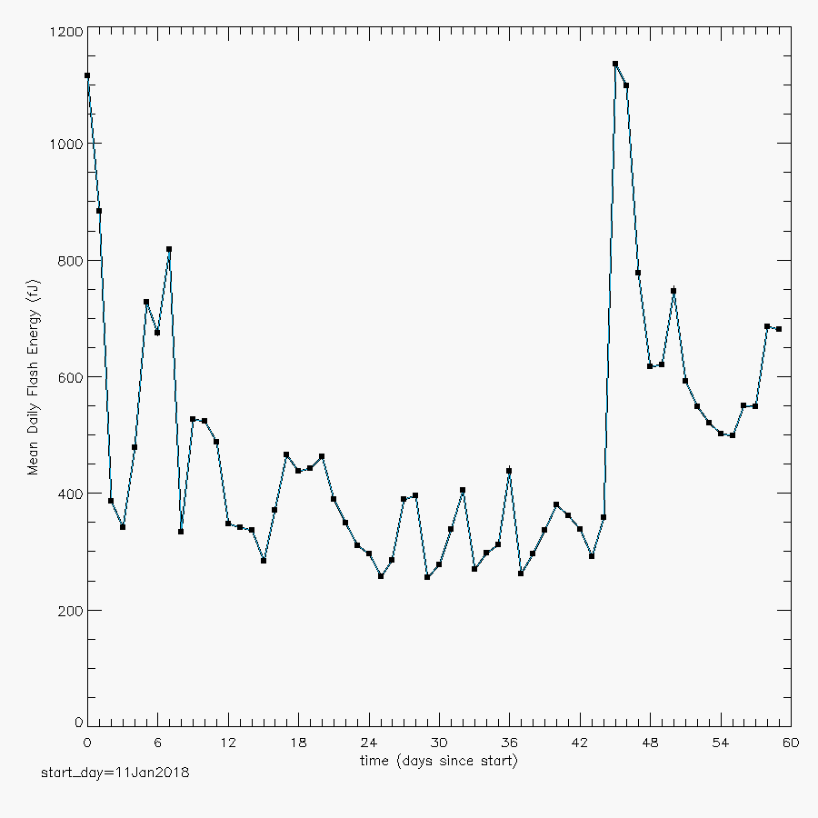
152 day Trend
of
Daily Mean
Flash Energy
(no energy filter)
Koshak, NASA/MSFC

