Slide 1




GLM observations, applications and validation in Brazil during
SOS-CHUVA field experiment
2018 GLM Annual Science Meeting – 11-13 September 2018 – Huntsville, AL
by Rachel Albrecht
Acknowledgements: Luiz Machado, Jean-François Ribaud, João Chinchay,
Carolina Araujo, and SOS-CHUVA Team
rachel.albrecht@iag.usp.br.

Slide 2

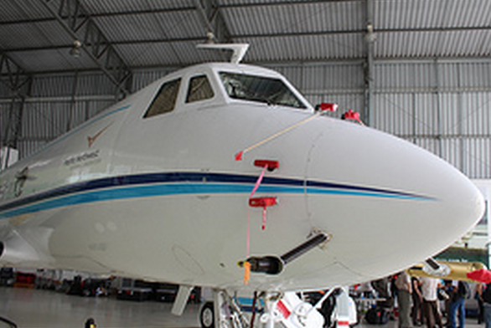
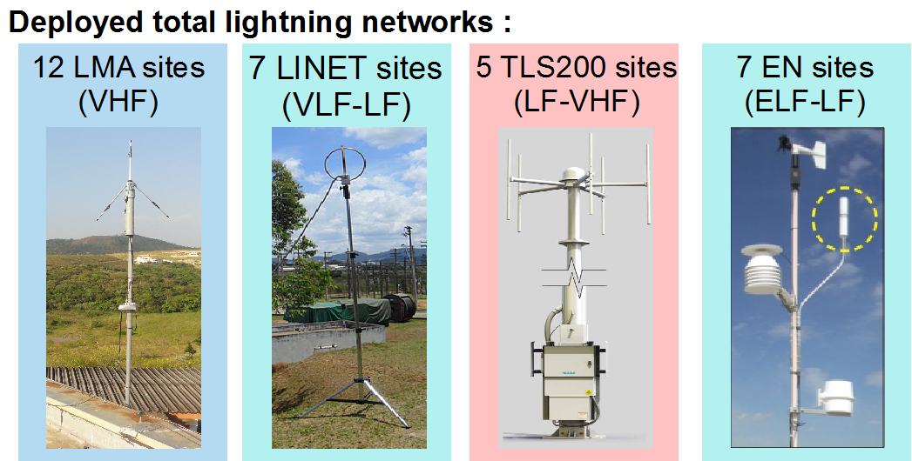
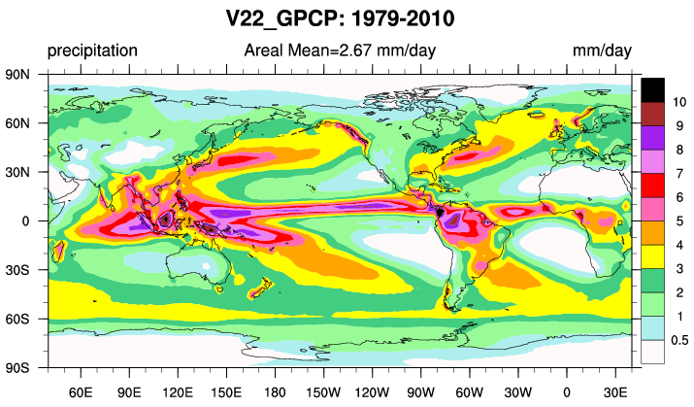
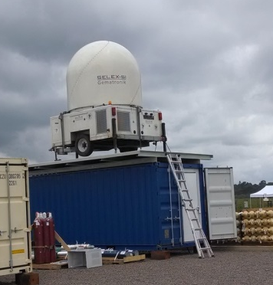

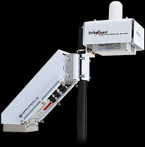
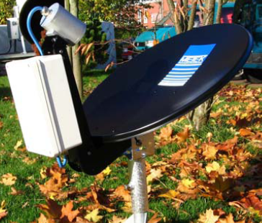
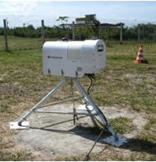
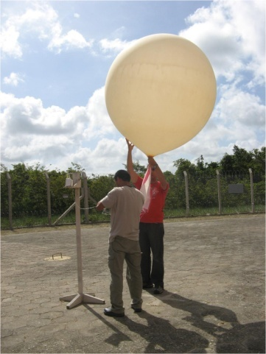
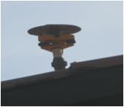
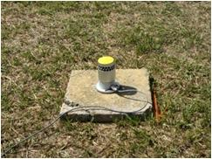
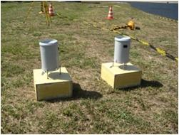
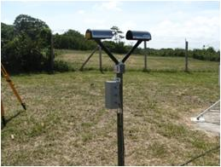
What is ”CHUVA”?
CHUVA Project (2010-2015)
  Cloud processes of tHe main precipitation systems in Brazil: A contribUtion to cloud resolVing modeling and to the GPM (GlobAl Precipitation Measurement)
  ”Chuva” means rain in Portuguese
6
3
2
6
1
Belém-PA
Manaus-AM
Fortaleza-CE
4
4
GPCP (1979-2010) rainfall (mm/day)
Alcântara-MA
5
S.J.Campos-SP
Sta Maria -RS

Slide 3
What is ”SOS-CHUVA”?
SISTEMA DE OBSERVAÇÃO E PREVISÃO DE TEMPO SEVERO
  = Observation System and Nowcasting of Severe Weather
SOS-CHUVA Project (2016-2019) objectives:
  Apply cloud microphysics knowledge learned in CHUVA Project
  Understand the evolution of cloud microphysics as they change to become extreme events
  Build conceptual models and predict these changes
  Develop a warning system of storm intensification
  Make this information useful and reachable to the society:
    Information sent directly to the Civil Defense
    Information sent directly to the general public

Slide 4
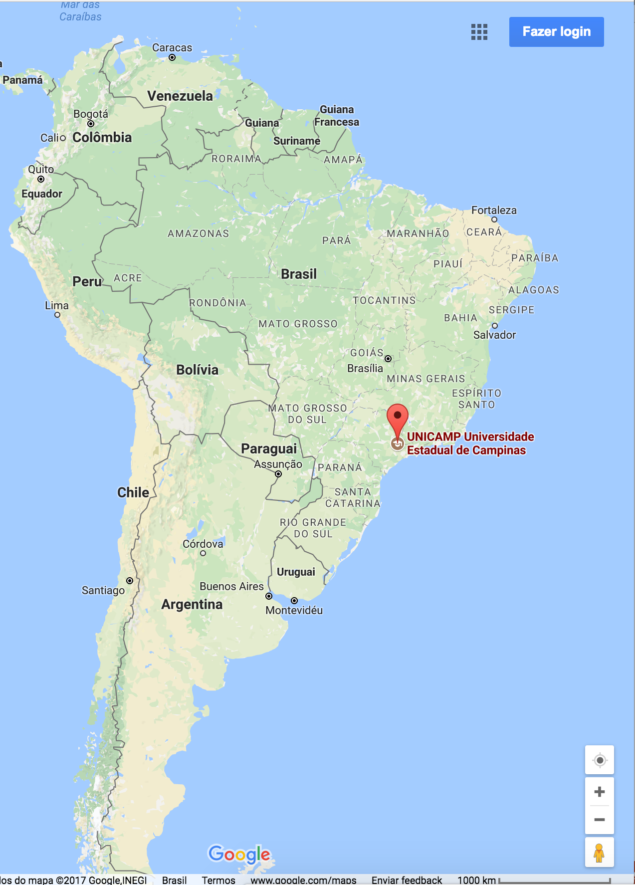
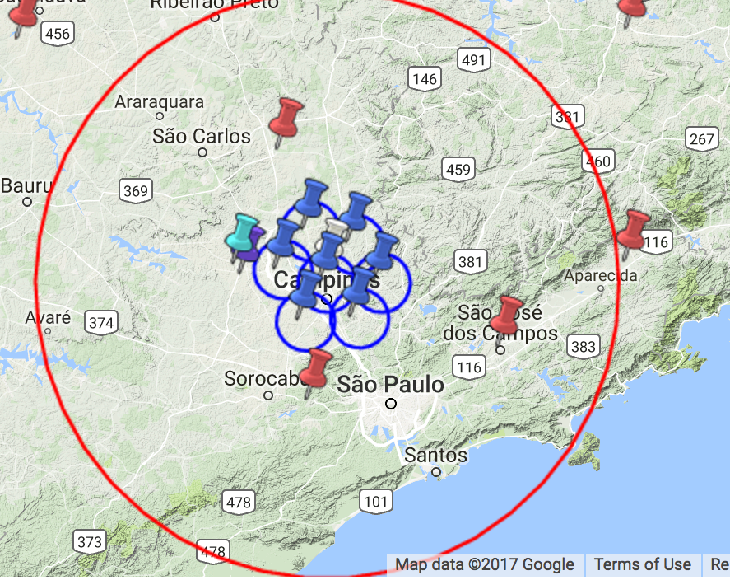
Location
What is ”SOS-CHUVA”?
Base site at Campinas-SP (~90km from São Paulo)
60km
Sellex X-Pol radar
Micro-Rain Radar
Radiometer
Disdrometers
GPS total water vapor
Rain gauges
Aerosol size distribution
CCN concentration
Weather station
Hailpad network
200km

Slide 5
Overview of GLM observations over Brazil

Slide 6
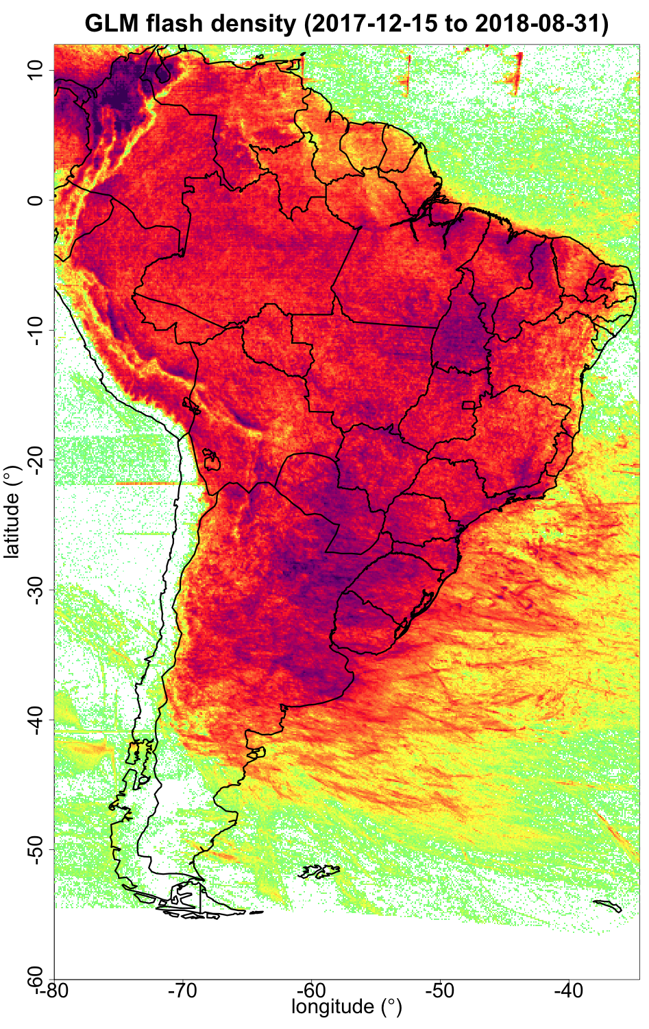
GLM composite maps over Brazil (Dec 2017-Jul 2018)
GLM flash density (2017-12-15 to 2018-07-31)
REAL FEATURES:
”UNREAL” FEATURES:
HIGH flash density over Lake Maracaibo, Colombia valleys, and LOW flash density over Andes’s mountains
?
Noise artifacts
”Geometric features” from solar glint or intrusion
?
High flash density over Amazon rivers
Cloud stricks
(small organized convective cells)

Slide 7
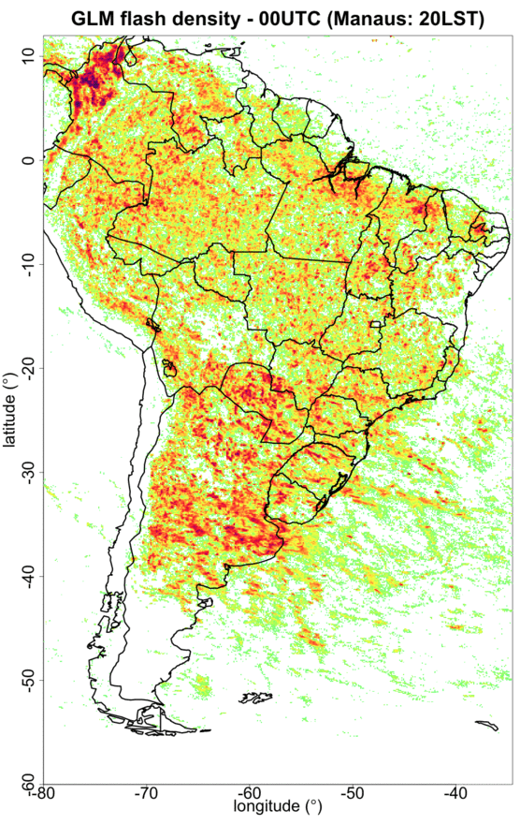
GLM composite maps over Brazil (Dec 2017-Jul 2018)

Slide 8
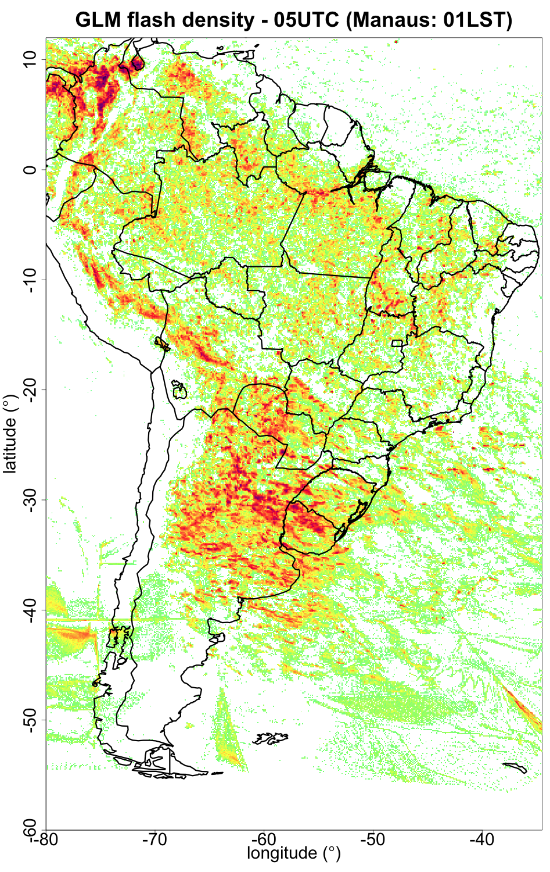
GLM composite maps over Brazil (Dec 2017-Jul 2018)
”UNREAL” FEATURES:
”Geometric features” from solar glint or intrusion
00 LST @ 75ºW:
Sun behind the Earth, exactly behind 75ºW?

Slide 9
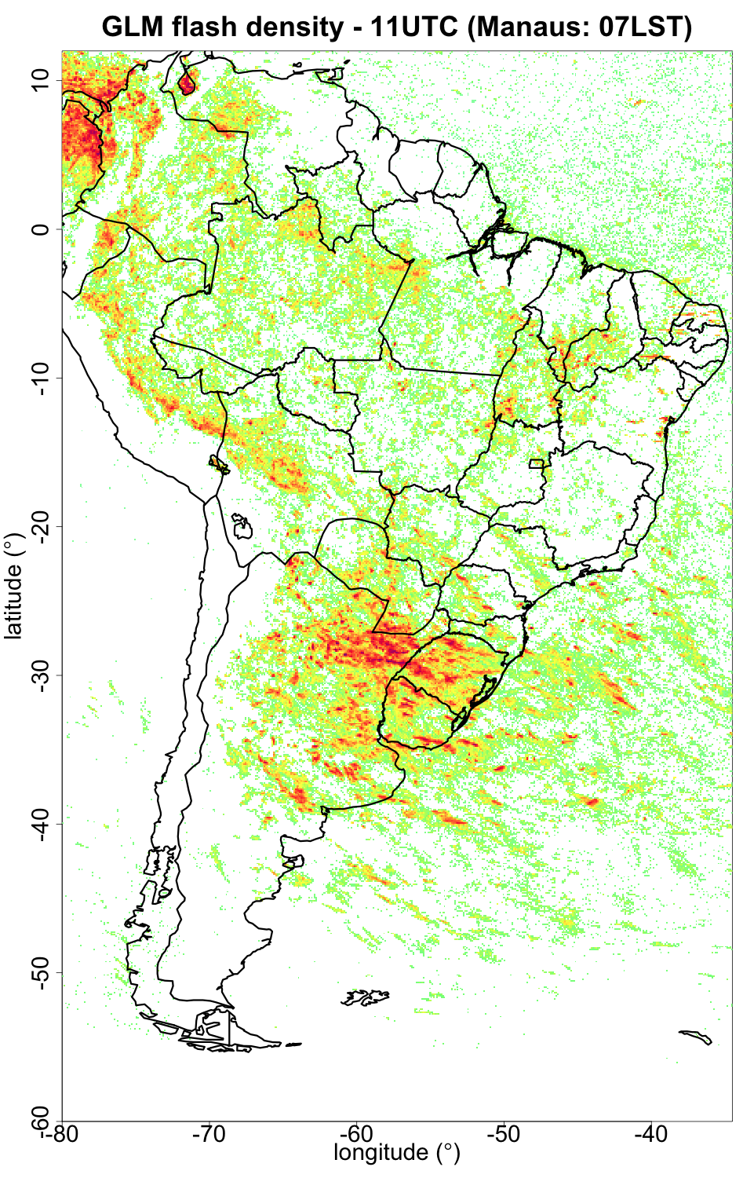
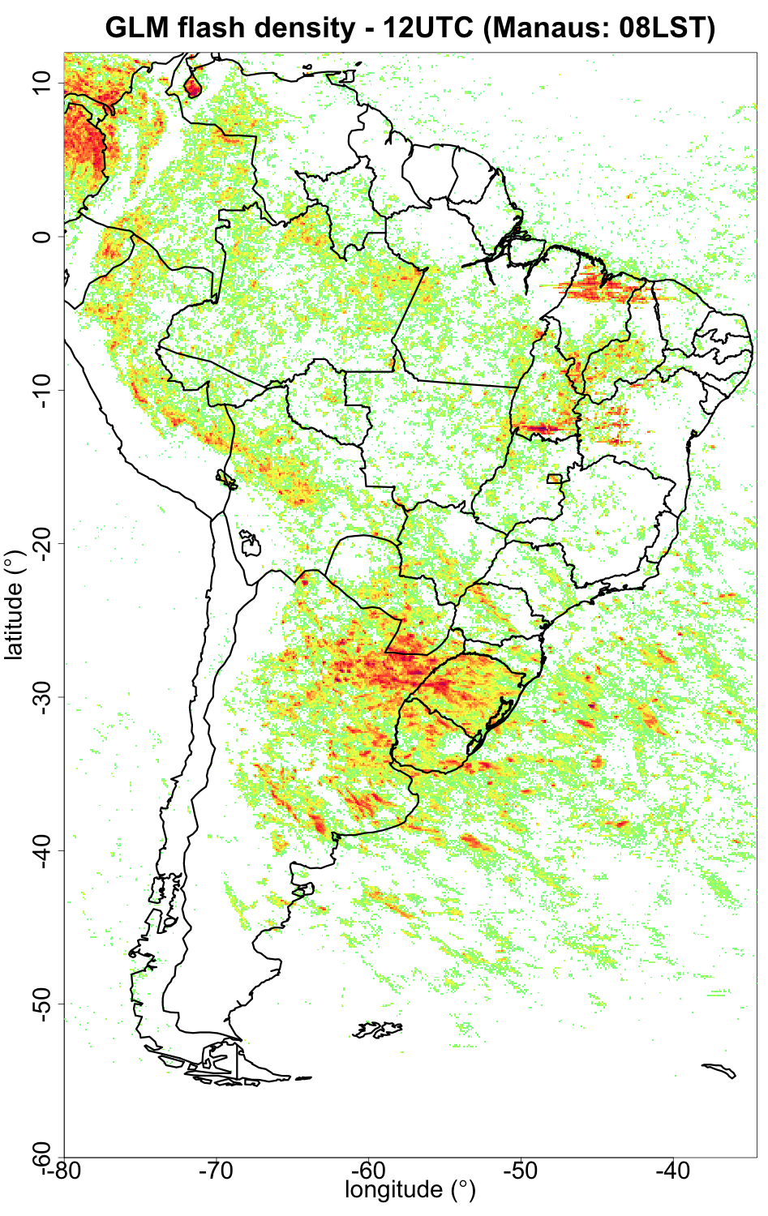
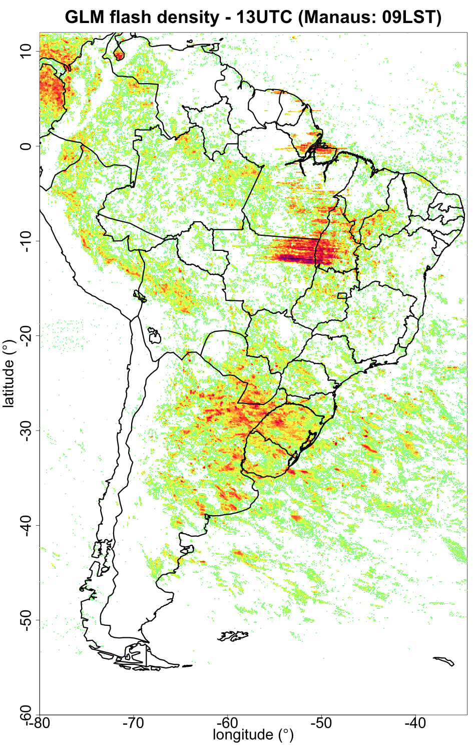
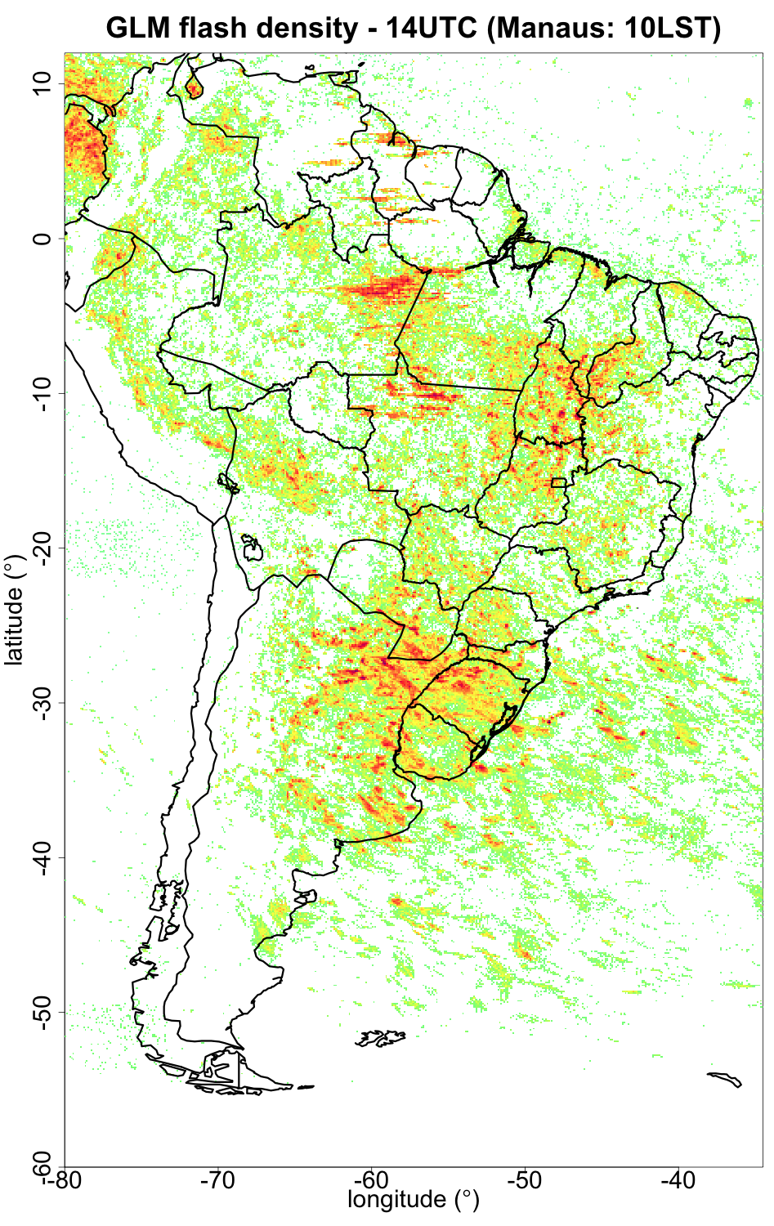
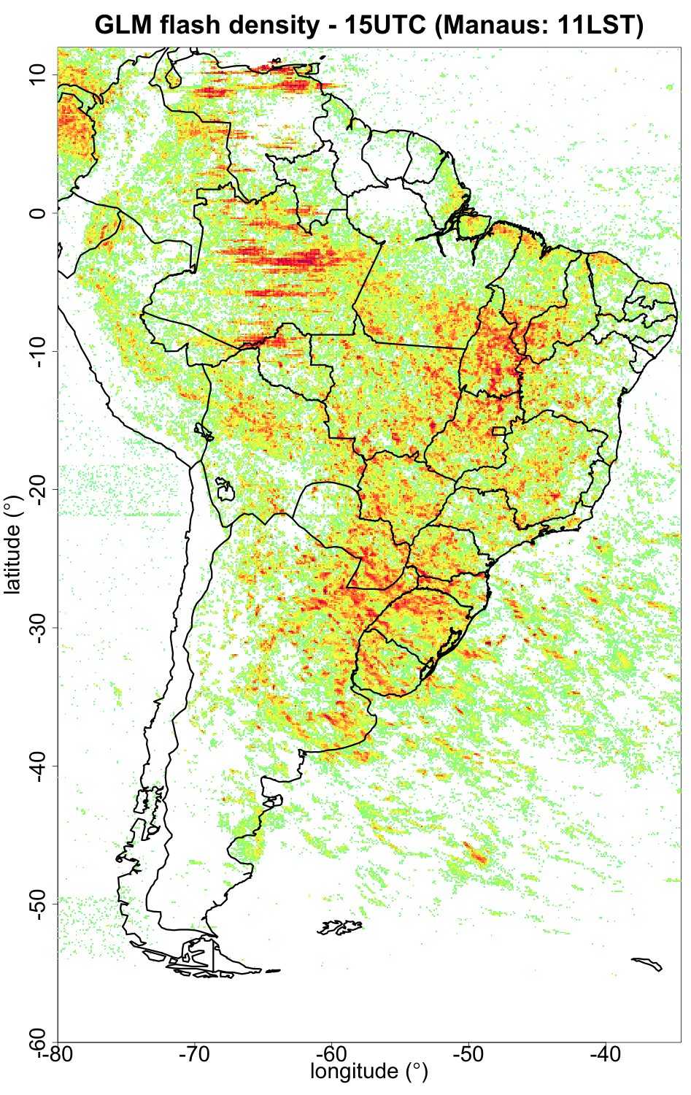
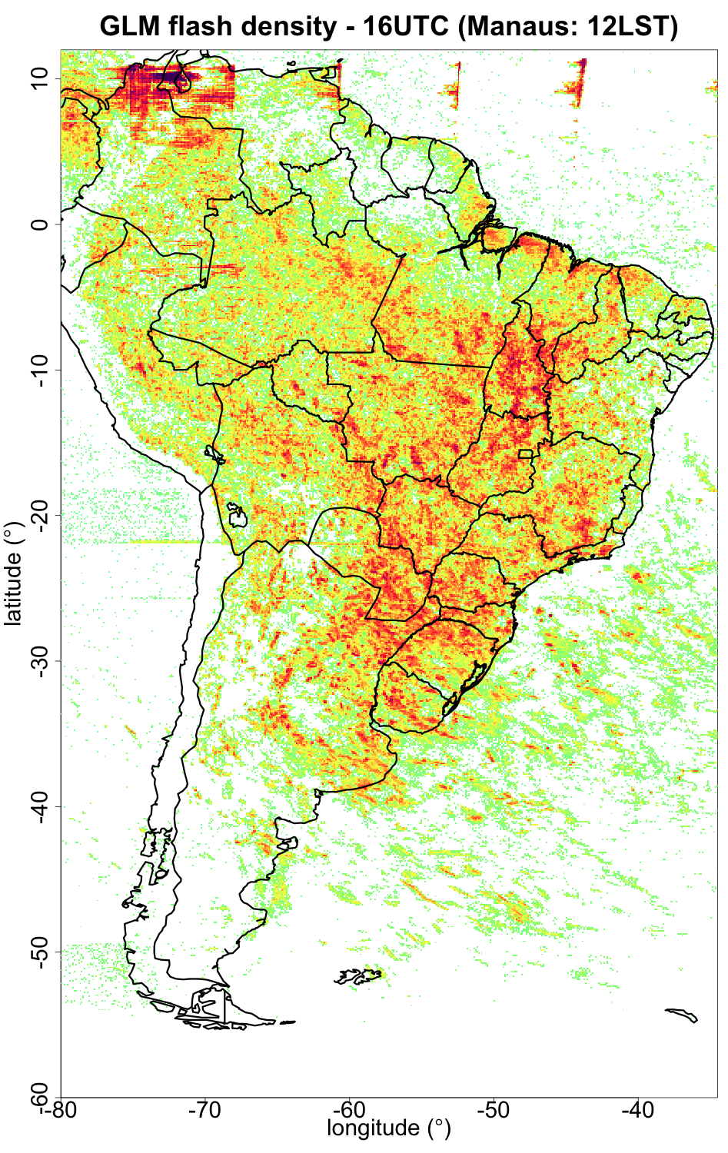
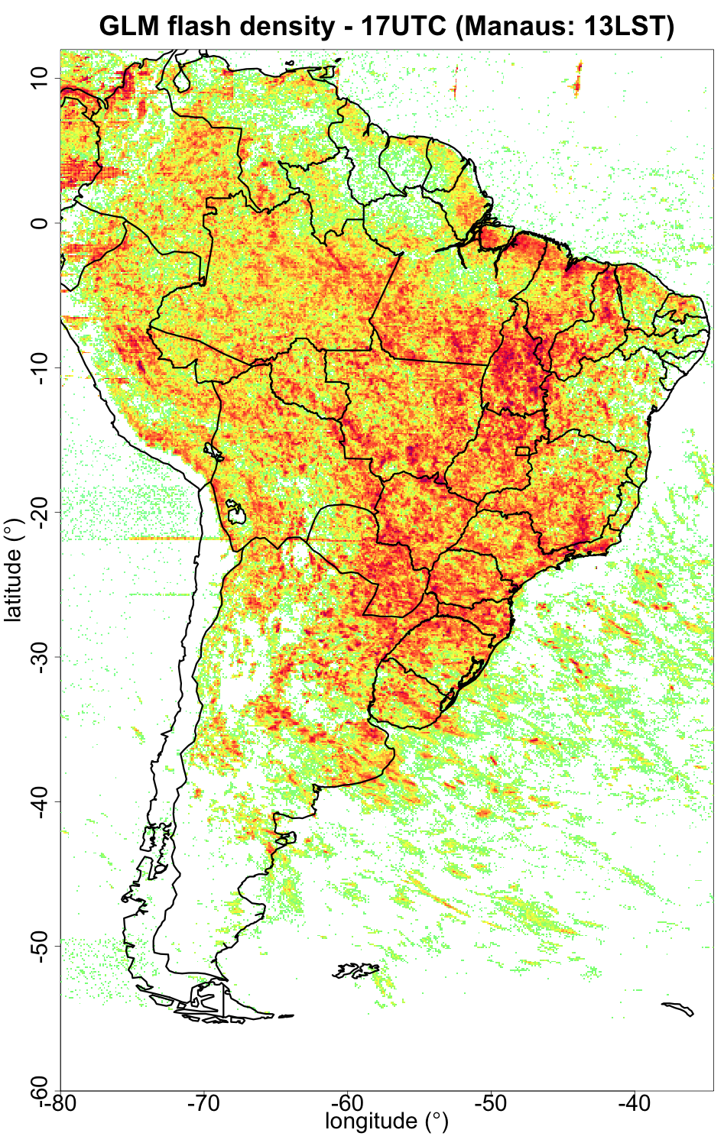
”UNREAL” FEATURES:
”Geometric features” from solar glint or intrusion

Slide 10
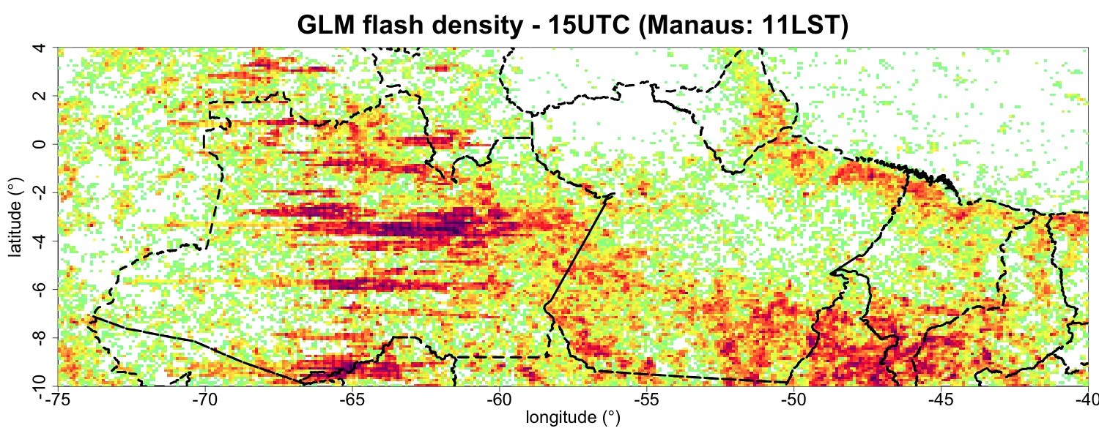
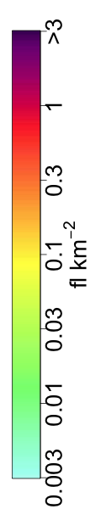
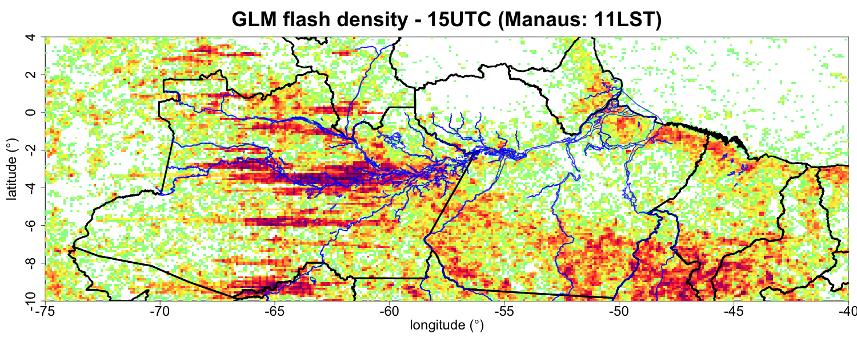
Solar glint right over the Amazon River @ local noon

Slide 11
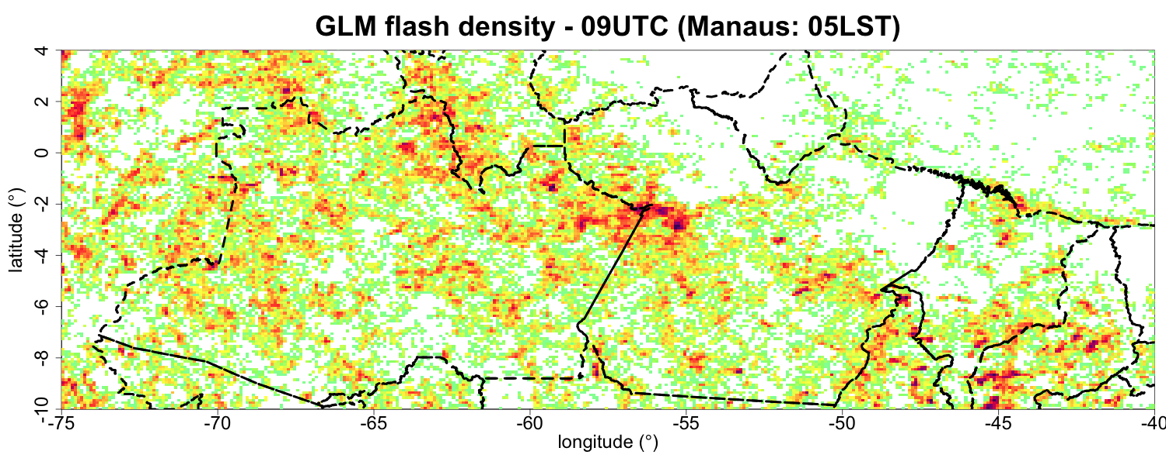
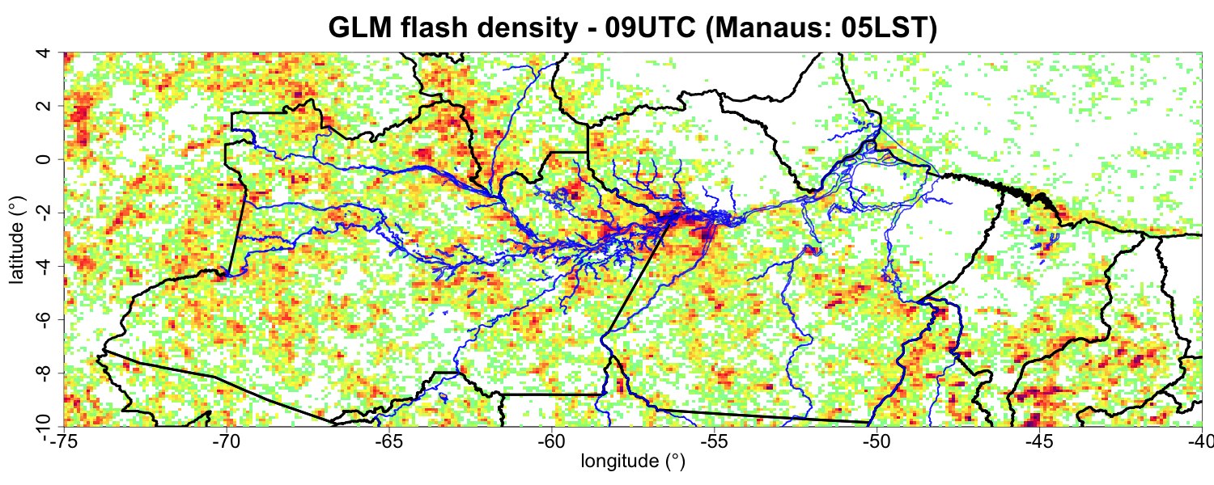
Nocturnal convection over the Amazon River

Slide 12
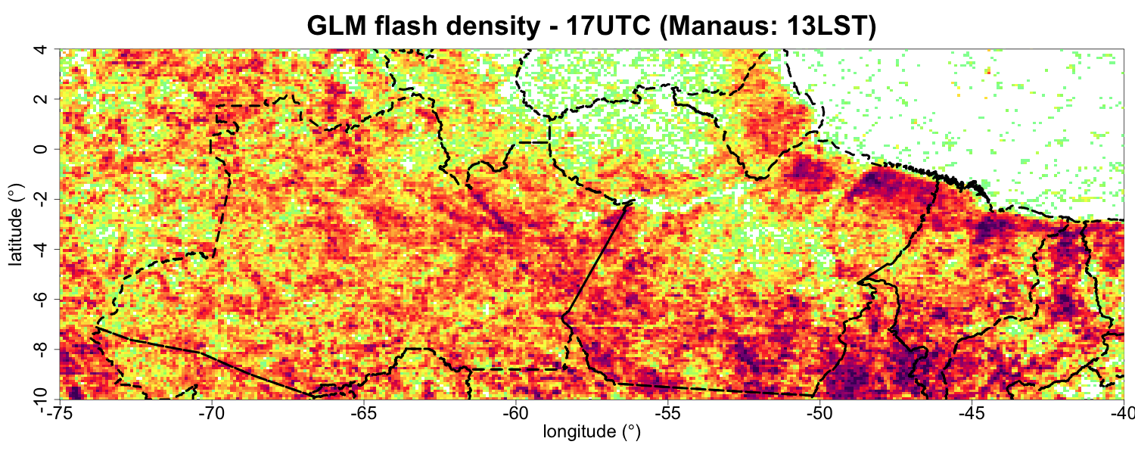
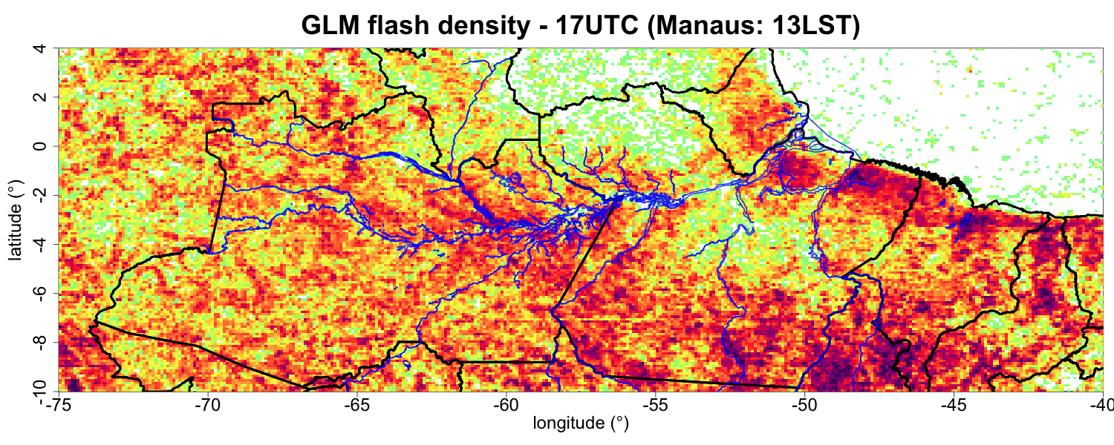
Diurnal convection over the margins of Amazon basin rivers
(clear sky over the rivers)

Slide 13
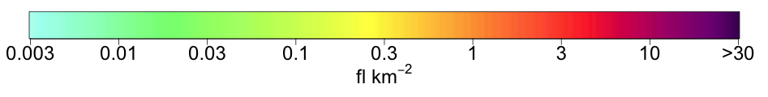
GLM composite maps over Brazil (Dec 2017-Jul 2018)
”Real”, but overestimated: real afternoon lightning + solar glint
”Real”: Nocturnal lightning

Slide 14
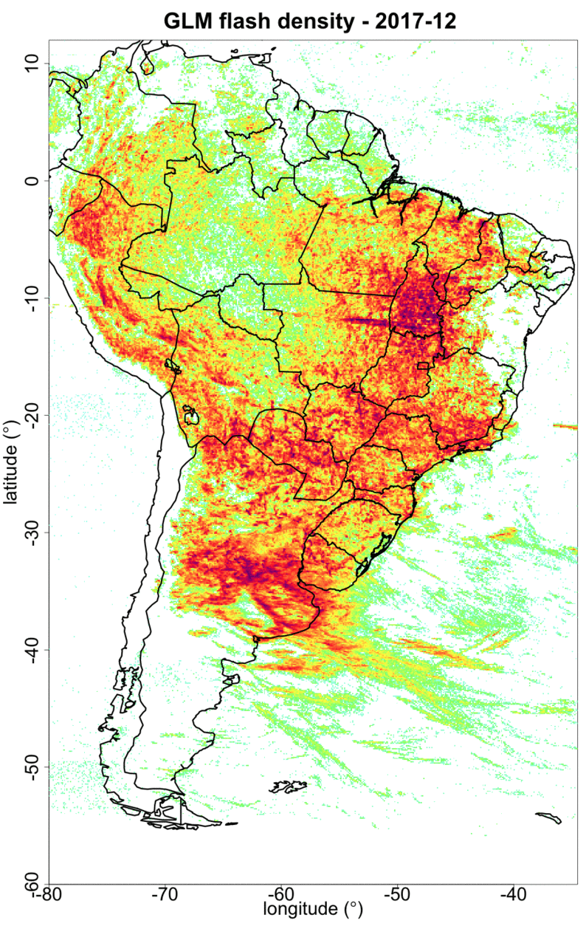
GLM composite maps over Brazil (Dec 2017-Jul 2018)

Slide 15
Overview of GLM applications in Brazil

Slide 16
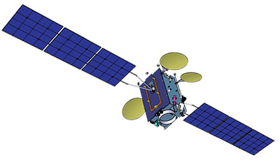
GLM group rate assimilation in WRF
Associate GLM group rate (proxy using BrasilDAT/EN strokes) with a vertical radar reflectivity profile (Z_{h})
SOS-CHUVA XPOL radar
Radar data + GLM group rate
Courtesy of Carolina Araujo (CPTEC/INPE)

Slide 17
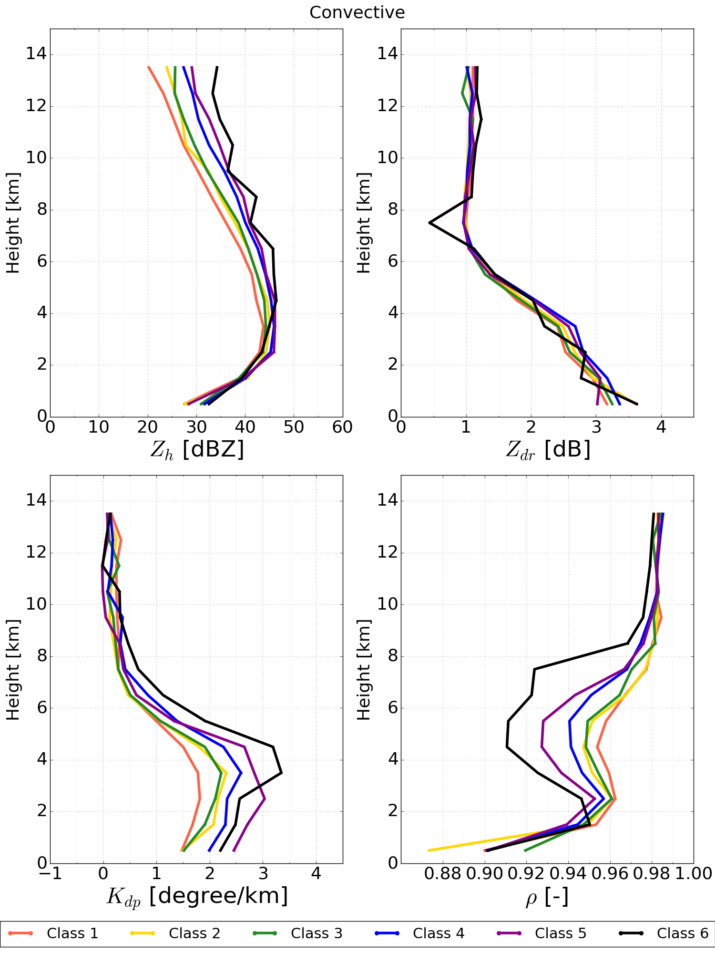
GLM group rate assimilation in WRF
Mean Z_{h} profiles were computed for 6 classes of group rate;
Mean Z_{h} profiles
Group Rate Class
Geometric Sequence
#gr/(5 min)
Courtesy of Carolina Araujo (CPTEC/INPE)

Slide 18
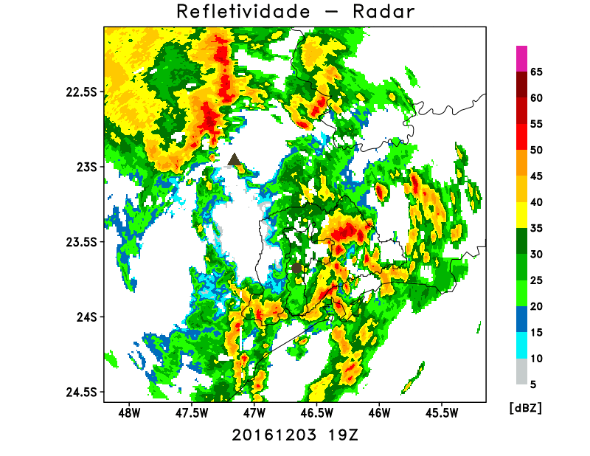
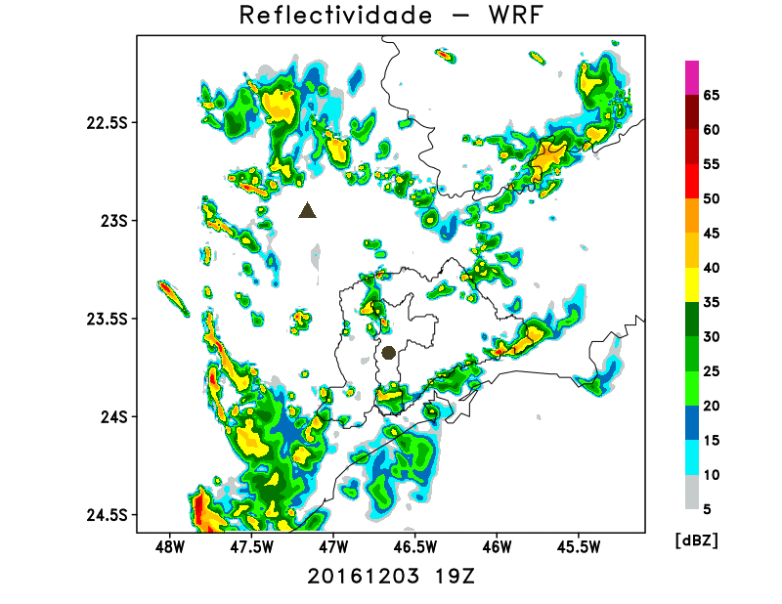
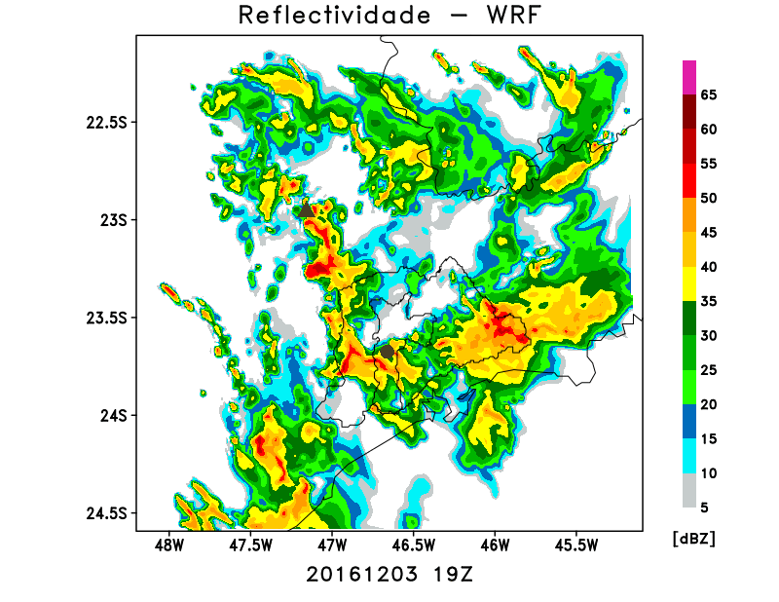
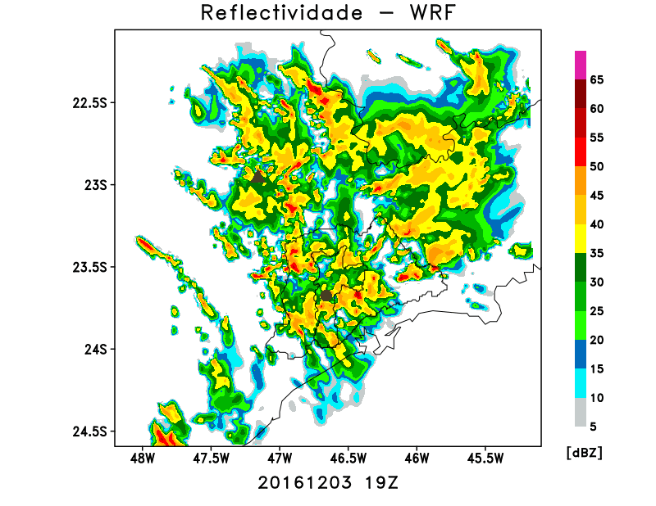
Assimilate mean Z_{h} profile as rainwater mixing ratio:
  Case study for 03 December 2016
Radar observations
Without assimilation
Radar data assimilation
GLM proxy assimilation
Courtesy of Carolina Araujo (CPTEC/INPE)

Slide 19
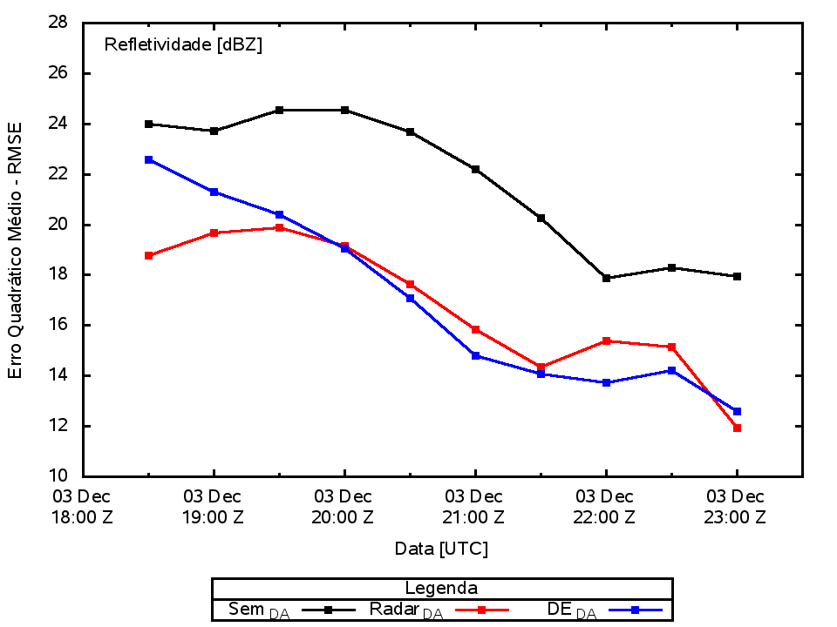
Root Mean Square Error
Fraction Skill Score
No assimilation
GLM proxy assimilation
Radar assimilation
Radar and GLM group rate assimilation improve the RMSE and FSC, being very similar in performance.
Courtesy of Carolina Araujo (CPTEC/INPE)

Slide 20
Summary of current use of GLM data:
Broadcast density maps of flashes, groups and events trough Geonetcast-Americas
Display of flashes, groups and events density maps into ”Web Nowcasting” (CPTEC operational tool to display data)
Research:
  Case studies during SOS CHUVA
  Better ways to use GLM data in the forecast offices
  GLM data assimilation
  Combine ABI-GLM to predict lightning using only ABI

Slide 21
Overview of GLM validation in Brazil

Slide 22
How is GLM performance compared to GLD360?
Preliminary analysis:
  Assume that GLM sees everything (”the TRUTH”);
  Compare GLM groups to GLD360 strokes, using:
    Δt =330ms and Δs=25km (same as Rudlosky et al. 2013, 2015, 2017);
  Compute Relative Detection Efficiency (RDE) (GLD360 relative to GLM) and display into 0.5ºx0.5º boxes (i,j) across Brazil:

Slide 23
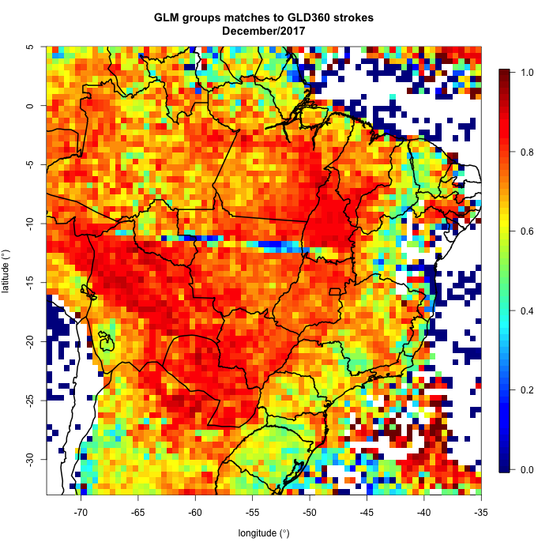
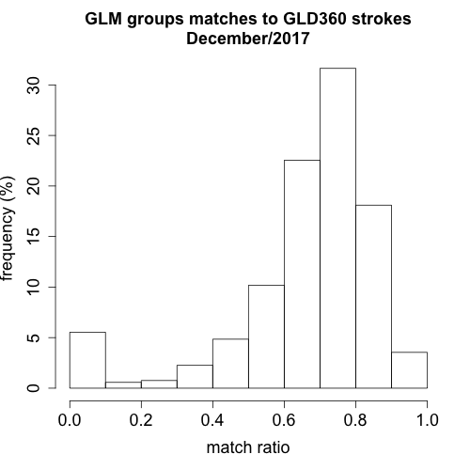
GLM performance compared to GLD360
GLD360 Detection Efficiency Relative to GLM groups
Blooming
Sunglint
Median = 71% RDE
Mean = 66% RDE

Slide 24
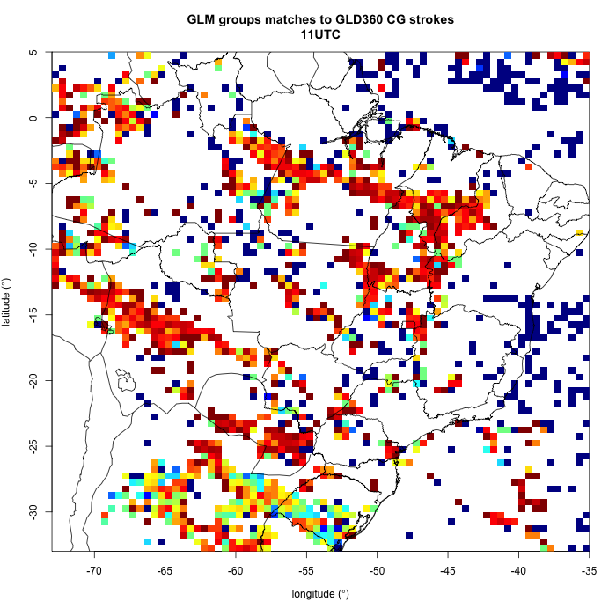
GLM performance compared to GLD360
11 UTC
Blooming
Sunglint

Slide 25
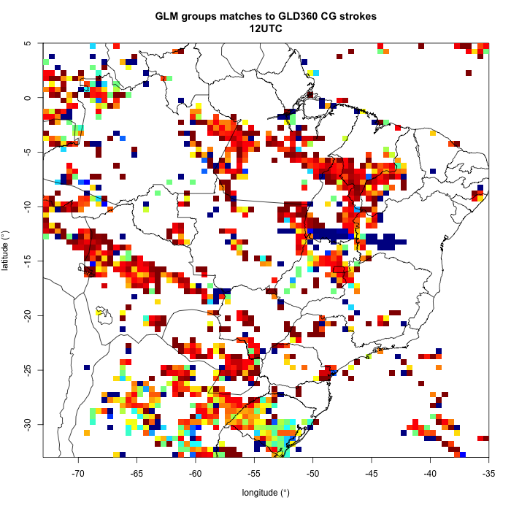
GLM performance compared to GLD360
12 UTC
Blooming
Sunglint

Slide 26
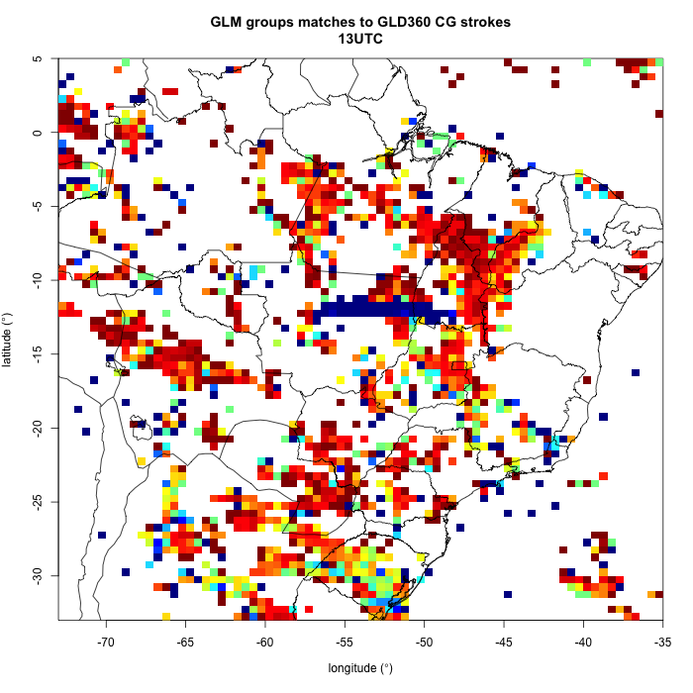
GLM performance compared to GLD360
13 UTC
Blooming
Sunglint

Slide 27
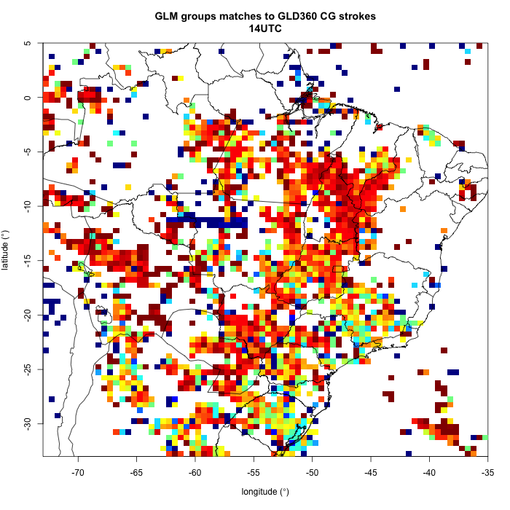
GLM performance compared to GLD360
14 UTC
Blooming
Sunglint

Slide 28
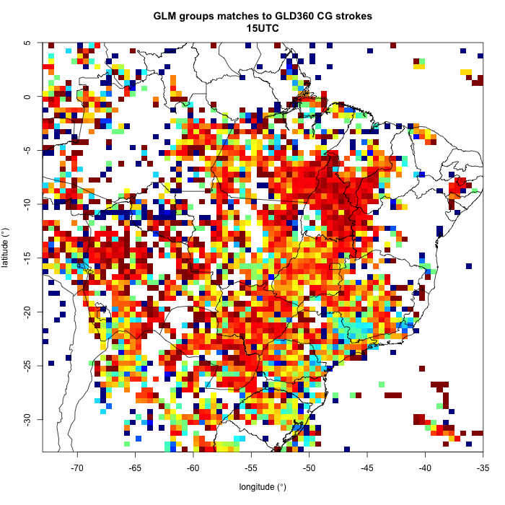
GLM performance compared to GLD360
15 UTC
Blooming
Sunglint

Slide 29
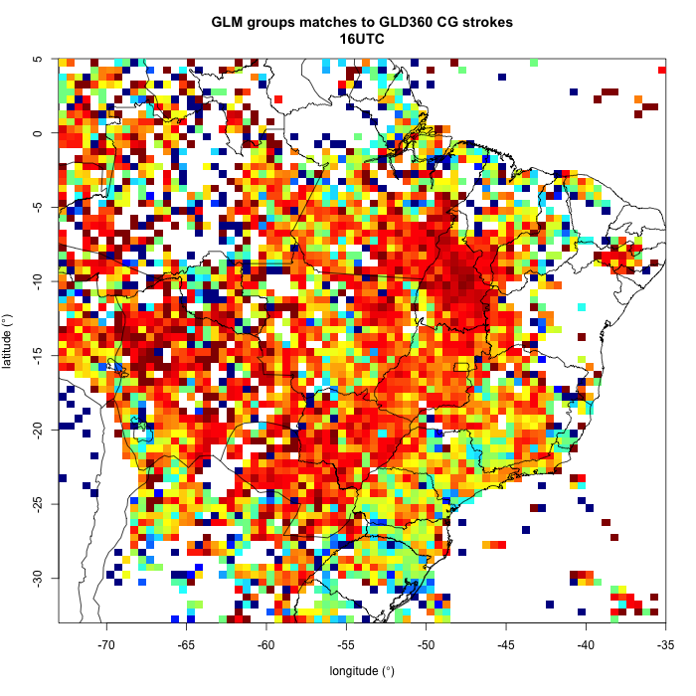
GLM performance compared to GLD360
16 UTC

Slide 30
Future data collection of interest

Slide 31
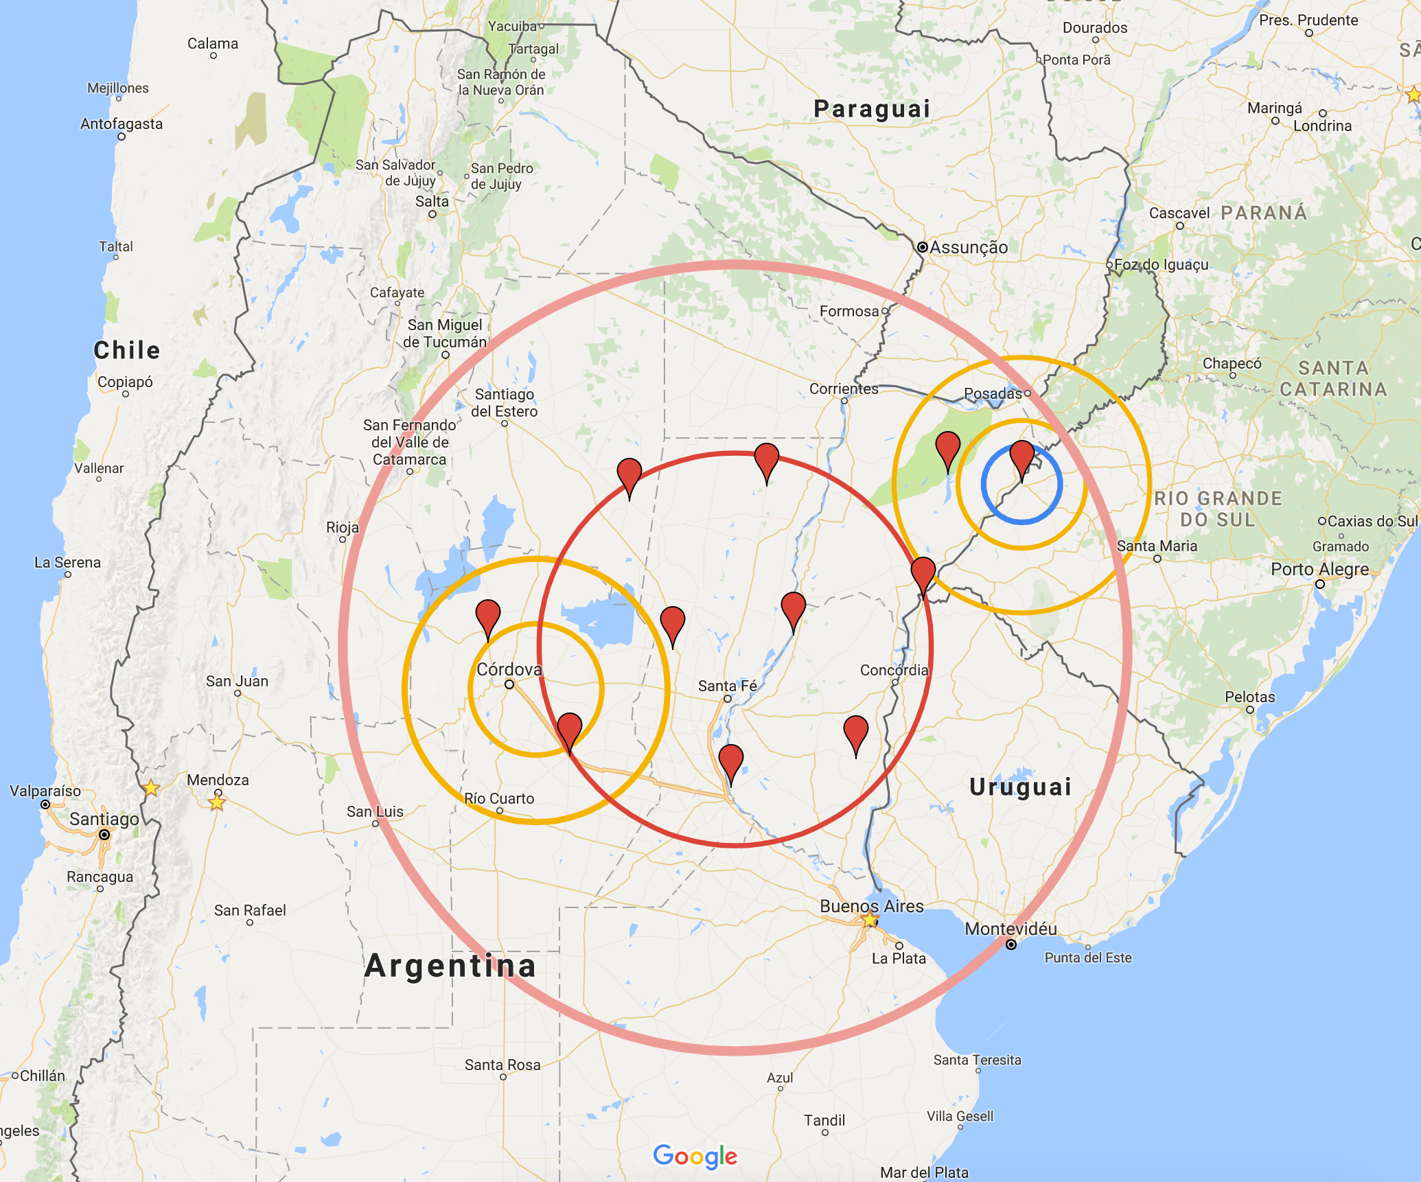
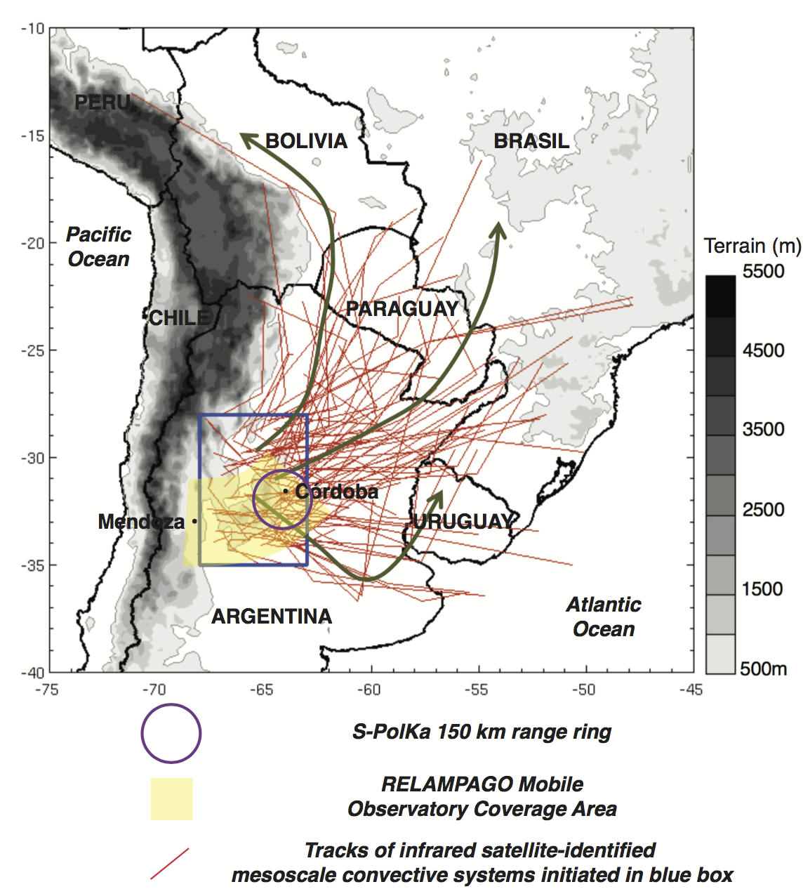
Future: SOS-CHUVA during RELAMPAGO
01 Nov – 20 Dec 2018
São Borja, RS
( BrasilDAT, GLD360, STARNET + XPOL +EFM + radar, disdrometer, MRR, hailpad network)
LMA in
Córdoba, AR (+hailpad network)
Courtesy of Luciano Vidal and Paola Salio

Slide 32


Future: TUPÃ - ThUnderstorm, Precipitation and Aerosol interactions (2019-2021)
ATTO tower (aerosols, chemistry, lidar, RWP, Ka-band, MP3000, etc)
XPOL radar
S-band radar
LMA network
Short-baseline EN network

Slide 33



Thank you!

