Slide 1
Preliminary GLM Detection Efficiency and Climatology
Monte Bateman
GLM Cal/Val Team

Slide 2
Sources
Compare GLM against
ENTLN + WWLLN and
GLD360
Two systems whose domains most closely match the FOV of GLM

Slide 3
Technique
Calculate DE in 1° x 1° bins
Over 8 months, Jan-Aug 2018
If a GLM flash is within ±0.5s and a range of 50km of a gnd system detect, increment bin
DE fraction = coinc / total
Single number average DE over whole FOV

Slide 4
“Stoplight Chart”: Color Code
If > 0.7, green
If >= 0.50, darkgreen
If >= 0.25, light gray
If > 0.0, dark gray
If GLM detect with no gnd detect, yellow
If gnd detect with no GLM, red

Slide 5
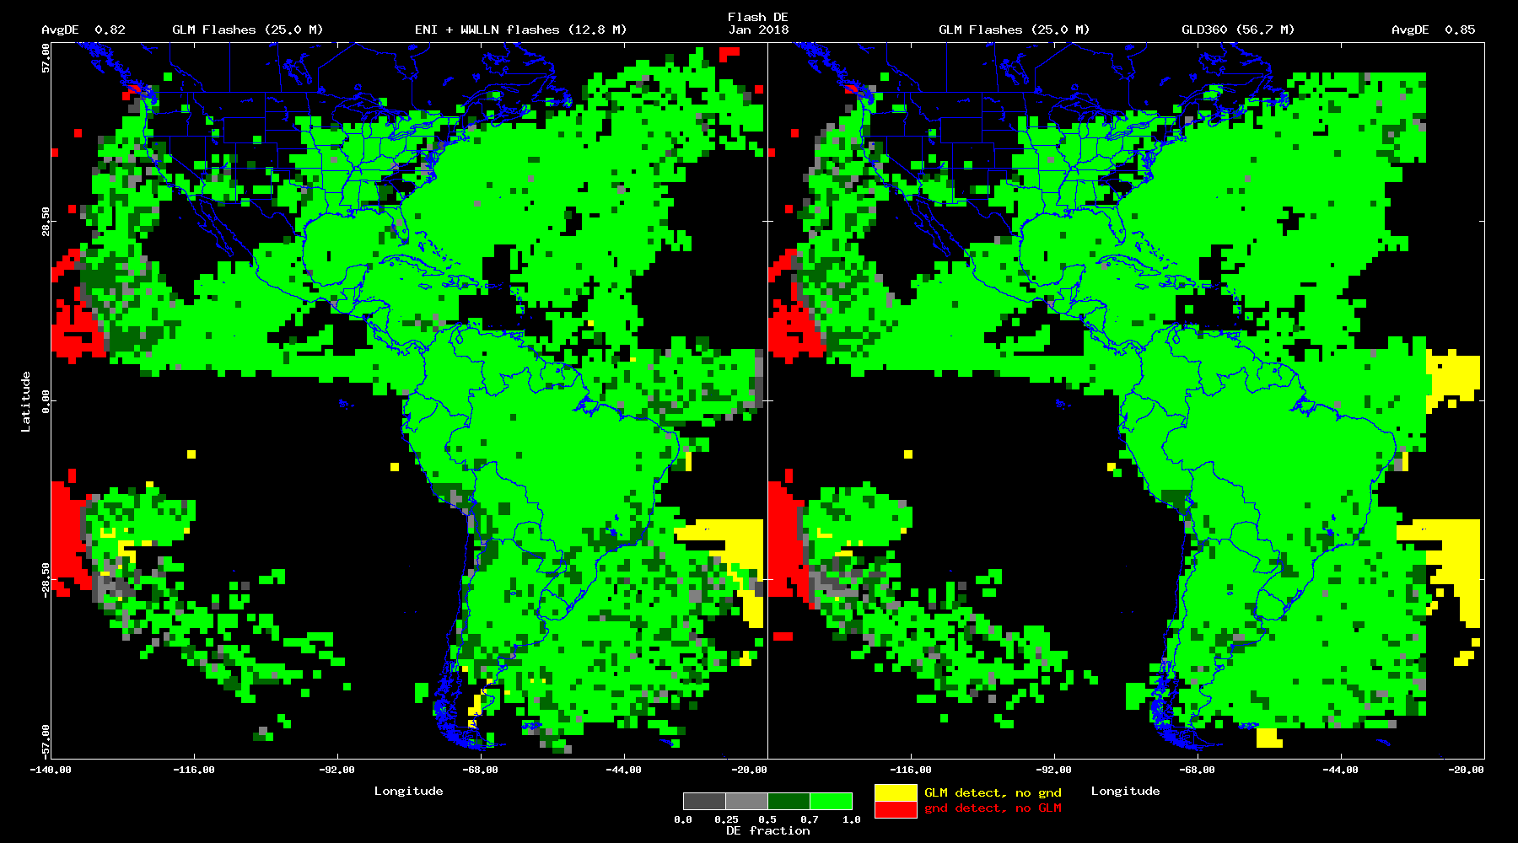
DE Map, Jan 2018

Slide 6
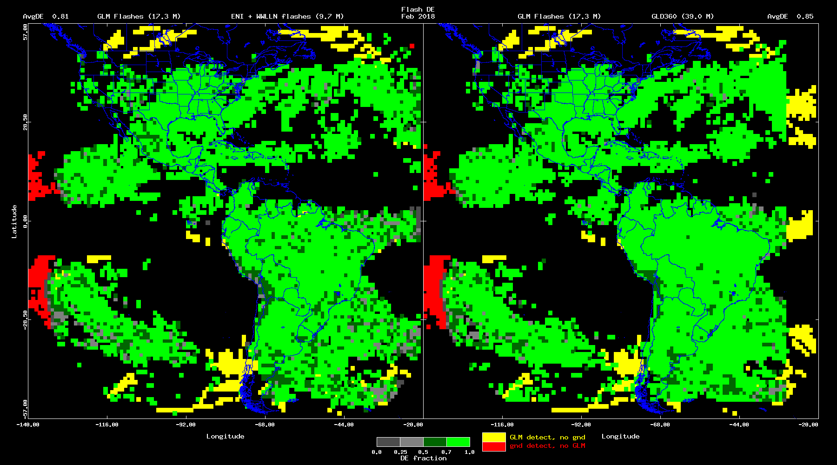
DE Map, Feb 2018

Slide 7
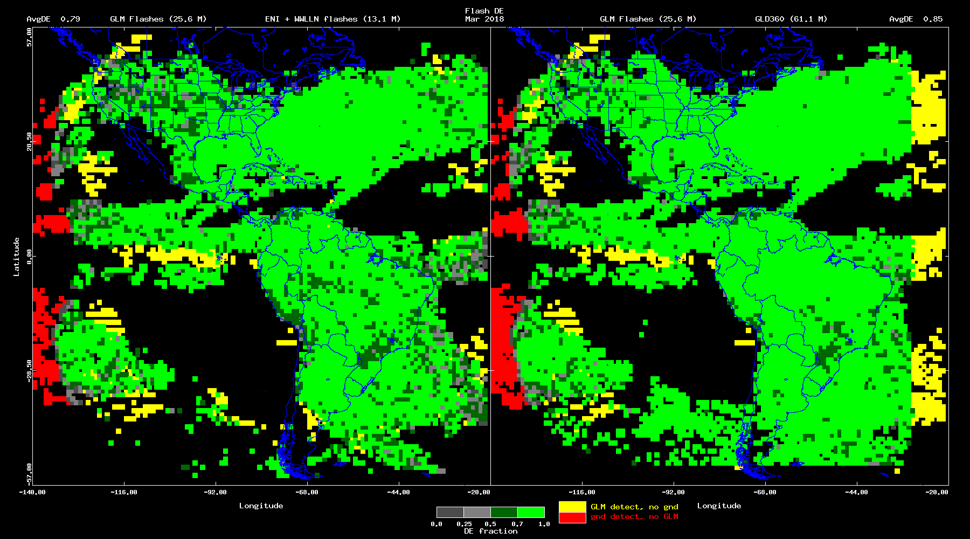
DE Map, Mar 2018

Slide 8
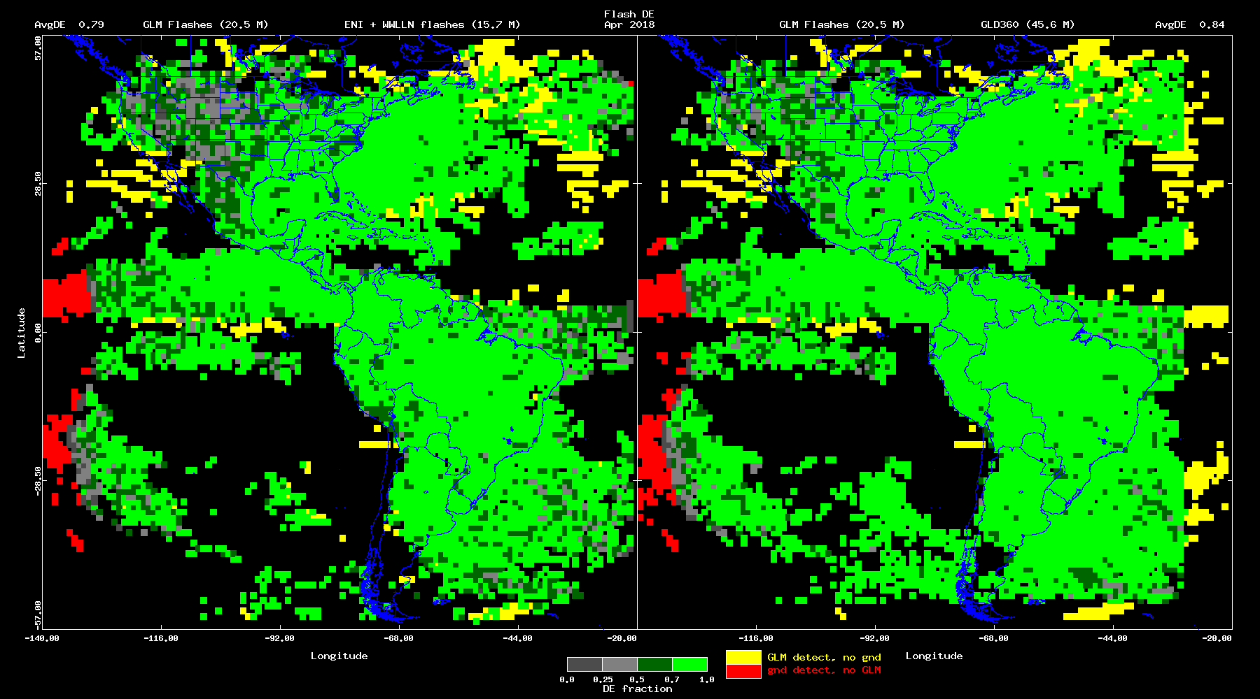
DE Map, Apr 2018

Slide 9
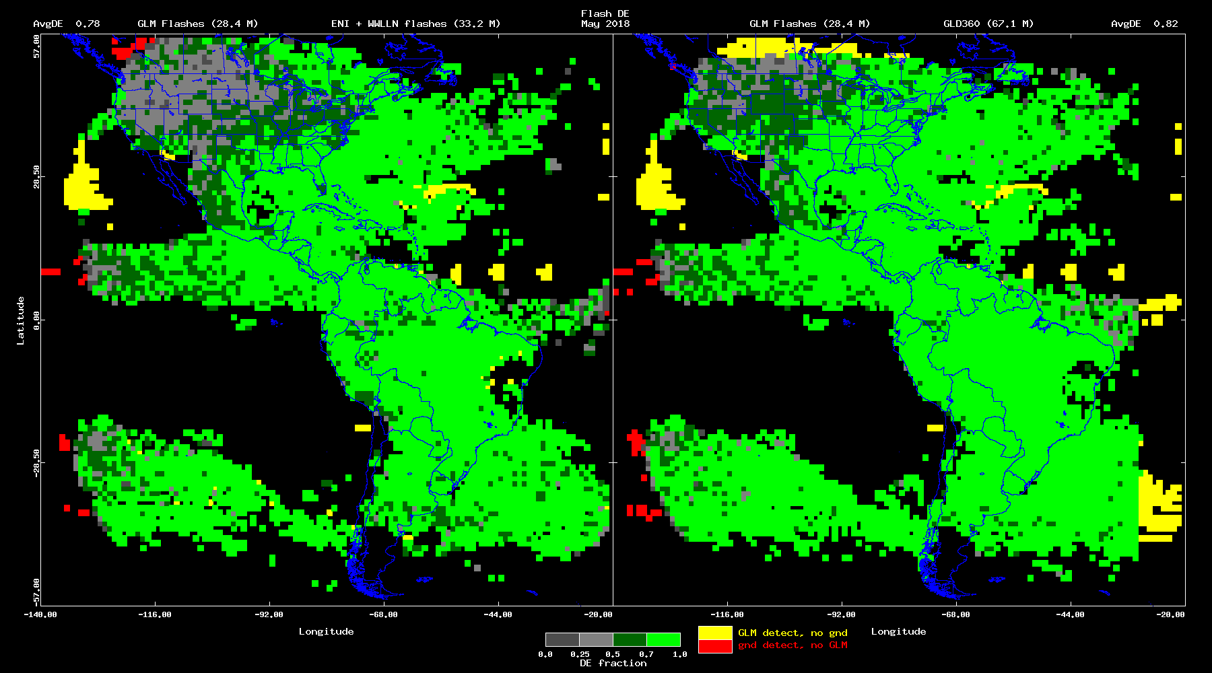
DE Map, May 2018

Slide 10
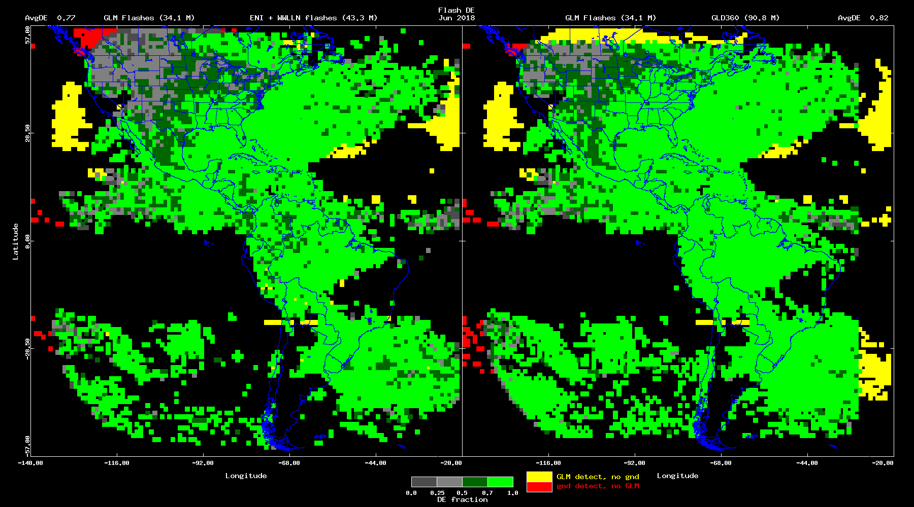
DE Map, Jun 2018

Slide 11
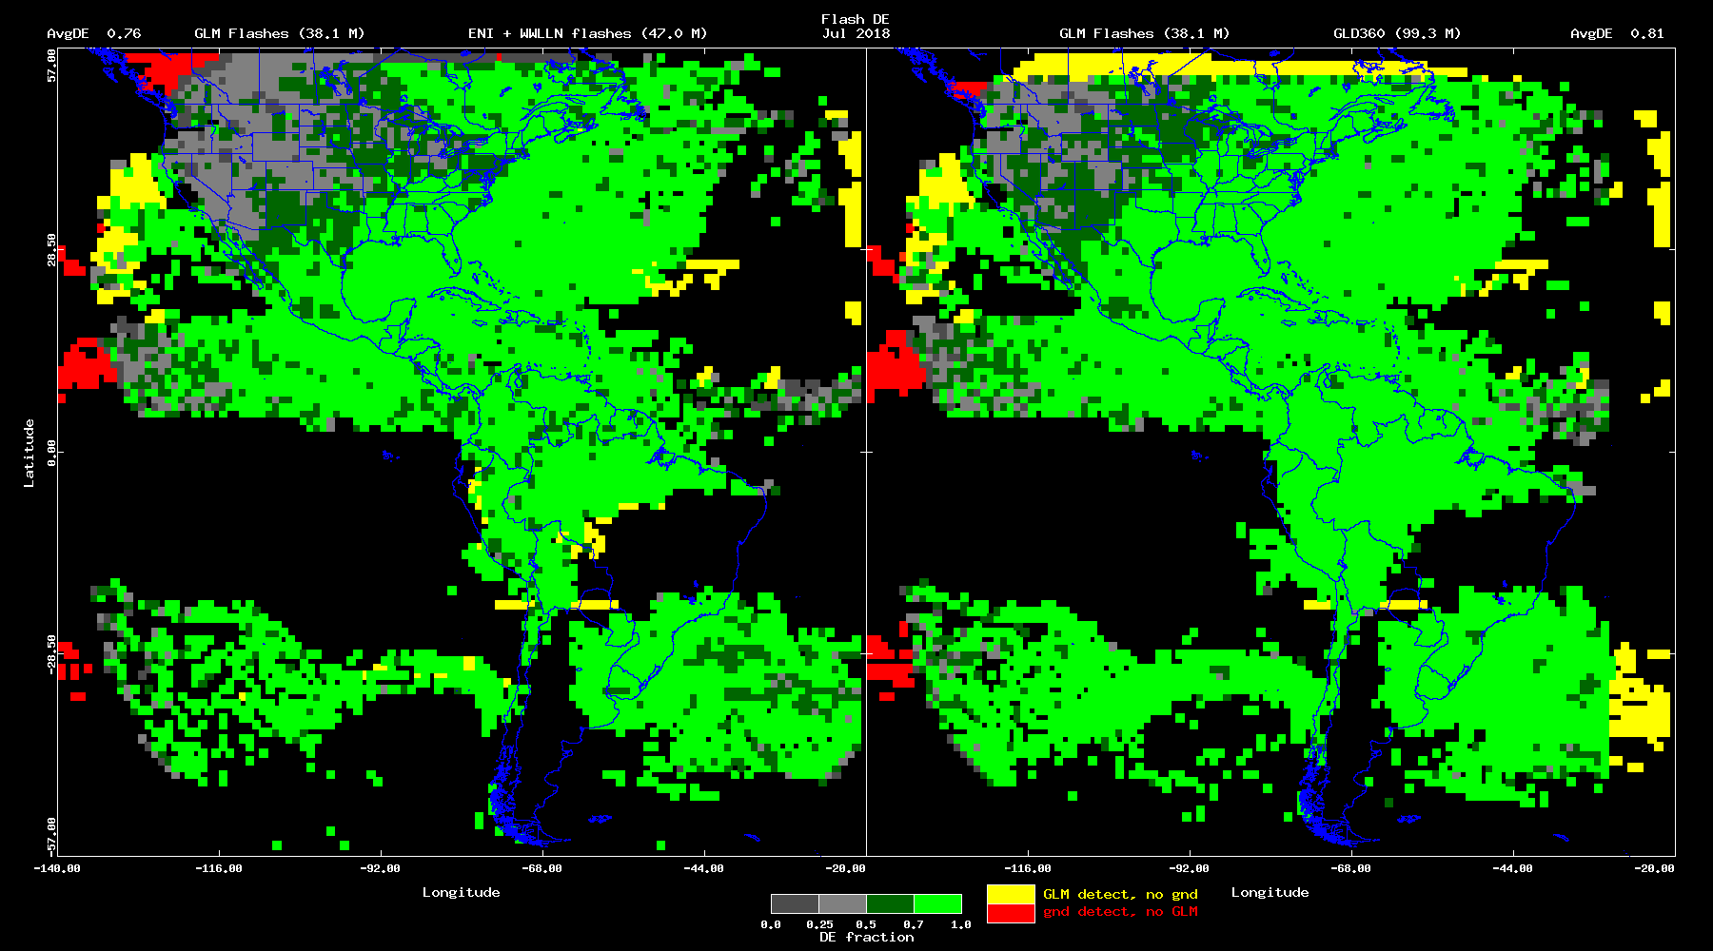
DE Map, Jul 2018

Slide 12
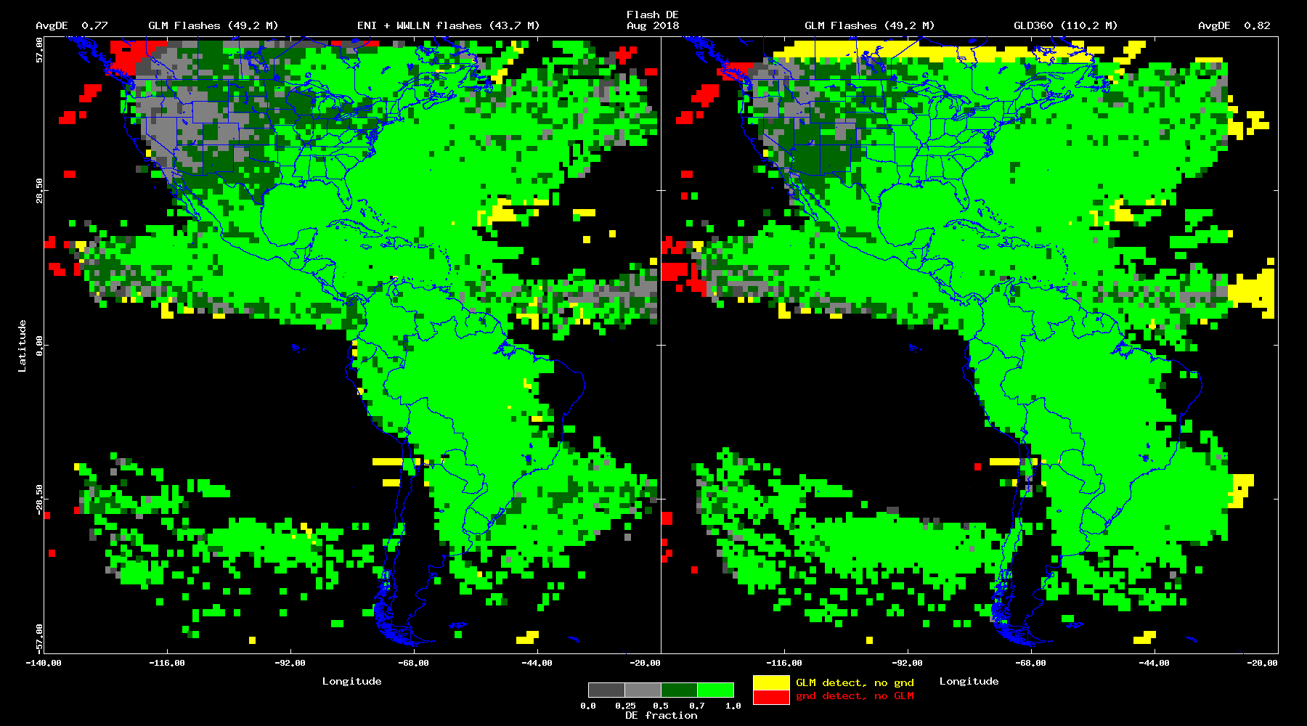
DE Map, Aug 2018

Slide 13
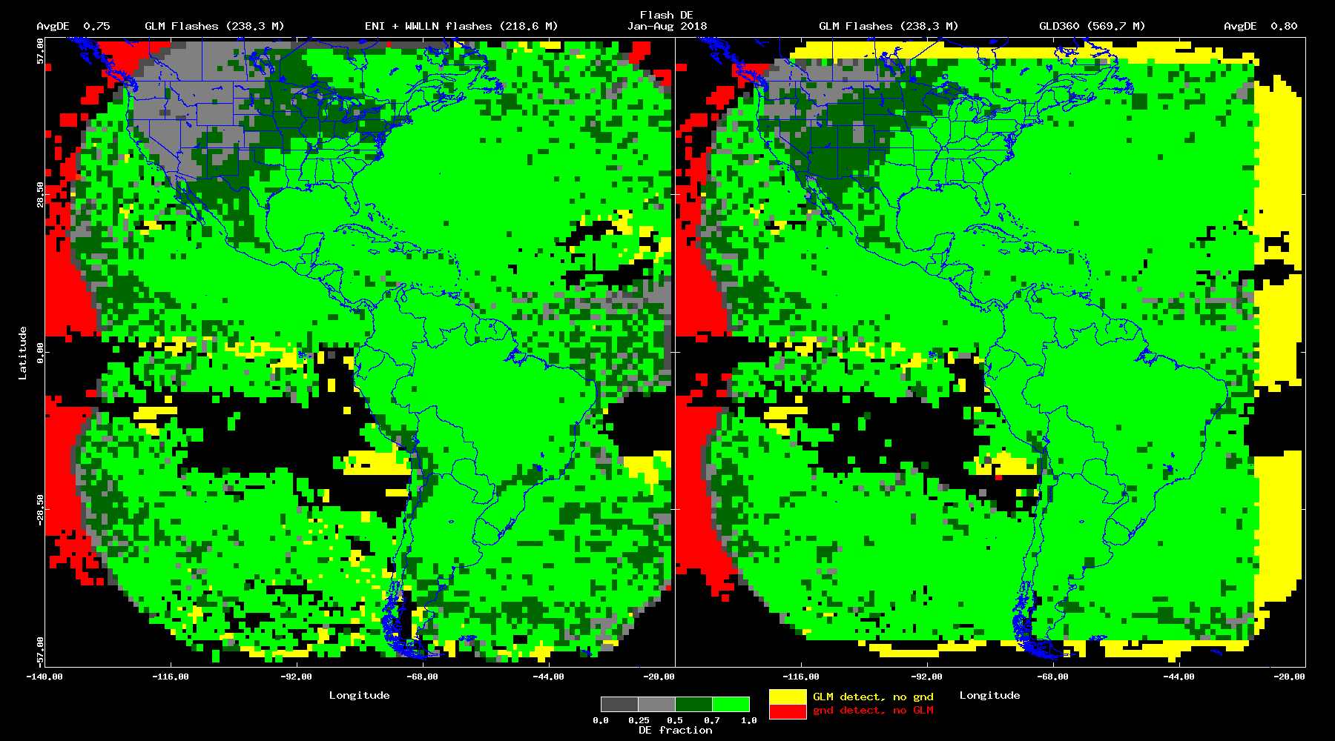
DE Map, Jan-Aug 2018

Slide 14
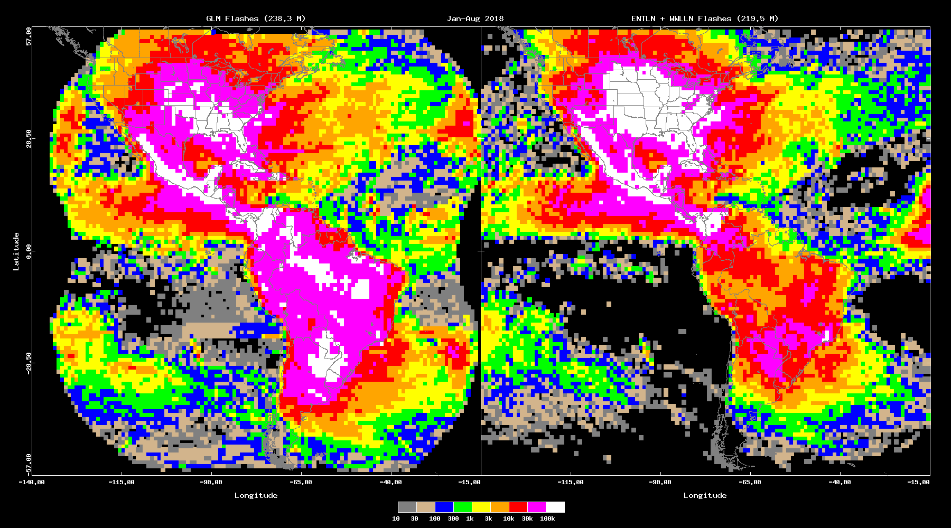
Climatology Jan-Aug 2018 GLM and ENTLN + WWLLN

Slide 15
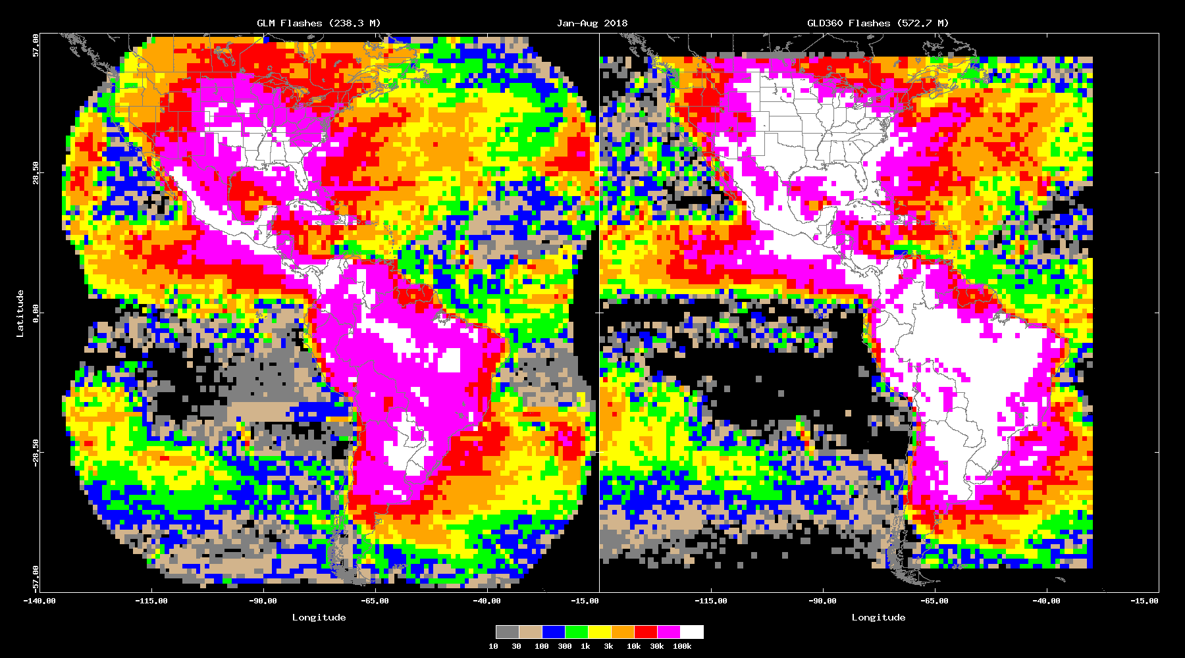
Climatology Jan-Aug 2018 GLM and GLD360

Slide 16
DE Map, Jan-Aug 2018

Slide 17
Avg DE Time Series, Jan-Aug 2018

Slide 18
Summary
GLM shows good DE everywhere except NW CONUS
In NW CONUS, comparison with GLD360 seems more favorable than with ENTLN + WWLLN
Over whole GLM FOV, DE > 0.70 every day this year
Some days as high as 0.90

