Slide 1
Development of GLM gridded imagery for operations and research
Eric Bruning
TTU Department of Geosciences
Atmospheric Science Group
Crucial contributions by
Scott Rudlosky — NESDIS
Clem Tillier, Samantha Edgington — Lockheed Martin
Joe Zajic — NWS TOWR-S team
Chad Gravelle, Matt Foster — NWS OPG
Kristin Calhoun, Adrian Campbell, Tiffany Meyer — OU/NSSL/HWT
Geoffrey Stano and Christopher Schultz — NASA SPoRT
GLM Science Meeting, Huntsville, AL
11-13 September, 2018

Slide 2
Status of GLM grids as of a year ago
A year ago, imagery made from GLM L2 data was full of undesirable compromises
Point displays did not depict extent of lightning flashes.
8 vs. 9 vs. 10 km regular lat-lon grid resulted in either double counting or introduction of gaps.
High level goal: encourage (correct, quality-controlled) usage of lightning data by those with minimal expertise in lightning by producing the time series imagery needed to visualize meteorological processes.
1st priority: link flash and event data to produce flash extent density grids,
Make the above available to NWS operations,
Disseminate to non-expert academic and research community.

Slide 3
Progress in the last year
Efforts in last year have addressed the needs identified on the previous slide, and have resulted in a suite of GLM gridded products.
Quantitatively visualize the GLM L2 data
Stay close to the hardware: visualize the detector array
A sort of “base data” imagery — think of NEXRAD radar moments
Core algorithm implemented at TTU in glmtools package
Python, open source, capitalizes on lmatools built for other cal/val purposes
Packaged behind a single command line script that generates NetCDF imagery — overlays on ABI imagery with no remapping
Effort had excellent support from NESDIS, Lockheed Martin, NWS OPG & TOWR-S, NSSL HWT, NASA SPoRT.
< 9 mo from implementation green light to NWS rollout

Slide 4
GLM grids are made by converting the basic
L2 measurements into imagery
Nearly all of the basic and augmented L2 properties are used to construct the grids
 |  | Flash | Group | Event
L2 Coordinate | Time | start | time | time
 |  | end
 | Space | centroid latitude | centroid latitude | latitude
 |  | centroid longitude | centroid longitude | longitude
 | Hierarchy | id | id | id
 |  |  | flash parent id | group parent id
 |  |  |  | flash parent id
 |  | event count | event count
 |  | group count
L2 Measurement | Physical | energy | energy | energy
 |  | area | area | corner points
Grid property | Centroid-based totals | count (unique id) | count (unique id) | count (suffers from gappiness)
 | Extent-based totals | count (unique id) | count (unique id) | count (unique id)
 |  | area | area | area
 |  | energy | energy | energy
Augmented data post-L2

Slide 5
glmtools automates the traversal of arbitrarily many levels of the hierarchy
flashes
events
included in dataset
needs to be reconstructed by traversal
groups
summarization: event_count, max_event_radiance, …
summarization:
group_count, max_group_radiance, …
summarization: event_count, max_event_radiance, …
replication: flash_id, flash_lat, …
replication:
group_id, group_lat, …
replication: flash_id, flash_lat, …
pruning: reduce dataset to the first two flashes
✂️
group_parent_flash_id and event_parent_group_id are replications that are already included in the dataset
Notes:
What we want is to be able to automate the replication of information down the tree, and summarization of info up the tree. For instance, we might want to count events, or replicate the flash_id along the event dimension. The idea even extends to other calculations, such as maximum radiance, or the flash latitude and longitude that corresponds to each event.
A final operation that we might want to do is prune out flashes of interest, reducing the size of the dataset.

Slide 6
Example: 20 May 2018, 01-02 UTC
Images every minute. GLM pixels visible, oversampled at 2 km on ABI fixed grid.
FED
AFA
TOE
GED
AGA
West Texas LMA, 1 hr composite
See talks on Thursday

Slide 7
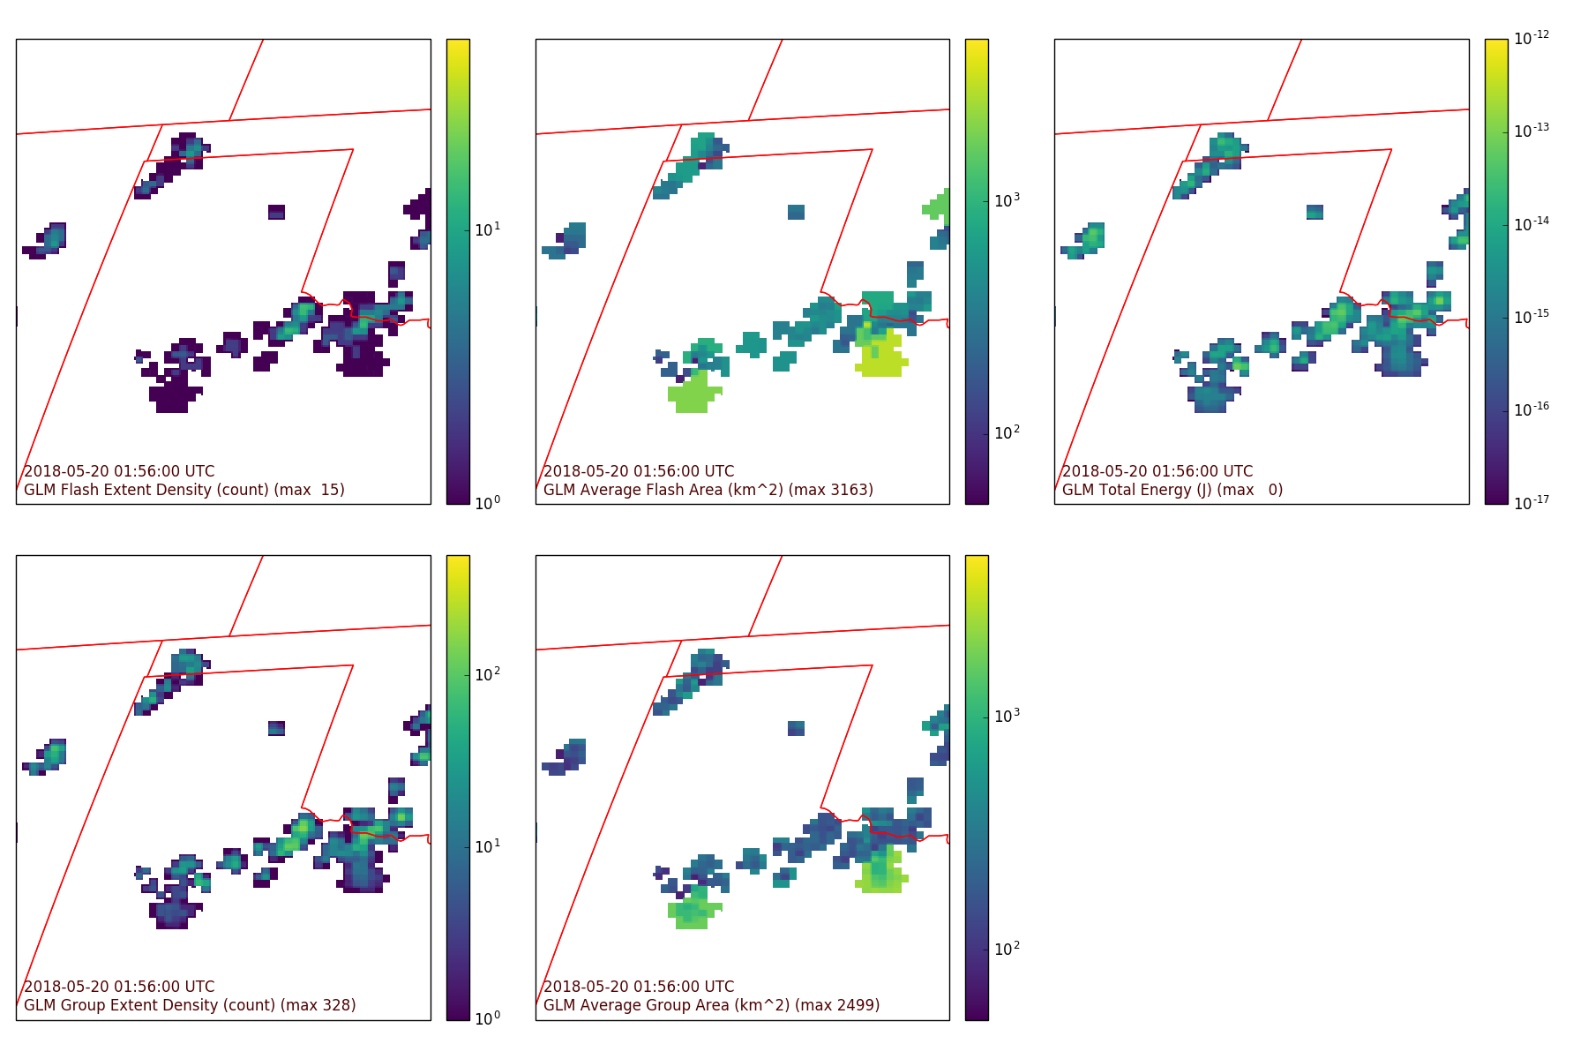
Examples: storm cores and anvils
FED
AFA
TOE
GED
AGA
The combination of flash extent density and average flash area distinguishes between low flash rate storm cores and extensive anvil or stratiform discharges.

Slide 8
Examples
FED
FCD
TOE
GED
GCD
FCD, GCD:
• Too sparse for good visualization
• Still needed: sum to find flash and group rates within a storm cell or within current AWIPS view

Slide 9
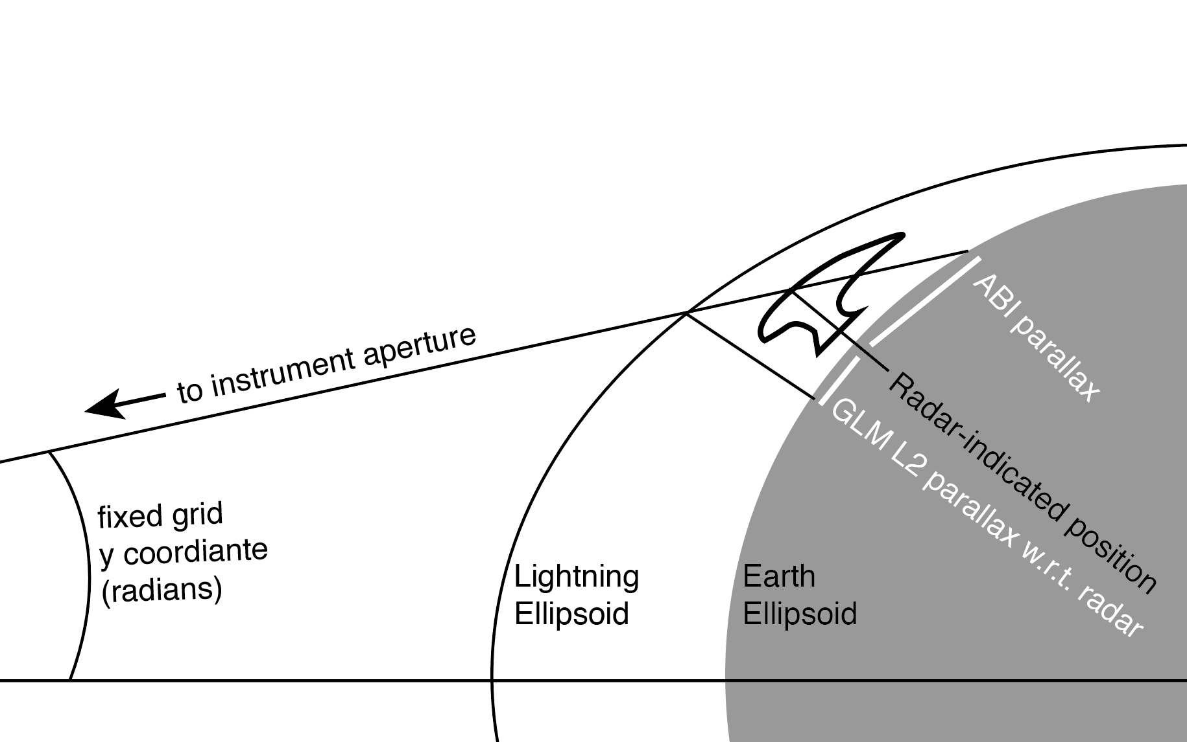
Implementation details
Challenge | Solution
The same storm may be displayed in three locations on an end user display Ground-referenced position (radar, CG) ABI parallax GLM offset due to any mismatch between cloud top height and lightning ellipsoid | Dissemination of imagery on the ABI fixed grid without parallax correction or a lightning ellipsoid. Result: a single parallax for all satellite data
In this example, the GLM L2 position is offset to the south of the desired radar-indicated position because the storm top was below the lightning ellipsoid

Slide 10
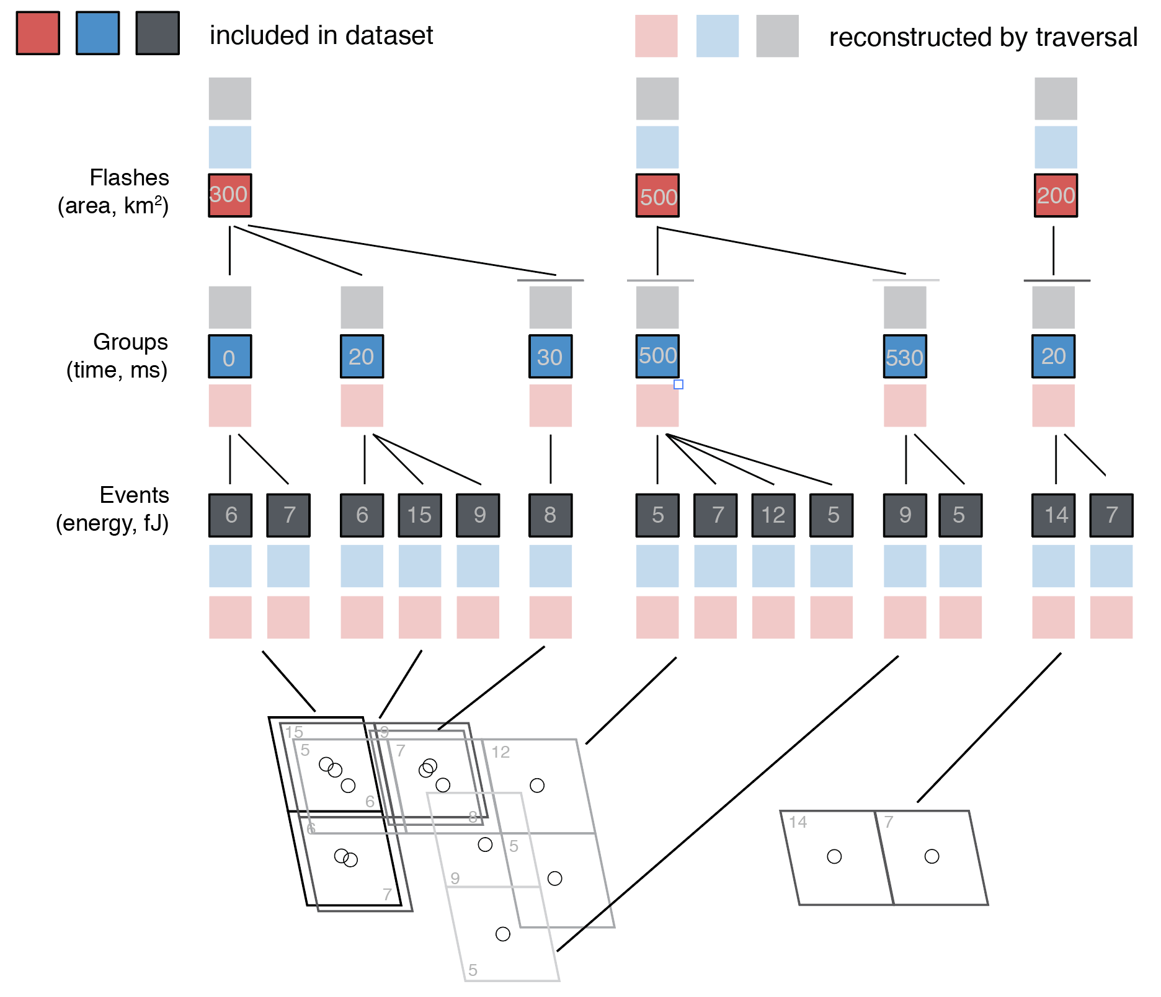
Challenge | Solution
The spatial footprint of each L2 event is not provided at L2, but is needed for flash extent density | Restore event corner points using a lookup table, preserving L2 solutions that already incorporate the best-available navigation
3 flashes
6 groups
14 events
Area at flash and group
level must be replicated to
event level
Ordinary jitter and
one major excursion at 530 ms

Slide 11
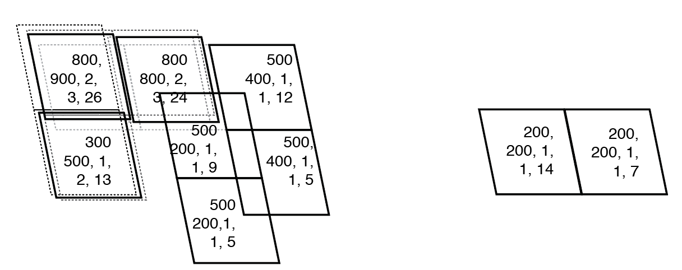
Challenge | Solution
Event positions may shift due to spacecraft jitter or maneuvers, but processing of large event counts on a per-event basis was too slow. | Aggregate flash properties at discretized event locations, reducing per-event processing
Total flash area (km²),
Total group area (km²), Flash count
Group count, Total energy (fJ)
Event locations discretized to nearest 28 µrad (~ 1km, greater than typical jitter). Discretized location is mean of original event centroids.

Slide 12
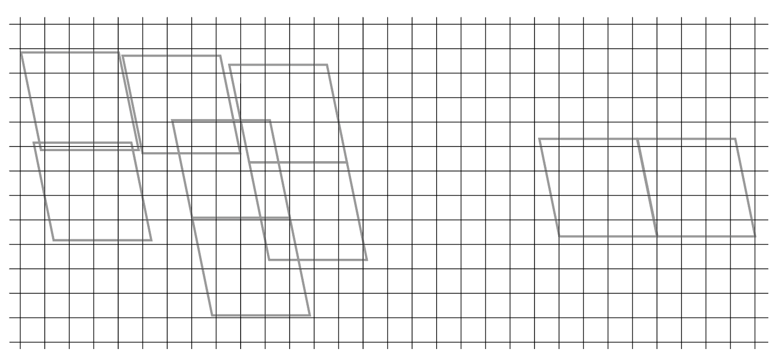
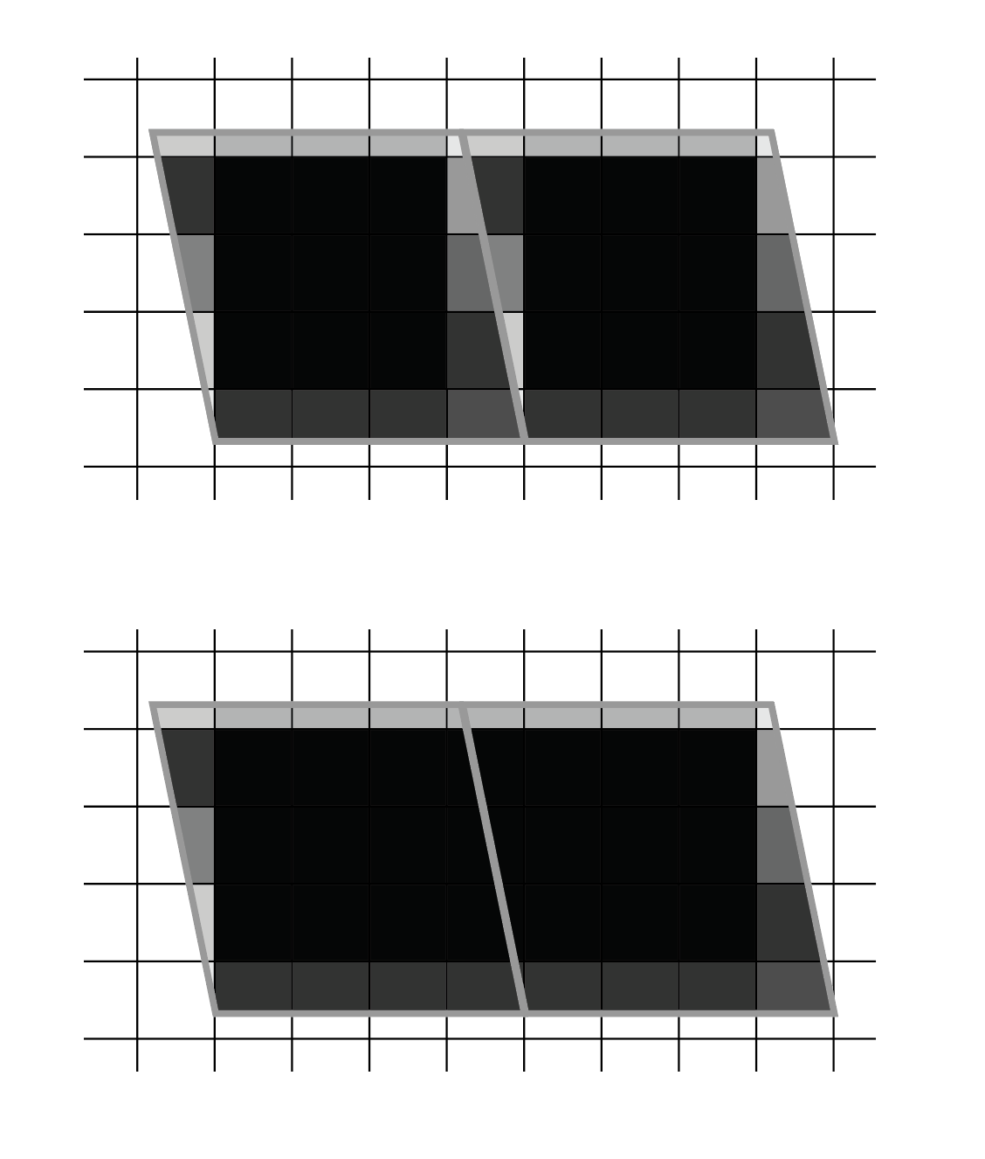
Challenge | Solution
Event shapes must be mapped onto the target fixed grid — one at a time since the positions are irregular | Use polygon clipping and area weighting to assign final values. Results in oversampled, antialiased image, retaining flexible event positioning.
1. Use the target grid to slice each event into sub-event polygons
2. Calculate fraction of target grid fg covered by each sub-poly
3. Calculate fraction of each event f0 covered by each sub-poly
fg (above) and the
sum of fg (below) in each grid box
A subtle distinction in assigning weights:
4a. For an extensive quantity qe (flash count, total area, etc.), qeg = qefg
4b. For a conserved quantity qc (total energy), qcg = qcf0 = qc fg Ag / A0
Extent density is the sum of weighted (flash, group) counts for all event polygons that contribute to a grid box
Average area is the sum of all areas for all event polygons that contribute to a grid box, divided by the extent density

Slide 13
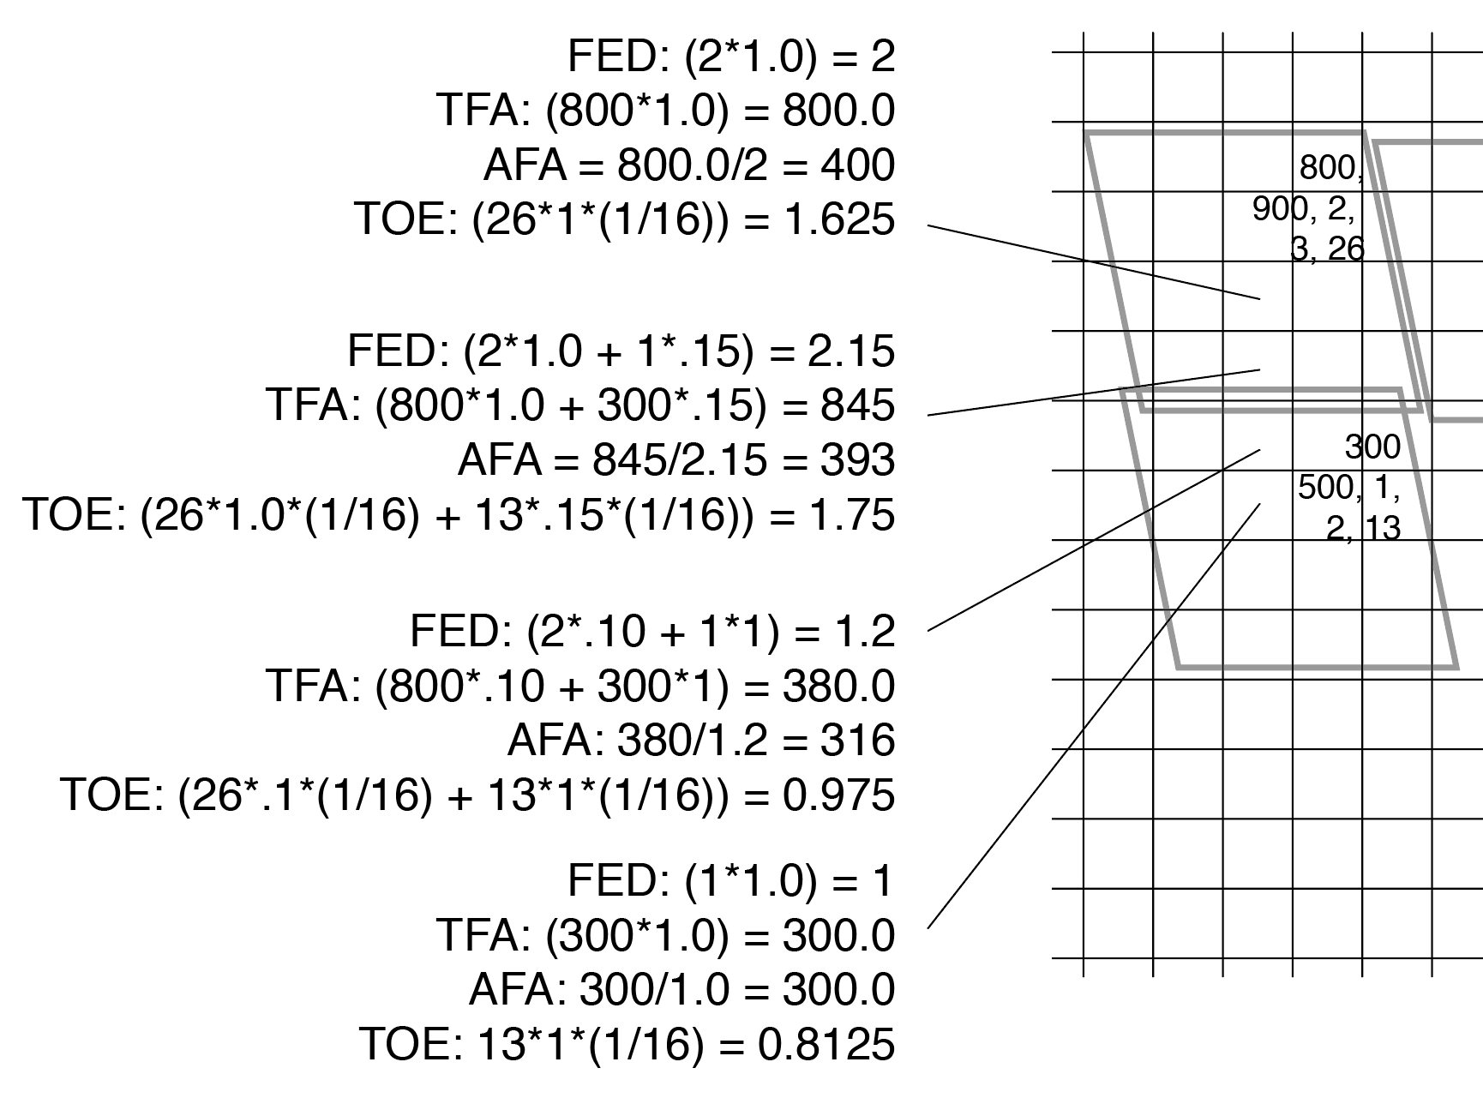
Challenge | Solution
Event shapes must be mapped onto the target fixed grid — one at a time since the positions are irregular | Use polygon clipping and area weighting to assign final values. Results in oversampled, antialiased image, retaining flexible event positioning.
Calculations from the pre-aggregated event-totals for four grid cells shown to the right.
No need to study this live on the screen, but the calculations are not elaborate.
Extent density is the sum of weighted counts for all polygons that contribute to a grid box
Average area is the sum of all areas for all polygons that contribute to a grid box, divided by the extent density

Slide 14
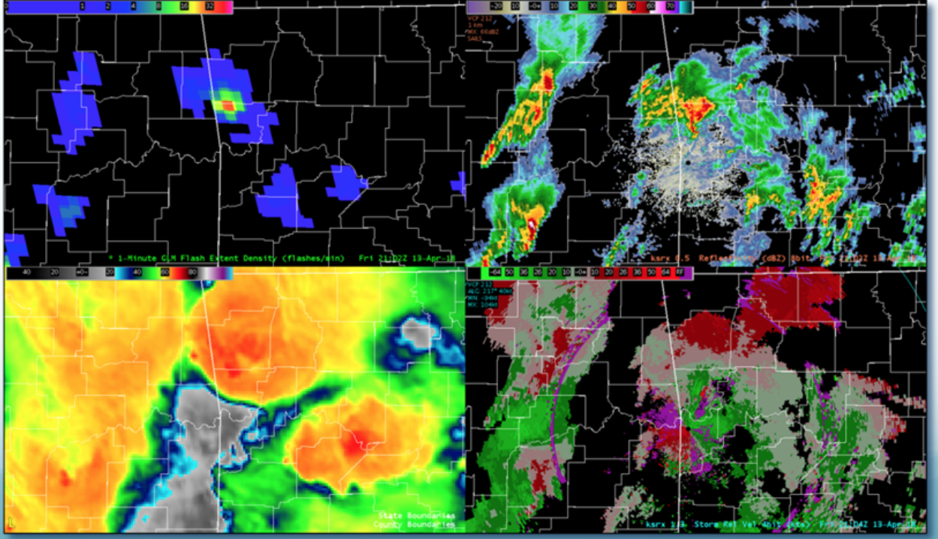
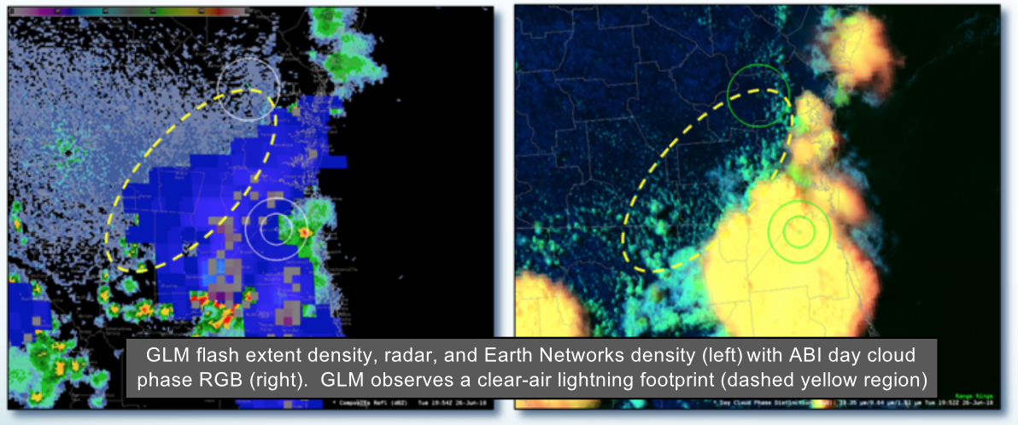
Status of NWS dissemination
Rollout of flash extent density to 130 WFOs complete as of late August
1 min, 5 min accumulations with 1 min update
CONUS sector
NSSL HWT activities in May and OPG-led pre-operational demonstration through summer with 20 offices addressed
Timeliness and correctness of imagery
AWIPS display performance and colormaps
Refinement of training narrative and materials
Surprises such as scattering of light by low clouds
Instrument artifacts (e.g., overshoots in Bahamas)
20 offices continue to evaluate average flash area and total optical energy
HWT feedback: it really helps to see all fields to gain confidence!
Feedback from offices with less expert, on-site guidance: not sure what I’m supposed to do with these!
From SPoRT-led NWS training quick brief

Slide 15
NWS ISatSS implementation
Led by TOWR-S / Joe Zajic: intermediate, real-time-grade processing layer to prepare GOES-R data for AWIPS
Python, with core packages available (NetCDF, xarray, etc.)
glmtools integrated as processing module within this infrastructure
Pre-operational demonstration run on AWC ISatSS instance adjacent to OPG and products distributed over LDM, before rollout to NCEP Central Operations

Slide 16
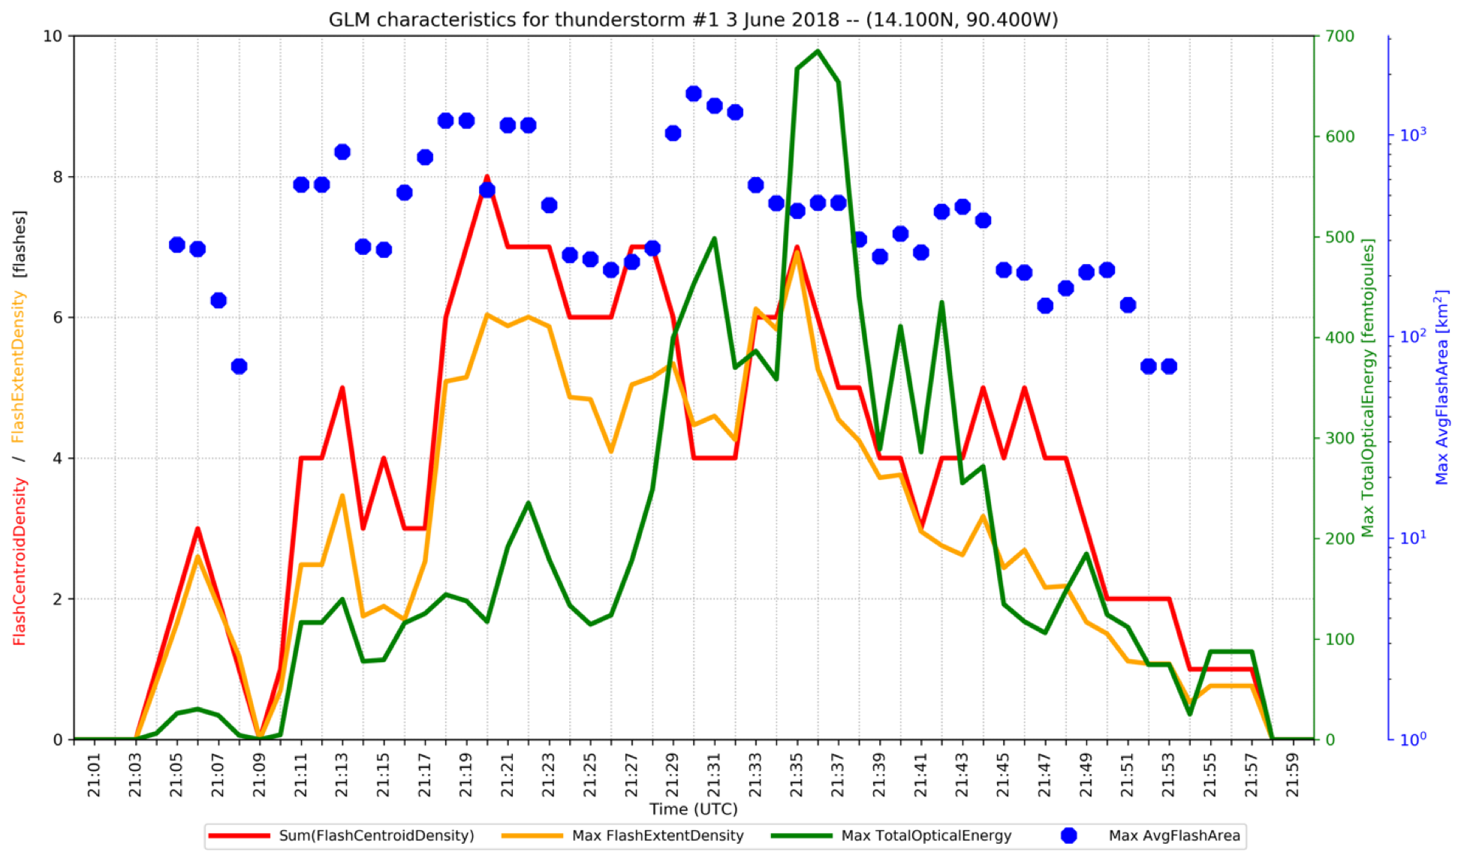
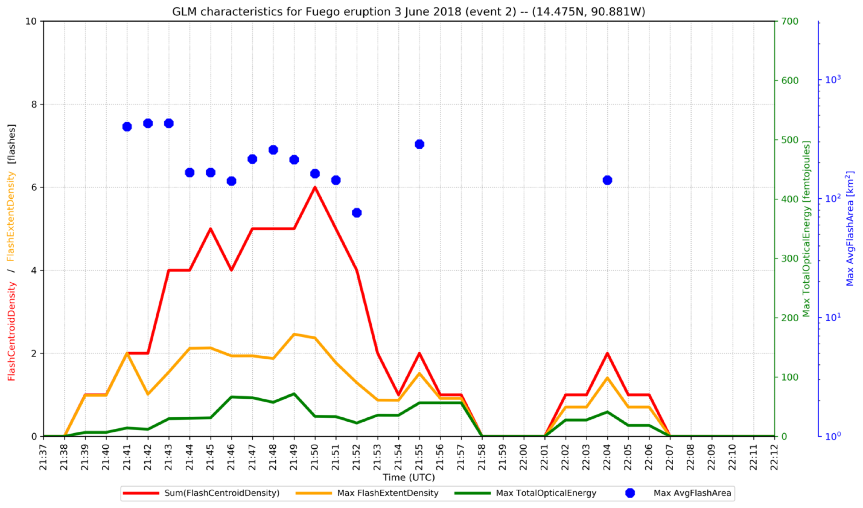
Preliminary integration into probsevere
Face-to-face interaction at HWT with ProbSevere team (Sieglaff) led to visit at UW with (Cintineo)
Identified a few bugs and clarified product interpretation
Facilitated initial probabilistic characterization of GLM data
Fuego volcano comparison: 3 June 2018 (Cintineo)
Dimmer optical signals from volcano event at same flash rate
Availability of imagery-like products seems to speed adoption and inquiry of GLM data —beyond flash rate
2145 UTC
(image: CSU/CIRA)
Thunderstorm
Volcano

Slide 17
Community-focused dissemination
Equipment award from Unidata to TTU will support generation of all 7 GLM grids and their distribution over LDM to any interested user.
Nominal plan is CONUS and a special mesoscale domain to support RELAMPAGO / CACTI
Working with Unidata to add GLM grid display to McIDAS
needed, for example, to allow display on widely used College of DuPage experimental GOES-16 viewer
You can run it, too!
python make_GLM_grids.py -o /path/to/output/ \
--fixed_grid --split_events \
--goes_position east --goes_sector conus \
--dx=2.0 --dy=2.0 \
OR_GLM-L2-LCFA_G16_s20181830433000_e20181830433200_c20181830433231.nc \
OR_GLM-L2-LCFA_G16_s20181830433200_e20181830433400_c20181830433424.nc \
OR_GLM-L2-LCFA_G16_s20181830433400_e20181830434000_c20181830434029.nc \
github.com/deeplycloudy/glmtools/

Slide 18
Next steps
(Loop by Scott Rudlosky/ NESDIS/UMD)
Identify a final operational home for GLM grids
Build a large library of short 1-3 min use case vignettes for NWS
Advocate for use of products beyond FED within NWS

