Slide 1
GLM Laser Beacon Activities
GLM Science Meeting, Huntsville AL
September 12, 2017
Dennis Buechler, NASA/MSFC
(other team members)

Slide 2
GLM Laser Beacons
Use laser beacons as well characterized signals to evaluate GLM geolocation accuracy
Laser locations are well characterized (within few mm)
Lasers tuned to near 777.4 nm wavelength
Two lasers to provide large baseline
Greenbelt, MD
Monument Peak, CA
The lasers are pulsed (50 Hz or 100 Hz) so GLM events are processed as lightning by the Ground Processing Algorithm
The GPA will geolocate the laser signal
The laser location is well known and can be compared to the GPA derived geolocation
GLM geolocation requirement 5 km (MRD)
Examine diurnal changes in geolocation accuracy

Slide 3
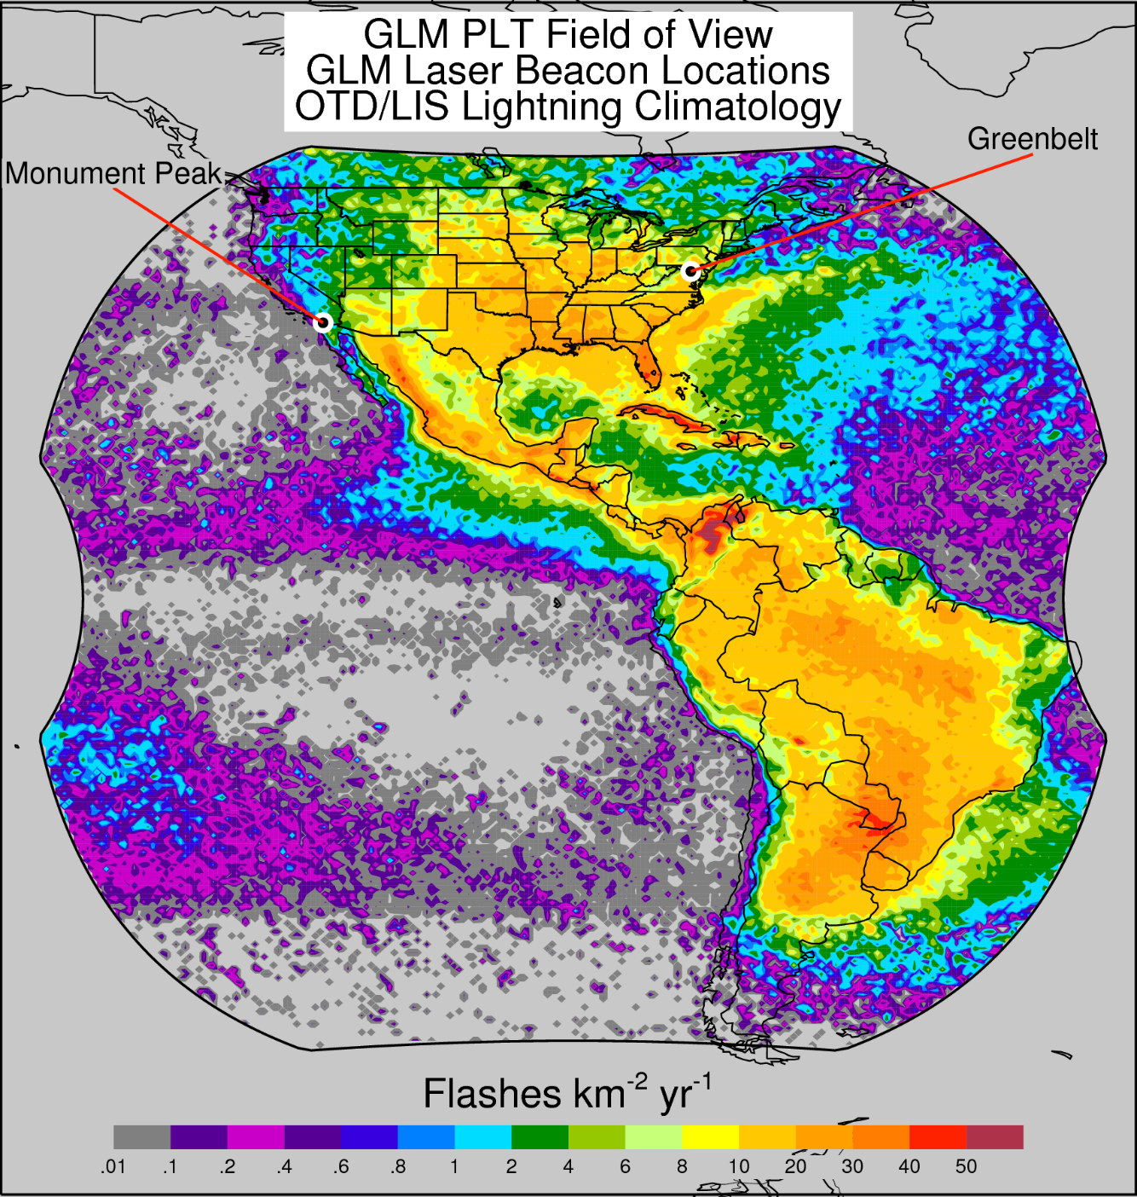
Laser Beacon Locations

Slide 4
GOES-16 Laser Operations
Date | Time (UTC) | Location GB-Greenbelt MP-Monument Pk | Notes
April 19, 2017 | 0152-0352 | GB
April 29, 2017 | 0055-0200 | GB
May 3, 2017 | 1720-1850 | GB | dither
May 8, 2017 | 1730-1840 | GB
June 9, 2017 | 1645-1710 | GB
June 11, 2017 | 0300-0340 | GB
June 13, 2017 | 1700-1712 | GB | dither
June 24, 2017 | 0420-0510 | MP
June 28, 2017 | 1750-1754 | GB | Very few events
July 13, 2017 | 0339-0715 | GB & MP
Aug 10, 2017 | 0225-0323 1440-1552 | GB & MP GB & MP | Night Day
Sep 5, 2017 | 1405-1455 | GB & MP

Slide 5
GOES-16 Laser Operations (continued)
Date | Time (UTC) | Location GB-Greenbelt MP-Monument Pk | Notes
Sep 21, 2017 | 1450-1655 1850-1830 | GB & MP GB & MP
Oct 2-3, 2017 | 1020/2-1409/3 | GB & MP | 24 hr test (hourly obs)
Nov 28, 2017 | 0340-0425 | GB
Nov 29, 2017 | 0250-0320 2149-2215 | GB & MP GB & MP
Nov 30, 2017 | 0350-0415 | GB & MP
Dec 19, 2017 | 2115-2130 2200-2240 | MP GB & MP | At 75.2° W
Dec 20 , 2017 | 0010-0045 0155-0225 | GB & MP GB & MP
Jan 5, 2018 | 0018-0040 2250-2328 | GB GB & MP
Jan 6, 2018 | 0210-0240 | GB & MP
Jan 17, 2018 | 2225-2255 | MP | @ GOES-E Prior to PS-PVR
Jan 18, 2018 | 0150-0210 0445-0515 | GB & MP GB & MP | INR optimized

Slide 6
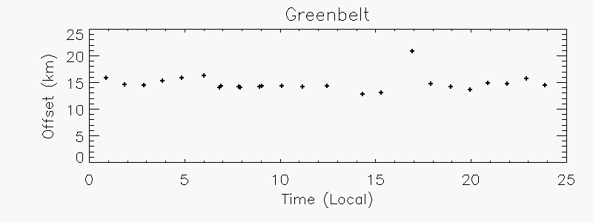
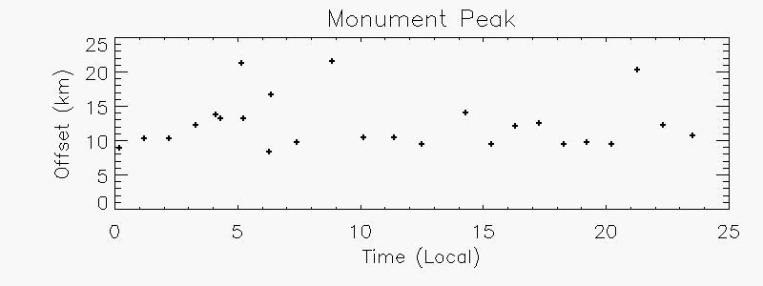
GOES-16 24 Hr Test 2-3 Oct 2017

Slide 7
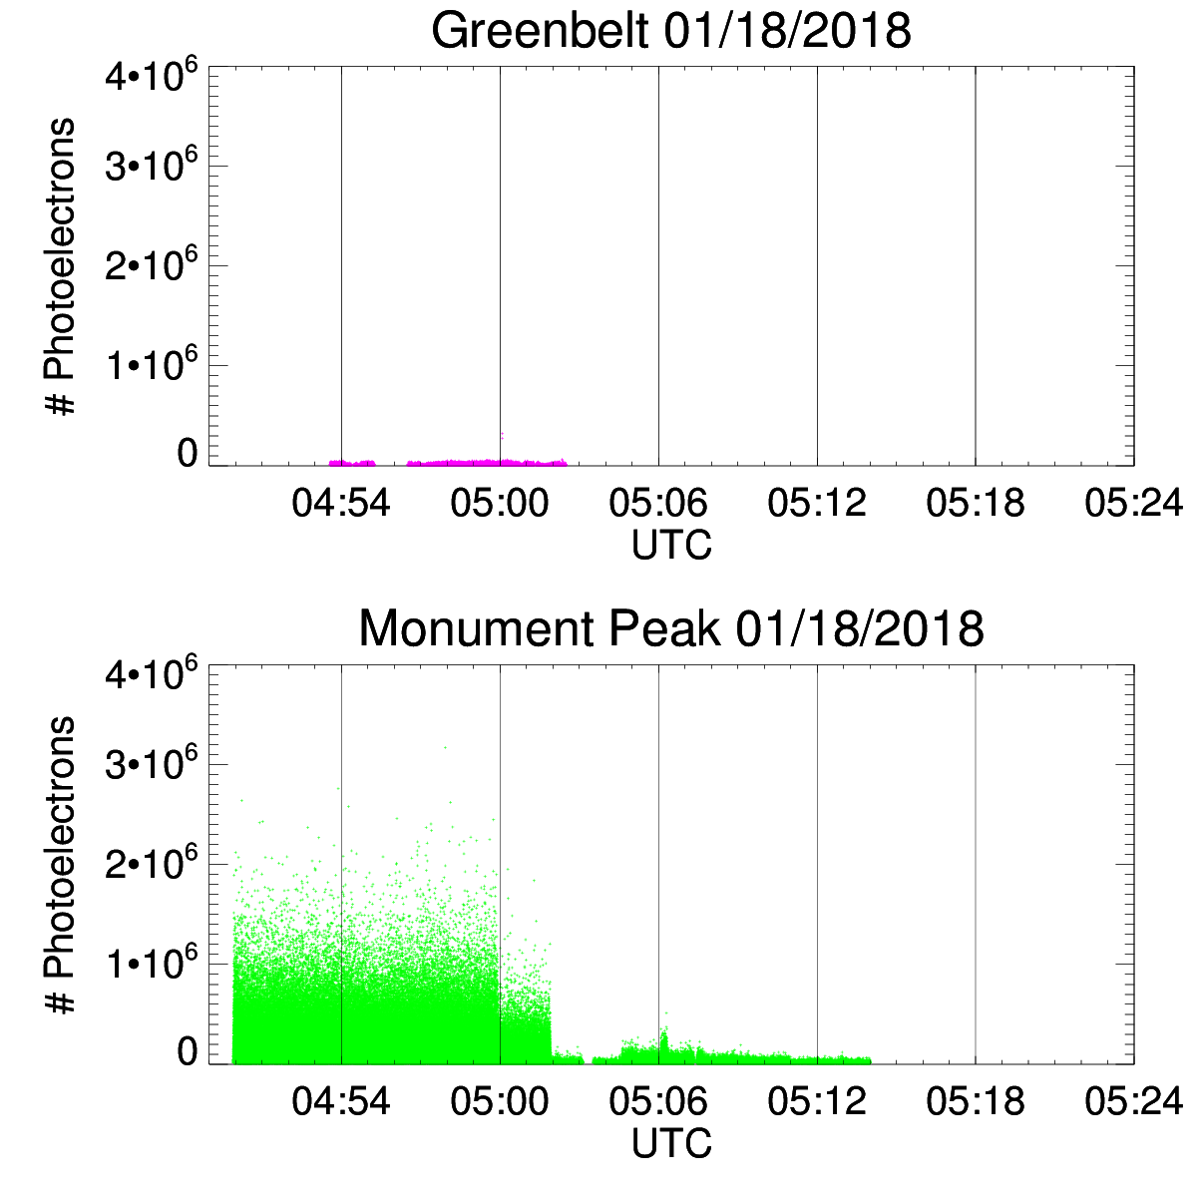
GOES-16 Laser Test 3

Slide 8
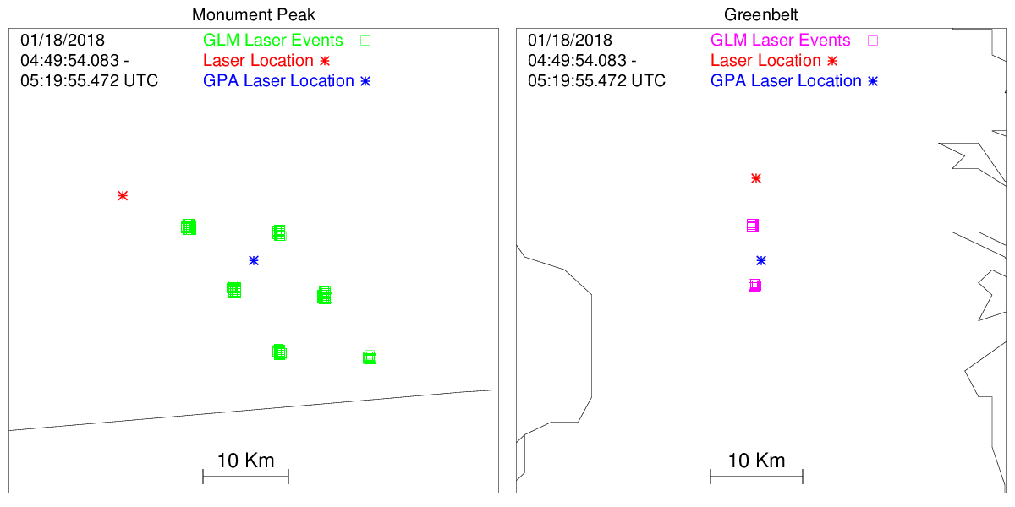
GOES-16 Laser Test 3
Events

Slide 9
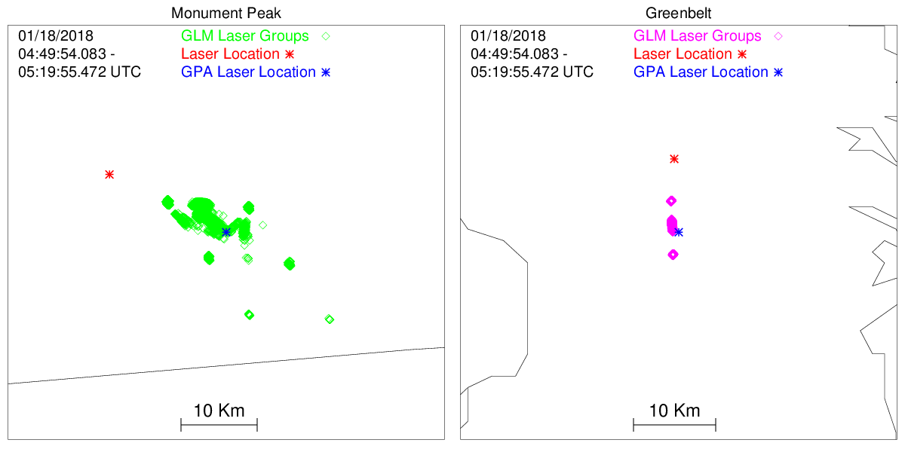
GOES-16 Laser Test 3
Groups

Slide 10
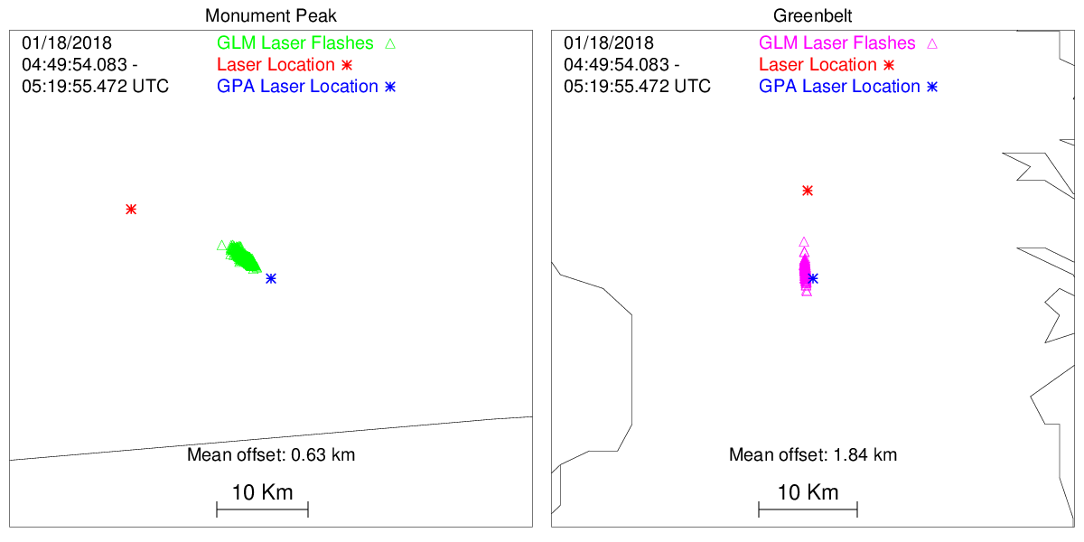
GOES-16 Laser Test 3
Flashes

Slide 11
GOES-16 GLM
Geolocation Offsets
Date | Time (UTC) | Monument Peak | Greenbelt
Jan 17, 2018 | 2225-2255 | 2.86 | ----
Jan 18, 2018 | 0150-0210 | 2.64 | 4.38
Jan 18, 2018 | 0445-0515 | 0.63 | 1.84

Slide 12
GOES-17 Initial Laser Beacon Tests

Slide 13
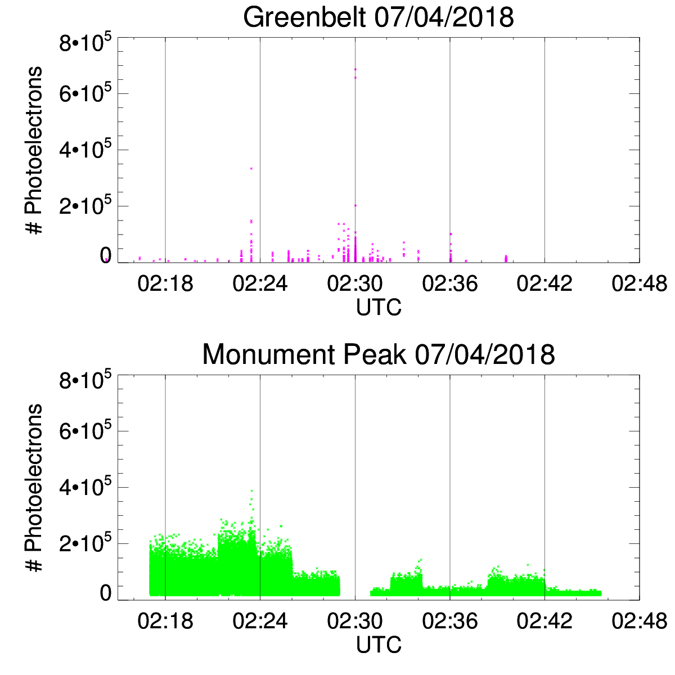
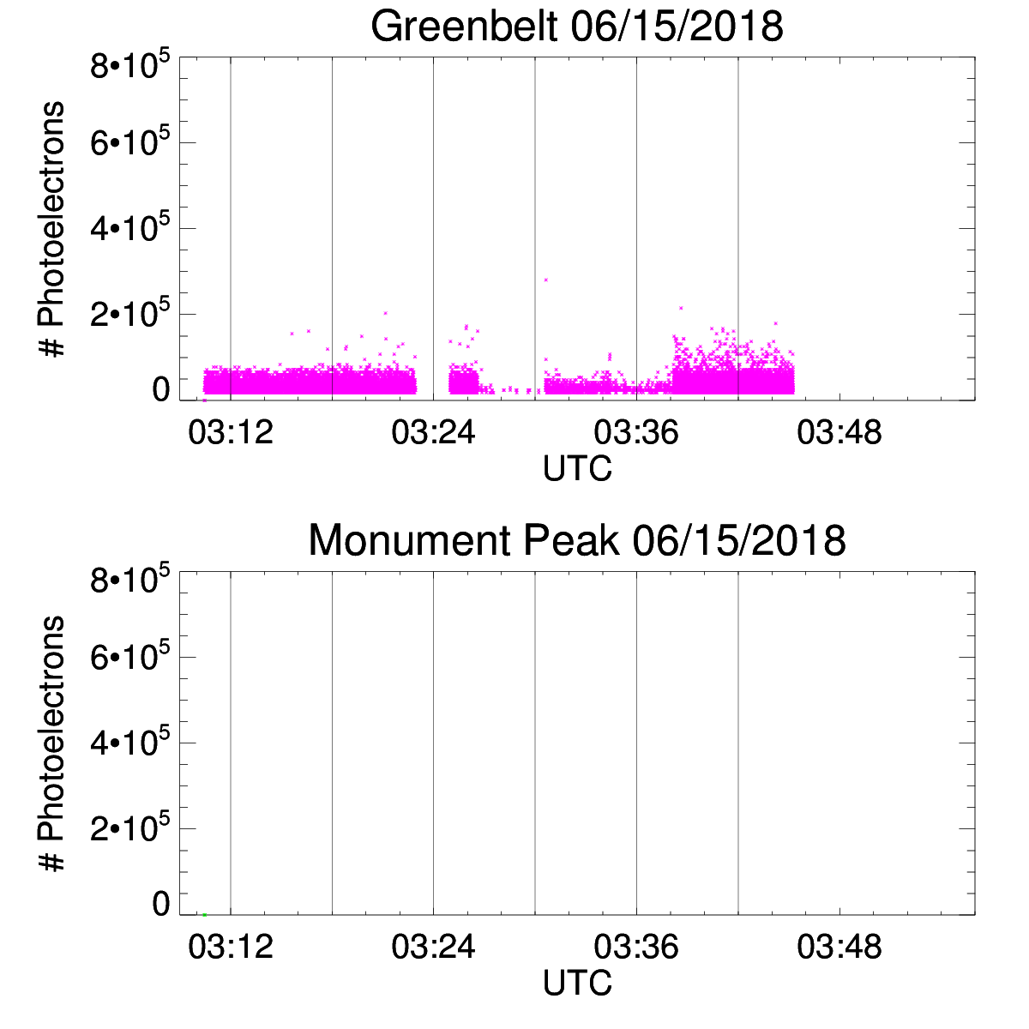
GOES-17 Laser Tests
NOAA's GOES-17 satellite has not been declared operational and its data are preliminary and undergoing testing. Users receiving these data through any dissemination means (including, but not limited to, PDA and GRB) assume all risk related to their use of GOES-17 data and NOAA disclaims any and all warranties, whether express or implied, including (without limitation) any implied warranties of merchantability or fitness for a particular purpose.

Slide 14
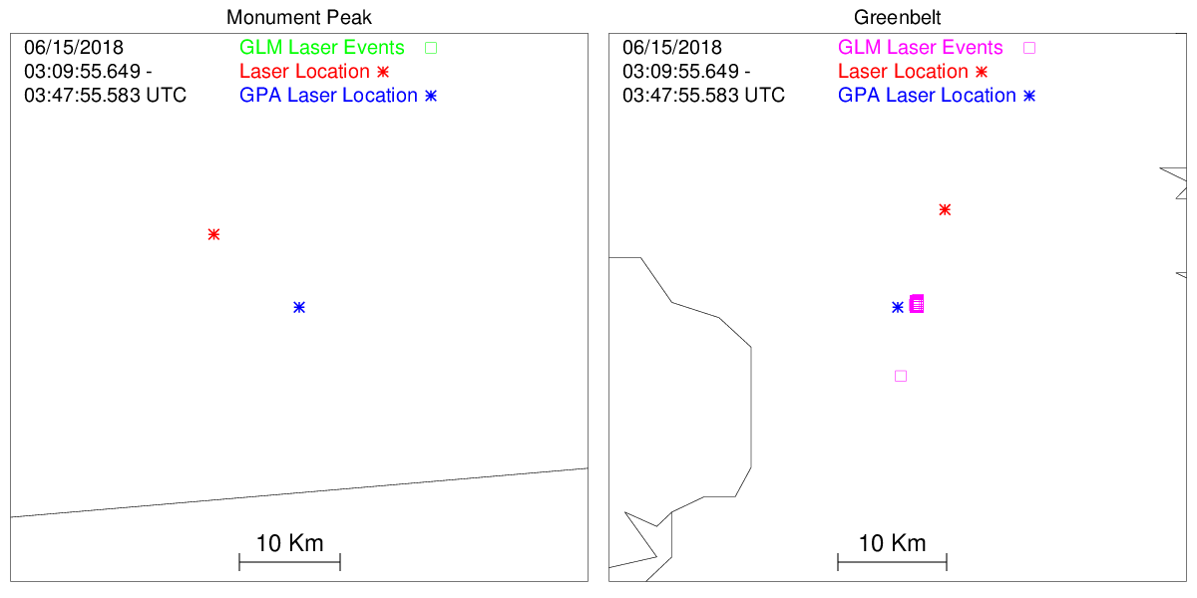
GOES-17 Laser Test (GB)
Events
NOAA's GOES-17 satellite has not been declared operational and its data are preliminary and undergoing testing. Users receiving these data through any dissemination means (including, but not limited to, PDA and GRB) assume all risk related to their use of GOES-17 data and NOAA disclaims any and all warranties, whether express or implied, including (without limitation) any implied warranties of merchantability or fitness for a particular purpose.

Slide 15
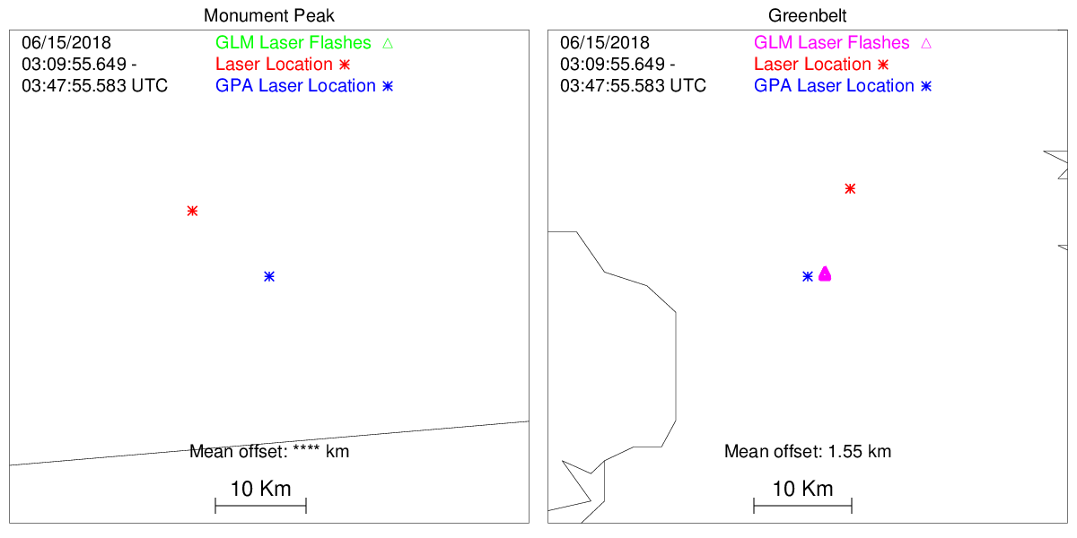
GOES-17 Laser Test (GB)
Flashes
NOAA's GOES-17 satellite has not been declared operational and its data are preliminary and undergoing testing. Users receiving these data through any dissemination means (including, but not limited to, PDA and GRB) assume all risk related to their use of GOES-17 data and NOAA disclaims any and all warranties, whether express or implied, including (without limitation) any implied warranties of merchantability or fitness for a particular purpose.

Slide 16
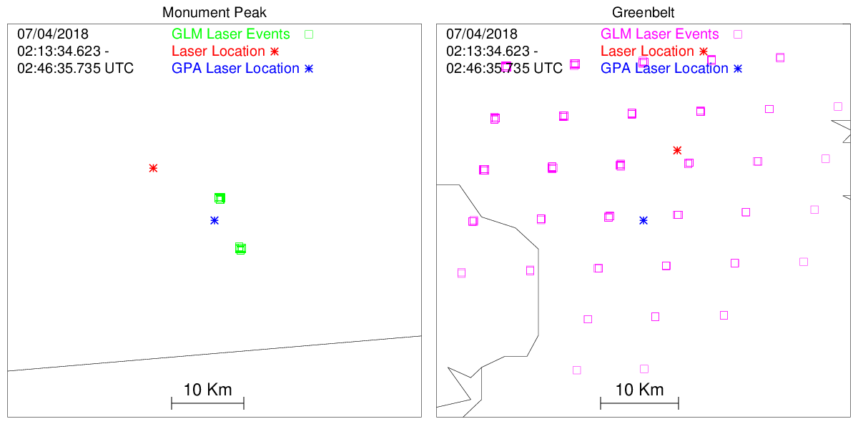
GOES-17 Laser Test (MP)
NOAA's GOES-17 satellite has not been declared operational and its data are preliminary and undergoing testing. Users receiving these data through any dissemination means (including, but not limited to, PDA and GRB) assume all risk related to their use of GOES-17 data and NOAA disclaims any and all warranties, whether express or implied, including (without limitation) any implied warranties of merchantability or fitness for a particular purpose.

Slide 17
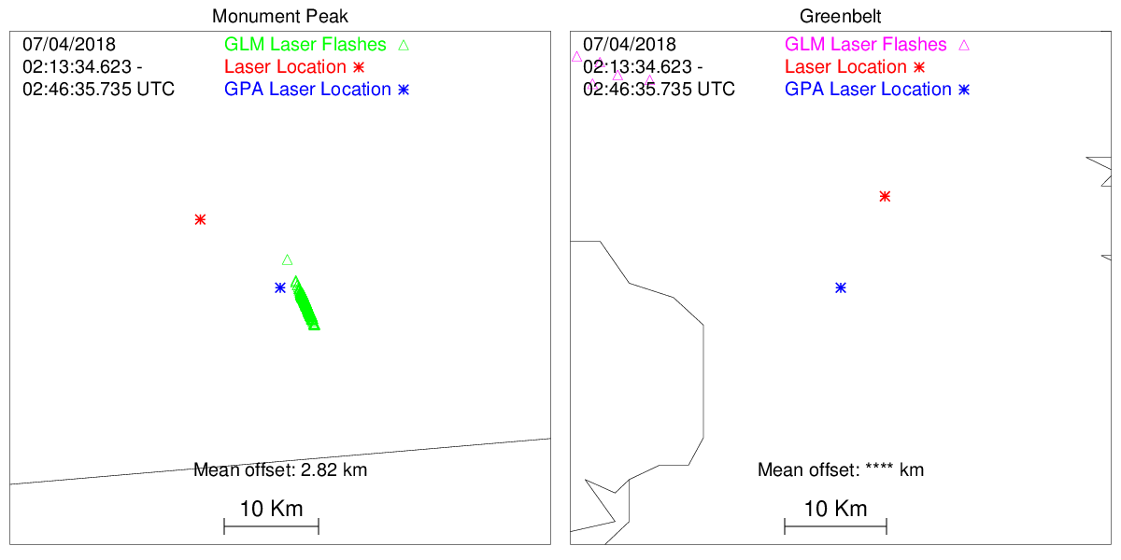
GOES-17 Laser Test (MP)
Flashes
NOAA's GOES-17 satellite has not been declared operational and its data are preliminary and undergoing testing. Users receiving these data through any dissemination means (including, but not limited to, PDA and GRB) assume all risk related to their use of GOES-17 data and NOAA disclaims any and all warranties, whether express or implied, including (without limitation) any implied warranties of merchantability or fitness for a particular purpose.

Slide 18
Future Laser Tests
GOES-16/17 Comparison
Can accomplish GOES-17 geolocation goals while comparing with GOES-16 with current GPA updates
Laser on one satellite for 5-15 min then on the other for 5-15 min
Compare other GLM parameters (geolocation, energy, overshoot correction)
Test 1: Pre yaw flip (24 Sep 2018)
Test procedure for three different times
Different CCD pixels than post yaw flip
Test 2: 24 hour test
Examine diurnal geolocation accuracy
Test 3: After GOES-17 drift (only at Monument Peak)
Baseline measurements at GOES-W

Slide 19
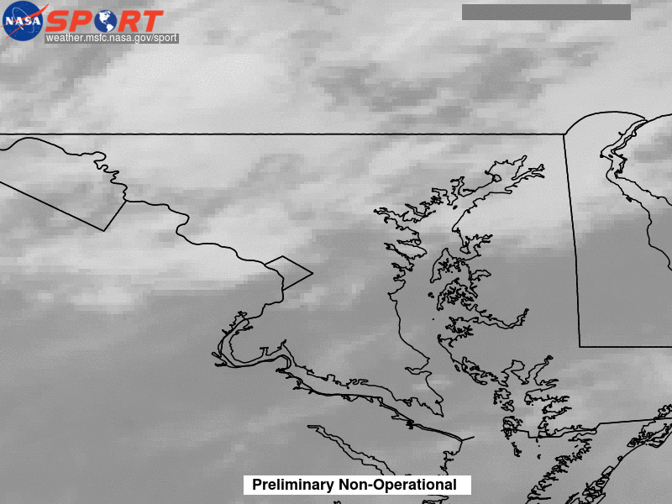
Laser Beacon Animations
GOES-16 Laser Beacon Test 13 July 2017
13 July 2017 (GLM data over ABI IR image):
Times are not synched up in animations
Note effect of clouds on Greenbelt performance

Slide 21
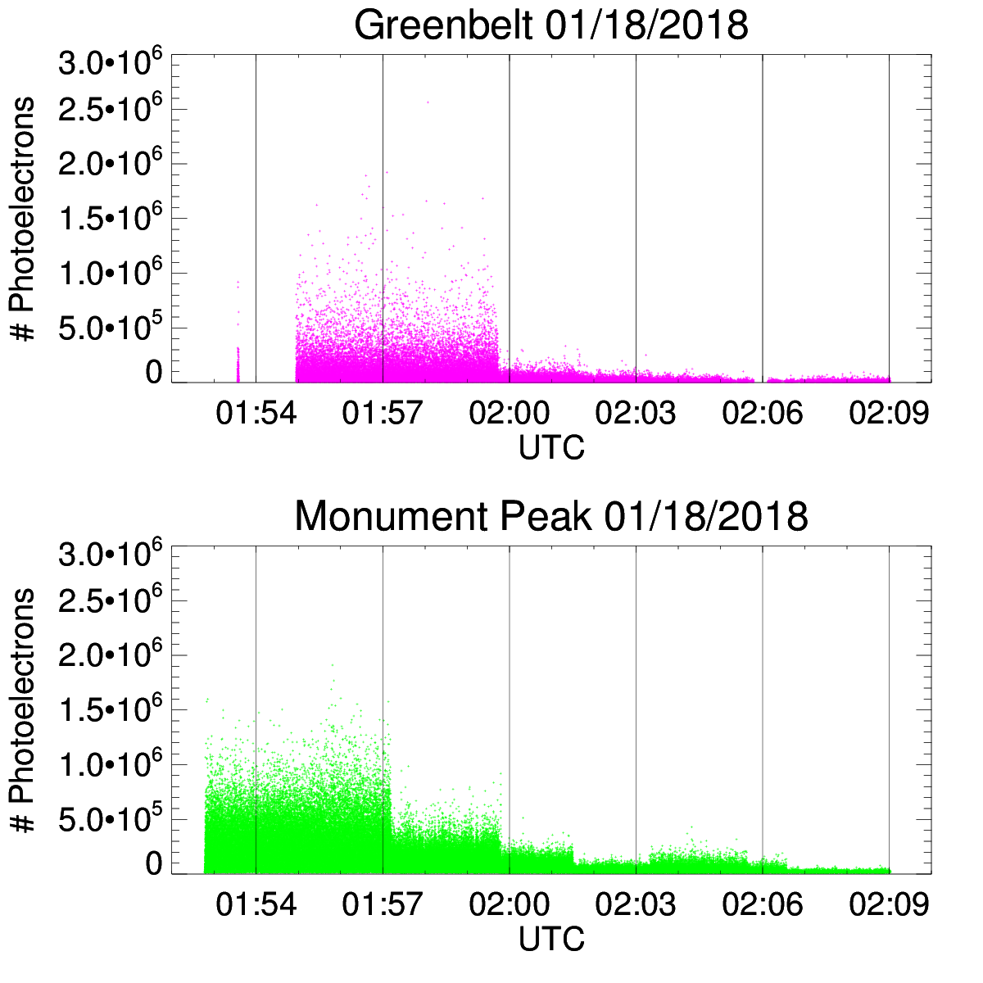
GOES-16 Laser Test 2 2

Slide 22
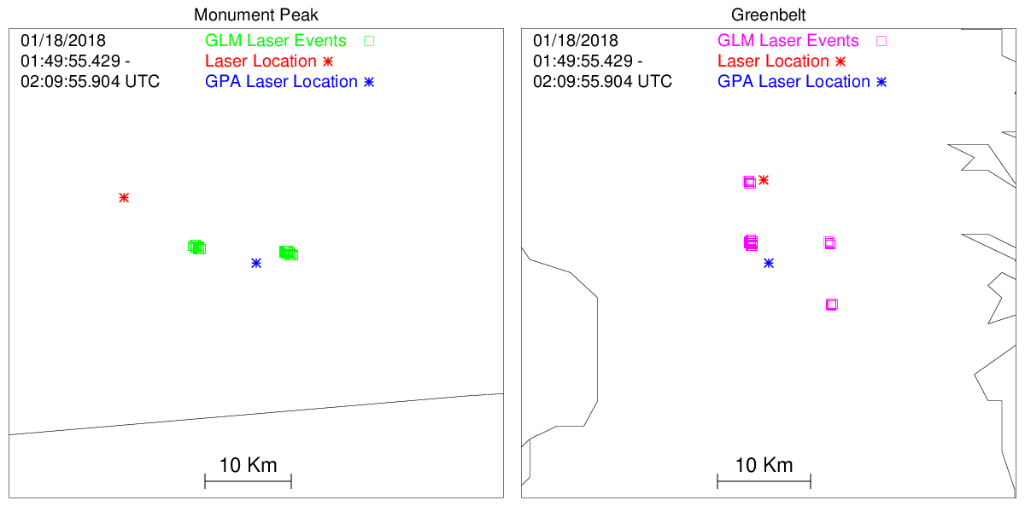
GOES-16 Laser Test 2
Events

Slide 23
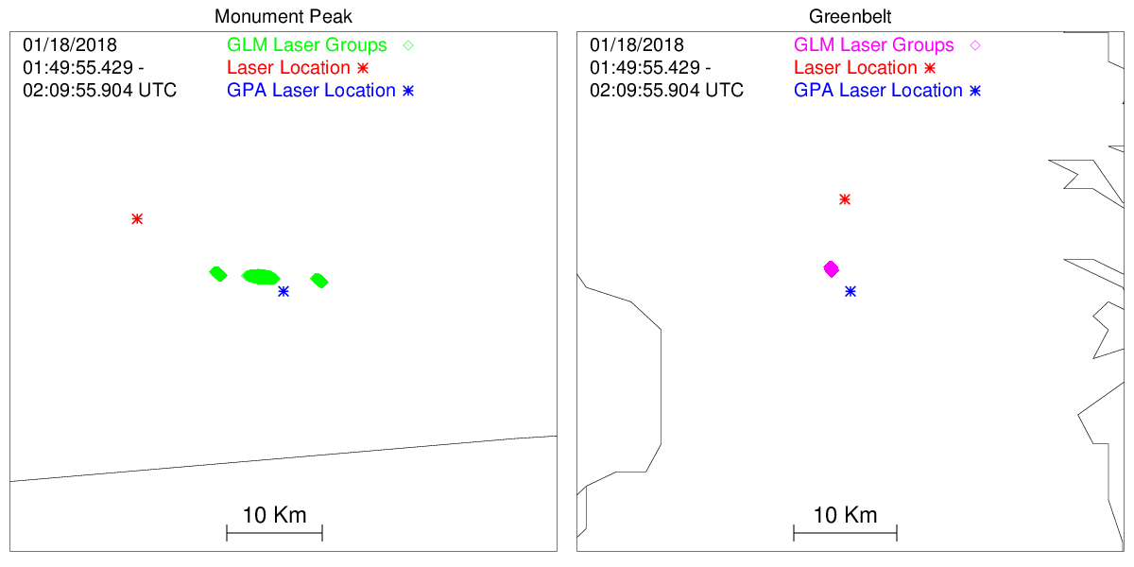
GOES-16 Laser Test 2
Groups

Slide 24
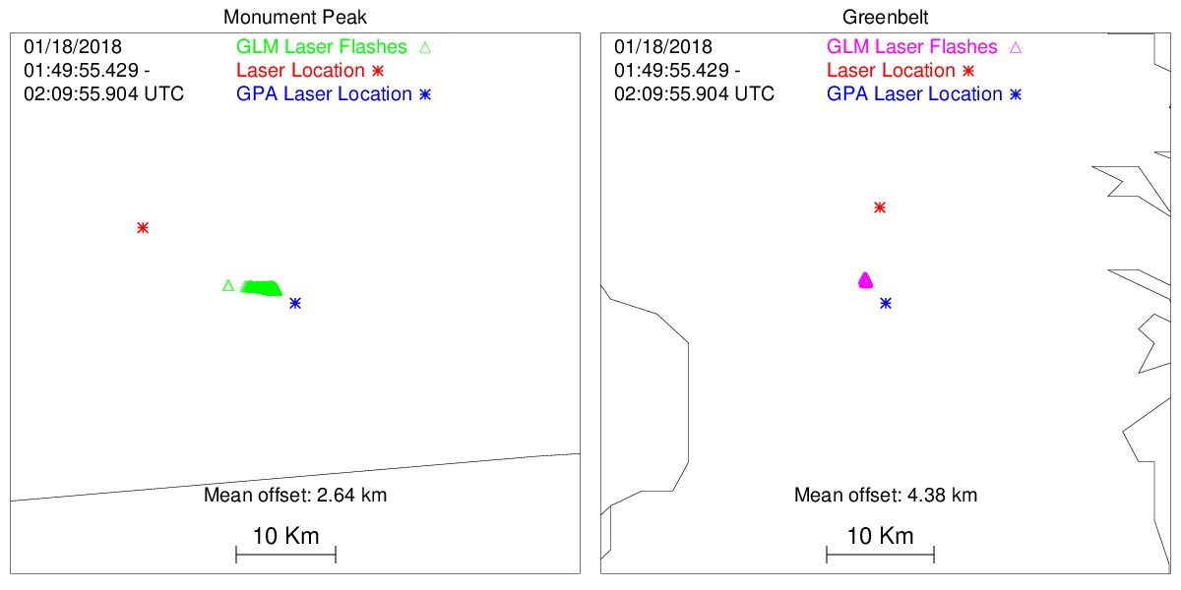
GOES-16 Laser Test 2
Flashes

Slide 25
Satellite Laser Ranging Group
The SLR Satellite Ranging Group has a number of installations
Tracking/locating satellites
Identified and procured lasers based on GLM detection methodology
Wavelength near 777.4 nm
Pulse width ~1.5 ms
50 Hz
Sufficient power at GLM
Installed and mounted lasers on existing mounts
Developed test procedures and procured safety approvals
Tested that GLM detected laser signal
Trained crews to run the laser beacon tests

Slide 26
Laser Beacon Test Procedure
Schedule date
Notify NOAA so notifications can be sent out
Monitor weather conditions at sites
Morning of test confirm go/no go
Weather
Personnel
Data availability
Start web tool for monitoring test
Hosted on the GOES-R Field campaign web site

Slide 27
Laser Operations
Date | Time (UTC) | Location GB-Greenbelt MP-Monument Pk | Notes
April 19, 2017 | 0152-0352 | GB
April 29, 2017 | 0055-0200 | GB
May 3, 2017 | 1720-1850 | GB | dither
May 8, 2017 | 1730-1840 | GB
June 9, 2017 | 1645-1710 | GB
June 11, 2017 | 0300-0340 | GB
June 13, 2017 | 1700-1712 | GB | dither
June 24, 2017 | 0420-0510 | MP
June 28, 2017 | 1750-1754 | GB | Very few events
July 13, 2017 | 0339-0715 | GB & MP
Aug 10, 2017 | 0225-0323 | GB & MP | Night drift
Aug 10, 2017 | 1440-1552 | GB & MP | Day, drift
Sep 6, 2017 | 1405-1455 | GB & MP

Slide 28
Laser Beacon Web Display
Uses GLM L2 PDA data from the GHRC
IDL tool
Monitors when new GLM L2 file is available
Plots image of last 4 minutes of GLM data around the laser locations
Updates image when new L2 file comes in
GHRC developed tool loads the image onto web page
Latency generally varies from 1.5 to 2.5 minutes

Slide 29
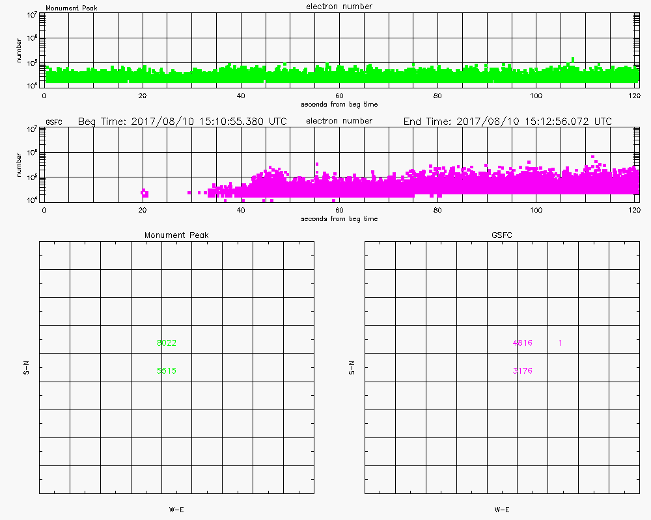
Laser Beacon Web Example

Slide 30
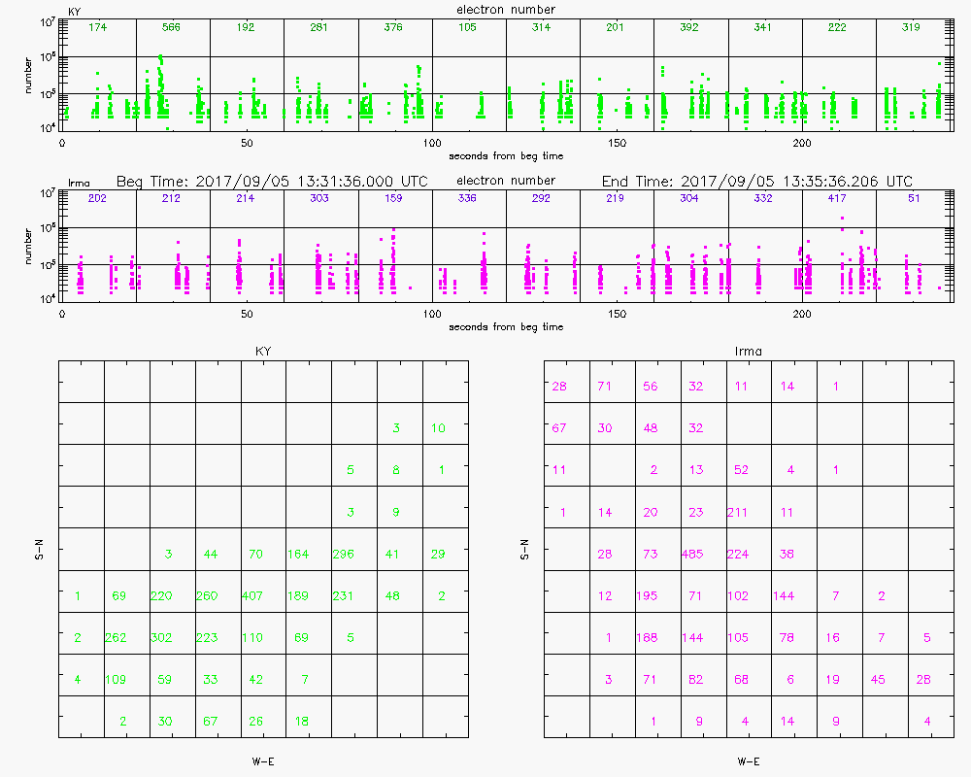
Lightning Web Example

Slide 31
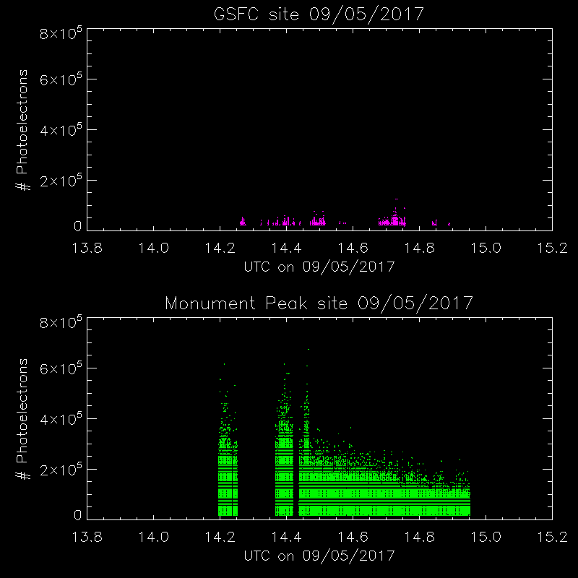
Laser Beacon Time Series

Slide 32
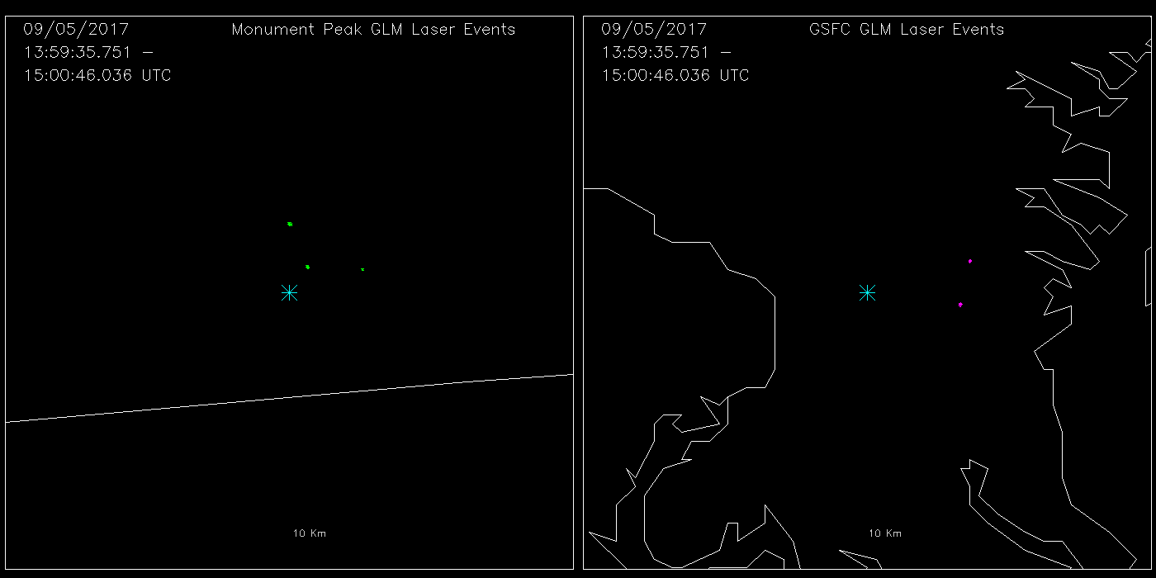
Laser Beacon Events (OE)

Slide 33
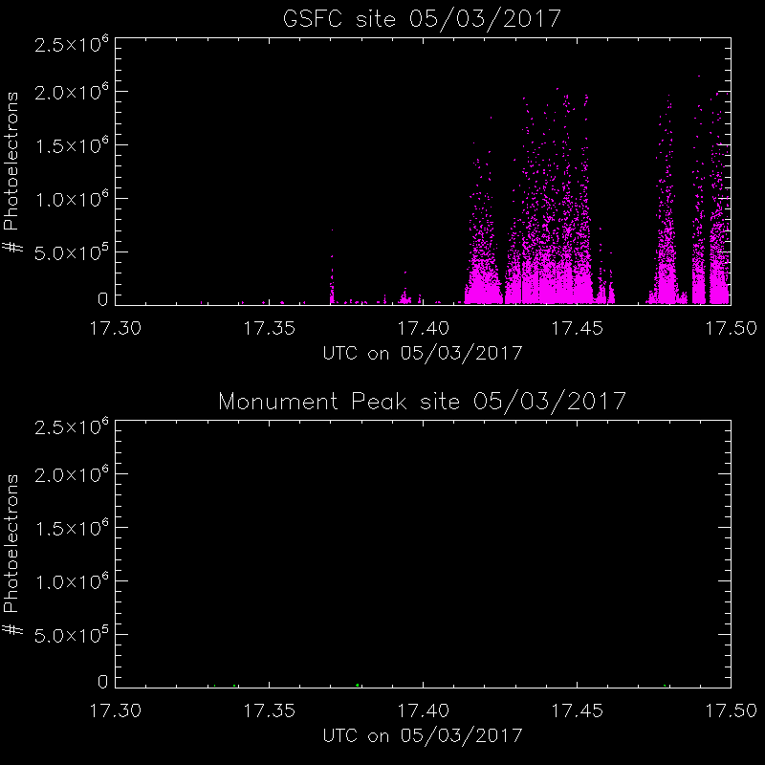
Dither Time Series

Slide 34
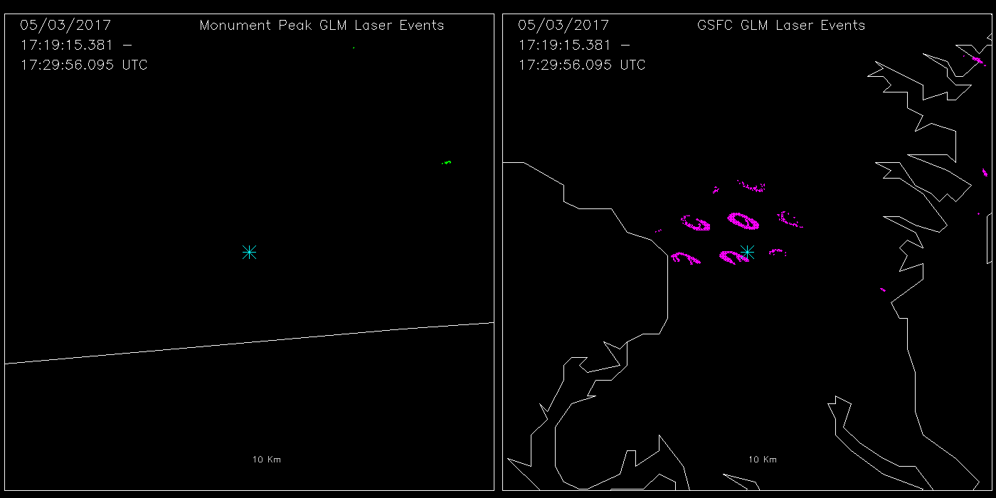
Dither Events

Slide 35
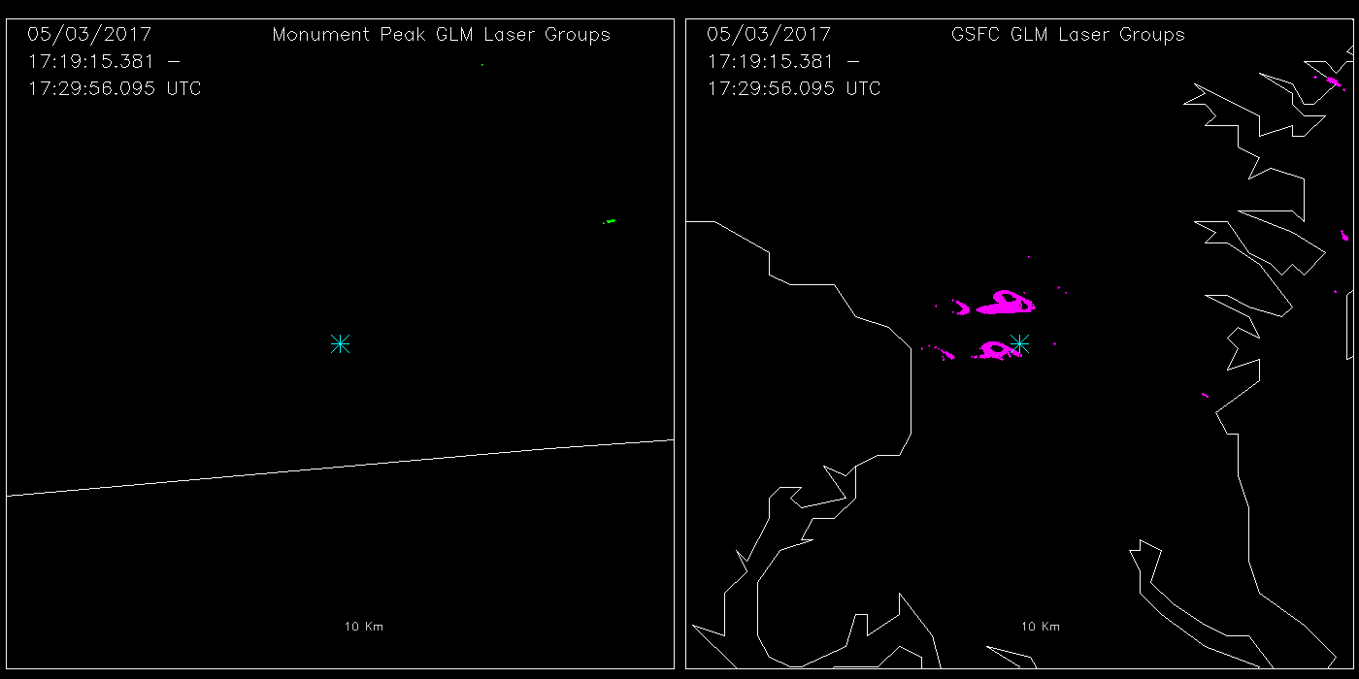
Dither Groups

Slide 36
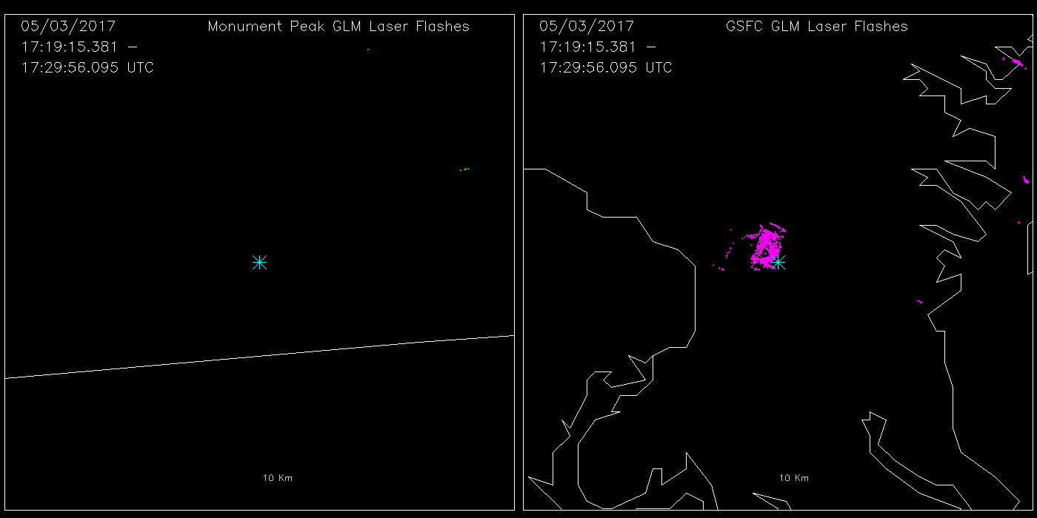
Dither Flashes

Slide 37
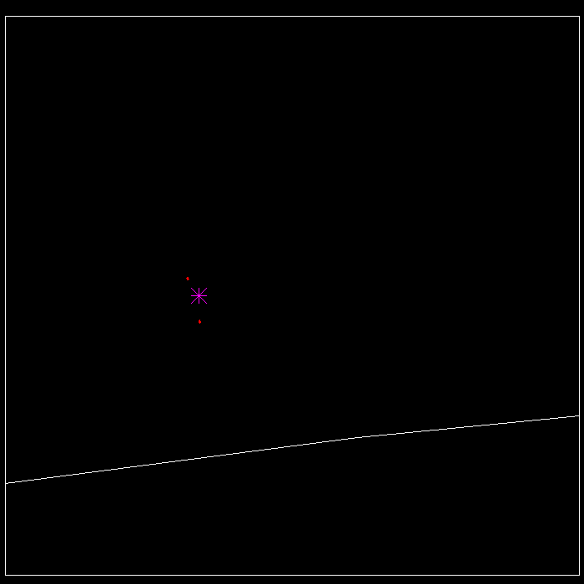
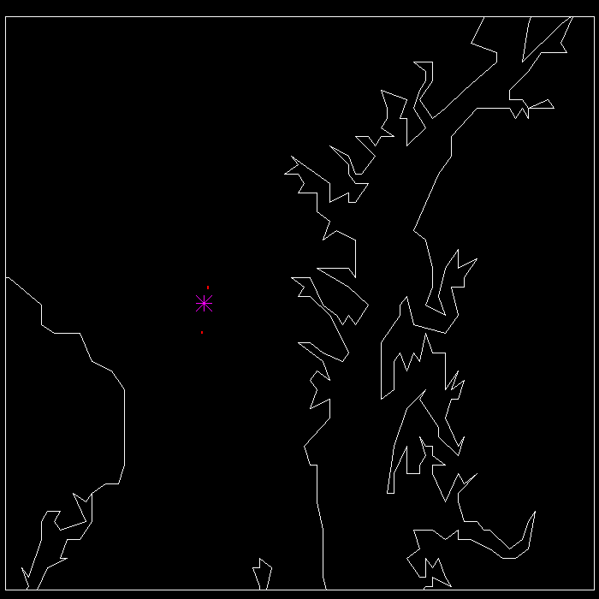
LM Geolocation
GLM events computed using LM algorithms
Located to surface
10 Aug 2017

Slide 38
Laser Beacon Summary
Demonstrated that laser beacons can be safely used as a proxy for GLM lightning
Successful development of web based realtime feedback
Observed offset between laser location and GLM geolocation

Slide 39
Laser Beacon
Continue comparisons with GLM L2 data
Examine parallax corrections
Continue geolocation analysis
apply latest overshoot corrections
Apply latest geolocation parameters
Conduct a 24 hour test to examine diurnal changes in geolocation
Lasers will be visible to GLM when in East position
GOES-S will have fewer coastlines for navigation

Slide 41
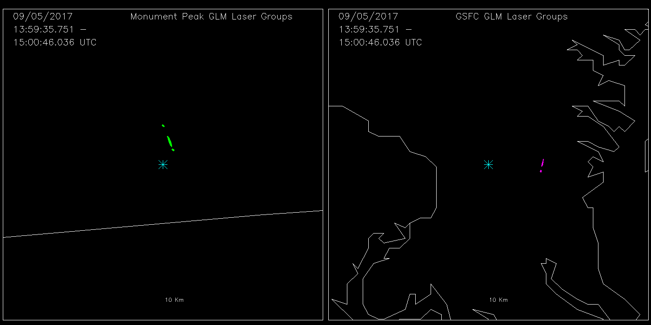
Laser Beacon Groups (OE)

Slide 42
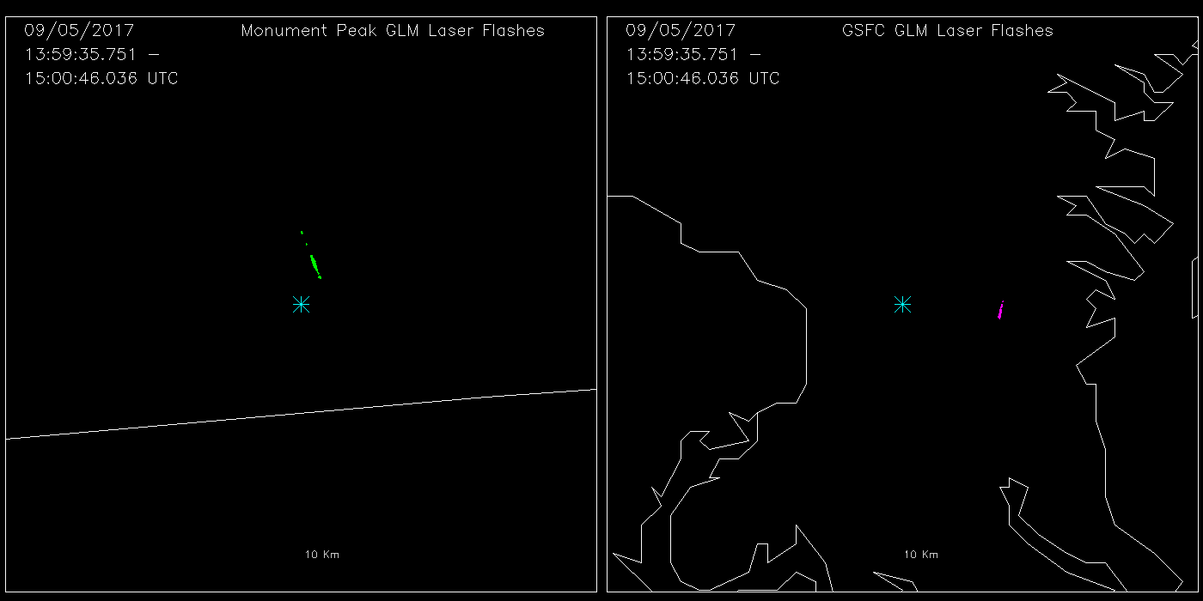
Laser Beacon Flashes (OE)

Slide 43
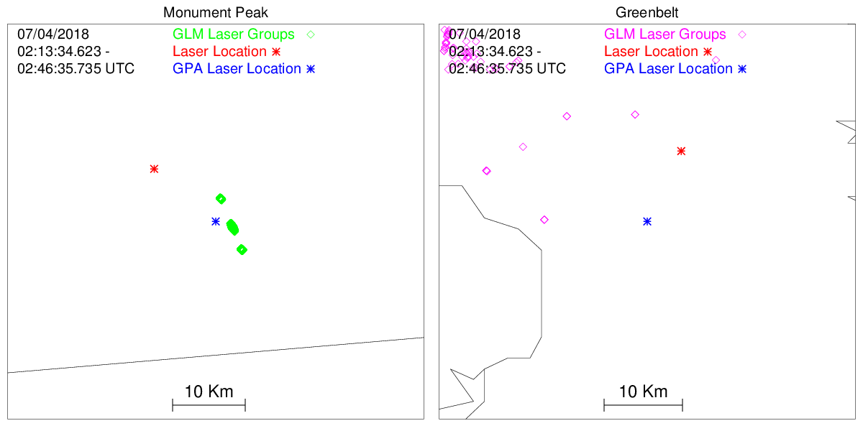
GOES-17 Laser Test (MP)
Groups
NOAA's GOES-17 satellite has not been declared operational and its data are preliminary and undergoing testing. Users receiving these data through any dissemination means (including, but not limited to, PDA and GRB) assume all risk related to their use of GOES-17 data and NOAA disclaims any and all warranties, whether express or implied, including (without limitation) any implied warranties of merchantability or fitness for a particular purpose.

