Slide 1
GOES-R Series
PRO TEAM
Update
Elizabeth Kline
Randall Race
GOES-R Product Readiness and Operations (PRO) Team
GLM Science Meeting
September 11-13, 2018

Slide 2
PS-PVR Background

Slide 3
Product Maturity Levels
What do the Product Maturity Levels mean?
There is a Peer Stakeholder Product Validation Review (PS-PVR) at
each stage as a method of informing the user community of the following readiness for use:
Beta: Products are made available to users to gain familiarity with data formats and parameters. It has been minimally validated and may still contain significant errors and is not optimized for operational use.
Provisional: Product ready for operational use but has documented known issues. Product analyses are sufficient to communicate product performance to users relative to expectations.
Full: Product is operational. All known product anomalies are resolved and/or documented and shared with the user community.

Slide 4
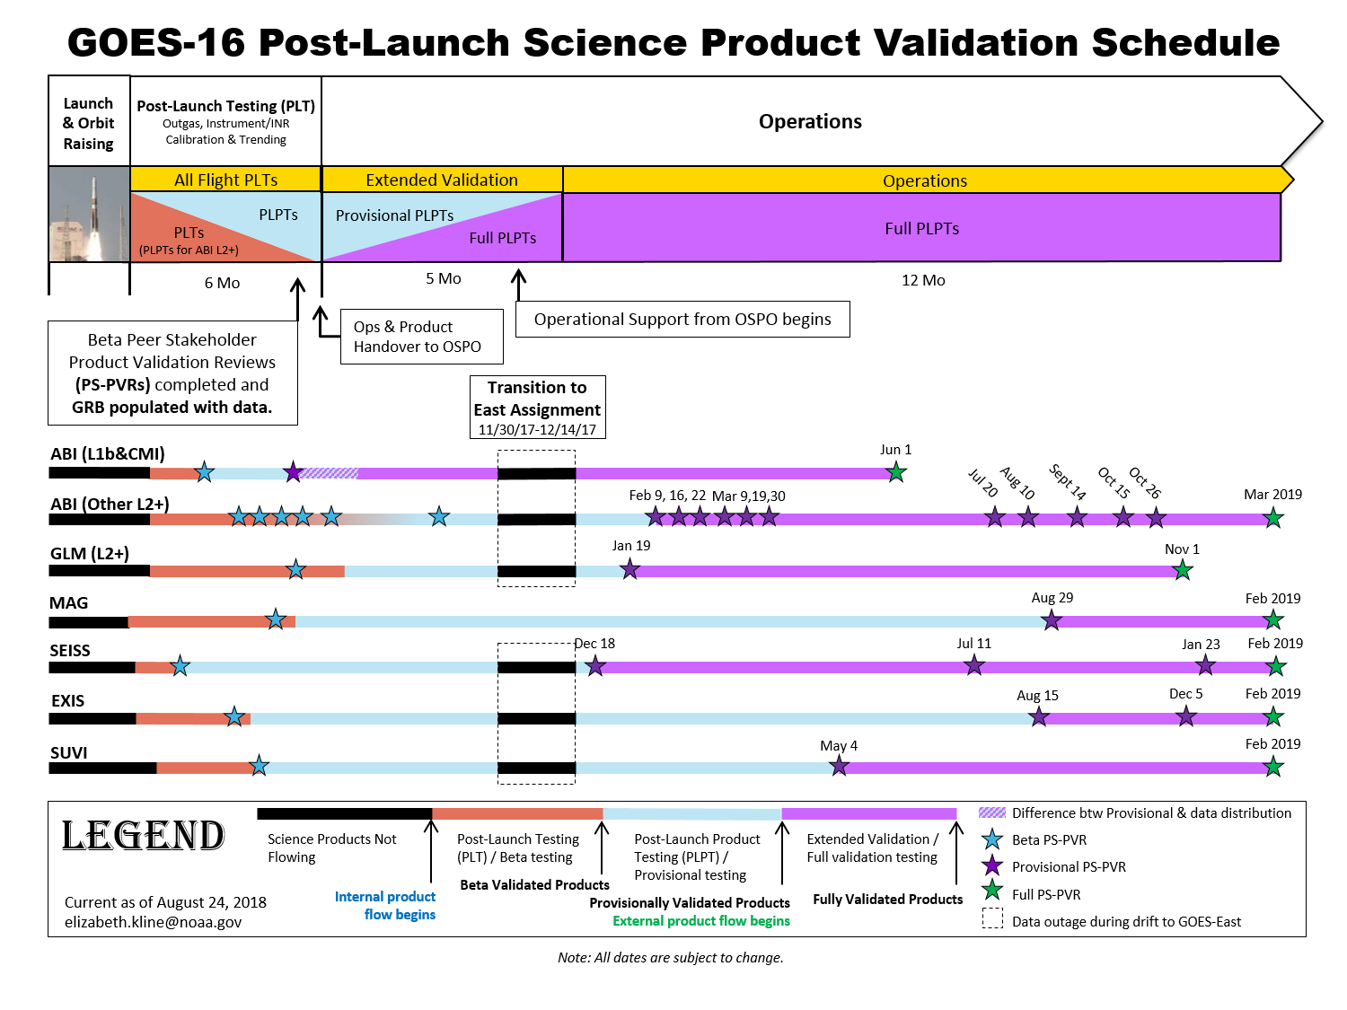
GOES-16 Validation Schedule

Slide 5
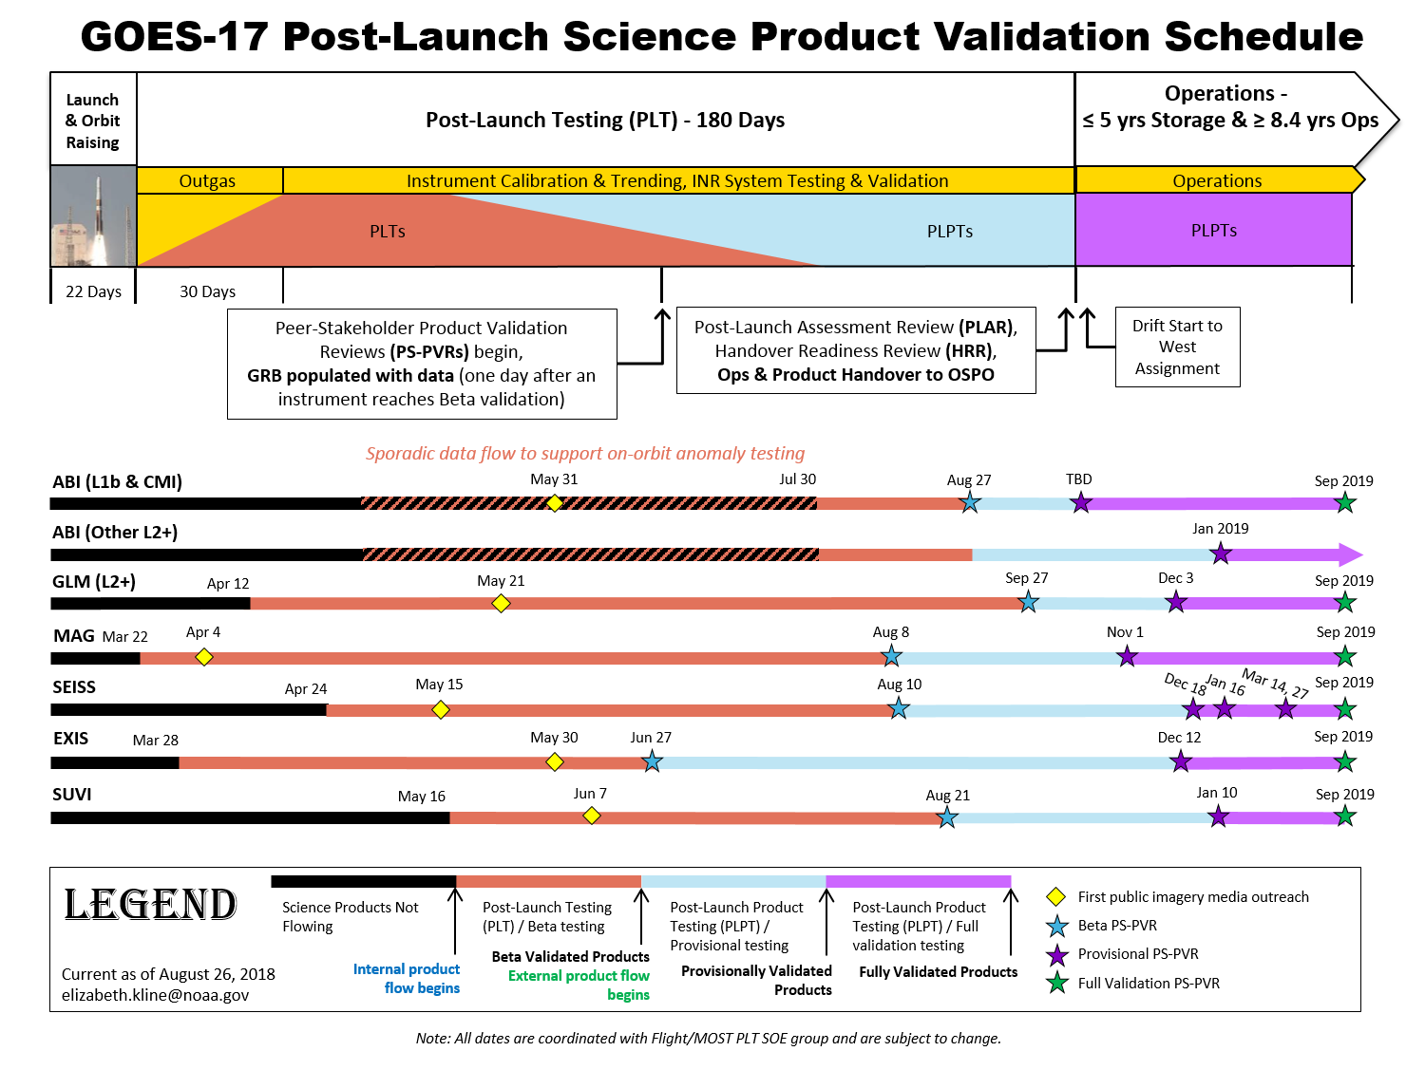
GOES-17 Validation Schedule

Slide 6
By 2019, GOES-16 GLM will be Fully validated & GOES-17 GLM will be Provisional!

Slide 7
Algorithm Change Process (ACP)

Slide 8
Detect
Prioritize
Investigate
Resolve
Implement
Verify
Report
Detect/Identify discrepancy (Algorithm Issue) in operational data product
Report issue for communication with Project and Team
Prioritize within Discipline’s tasks after evaluation if within scope and resources
Investigate cause
Resolve the issue in the code, deliver change package, test, and approve the change to the baseline
Implement the solution in the operational system
Verify solution implemented correctly in operational system

Slide 9
ACP
The ACP is facilitated by the Algorithm Action Review Team (AART) and the Algorithm Review Board (ARB).
The AART is a working group that acts on behalf of the ARB to adjudicate Algorithm Discrepancy Reports (ADRs).
The ARB manages the science configuration of the Operational System. It approves ADRs for implementation.
The ARB is responsible for managing the science content of the GS.
The ARB approves ADRs that make changes to the science but not bug fixes. If a bug fix is needed, a WR can be written without ARB approval.

Slide 10
Types of Changes
Non-Science Changes – Changes that do not affect the science algorithms. These go straight to the WR/DCRB process.
Look-up Tables (LUTs) – an array that replaces runtime computation with a simpler array indexing operation. This is used to save processing time when the values are known within sufficient precision.
Simple Code Changes – Any code change that does not affect to I/O, is under 200 lines of code, and is Product Generation only.
Complex Code Changes – Any code change that does not meet the simple criteria.

Slide 11
Types of Software Releases
The GS contractor, Harris, delivers code updates to the Data Operations (DO) baseline in the format of a Build, a Patch, or an Emergency Patch.
The naming convention is DO.BB.PP.EP, where
BB = build number, e.g. 07
PP = patch number, e.g. 00 or 01
EP = emergency patch number, e.g. 00 or 01
The next major build is DO.07.00.00, due to transition to the Operational Environment on 10/09/18.
The PRO PASS team also releases code updates with a similar naming convention, but with the prefix PR.
For example, the next update that PRO PASS will deploy after DO.07.00.00 will be called PR.07.00.00.

Slide 12
Now onto the fun stuff with Randy Race!
For questions or general information, please contact:
Elizabeth.Kline@noaa.gov or Randall.Race@noaa.gov

