Slide 1
GLM vs. ENGLN
Michael Stock, Jeff LaPierre

Slide 2
Simple Density Comparison
0.25 degree bins
Lat : -60 – 60 Lon: -130 – -30
January – August 2018
Counting Flashes
ENGLN – All flashes
GLM – All flashes longer than 3 ms (QC flag ignored)

Slide 3
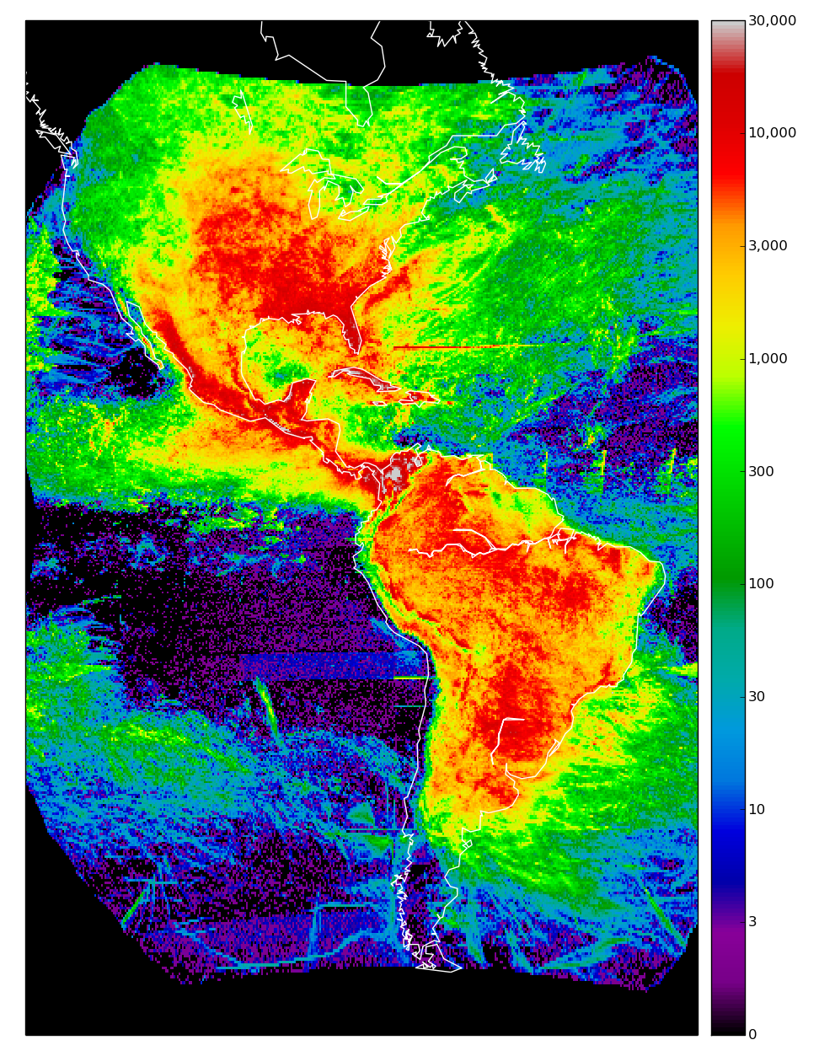
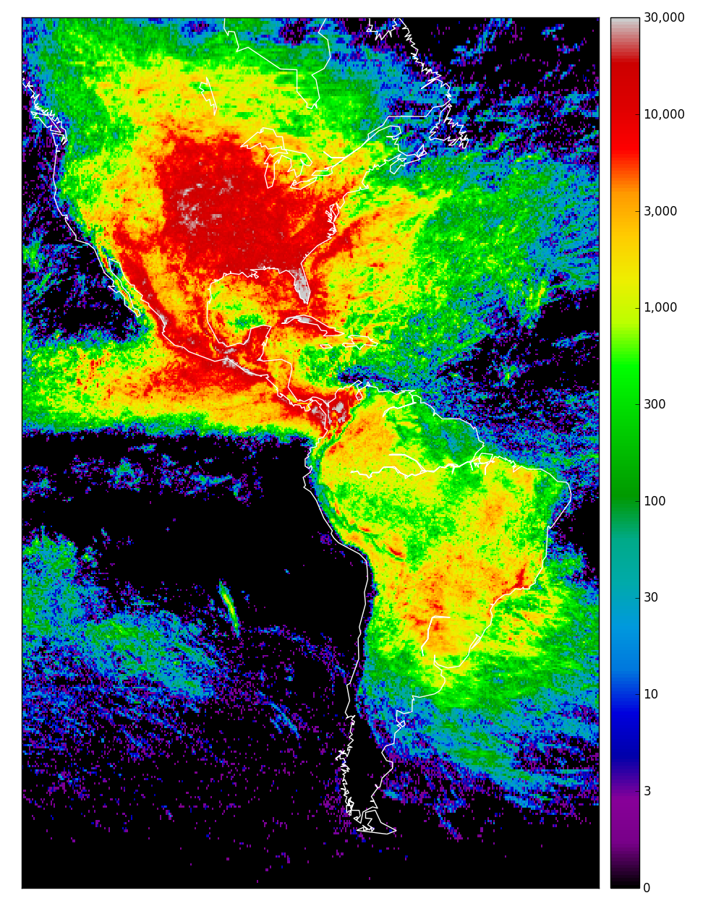
GLM
ENGLN
221,762,879
231,836,840

Slide 4
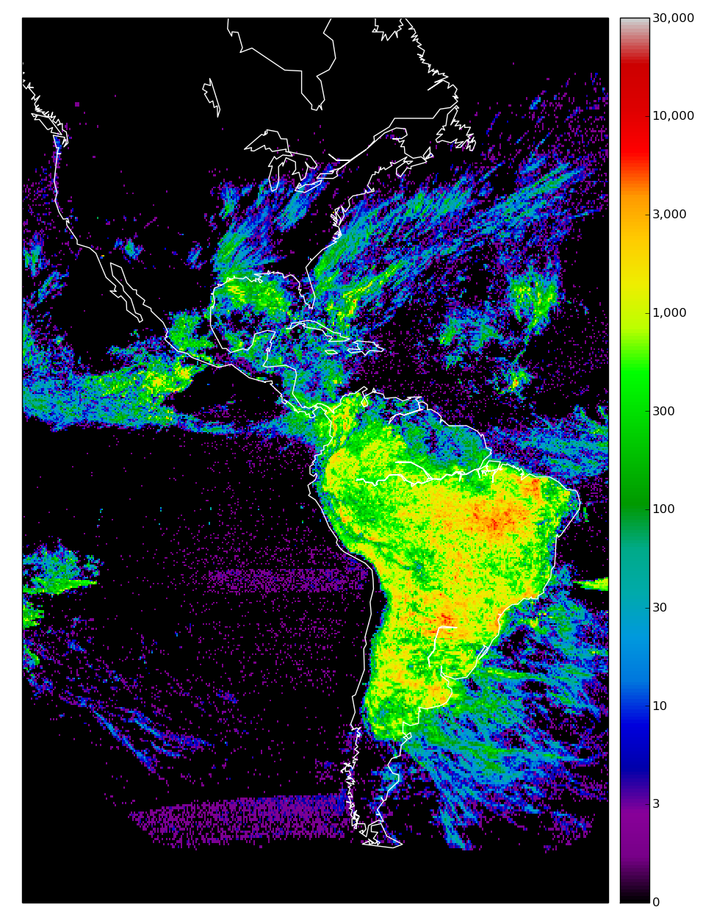
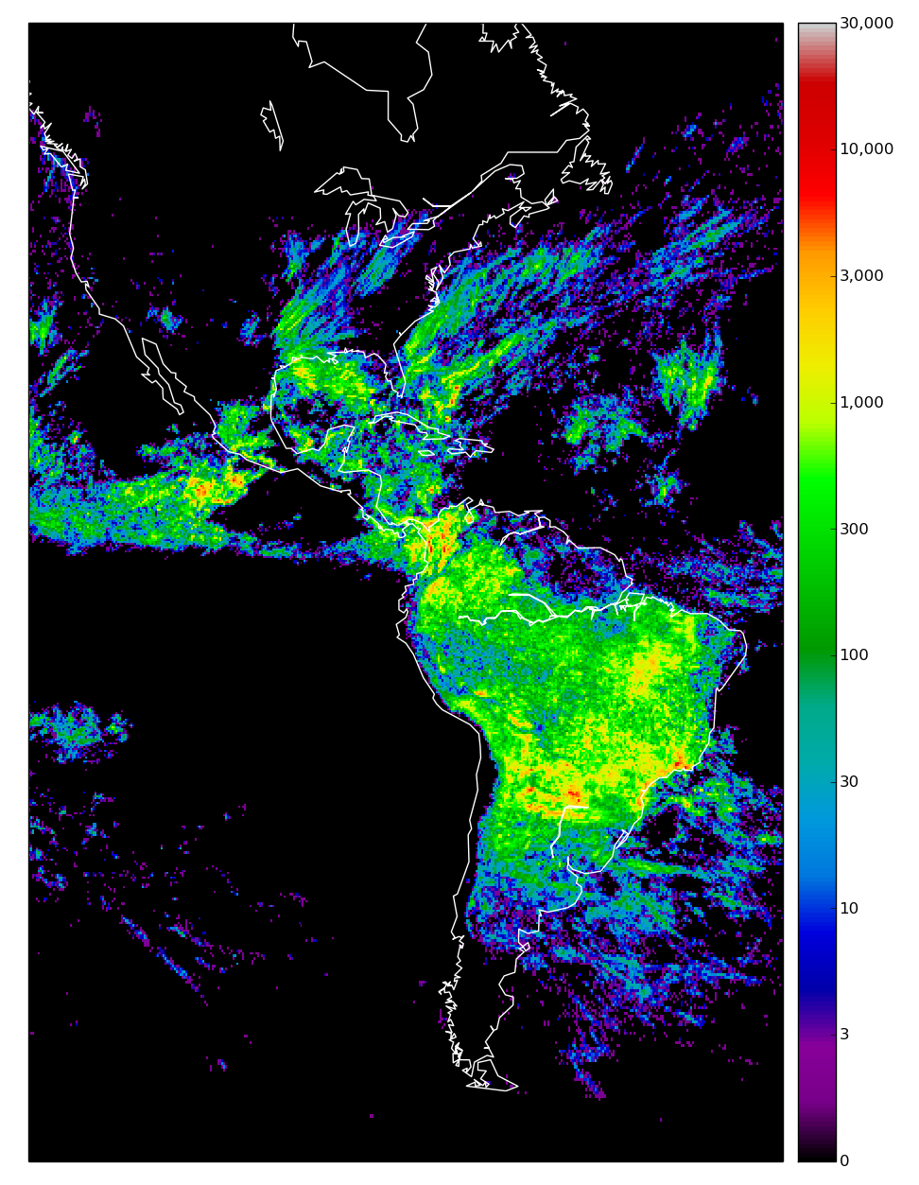
GLM
January
ENGLN
23,065,218
12,231,148

Slide 5
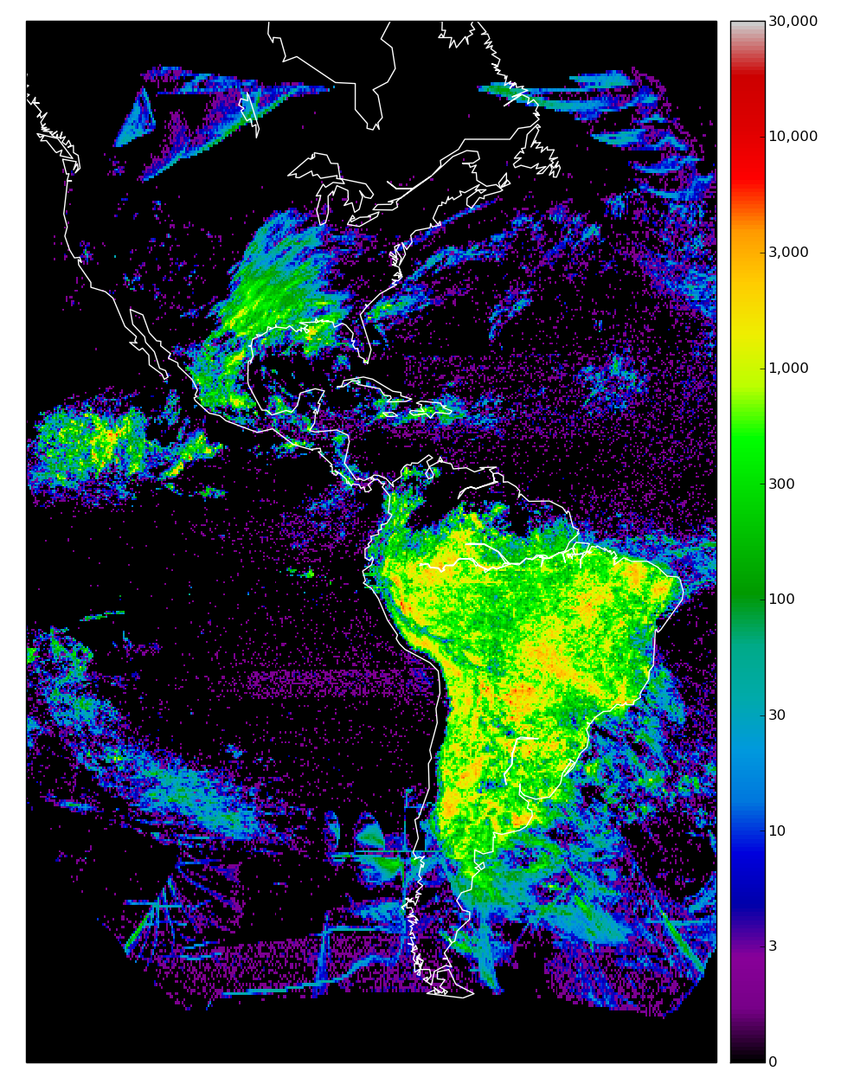
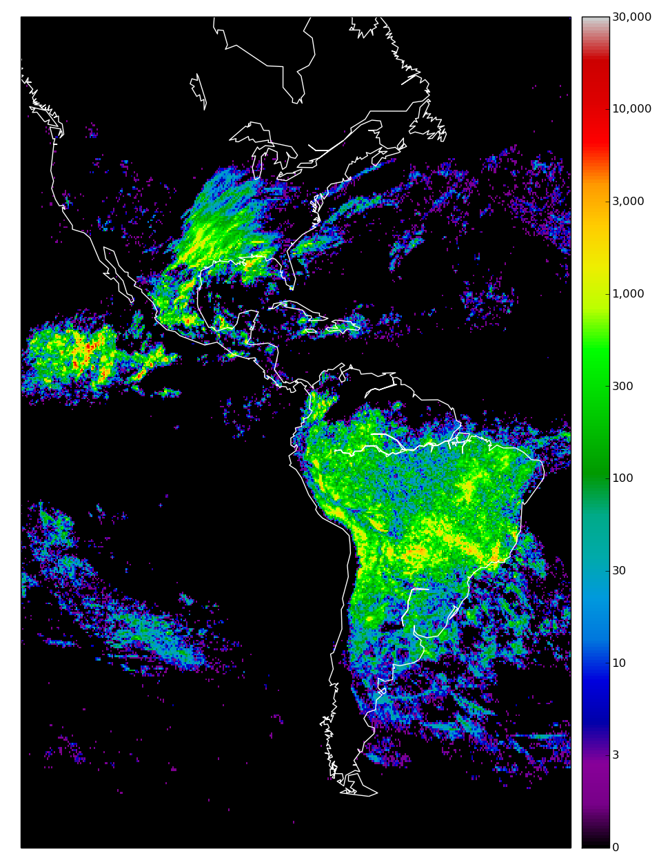
GLM
February
ENGLN
16,435,188
8,498,052

Slide 6
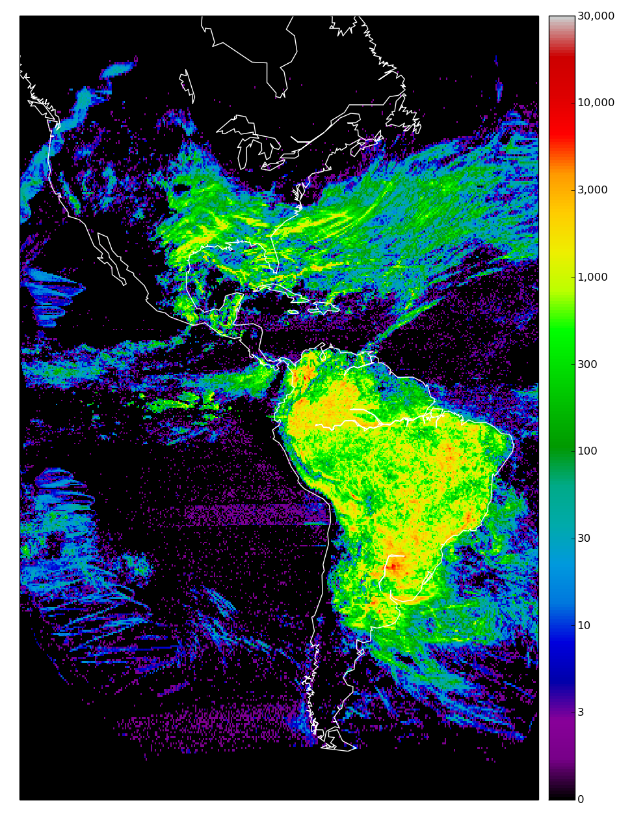
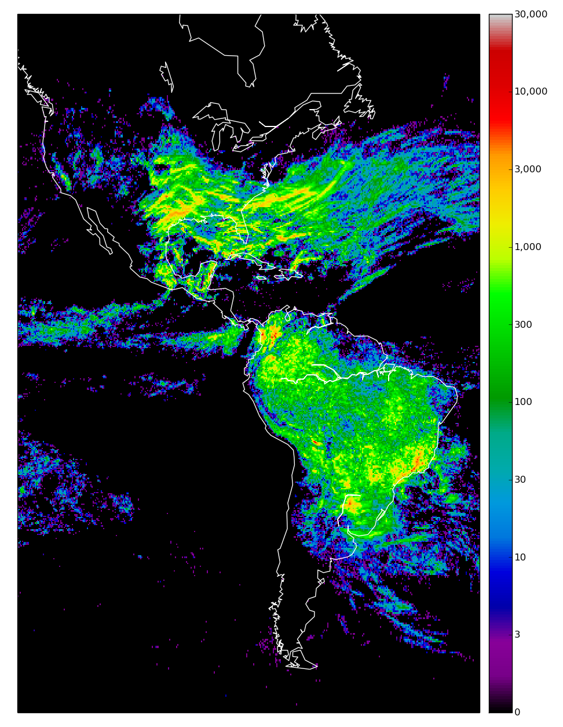
GLM
March
ENGLN
24,790,437
12,072,188

Slide 7
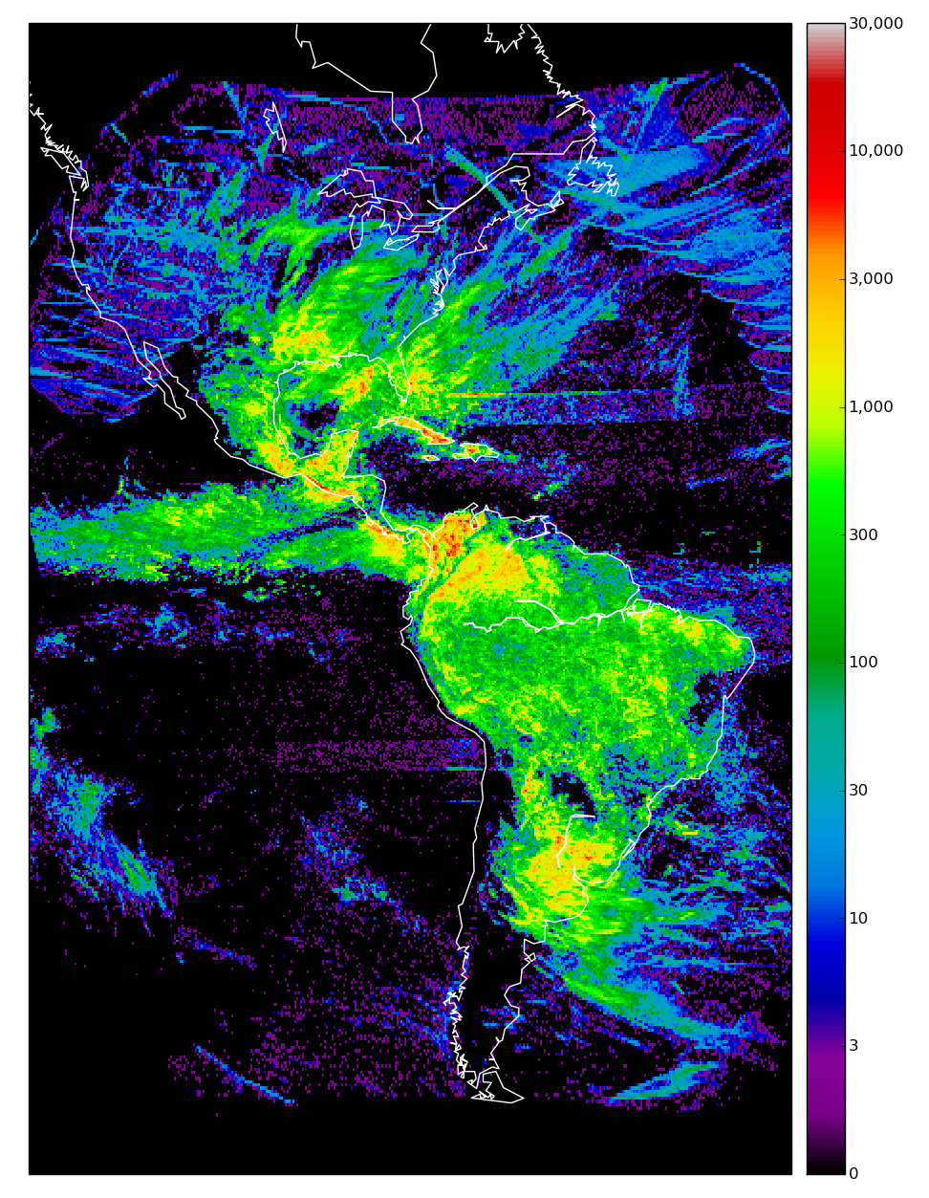
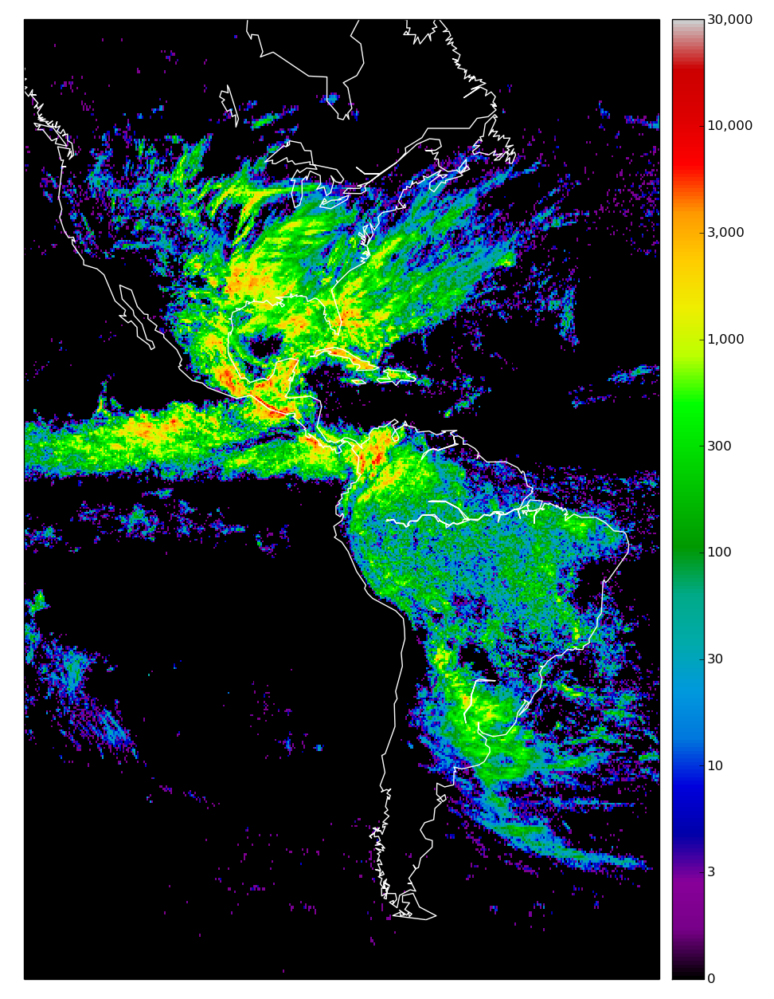
GLM
April
ENGLN
19,996,788
16,377,478

Slide 8
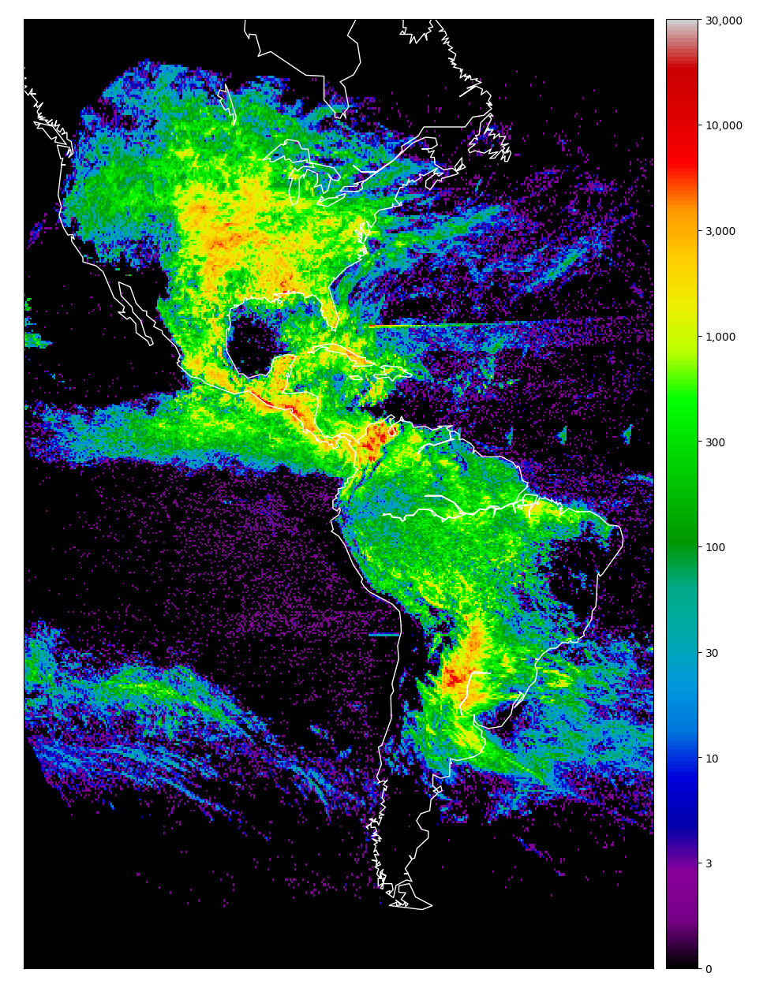
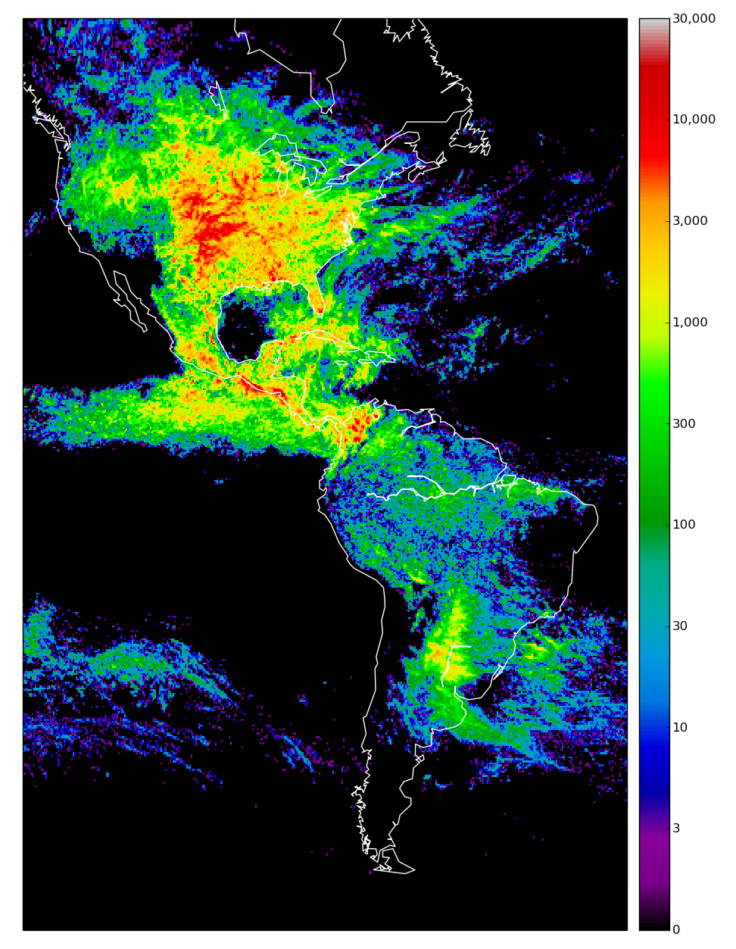
GLM
May
ENGLN
27,570,292
36,781,233

Slide 9
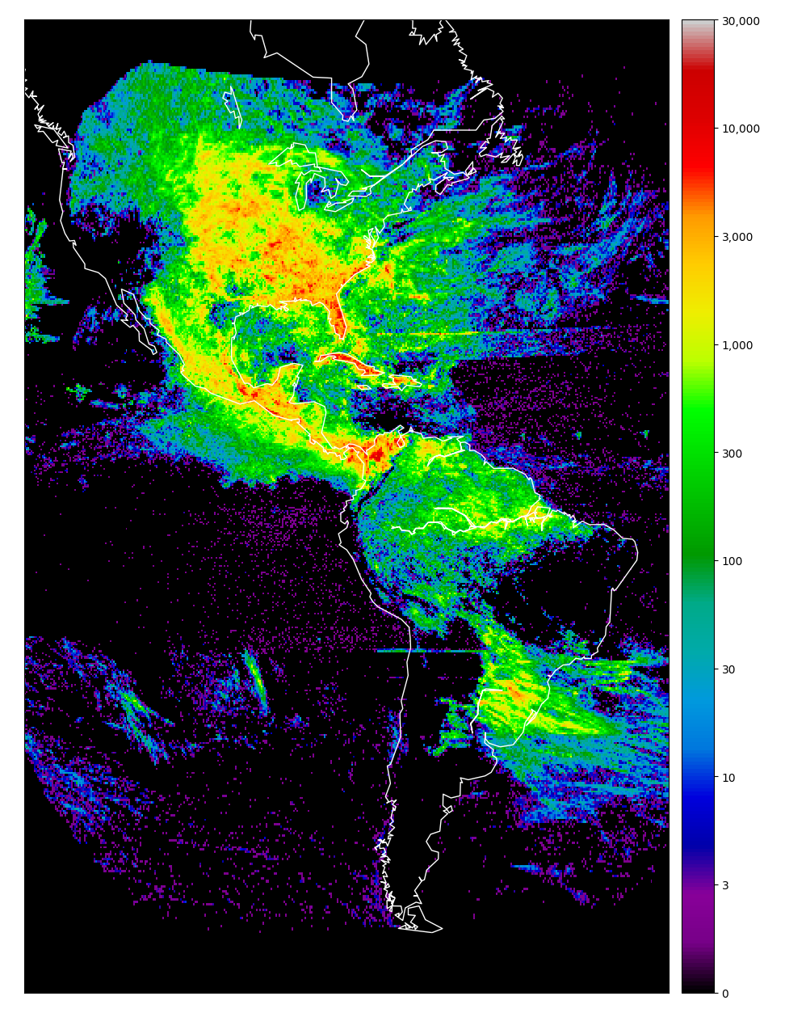
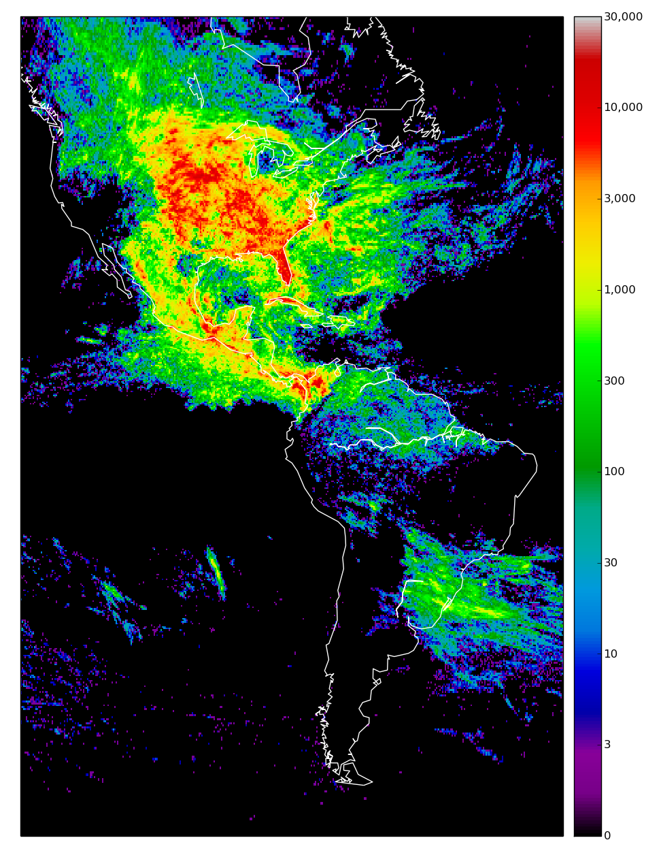
GLM
June
ENGLN
31,409,548
46,598,388

Slide 10
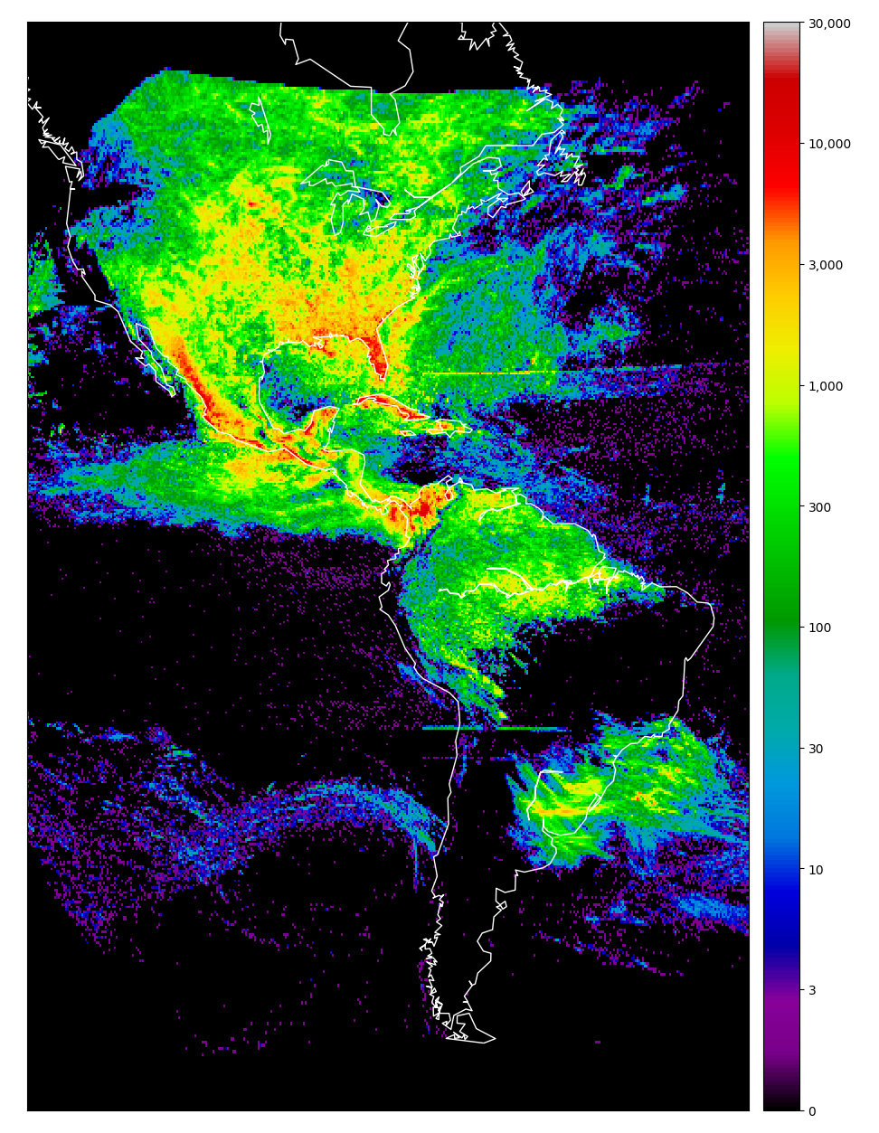
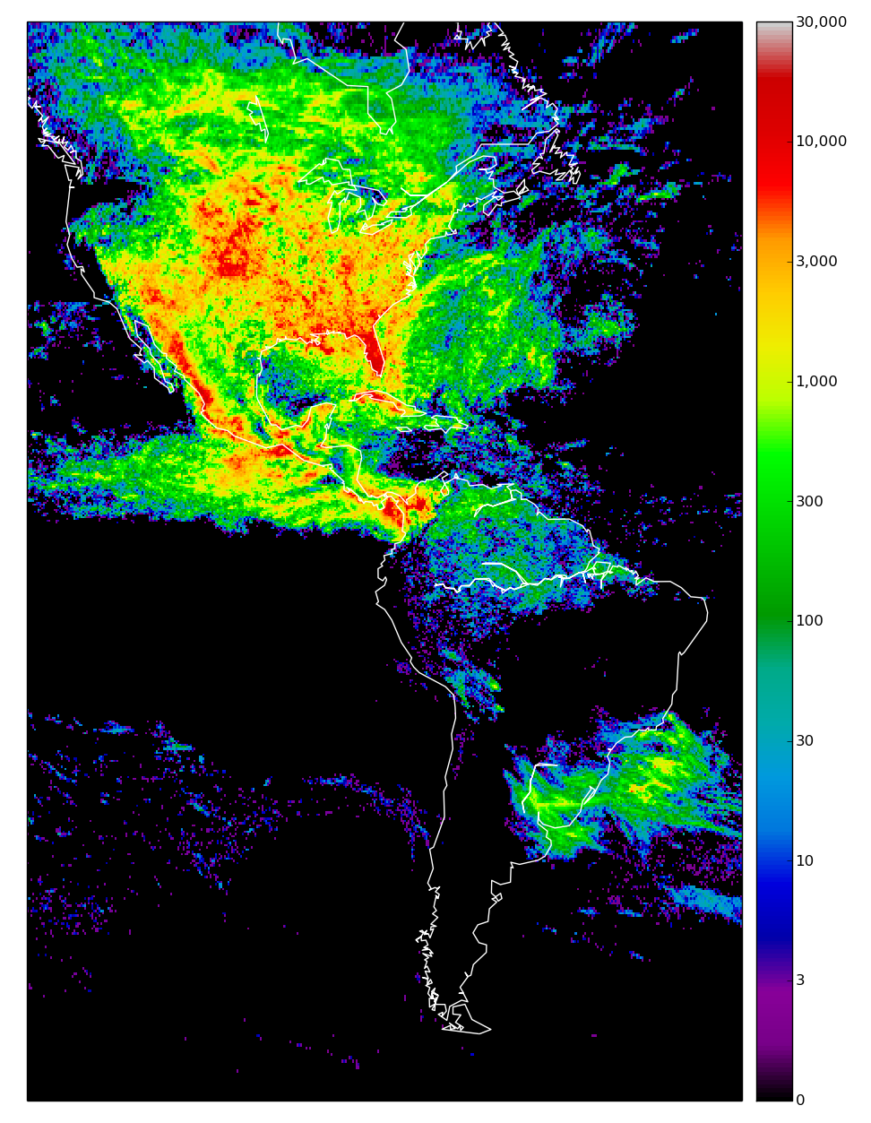
GLM
July
ENGLN
36,696,076
51,230,426

Slide 11
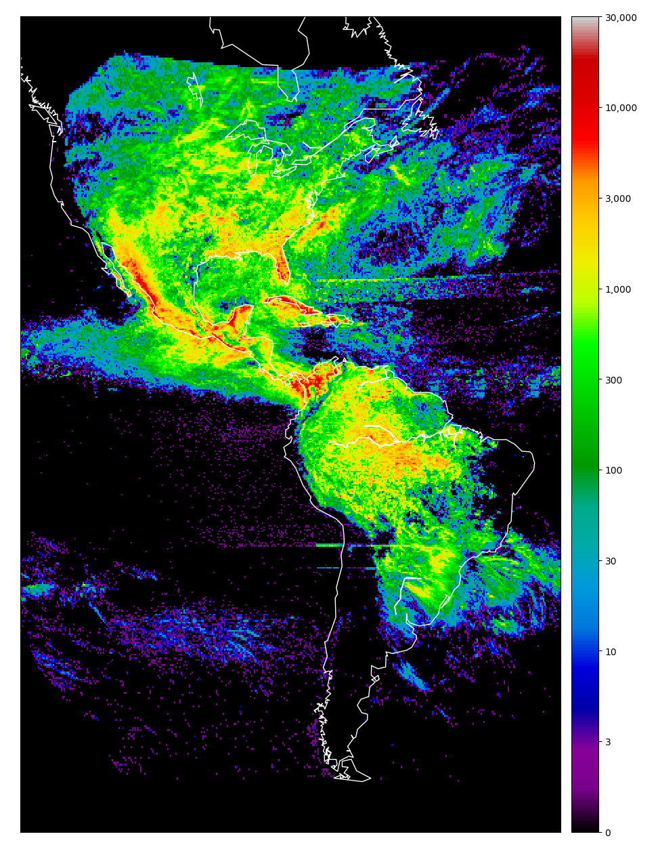
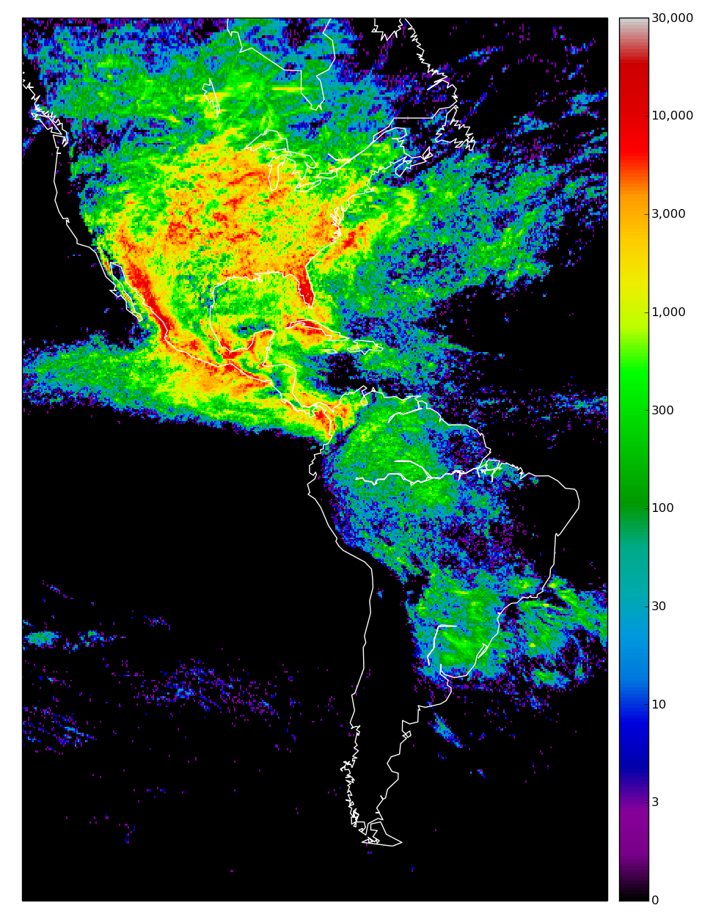
GLM
August
ENGLN
41,799,332
47,855,927

Slide 12
About the QC flag
According to the documentation:
0 = good
Anything else = bad
Filtering on QC flag removes about 3.5% of flashes
QC filtering does not remove all spurious flashes

Slide 13
GLM (No QC)
April
ENGLN
19,996,788
16,377,478

Slide 14
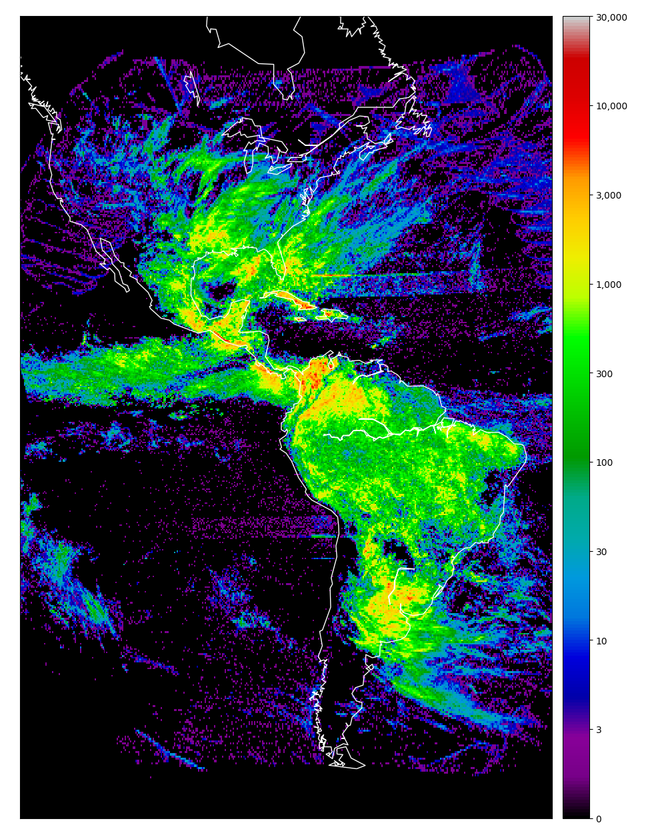
GLM (QC)
April
ENGLN
19,084,917
16,377,478

Slide 15
GLM (QC)
August
ENGLN
41,799,332
47,855,927

Slide 16
GLM (QC)
August
ENGLN
40,412,146
47,855,927

Slide 17
Matching Flashes
An ENTLN and GLM flash match if:
Durations of flashes overlap
Center of flashes are closer than 50 km
Dec 2017 through July 2018
GLM filters:
QC = 0
Single group flashes excluded
1 degree bins, minimum 100 flashes
ENGLN filters:
Exclude GLM blackouts

Slide 18
Numerical Overview
 | ENGLN | GLM (East)
Total Flashes Located | 189,000,367 | 192,539,614
Total Flashes Matched | 95,225,159 | 64,643,981
CG Flashes Matched | 44,050,017 | 25,451,066
N. Hemisphere Flashes Located | 160,410,159 | 109,274,892
N. Hemisphere Flashes Matched | 81,193,334 | 52,426,946
CG Flashes Matched | 65,765,391 | 16,541,198
34%
49%
74%
32%

Slide 19
Southern Hemisphere
ENTLN
GLM

Slide 20
Northern Hemisphere
ENTLN
GLM

Slide 21
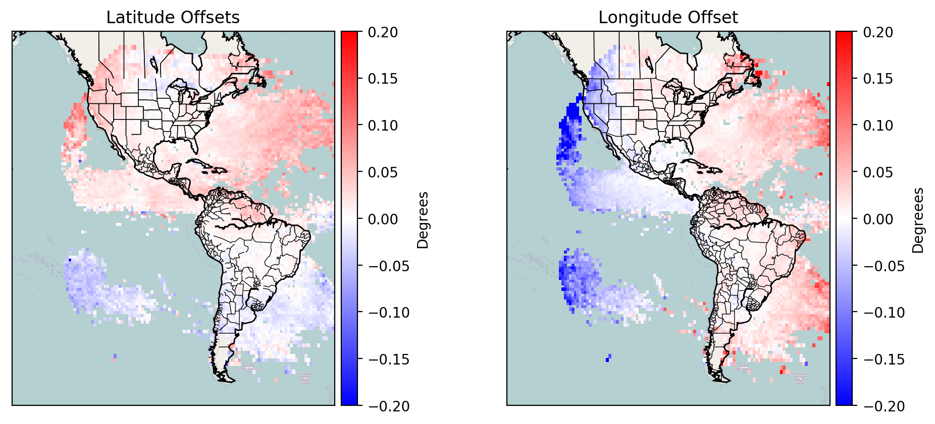
Location Accuracy

Slide 22
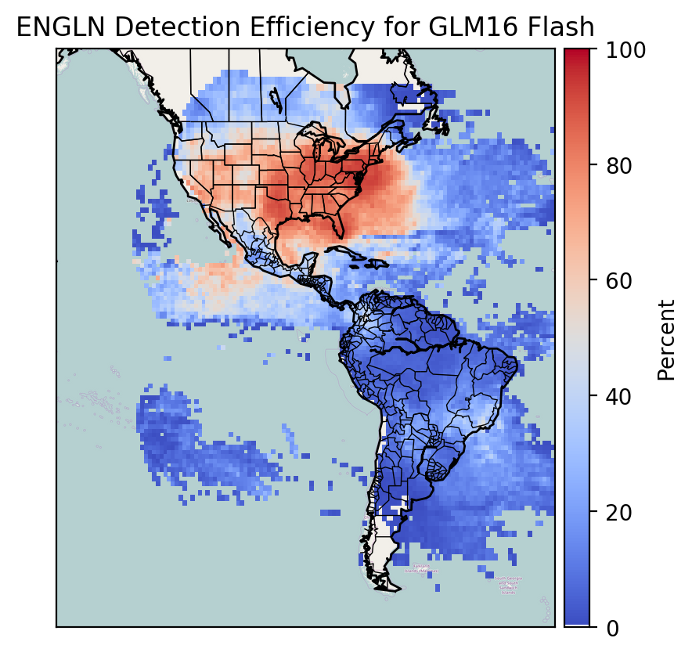
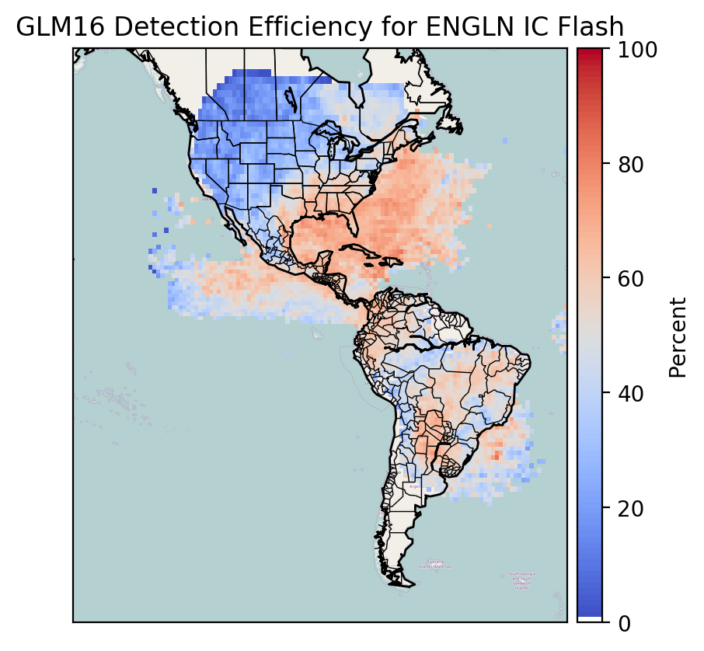
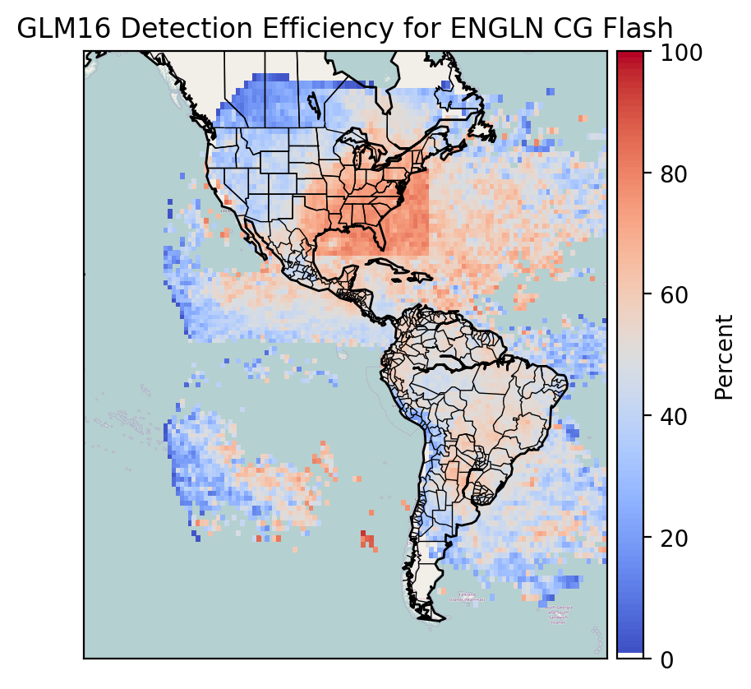
Detection Efficiency
ENTLN
GLM

Slide 23
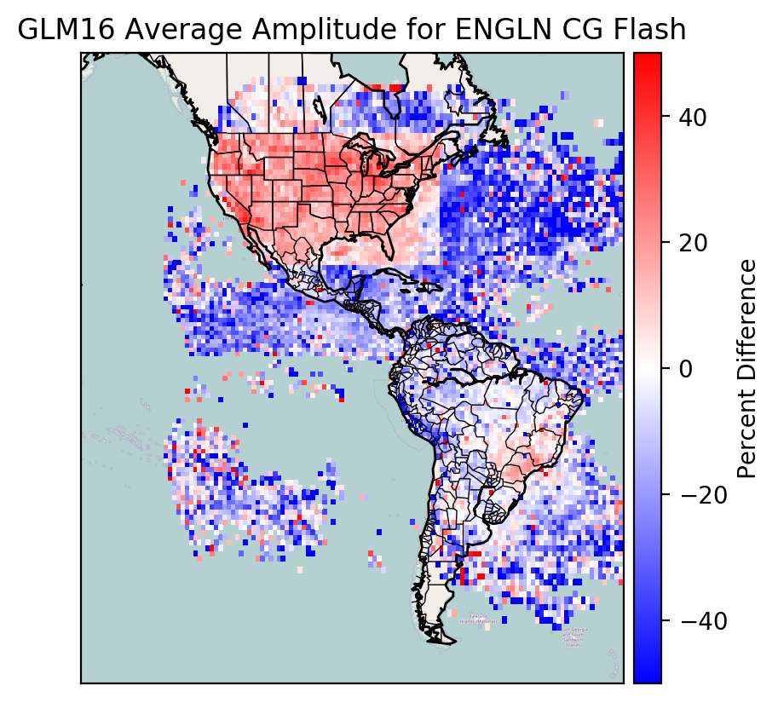
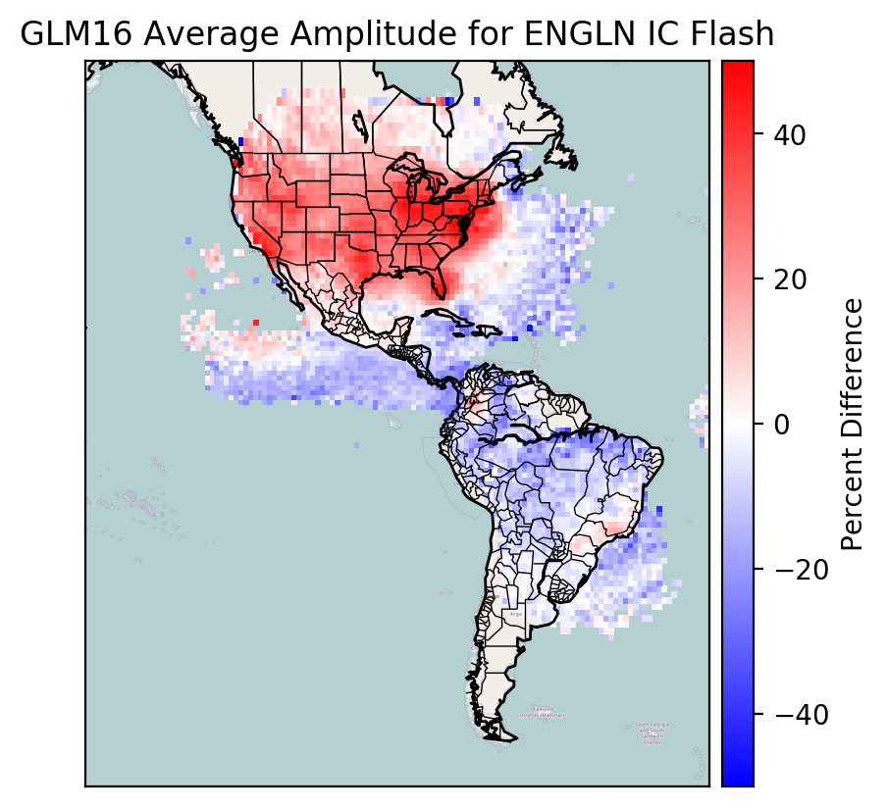
GLM Amplitude Bias

Slide 24
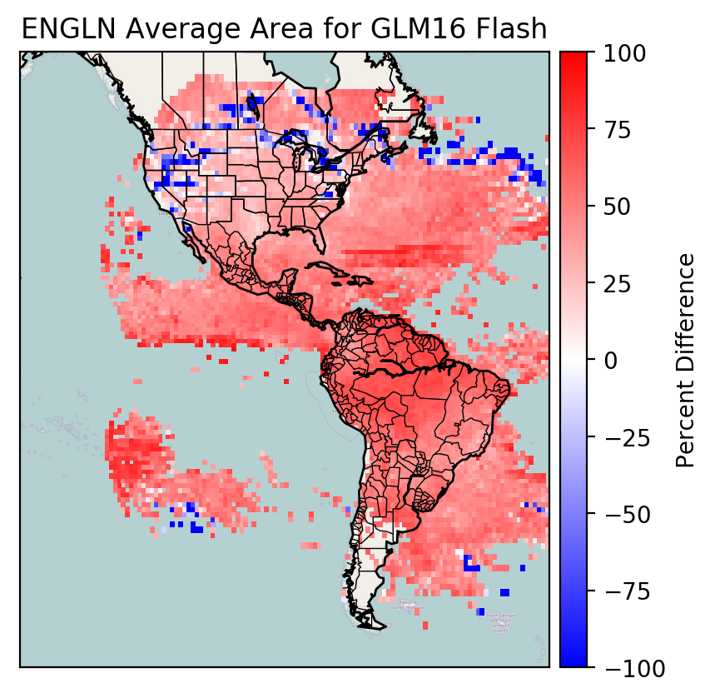
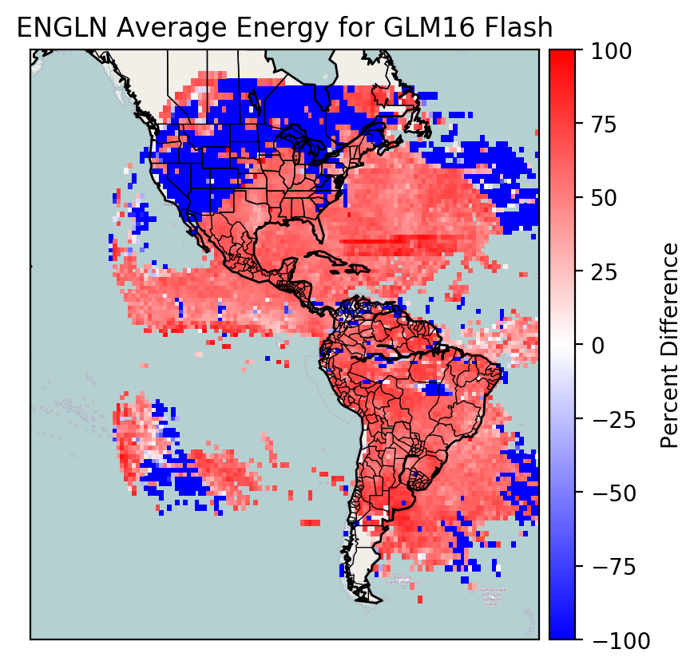
ENGLN Area and Energy Bias

Slide 25
Summary
GLM and ENGLN locate about the same quantity of lightning, but only match about 50%
GLM detection efficiency is not uniform
GLM QA flag needs some work for operational use
GLM location accuracy is much improved

