Slide 1
GLM and STARNET+LINET measurements in South America
Carlos Augusto Morales
http://www.starnet.iag.usp.br

Slide 2
STARNET
VLF LONG RANGE LIGHTNING DETECTION NETWORK
COVERAGE: MAINLY SOUTH AMERICA AND SURROUNDING OCEANS
13 SENSORS
LOCATION ACCURACY: 2-5 km
DETECTION EFFICIENCY: 30-39% Strokes and 50-70% Flashes.

Slide 3
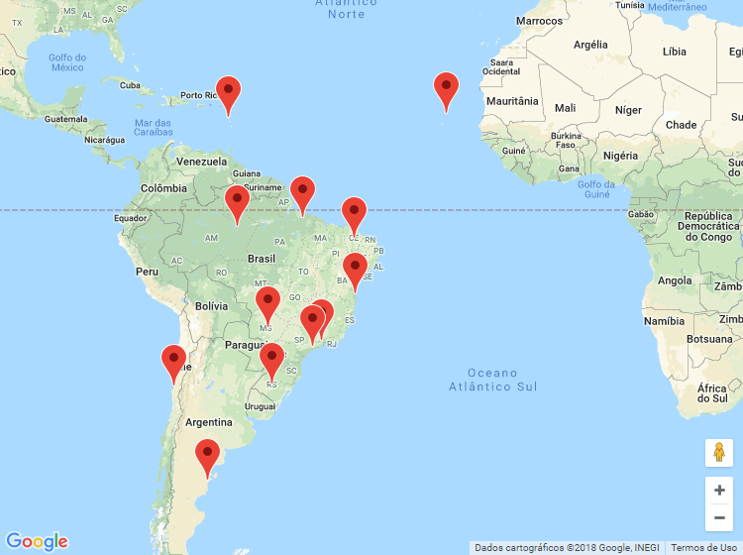
STARNET CONFIGURATION

Slide 4
STARNET – DETECTION EFFICIENCY

Slide 5
LINET
VLF/LF Total lightning detection system
COVERAGE: MAINLY STATE OF SÃO PAULO
9 SENSORS
LOCATION ACURRACY: 0.5-2 km
DETECTION EFFICIENCY: Estimated: 80-90% (30%) CG (IC) strokes Cooperation: DLR+NOWCAST

Slide 6
LINET CONFIGURATION

Slide 7
MONTHLY VARIABILITY

Slide 8
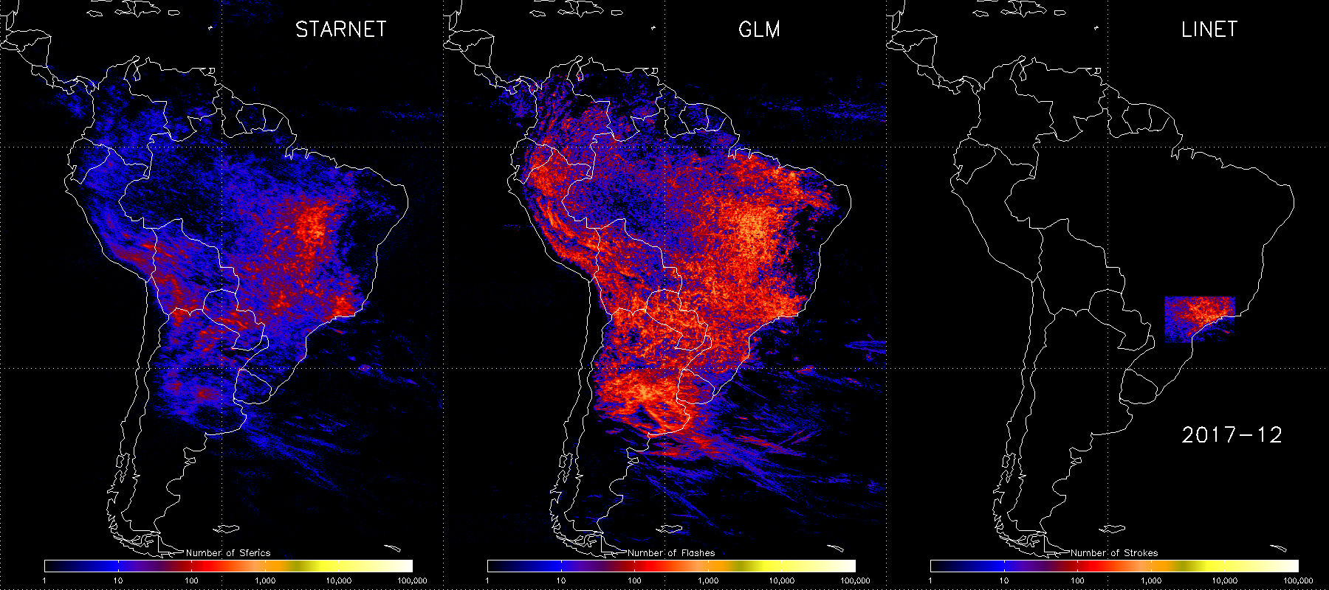
MONTHLY ACCUMULATIONS: DECEMBER 2017 – JUNE 2018
STARNET GLM LINET

Slide 9
GROUND VALIDATION
GLM – LEVEL 1
STARNET: 90-30W and 40S-20N
June – Aug 2018
Flash X Sferics: Thunderstorms (258 K)
Diurnal variation
Latitude/Longitude

Slide 10
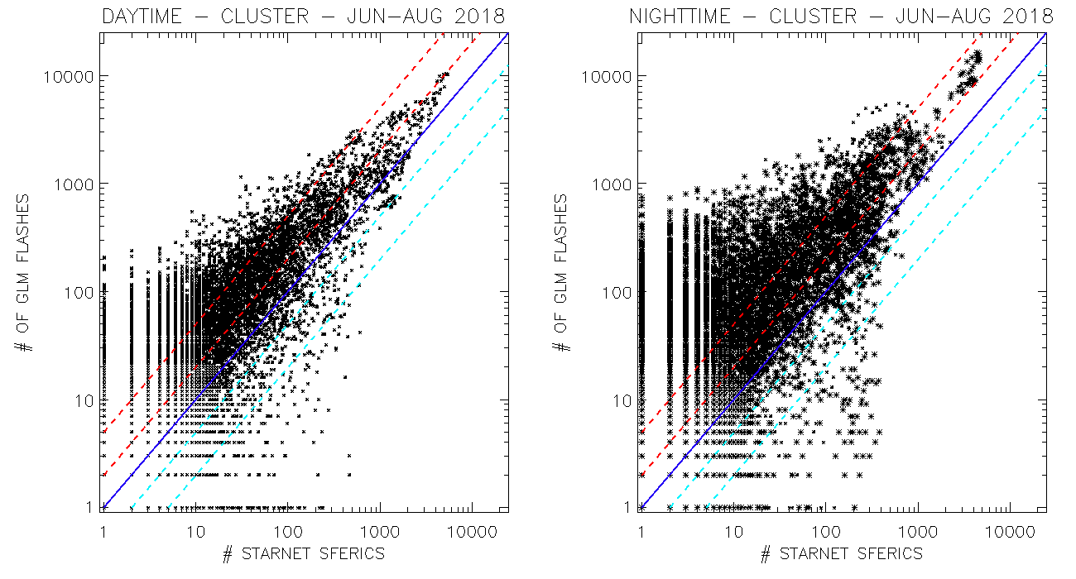
DAYTIME NIGHTTIME
2x
2x
5x
5x
2x
2x
5x
5x

Slide 11
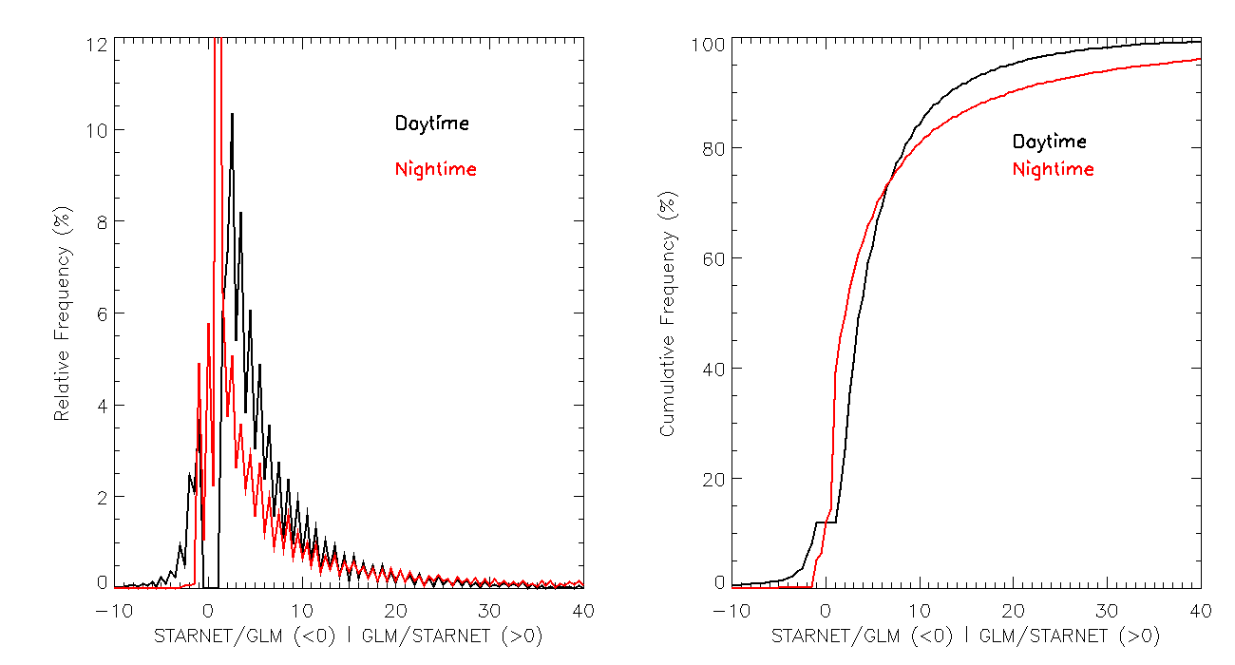
RELATIVE CUMULATIVE

Slide 12
DAY
NIGHT

Slide 13
GLM FLAHES / STARNET SFERICS
All | 90-70W | 70-50W | 50-30W
0-20N | 7.59 | 9.96 | 3.96
20S-0 | 8.19 | 14.83 | 16.09
40S-20S | 3.31 | 4.96 | 2.24
Day | 90-70W | 70-50W | 50-30W
0-20N | 6.03 | 4.83 | 1.24
20S-0 | 7.09 | 6.81 | 7.45
40S-20S | 3.09 | 3.07 | 1.47
Night | 90-70W | 70-50W | 50-30W
 | 10.44 | 20.77 | 6.52
 | 12.51 | 37.38 | 35.64
 | 3.470 | 6.41 | 2.74

Slide 14
GROUND VALIDATION
GLM – LEVEL 1
LINET: 52-46W and 25-20S
June – Aug 2018
Flash X Sferics: Thunderstorms (258 K)
Diurnal variation

Slide 15
DAYTIME NIGHTTIME
2x
2x
5x
5x
2x
2x
5x
5x

Slide 16
RELATIVE CUMULATIVE

Slide 17
CONCLUSIONS
DETECTION EFFICIENCY
DAY AND NIGHT VARIATION
PARALLAX
NEXT STEPS:
EVALUATE THUNDERSTORM LIFECYCLE
EVALUATE FLASHES AND GROUPS - TOWERS
EVALUATE FLASHES AND GROUPS IN TERMS OF LINET HEIGHT DISTRIBUTION
UNDERSTAND THE LOW DETECTIONS - 1 GLM FLASH → SEVERAL STARNET STROKES
- 1 STARNET STROKE → SEVERAL GLM FLASHES

