Slide 1
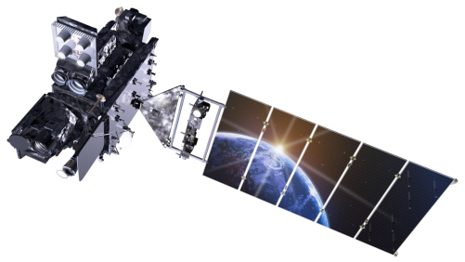
Recent GRL Manuscript Submission Scott Rudlosky (NOAA/NESDIS/STAR) Steve Goodman, Katrina Virts, and Eric Bruning GLM Science Week (11-14 September 2018)

Slide 2
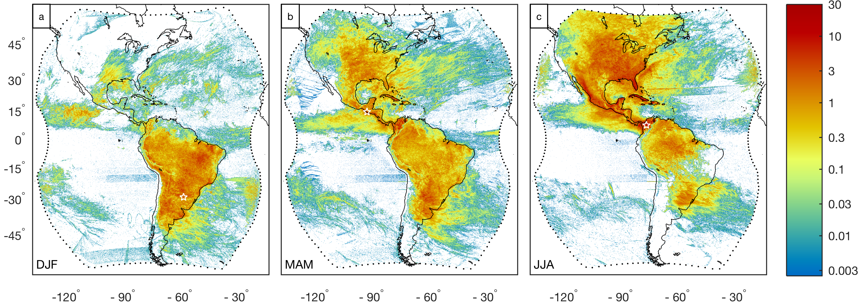
Recent GRL Submission
Initial nine months of observations from the GOES-East position (Dec 2017 – Aug 2018)
Rudlosky S. D., S. J. Goodman, K. S. Virts, and E. C. Bruning (2018), Initial Geostationary Lightning Mapper Observations, Geophy. Res. Lett., Under review
Notes:
The gridded products all provide additional context for comparable applciations

Slide 3
Overall Distributions
Initial GLM results confirm similar spatial patterns of lightning occurrence found in previous studies
The average GLM flash extends 454 km², lasts 301 ms, produces 262 fJ at instrument aperture, and contains 16.4 (42.2) groups (events)
The largest and longest GLM flashes are >2500 km² and >1 sec
Overall | Mean | Median | 90th | 99th
Flash Area (km²) | 454 | 291 | 965 | 2570
Flash Duration (ms) | 301 | 240 | 626 | 1170
Flash Energy (fJ) | 261 | 90 | 658 | 2390
Groups per Flash (count) | 16.4 | 10.0 | 40.0 | 83.0
Events per Flash (count) | 42.2 | 22.0 | 106.0 | 267.0
Events per Group (count) | 2.6 | 2.0 | 5.0 | 14.0
Group Area (km²) | 180 | 135 | 350 | 1010
Group Energy (fJ) | 16.2 | 6.1 | 33.6 | 153.0
Event Energy (fJ) | 6.2 | 3.1 | 12.2 | 48.8
Notes:
The gridded products all provide additional context for comparable applciations

Slide 4
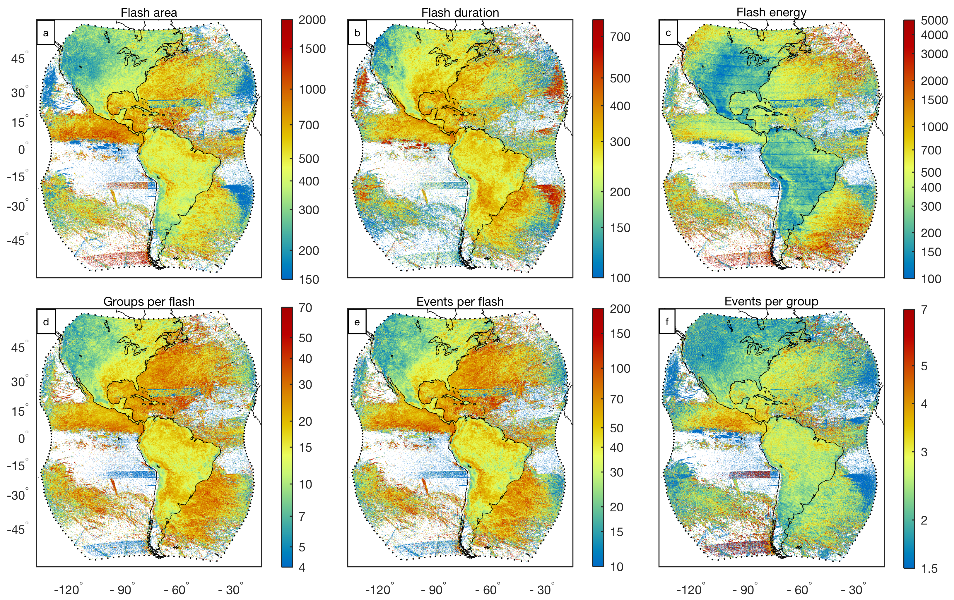
Land versus Ocean Contrast
On average, GLM flashes over the oceans are larger (570 km2), longer duration (345 ms), and brighter (420 fJ) than flashes over land (431 km2, 293 ms, 230 fJ).
Mean Values | All | Land | Ocean | Difference (%)
Flash Area (km²) | 454 | 431 | 570 | 30.6
Flash Duration (ms) | 301 | 293 | 345 | 17.3
Flash Energy (fJ) | 261 | 230 | 420 | 72.8
Groups per Flash (count) | 16.4 | 15.4 | 21.3 | 36.0
Events per Flash (count) | 42.2 | 39.3 | 57.0 | 41.9
Events per Group (count) | 2.6 | 2.5 | 2.8 | 11.5
Group Area (km²) | 180 | 175 | 196 | 11.7
Group Energy (fJ) | 16.2 | 15.1 | 20.0 | 30.2
Event Energy (fJ) | 6.2 | 6.0 | 7.1 | 17.7
Notes:
The gridded products all provide additional context for comparable applciations

Slide 5
Beyond GLM Flash Counts
Data quality artifacts are much more apparent in plots of the other GLM characteristics
In addition to investigating long time series of lightning properties, these additional GLM parameters can help diagnose data quality in real time
Notes:
The gridded products all provide additional context for comparable applciations

Slide 6
Summary
Technological advancement now allows continuous operational monitoring of lightning on time and space scales never before available
This has led to a golden age of lightning observations, which are presently at the beginning of a growth curve begun by other remote sensing platforms decades prior
The continuous availability of spatially extensive total lightning data will spur more rapid progress toward synthesis of these observations with other meteorological datasets and forecasting tools
The GLM data quality continually improves as known issues are patched and new issues are identified and addressed
The GLM presents profound possibilities, with countless new applications anticipated over the coming decades

Slide 7
GLM Visualization and Social Media
NESDIS social media channels have wide following
Helpful for reaching out to both the public and NWS
Most popular tweets receive tens of thousands of views
Most popular video was the spider lightning animation shared on Friday the 13th
Access to Michael Peterson’s routinely created GLM videos
https://www.dropbox.com/sh/uamym2vtztxe7g9/AABhm0tnO0r0DNUZJIBUwPXAa?dl=0

