Slide 1
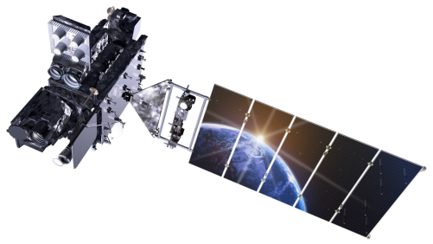
GLM Support from the NOAA/OAR Joint Technology Transfer Initiative (JTTI) Program Scott Rudlosky (NOAA/NESDIS/STAR) GLM Science Week (11-14 September 2018)

Slide 2
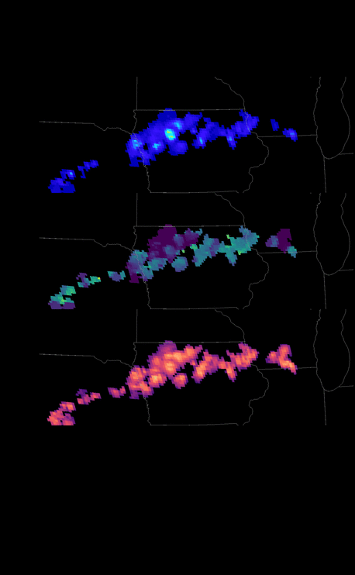
Optimizing GLM Use in AWIPS
Project was selected late in the funding cycle
Leveraged GOES-R science funds to accomplish the first year
Principal Investigator: Scott Rudlosky, NOAA/NESDIS/STAR, UMD/CICS-MD <scott.rudlosky@noaa.gov>
Co-Investigators: Eric Bruning – TTU <eric.bruning@ttu.edu>
Jason Burks – NWS/CIRA/MDL <jason.burks@noaa.gov>
Matthew Foster – NWS/OPG <matthew.foster@noaa.gov>
Michael Folmer – NWS/OPC/TAFB, UMD/CICS-MD <Michael.Folmer@noaa.gov>
Chad Gravelle – NWS/OPG, UW/CIMSS <chad.gravelle@noaa.gov>
Darrel Kingfield – NOAA/NSSL <darrel.kingfield@noaa.gov>
Kristin Kuhlman – NOAA/NSSL, OU/CIMMS <kristin.kuhlman@noaa.gov>
Anita LeRoy – UAH, NGI < leroy@nsstc.uah.edu>
Tiffany Meyer – NOAA/NSSL, OU/CIMMS <tiffany.meyer@noaa.gov>
Michael Peterson – UMD/ESSIC/CICS-MD <mpeterso@umd.edu>
Peter Roohr – NOAA/NWS/STI <peter.roohr@noaa.gov>
Christopher Schultz – NASA SPoRT, <christopher.j.schultz@nasa.gov>
Geoffrey Stano – NASA SPoRT <geoffrey.stano@nasa.gov>
Joe Zajic – NOAA/NWS, IAI <joe.zajic@noaa.gov>

Slide 3
Project Overview
Implementation of a new Geostationary Lightning Mapper (GLM) plugin tool that provides forecasters with full access to the GLM data suite from both GOES-16 and GOES-17
A fixed-grid GLM product will be implemented in AWIPS to replace the initial gridded GLM display
Plan to revive the concept of Lightning Imaging Sensor (LIS) “Areas” by introducing GLM “Storms” comprised of GLM flashes, which can be used to display time series of GLM information
The proposed GLM tool moves beyond individual lightning products to introduce a new technique with a broad array of operational applications

Slide 4
Project Overview
Our team is composed of GLM and AWIPS experts, which given proper resources will allow for concurrent activities that can accomplish complete R2O transition in 3 years
An iterative process will help ensure that forecasters have access to the most useful tool possible throughout the product development process
Each new version will introduce new capabilities, will be demonstrated at testbeds, national centers, and/or forecast offices, and will be accompanied by a complete set of training materials

Slide 5
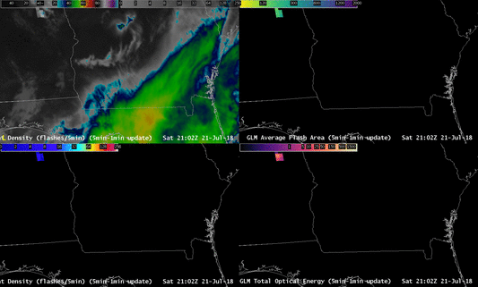
Project Overview
Plugin Version Summaries
Version 1: Basic GLM counts/densities on a fixed grid
Version 2: Incorporate hierarchical traversal and higher order parameters
Version 3: Display GLM storm boundaries
Version 4: Display quick-look GLM tables when hovering over storms
Version 5: Display GLM storm time series when right clicking storms
Version 6: Final plugin, incorporates findings from GOES-R3 projects

Slide 6
Completed Tasks
Coordinate teams to clearly define tasks
Identify means for sharing the fixed grid
Draft Transition Plan
Modify AWIPS plugin to display new GLM grids
Test new configuration in local proving ground (CICS-MD)
Develop initial training materials (NASA/SPoRT)
Implement and test product Version 1 using the NHDA system in Silver Spring, MD
Begin converting hierarchical traversal python codes to java
Begin demonstration of initial GLM grids in the Operations Proving Ground
Modify codes to incorporate hierarchical traversal, data quality flags, and user feedback on the display (Version 2)

Slide 7
Path Forward
Determine the best means for defining GLM Storms
Add GLM storm definition to the hierarchical traversal codes
Identify the best means for visualizing GLM storms
Incorporate modifications to define and display GLM storms (i.e., Version 3)
Implement and test Version 3 using the NHDA system in Silver Spring, MD
Refine and enhance product training materials
Demonstrate Version 3 in the Aviation Weather Testbed (AWT)
Link GLM storm definitions with hierarchical traversal to report higher order variables
Develop/implement means for displaying GLM variables when hovering over storms
Incorporate new components into Version 4
Refine and enhance product training materials
Implement and test Version 4 using the NHDA system in Silver Spring, MD
Explore methods for linking GLM storms in time
Implement means for linking GLM storms in time in AWIPS

Slide 8
Path Forward
Explore means for displaying GLM time series
Implement means for displaying GLM time series in AWIPS
Explore methods for GLM storm identification and tracking
Implement means for GLM storm identification and tracking
Incorporate new components into Version 5
Refine and enhance product training materials
Implement and test product Version 5 using the NHDA system in Silver Spring, MD
Demonstrate Version 5 in testbeds
Submit request to install Version 5 in the AWIPS baseline so that it is available nationwide
Explore means for merging GOES-16 and GOES-17 observations over the central U.S.
Modify baseline codes to include advanced lightning jump applications
Implement means for merging GOES-16 and GOES-17 observations over the central U.S.
Modify baseline codes to include findings using ground-based networks
Incorporate new components into Version 6
Refine and enhance product training materials
Declare GLM storm plugin operational and announce nationally

Slide 9
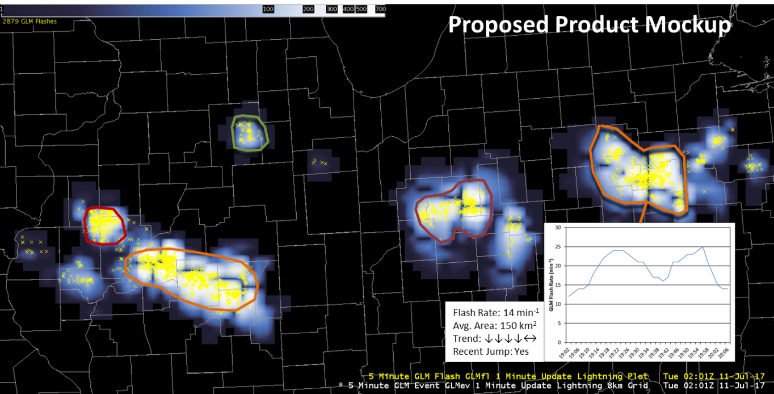
Path Forward
Identify Topical Leads
Code Development
Gridded Products
AWIPS implementation
Outreach and Training
Begin Bi-Weekly Discussions
Revise/solidify project plan
Notes:
http://cimss.ssec.wisc.edu/severe_conv/probsevtest.html

Slide 10
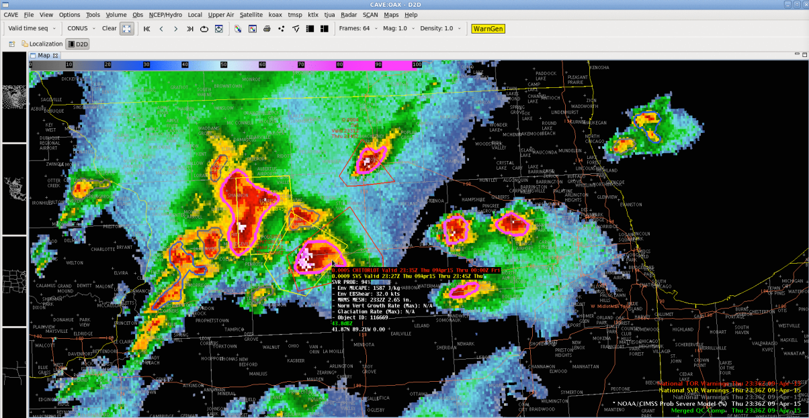
Low-Hanging Fruit
Increase the number of offices receiving additional gridded fields
Obtain time series from experimental ProbSevere to investigate trends and incorporate into training
Develop means for including flash and group counts in the top left of AWIPS displays

Slide 11
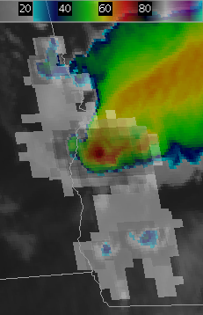
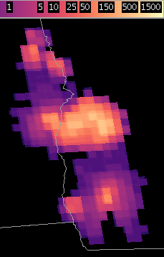
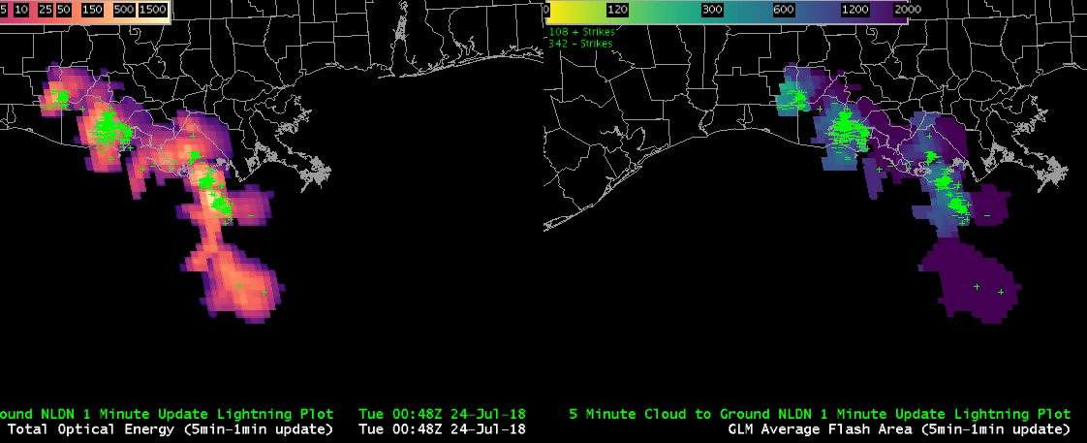
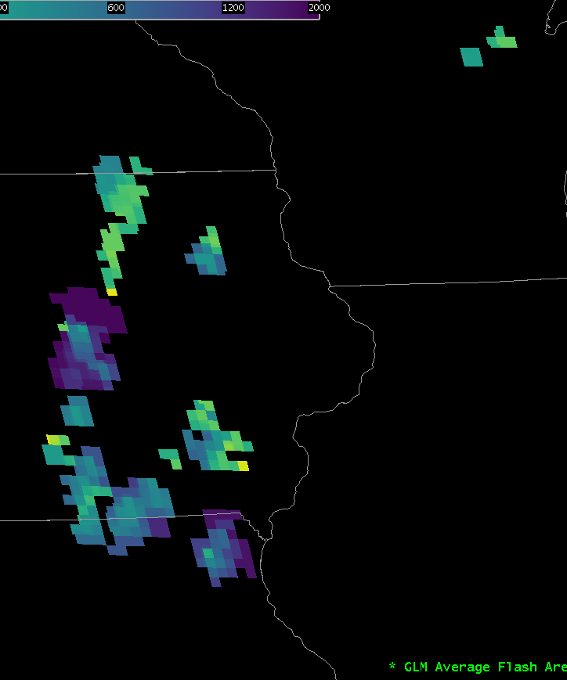
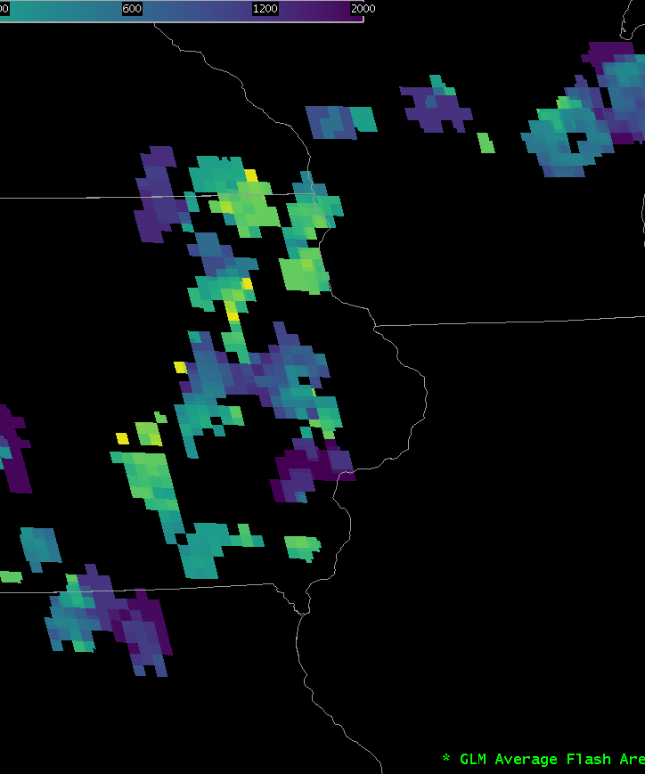
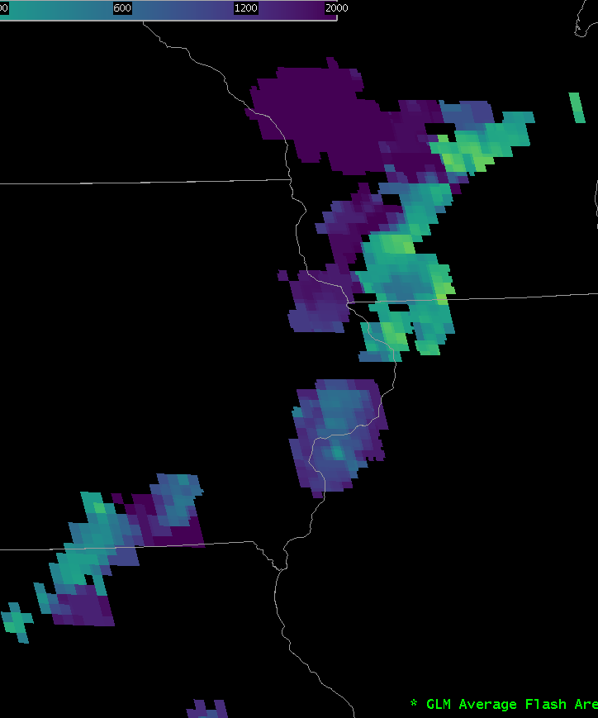
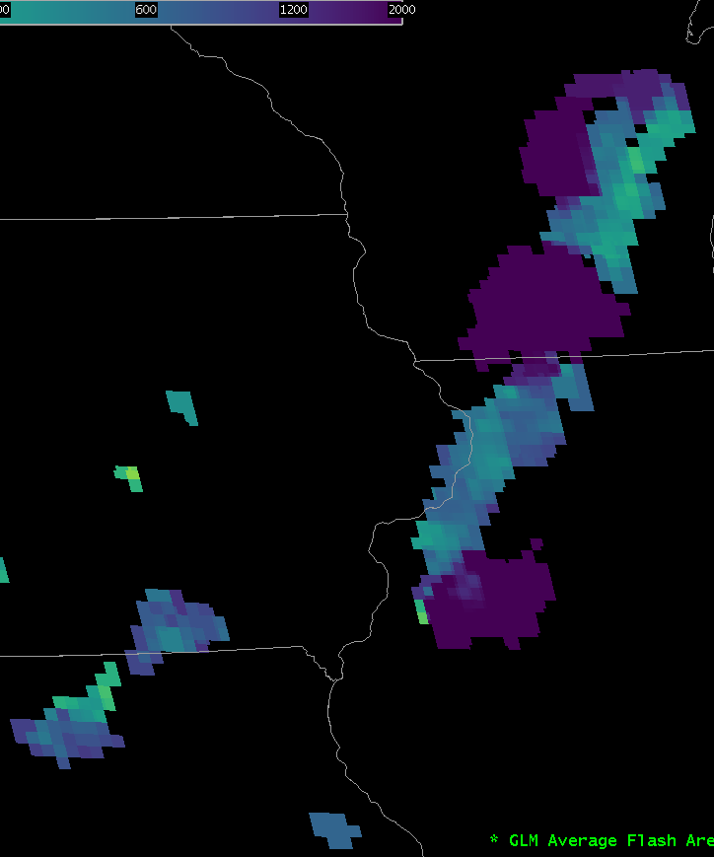
Additional Imagery
Low-Cloud Illumination
Extensive Flashes
AFA Depicting Convective Evolution

