Slide 1
Lightning Jump from the GLM Perspective
Nathan Curtis (UAH)
2018 GLM Science Team Meeting
September 13th, 2018
Supported by: NOAA GOES-R Series Risk Reduction Research (R3) and NASA MSFC-UAH Cooperative Agreement (NNM11AA01A)
R3 Team: Christopher Schultz (NASA MSFC), Lawrence Carey (UAH), Anita LeRoy (UAH), Matthew Smith (UAH), Phillip Bitzer (UAH), Kristin Calhoun (OU CIMMS, NOAA NSSL), Tiffany Meyer (OU CIMMS, NOAA NSSL)

Slide 2
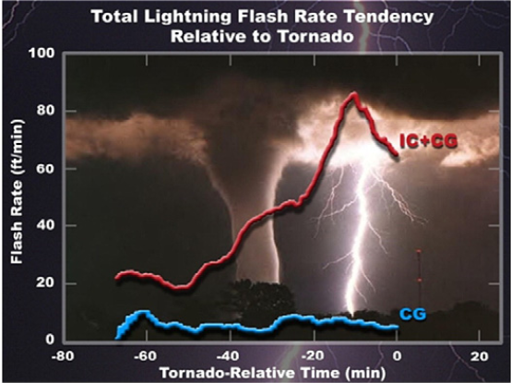
Introduction
Relationship between total lightning and severe studied since 1980’s
In last decade lightning jump algorithm (LJA) developed using Lightning Mapping Array (LMA) to support decision making
Goal of this project is to adapt and utilize LJA with GLM flash and/or sub-flash properties to remove constraint of being in LMA domain
Figure from Goodman et al. 2013

Slide 3
The Lightning Jump Algorithm
Current LJA triggers a “jump” when following criteria are met:
2 standard deviation (sigma) increase in total lightning during last 12 minutes
Total flash count of at least 10 flashes per minute
Storm Report Verification:
Schultz et al. (2009) showed POD of 87% and FAR of 33% for 107 storms
Schultz et al. (2011) showed POD of 79% and FAR of 36% for 711 storms
Schultz et al. (2016) using automated tracking and GLM proxy data showed POD of 60% and FAR of 73% (alt. verification POD 65%, FAR 63%) for 735 storms
Radar Verification:
Jumps were correlated to an increase in peak updraft speed and increases in 10 ms⁻¹ updraft volume (Schultz et al. 2015,2017)
Figure from E. Schultz et al. 2016

Slide 4
Deep Dive Cases
First step in evaluating utility of LJA with GLM was to look at few cases in depth comparing how original algorithm worked between LMA and GLM flashes
5 storms are isolated supercells, 2 storms are linear
April 22nd, 2017 – 2 semi-isolated supercells in N. Alabama
May 8th, 2017 – isolated supercell in Colorado
May 17th, 2017 – two linear storms in central Oklahoma
May 15th , 2018* – supercell in Texas Panhandle
June 13th, 2018* - isolated supercell in Colorado
One supercell and one linear storm shown herein

Slide 5
Data and Methodology
GLM data used for this portion of study was Lockheed Martin reprocessed days from GLM Cal/Val field campaign in 2017
*Two storms from 2018 using live feed on GOES-R portal
LMA data was taken from the Colorado LMA, North Alabama LMA, Oklahoma LMA, and West Texas LMA
LMA flashes clustered using WDSS-II using:
10 sources minimum
6 stations minimum
Radar data was taken from WSR-88D’s
Environmental data was taken from RAP model.
All data was gridded within WDSS-II to 1km x 1km x 1km boxes up to a height of 19km

Slide 6
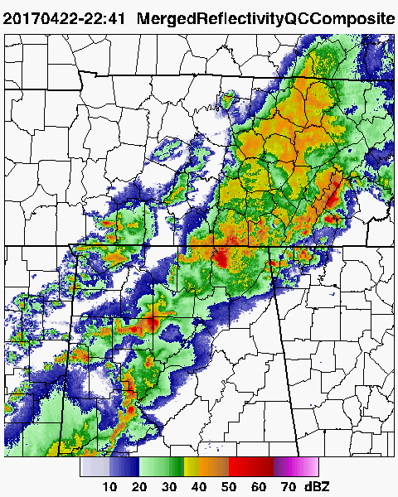
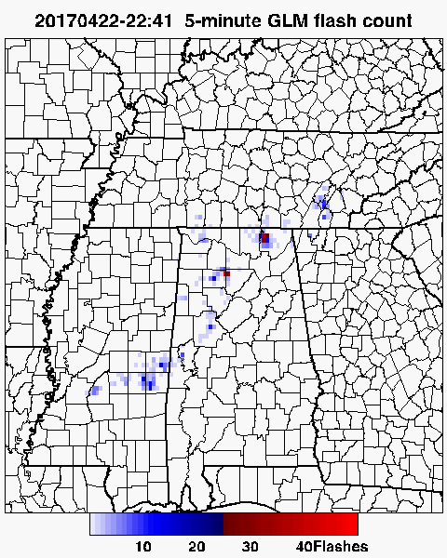
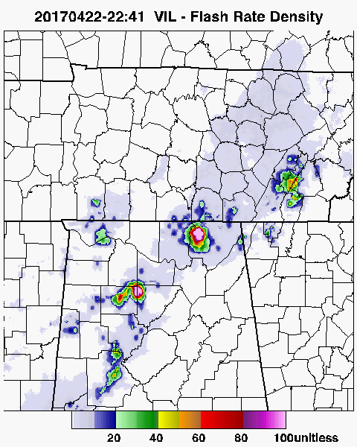
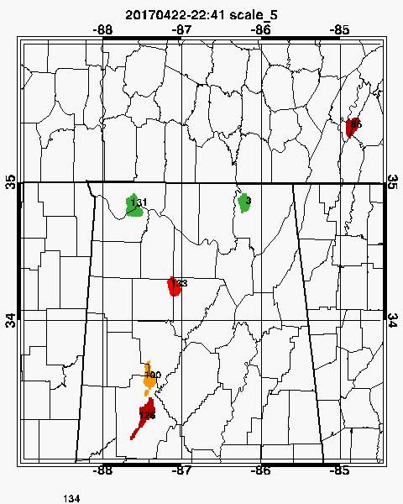
Data and Methodology
Cell tracking was done using automated method called VILFRD developed by Schultz et al. (2016)
$$VILFRD=100 X \left[\left(\frac{VIL}{45}≤1\right)+\left(\sqrt{\frac{FLCT5}{45}}≤1\right)\right]$$

Slide 7
Skyline, AL Supercell April 22nd 2017
Very little agreement between GLM and LMA in flash rates, trends, and jump times. Increased number of GLM jumps without matching radar intensity increase.

Slide 8
Central OK Linear Storm May 17th 2017
Fairly good agreement between LMA and GLM in flash rates and trends, yet still little agreement in jump times

Slide 9
Initial Results – Deep Dives
Times when there is fairly good agreement between LMA and GLM in flash rates, but often large differences.
Even when relatively good agreement in flash rate, still differences in number of jumps and timing of jumps.
Overall GLM tended to be much more “jumpy” than LMA and showed a lot of examples where there was a jump but no increase in radar intensity metrics
Results suggest a larger sample size study to determine utility of the original LJA criteria with GLM flashes
And to consider optimization of LJA criteria using GLM

Slide 10
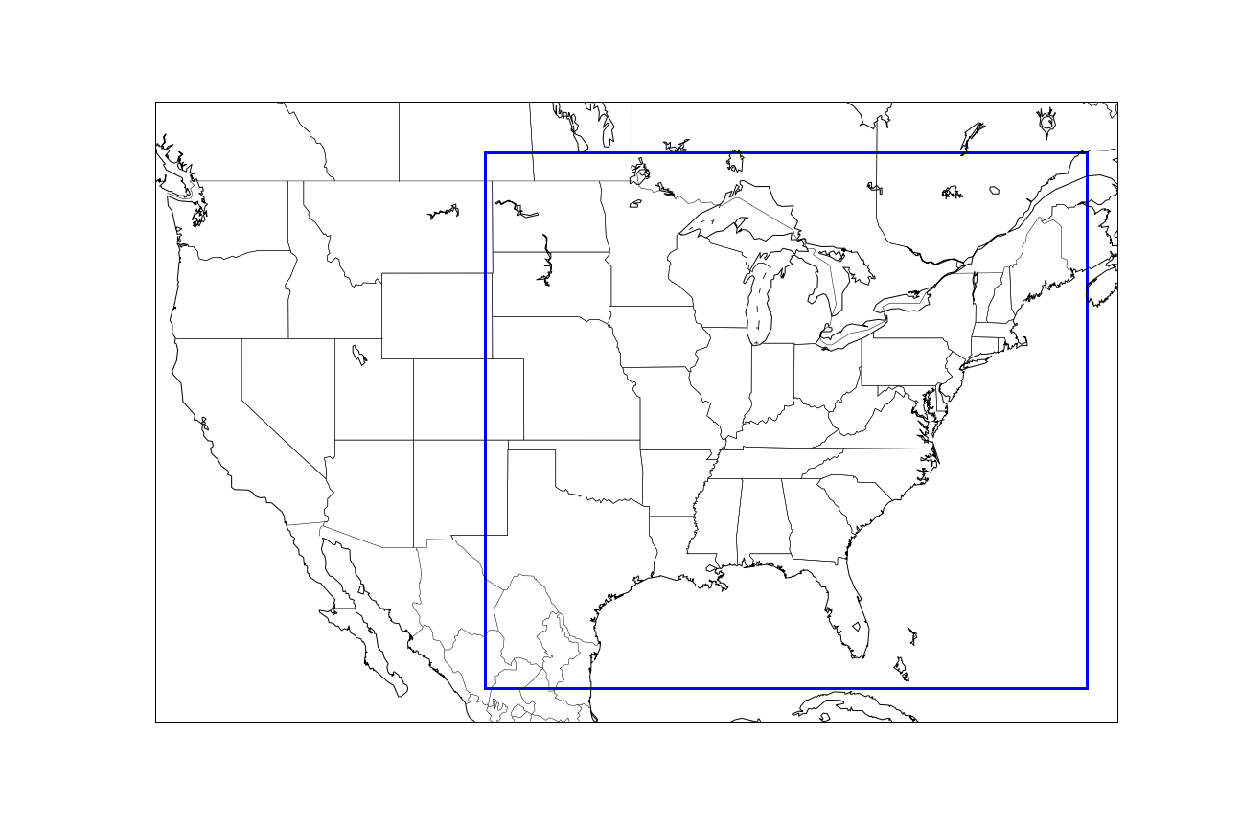
Large Sample Size Study
10 of the 11 Lockheed Martin reprocessed days during the GLM Cal/Val 2017 field campaign are used
No LMA data is used in this study.
All other methodology used is the same as in the deep dive cases mentioned earlier.
Domain:

Slide 11
Initial Results – Large Sample
930 total storms sampled
Storm report verification, 45 minute warning after each jump, reports binned in 6 minute intervals.
For original 2 sigma, min. 10 flashes per minute LJA criteria
Hits = 274, Misses = 128, False Alarms, 1528
POD = 68%
FAR = 85%
CSI = 0.14
Sensitivity testing done to see if there is a combination of criteria that works better with GLM
Sigma ranged from 1.0 to 4.0 by 0.1
Min flashes per minute ranged from 0 to 25 by 1

Slide 12
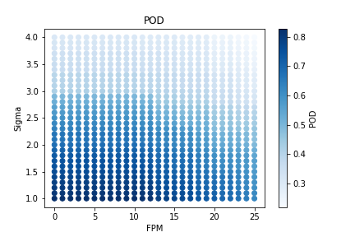
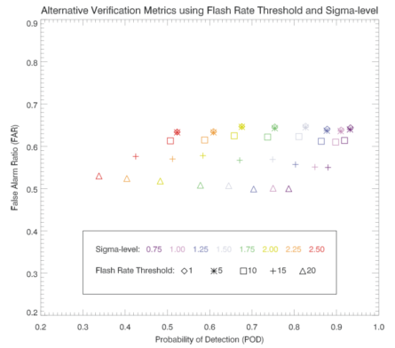
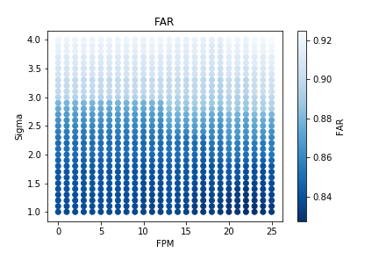
Initial Results – Large Sample
Figure from Schultz et al. (2016)
Similar trends in the two studies when altering flash rates and sigma-levels
Reduction in sigma increases POD without much increase in FAR
Results suggest more false jumps in the LJA than in LMA

Slide 13
Future Work
More in depth radar verification on the current large sample size study dataset
Looking at properties other than flashes.
Optical Energy
Flash Area
Groups
Moving from VILFRD to a GLM only tracking algorithm
Determining role of possible increased optical radiance extinction on GLM vs. LMA flash rate and jump differences due to increased presence of cloud water, ice, and hail in a storm using polarmetric radar data
Also look at storm size and morphology properties

