Slide 1
Intercomparison of LMA and GLM Over North Georgia
2018 GLM Annual Science Team Meeting
John Trostel, Jessica Losego, Madeline Frank
Severe Storms Research Center
Georgia Tech Research Institute

Slide 2
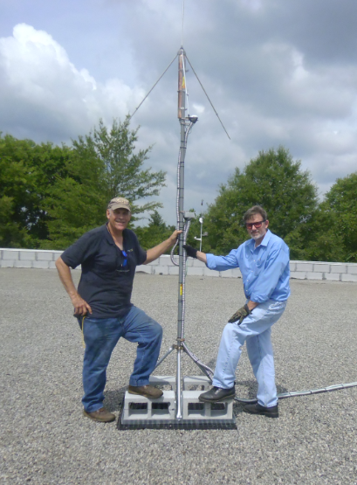
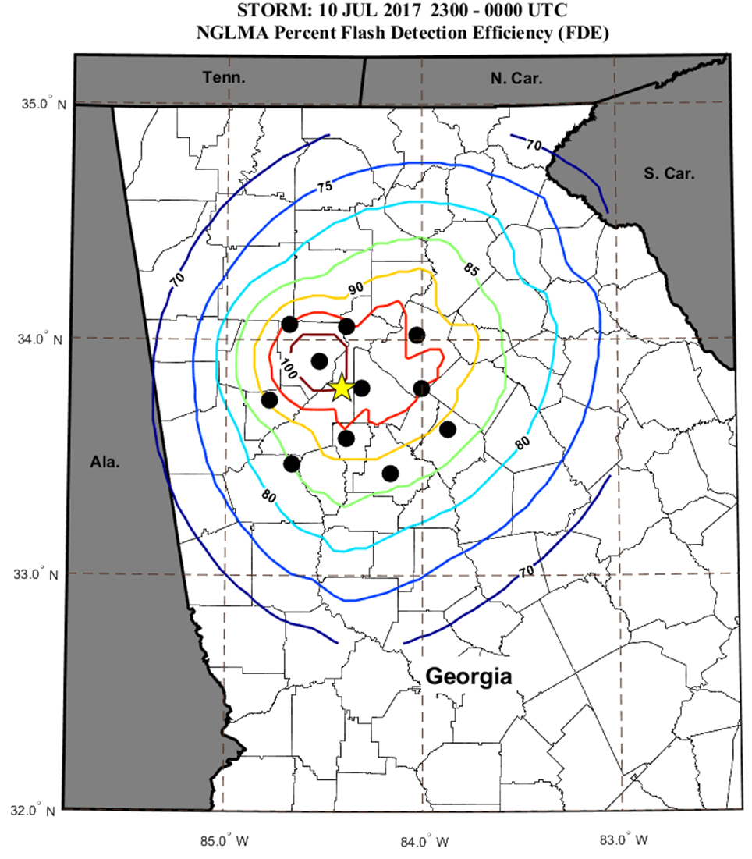
North Georgia Lightning Mapping Array (NGLMA)
Detects total lightning by measuring VHF in unused TV band (channel 6)
System designed by New Mexico Tech, assembled and installed by Georgia Tech Research Institute.

Slide 3
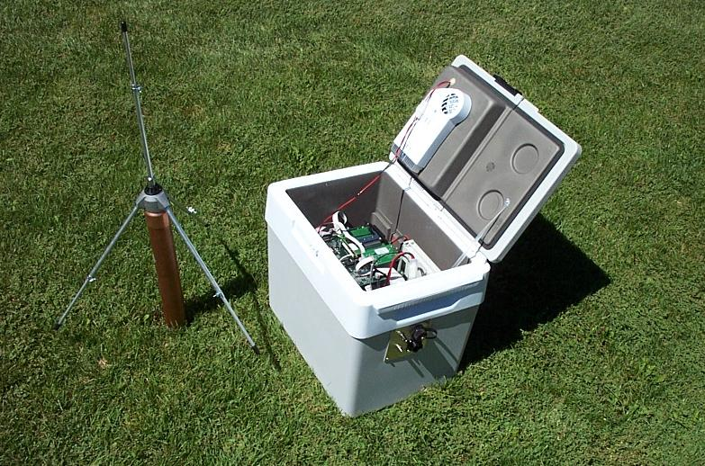
Original Equipment – Cooler Based
Two sensors of this type

Slide 4
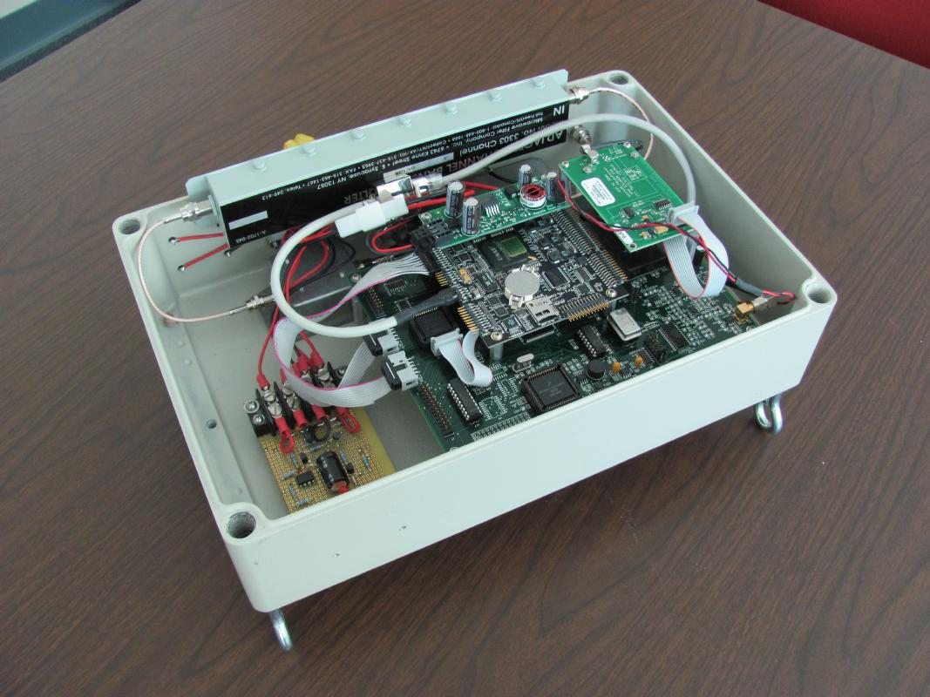
NGLMA Computer Setup
PC104 computers
FPGA-based analyzers
GPS time synchronization
9 of 12 sites currently operational
5 sites: local power and internet
2 sites: local powered and cellular connection
2 sites: solar power and cellular connection

Slide 5
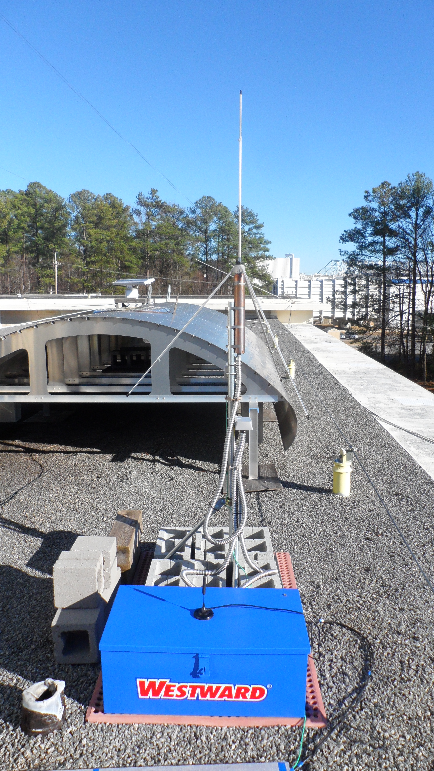
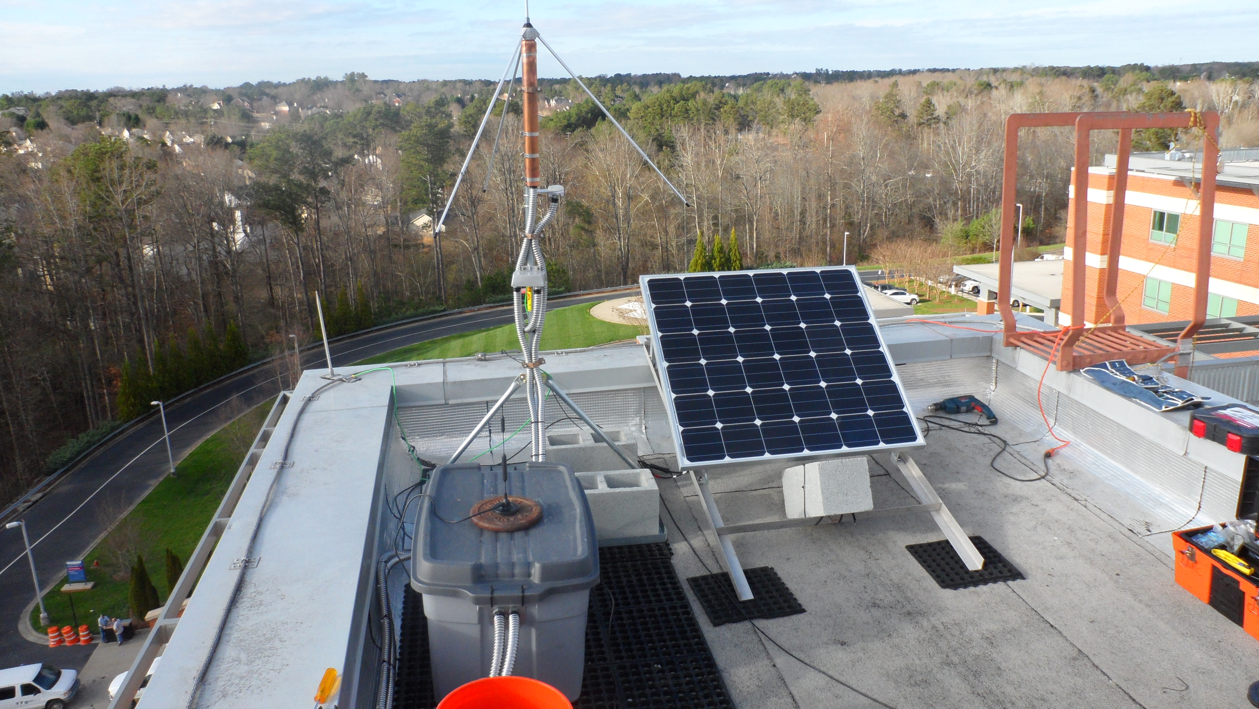
Latest Installs – Cell-modem and solar cells

Slide 6
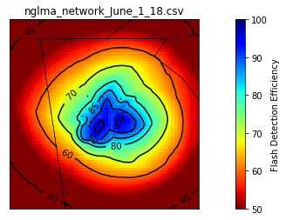
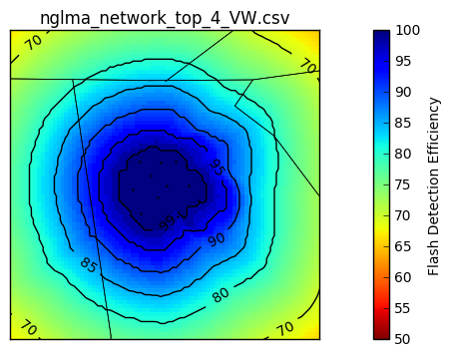
Current and Future FDE for NGLMA

Slide 7
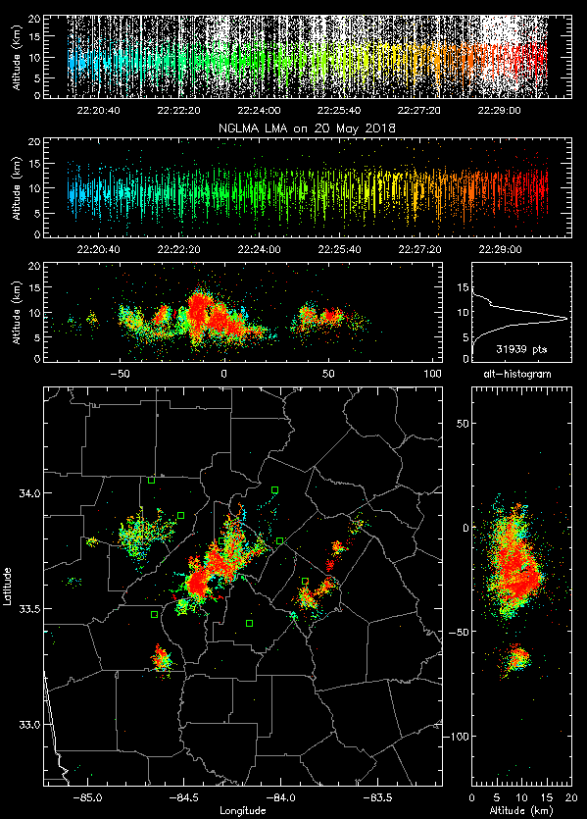
NGLMA and GLM Comparisons
Are GLM16 and GLM17 seeing what the NGLMA is seeing?
May 20, 2018
June 1, 2018
Aug 9 and 12, 2018
New Mexico Tech’s XLMA is used for analysis
May 20, 2018 NGLMA Sources for 22:20-22:30

Slide 8
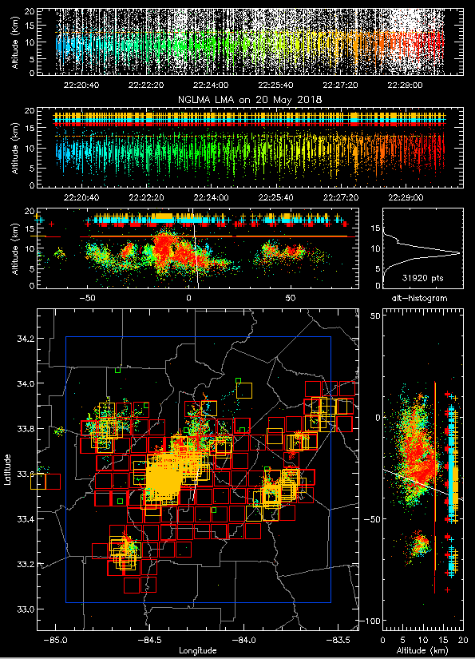
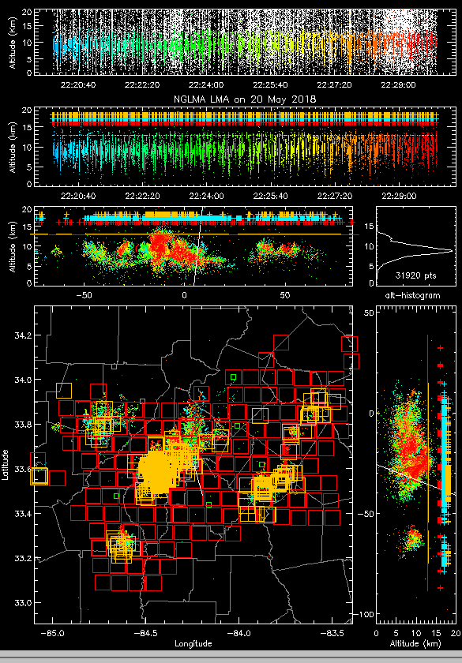
May 20, 2018
NGLMA and GLM16/17 for 22:20-22:30
NGLMA & GLM17
NGLMA & GLM16
GOES 17 data is preliminary and non-operational

Slide 9
May 20, 2018 GLM Flash Compare – from XLMA
 | GLM16
Flashes | 312
Events | 12,306
Offset-lon (km) | 0.30
Offset-lat (km) | 3.52
DE for lma flashes > 10 pts | 71%
DE for big lma flashes w/≥ 75 pts | 90%
DE for bigger lma flashes w/≥ 200 pts | 97%
DE for medium lma flashes w/11-74 pts | 65%
DE for small lma flashes w/<10 pts | 27%

Slide 10
May 20, 2018 at 22:23:35 (Echo Top ~ 12km)
NGLMA & GLM17
NGLMA & GLM16
GOES 17 data is preliminary and non-operational

Slide 11
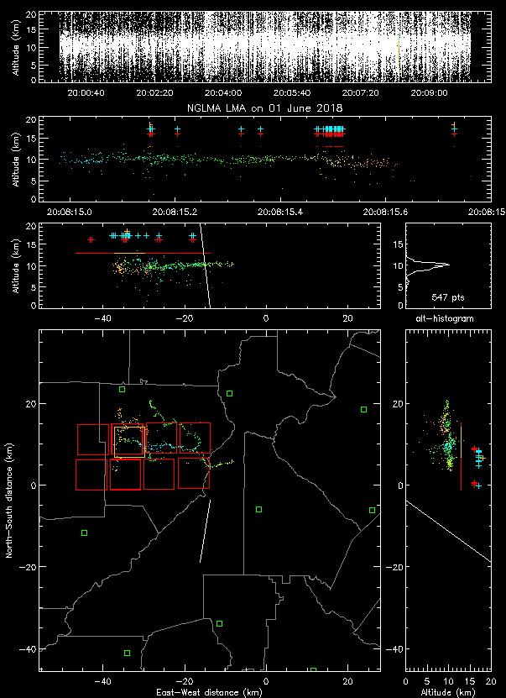
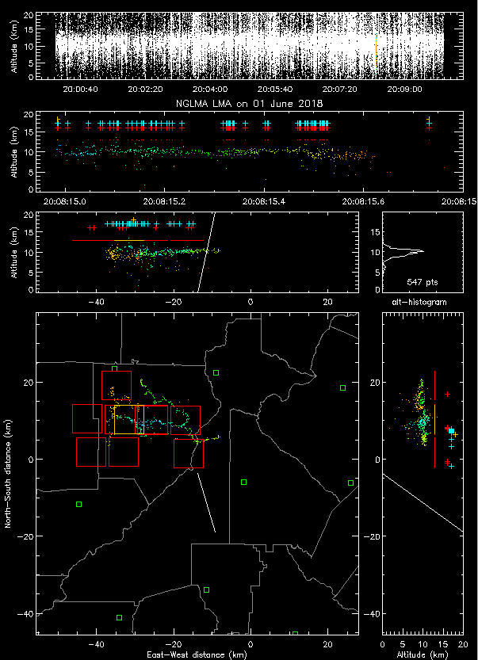
June 1, 2018 at 20:08:15
(Echo Top ~ 10 km)
NGLMA & GLM17
NGLMA & GLM16
GOES 17 data is preliminary and non-operational

Slide 12
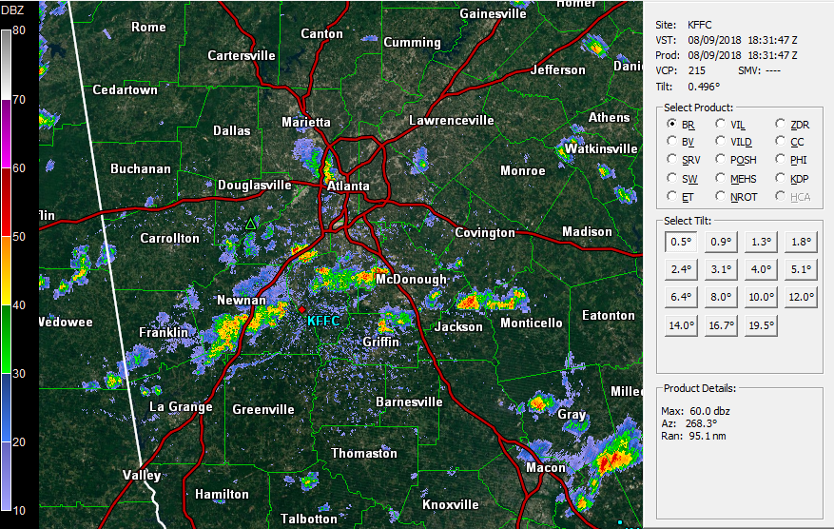
August 9, 2018
Reflectivity at 18:31

Slide 13
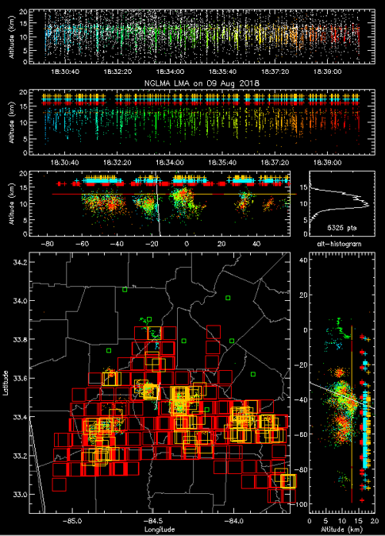
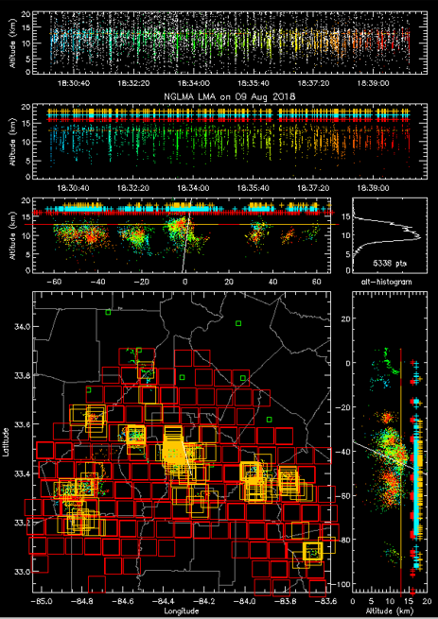
August 9, 2018
NGLMA and GLM16/17 for 18:30-18:39
NGLMA & GLM17
NGLMA & GLM16
GOES 17 data is preliminary and non-operational

Slide 14
August 9, 2018 GLM Flash Compare – from XLMA
 | GLM16
Flashes | 169
Events | 4,821
Offset-lon (km) | 0
Offset-lat (km) | 0
DE for lma flashes > 10 pts | 63%
DE for big lma flashes w/≥ 75 pts | 89%
DE for bigger lma flashes w/≥ 200 pts | N/A
DE for medium lma flashes w/11-74 pts | 61%
DE for small lma flashes w/<10 pts | 33%

Slide 15
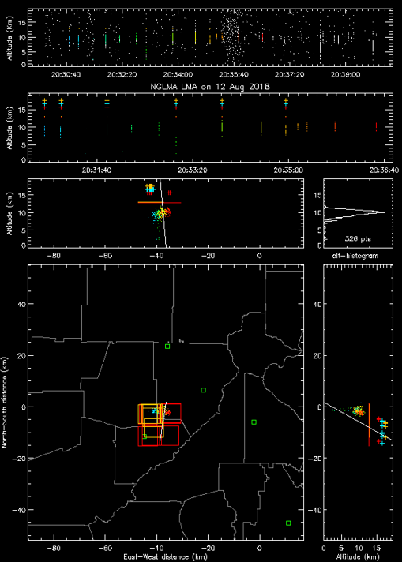
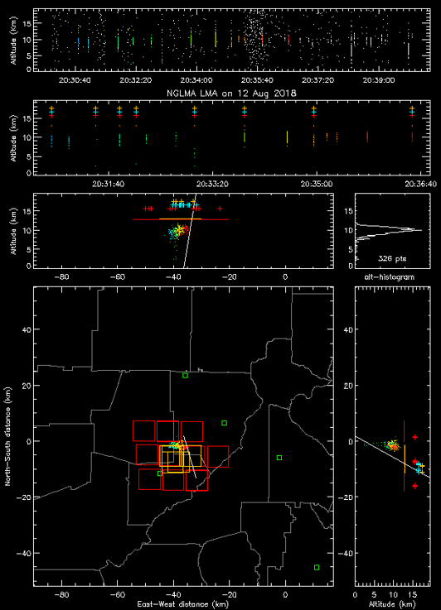
August 12, 2018
Sources at 10km Altitude
NGLMA & GLM17
NGLMA & GLM16
GOES 17 data is preliminary and non-operational

Slide 16
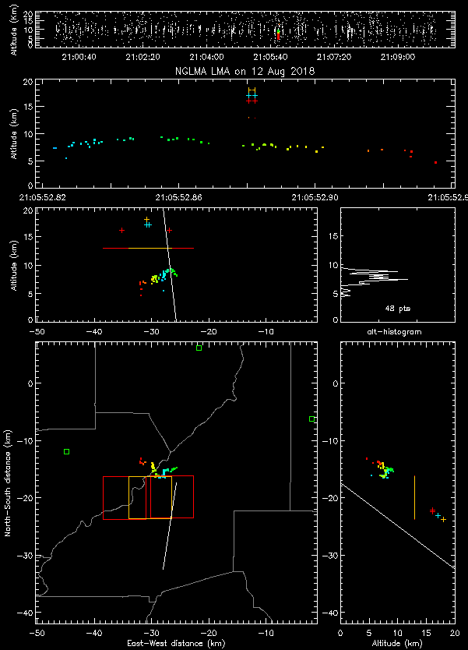
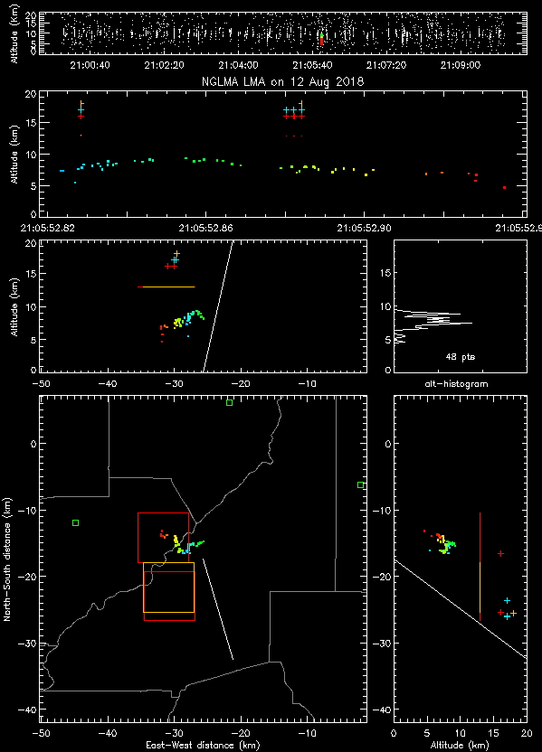
August 12, 2018
Sources at 6-9km Altitude
NGLMA & GLM17
NGLMA & GLM16
GOES 17 data is preliminary and non-operational

Slide 17
Summary
Storms in GA are often lower than assumed 12 km height of GLM
LMA source heights ranged from about 6 to 12 km
Echo tops ranged from 7.6 to 12 km
GLM detections are slightly off from NGLMA source locations (Aug 12)
DE decreases when lightning altitude is lower
Future work
Analyze data for overnight storm to see if light pollution affects GLMS
Compare GLM 16 and GLM 17 once all data becomes operational
Increase detection efficiency and range of LMA

