Slide 1
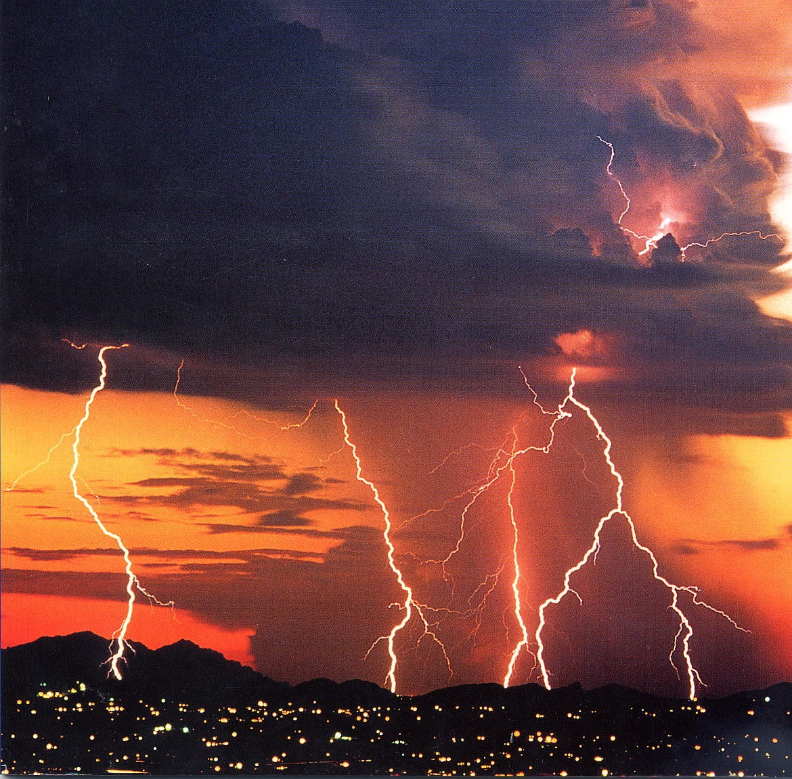
The Need for Science-based Ground Processing Algorithms
HUGH J. CHRISTIAN
The University of Alabama in Huntsville
Major Contributions: Samanthia Edgington
Clem Tillier

Slide 2
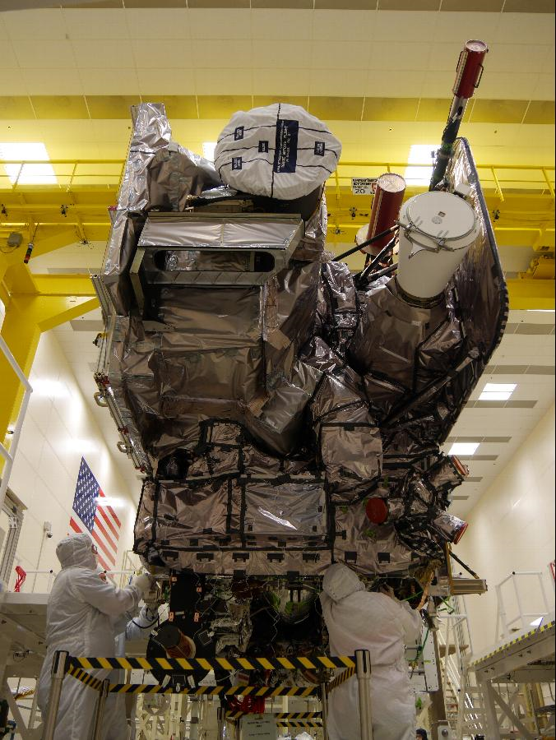
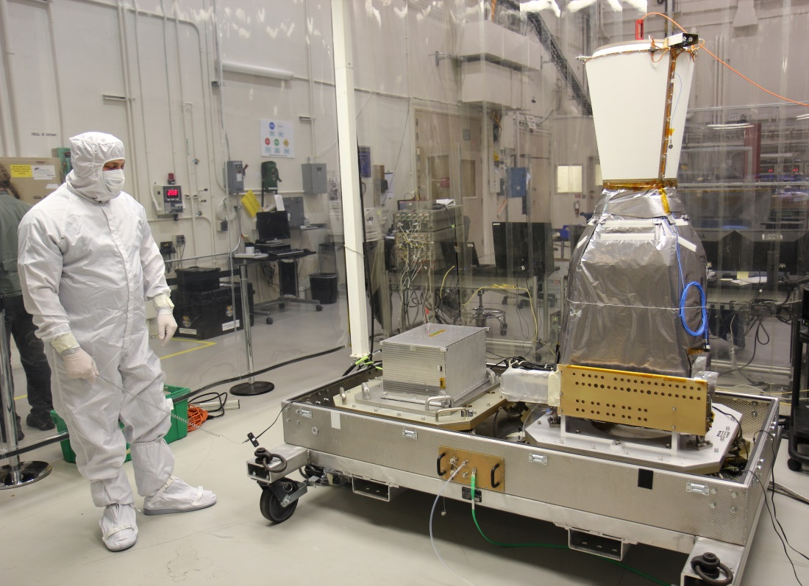
The GLM Instrument
GLM is a near-IR staring detector that continuously maps in-cloud & cloud-to-ground lightning with near uniform spatial resolution
Credit: Lockheed Martin
Credit: Lockheed Martin
GLM Electronics Unit and Sensor Unit
ABI and GLM installed on GOES-R

Slide 3
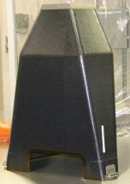
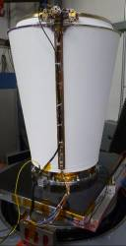
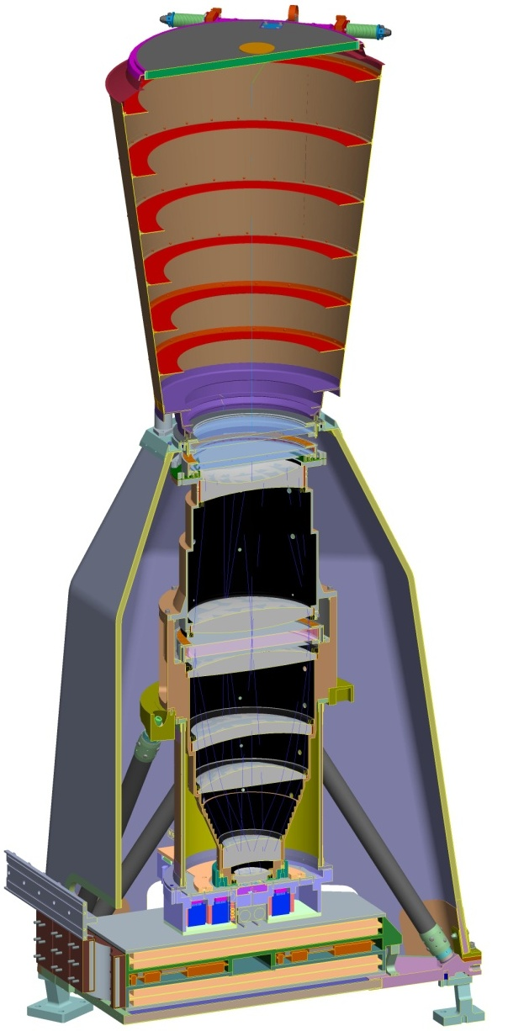
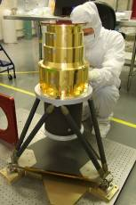
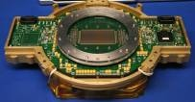
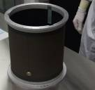
GLM Sensor Unit Overview
Solar Rejection Filter
Solar Blocking Filter
Baffle Support
Baffle & Door
Lens Housing & Support Structure
Narrow Band Filter
Variable Pitch CCD
Metering Tube
Focal Plane Array Assembly (FPAA)
Loop Heat Pipes (FPAA) and Thermal Straps (SEB)
Sensor Unit
Electronics Box (SEB)

Slide 4
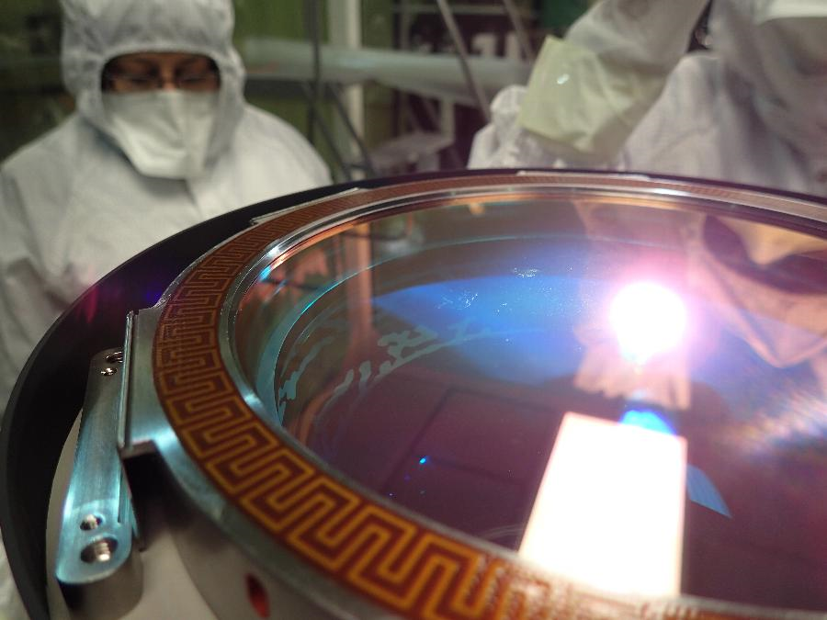
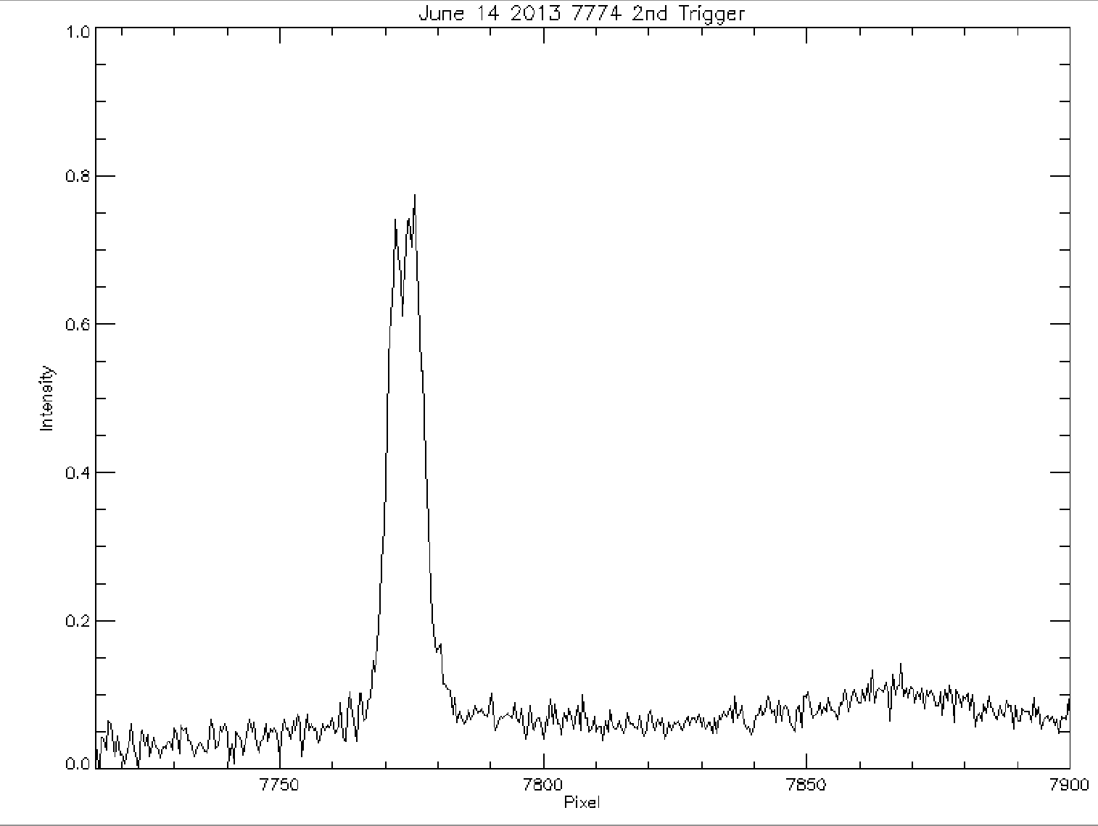
Challenges: Narrow Filters
Need a narrow band filter to pick out the Oxygen triplet against a strong background signal from sun light reflected from cloud tops
Detecting lightning at night is easy!
Daytime SNR driven by filter bandwidth (small) and aperture size (large)
Manufacturing and testing a large (20 cm) narrow-band filter was hard
Credit: Lockheed Martin
GLM Solar Blocking Filter Installed on the SU
Oxygen triplet signature observed in lightning

Slide 5
What is 70 / 90% Detection Efficiency?
Defined as detecting x% of the total lightning occurring within the GLM field of view over a 24 hour period.
Based on measured optical radiant energy from 73 lightning flashes detected over the tops of thunderstorms in the 1980s.
It is strictly an optical measurement with 90% of the detected lightning producing at least 4.7 uJ/m² st um of energy as detected by the onboard radiometer.
The OTD, LIS and GLM were all designed to achieve this design threshold
OTD fell short due to high electronic noise
LIS fell short due to limited telemetry bandwidth. It meets the design goal at night but detects closer to 80% during the daytime
GLM should be capable of detecting 90% of the lightning flashes within its FOV even over brightly lite clouds.
The radiometric throughput is the main determinator of space-based optical senor detection thresholds. More throughput, means lower thresholds and better performance
All these predictions are based on the erroneous assumption that the U-2 program optically detected 100% of the lightning flashes within its FOV.

Slide 6
GLM Instrument Overview
Photons
Video
Elec- tronics Unit
Sensor Unit
Events
GLM Hardware Characteristics
The Sensor Unit is a high-speed CCD video camera that senses emission lines from atomic Oxygen produced by lightning
The Electronics Unit is a configurable event detector that performs image processing to identify and downlink any positive change in the value of a pixel
GLM shoots anything that moves!
On-board processing reduces raw video by a factor of > 1000x
GLM Algorithm Characteristics
Identify lightning events using the coherency properties of lightning pulses within flashes, spatially and temporally
Allows the GLM hardware to send many noise events to the ground, and therefore collect many more weak lightning events (better SNR)
Ground Processing
Design Parameter | Value | Unit
Flash detection efficiency | 80 | %
CCD imaging area size | 1372 x 1300 | pixels
Frame rate | 500 | fps
ADC resolution | 14 | bits
Filter center wavelength | 777.4 | nm
Filter band pass | 1 | nm
Lens field of view | +/- 8 | deg
Ground sample distance | 8 – 14 | km
Lens focal length | 134 | mm
Lens f number | 1.2 | -
Pixel size (variable) | 30 x 30 | µm
Well depth (variable) | 2e6 | electrons
Event rate | 1e5 | sec⁻¹
Downlink rate | 7.7 | Mbps
Product latency (level 1b) | <10 | s
Mass | 125 | kg
Operational power | 290 | W
Notes:
PIRA (support):
Picture 1: http://www.goes-r.gov/spacesegment/glm.html
Picture 2: GOES-R GLM Program Management Status Review #XX (REF GLM## and attendance)
Contract Scope
15 year mission life
5 yrs on-orbit storage; 10 yrs operational; 5 yrs ground storage before launch
Basic Contract
Parts & material for Engineering Development Unit (EDU), 4 Flight Models (FM), and spares
EDU and FM-1
MGSE and EGSE
Option 1 FM-2 (exercised); Option 2 FM-3 (exercised); Option 3 FM-44

Slide 7
Radiometric Model Response: Design Parameters
 | Constants
R | 3.56 × 10⁷ m | sensor altitude
Ib | 375 Wm⁻² sr⁻¹ um⁻¹ | background radiance at 777.4 nm
h | 6.63 × 10⁻³⁴ Js | Planck’s constant
C | 3.00 × 10⁸ ms⁻¹ | speed of light in vacuum
 | Variables
As | 6.4 x 10⁷ m² | lightning illuminated source area (nom)
Ab | 6.4 x 10⁷ m² | background area imaged by a single pixel
D | 0.11 m | lens aperture
Q | 0.92 | FPA quantum efficiency (measured performance on LMS)
Fill factor | 100% | CCD fill factor
K | 0.8 | optical system transmission
Kf(θ) | Variable | filter transmittance as function of look angle (θ)
λ | 777.6 nm | center wavelength of spectral filter
Dl | 1 nm | filter bandwidth (narrow band interference)
Es | 4.7 × 10⁻⁶ J m⁻² sr⁻¹ | lightning radiant energy at 777.4 nm for 90% DE
t | 2 × 10⁻³ s | frame integration time
α | 0.8 | cloud albedo (used in radiometric equations to ensure performance margin)
αg | 0.6 | percent global cloud cover
r | 30 μm | pixel size

Slide 8
LIS vs. GLM Radiometric Throughput
Parameter | LIS | GLM | Difference
Satellite altitude (km) | 800 | 36000 | - 45
Lens aperture (cm) | 0.33 | 11 | + 33.3
CCD quantum efficiency (%) | 60 | 92 | + 1.53
Optical transmission (%) | 50 | 80 | + 1.6
Frame integration time (msec.) | 1.78 | 2 | - 1.1

Slide 9
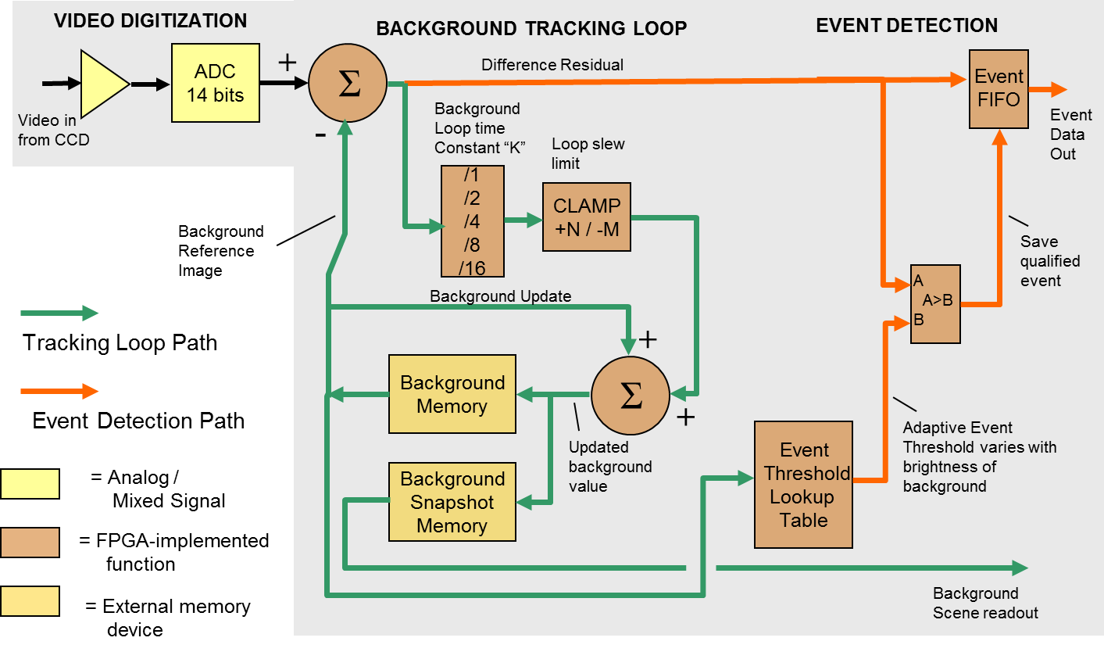
RTEP Functional Block Diagram
The Real Time Event Processor is a pipelined digital processor proven on-orbit to exceed GLM performance requirements.

Slide 10
RTEP Background Loop Noise Reduction
s
Event signal
±
The basis for conversion and event detection is a digitally-filtered, rapidly updated, precision background image against which each video frame is compared.
Current frame
+
Σ
K
µ
-
Background
Reference
Image
+
Background
Memory
Σ
µ
+
Weighting constant K | Effective # of video frames averaged | Noise Reduction in Background Image | Noise in output to Event Detection
1 | 1 | 1 | 1.41 σ
0.5 | 3 | 0.574 | 1.15 σ
0.25 | 7 | 0.378 | 1.07 σ
0.125 | 15 | 0.259 | 1.03 σ
0.063 | 31 | 0.180 | 1.02 σ
Reduced Background Image noise is essential for bright background scenes that occur during peak lightning activity
Use or disclosure of sensitive information contained on this page is subject to the restrictions on the title page of this proposal or document.
GOES-R Instrument Technical Data
Lockheed Martin Proprietary Information / Competition Sensitive
-083-

Slide 11
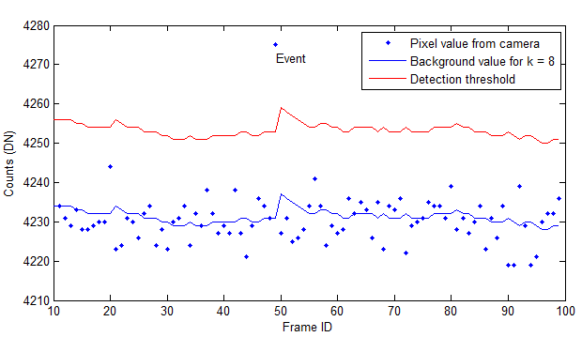
How does GLM detect lightning?
The GLM instrument is a lightning event detector
Any positive change in a pixel value that exceeds the programmed threshold is sent to the ground for further processing
Most of the events that GLM sends to the ground are expected to be noise events
Digging into the noise and identifying lightning events using their coherency properties is how GLM achieves high performance while limiting false alarms
GLM operates at the limits of the noise

Slide 12
Low threshold levels allow large numbers of lightning and false events; this large number of total events drives our false alarm rate to much lower than 5%
SNR = Signal to Noise Ratio
Normalized Gaussian Distribution STD=1
0.4
Sensitivity vs. False Event Rates
5
False Event Rate
(log scale)
4.5
Best performance occurs w/40,000 false events/sec
0.3
4
Sensitivity (uJ m⁻²str)
3.5
[Eth]
0.2
3
2.5
0.1
0.1
1
10
100
1000
10000
100000
Background Noise
Signal + Noise
0
-4
-2
0
2
4
6
8
Threshold setting required
to limit false event rate
False events exceeding threshold due to noise
SNR
Use or disclosure of sensitive information contained on this page is subject to the restrictions on the title page of this proposal or document.
As threshold (Eth) is lowered, the false event rate increases and more lightning signal is detected; false events are removed by robust algorithms in level 1b
GOES-R Instrument Technical Data
Lockheed Martin Proprietary Information / Competition Sensitive

Slide 13
Challenges: Virtual Baffle
AOI = 8.0°
AOI = 0
1.00
0.90
Solar Blocking Filter
Narrow Band
Filter
0.80
0.70
0.60
Filter Transmission
0.50
0.40
0.30
0.20
Lightning
0.10
0.00
775.0
775.2
775.4
775.6
775.8
776.0
776.2
776.4
776.6
776.8
777.0
777.2
777.4
777.6
777.8
778.0
778.2
778.4
778.6
778.8
779.0
Wavelength (nm)

Slide 14
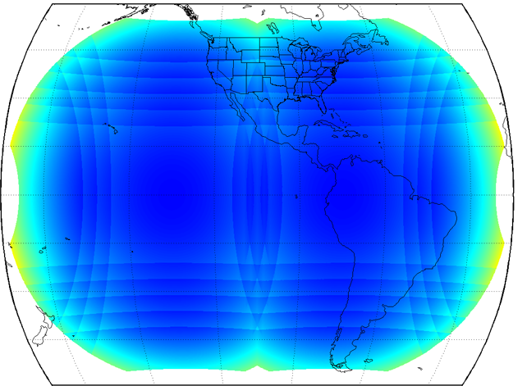
Variable Pixel Design Provides Near Uniform Spatial Uniformity of Data Over the Full Disk
GSD: Variable Pitch vs Fixed Pitch 15.1 deg FOV
17000
16000
GSD Variable Pitch
GSD Fixed Pitch
15000
0038
14000
13000
Earth Central Angle = 29.8º
at 10km GSD
GSD (m)
12000
Earth Central Angle = 48.1º
At 10km GSD
11000
10000
9000
8000
7000
0.0
5.0
10.0
15.0
20.0
25.0
30.0
35.0
40.0
45.0
50.0
55.0
Earth Central Angle (deg)
Variable Pitch
1300 x1372, 8 km GSD at Nadir
Unique variable pixel design compensates for the earth’s curvature and provides almost uniform GSD across the whole FOV

Slide 15
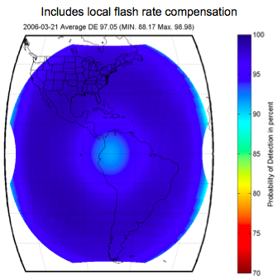
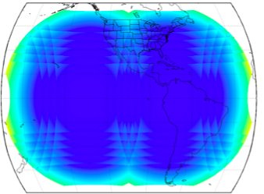
Geostationary Lightning Mapper (GLM) Performance and Coverage
Field of view coverage from GOES-E and Goes_W
Predicted Detection Efficiency

Slide 16
Performance Requirements Principally Defined by Flash Detection Efficiency
Validation is difficult because sensor systems do not directly detect lighting flashes
GLM, LIS etc. basically detect strokes
Ground networks such as GLD 360, Earth Networks, field change networks, and long range networks also detect strokes
Basically a stroke is:
Lightning component that occurs when a lightning channel conductively connects the main negative and positive charge regions or a main charge region to ground with a resulting charge exchange, a fully ionized hot channel and thunder
a stoke is the main mechanism for reducing electrical energy in a storm.
a lightning flash is composed of one or more strokes.
GLM validation should be based on stroke detection.
Comparisons with alternate systems should be based on stroke detection

Slide 17
How should GLM Performance compare to LIS Performance?
GLM should detect significantly more weak lightning strokes than LIS
It has more than 20% greater radiometric throughput
GLM has 100x the number of pixels but a 1000x the telemetry bandwidth
Allows lower threshold settings with more false events but also more lightning events
GLM has a more stable background (stationary vs. LEO) and programmable background averaging and clamp
Lower background variance – average over 63 frames instead of 1.5
Clamp at 2 instead of 8
Slower response to background changes but lower noise
Less background contamination due to lightning or high energy particles of glint

Slide 18
Other Advantages of GLM over LIS
Background intensity transmitted with each event
Allows more powerful ground processing algorithms
Variable pitch pixels
Provides better performance at the edges of the field of view
Percentage of pixels illuminated by high albedo clouds is much smaller for GLM than for LIS
Threshold setting for bright backgrounds can be much lower on GLM
Better GLM detection efficiency for where the lightning is
‘S” shape threshold curve vs. linear curve

Slide 19
A Few Disadvantages
The two main causes of FEs are shot noise from bright clouds (gaussian) and high energy particle impacts on the CCD (non-gaussian).
GLM also has electronics produced FEs called overshoots and undershoots
Removed with ground filtering – consumes bandwidth
Requires setting higher thresholds for dark backgrounds
A new second level threshold table tuned to each pixel (instead of for each RTEP) will correct much of these problems
Electronic gain is too high
Limits dynamic range. Can cause saturation under bright cloud, bright lightning conditions. (S &C)
Cannot be corrected on FM1 or FM2, but is a fairly rare condition
Saturation and blooming during solar eclipses
A piece inside the lens can cause internal reflects that can result in saturation during certain phases of an eclipse
Happens much more seldom than feared and corrected for future flight models
Ground filtering can reduce the affect

Slide 20
A Few Disadvantages (cont.)
When a lightning event strongly under fills a pixel, such as might happen during preliminary breakdown and leader propagation with a bright cloud top, GLM detection efficiency will be reduced significantly and LIS with its better spatial resolution could have a signal to noise ration advantage as large as two.
Both Bitzer and Cummins have indicated LIS is significantly better than GLM at detecting leaders
Ground-based data processing algorithms
LIS combines level 1b and level 2 processing algorithms.
They are separate for GLM be government requirement
much easier to remove single events when 1b and 2 are combined
consequently, GLM level 1b processing must remove all false events without the benefit of clustering.
this results in very short coherency intervals and higher probability requirements to pass real events
also requires higher threshold settings for dark backgrounds
also because operational requirements restrict looking back in time, the events occurring during the first frame a lightning sequence, are discarded.
these are often the brightest events and are necessary for accurate time sequencing

Slide 21
GLM: Near Term Improvements
The GLM can perform better
Thresholds can still be lowered for bright clouds
Better DE for active daytime thunderstorms
GOES 17 set lower during check-out
The present event rate is around 10,000 per second
System capacity is 100,000
Thresholds can be lowered further, GOES 17 running at about 40,000
Ground based algorithms
Not yet optimized
up-dates are planned
Recommendations
Develop alternate data processing for scientists
i.e. non-operational ground processing for the science communuty
Combine level 1b and level 2 without real-time requirements
Allows better detection and eliminates the loss of first strokes
A joint Huntsville and Lockheed effort
Results can be fed back to improve the operational processing

Slide 22
Proposal for New Science-based Algorithms
Develop ground algorithms that are independent of the operational ground processing.
allows rapid changes and updates
easy to test and evaluate new concepts
no requirement for real time processing so coherency can be tested over a much longer period of time and first events can be kept
Level 1b and level 2 can be combined
provides easy removal of single events and more accurate lightning detection (higher DE and lower FER)
Results can be fed back to the operational side resulting in improved operational performance and better on-orbit perimeter settings

Slide 23
Recommendations for New Science-based Algorithms
Funding required
Combine a team from UAH (Christian and Bitzer) with a team from Lockheed Martin (Tiller and Edgington) to develop the science-based processing.
Process all GLM data and archive at UAH
Make data easily available
Make processing software available as appropriate

Slide 24
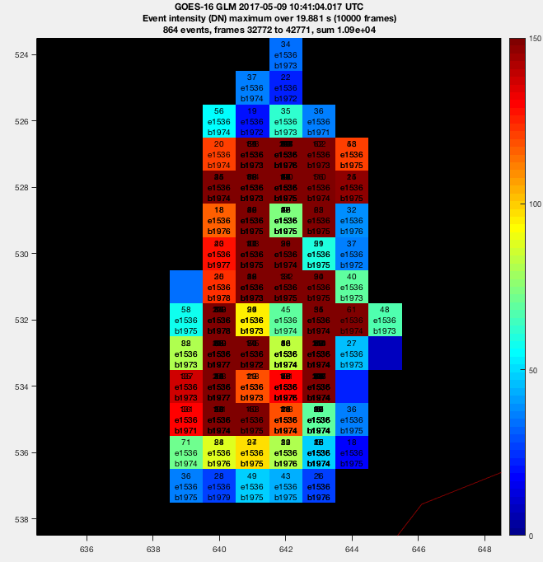
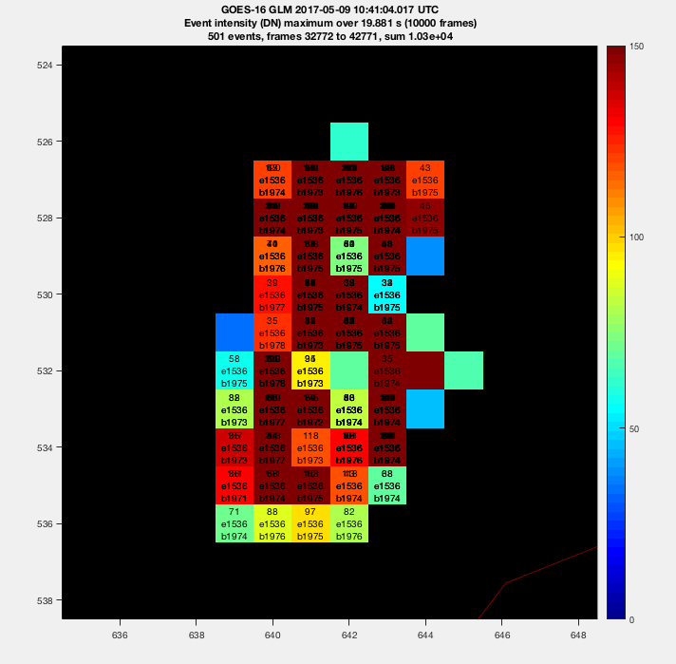
Same Data on Cellular Scale

Slide 25
Thank you
for Lightning?

Slide 27
LIS vs. GLM Radiometric Throughput
Parameter | GLM | LIS | Delta
Orbital altitude (km) | 36,000 | 400 | - 9.5
Lens aperture (cm) | 11 | 0.33 | + 5.7
CCD quantum efficiency | 0.92 | 0.6 | + 1.5
Optical throughput (%) | 80 | 60 | + 1.3
Frame integration time (ms) | 2 | 1.8 | - 1.1

