Slide 1
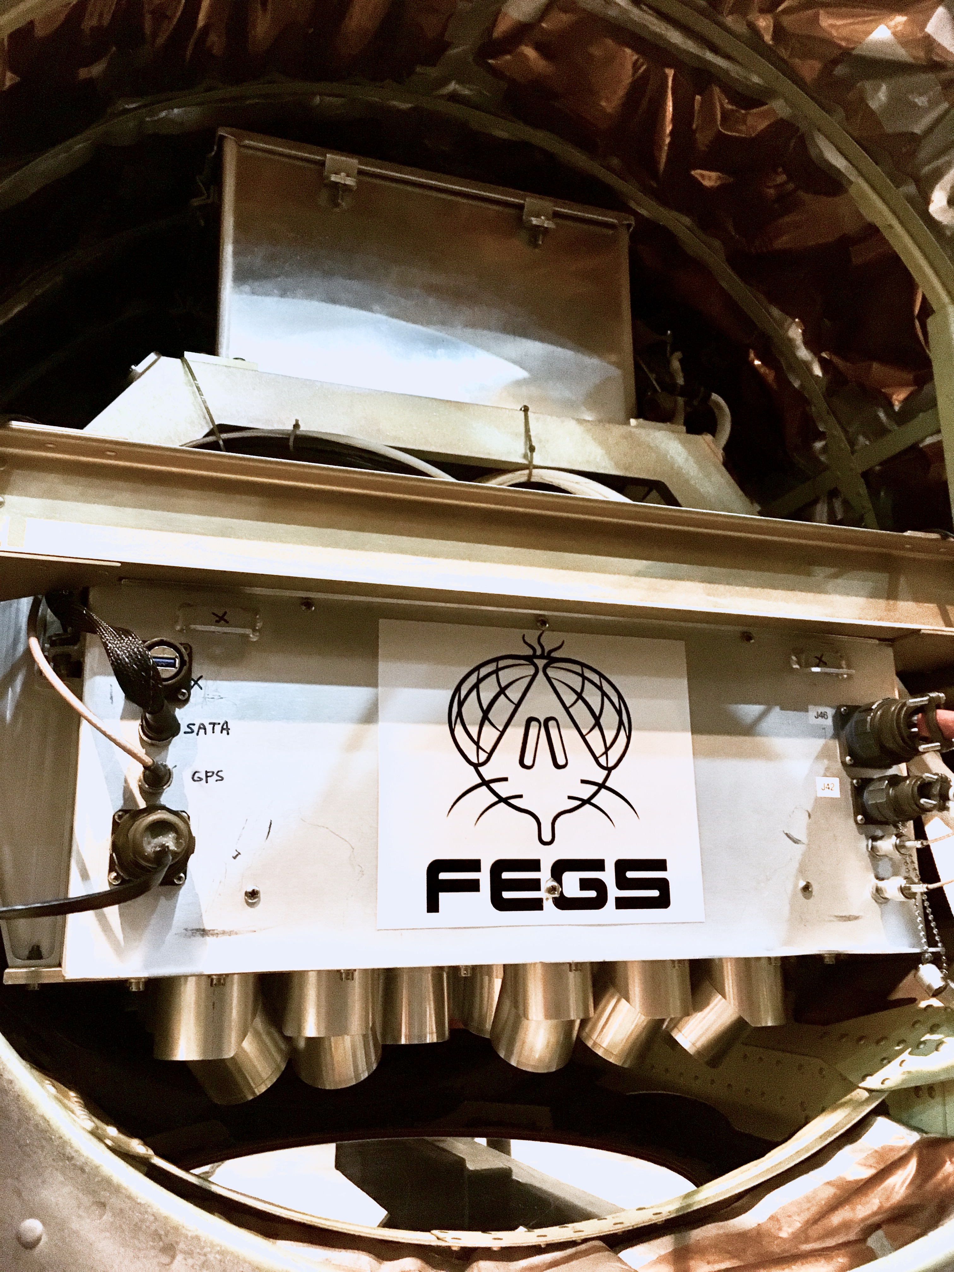
FEGS
Validation Analysis
Mason G. Quick
September 11, 2018
2018 GLM Science Meeting

Slide 2
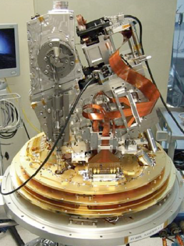
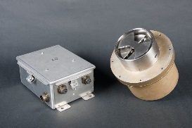
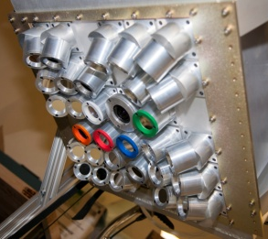
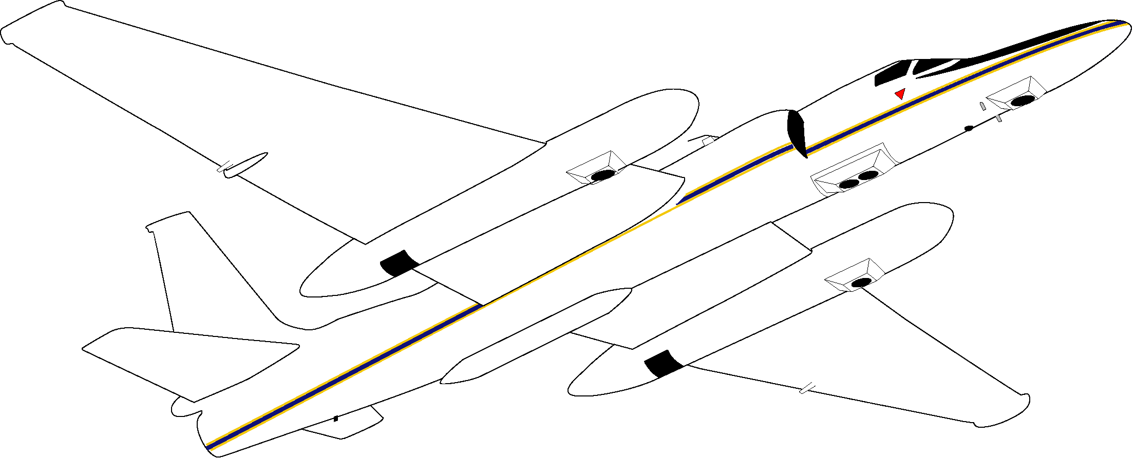
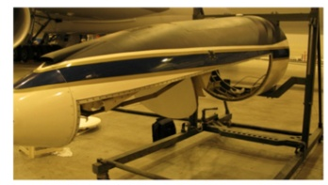
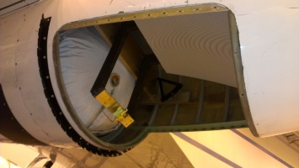
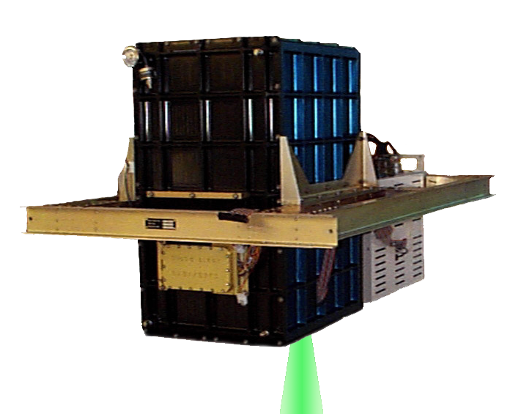
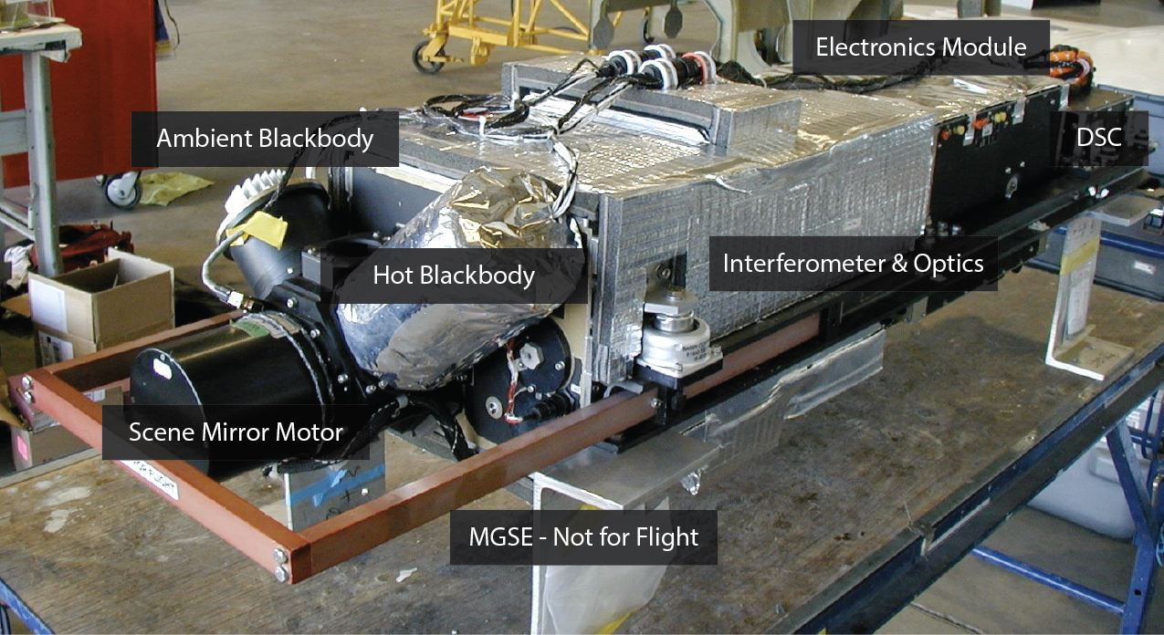
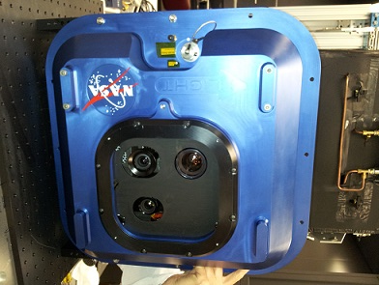
GOES-R Field Campaign ER-2 Based Instruments
AVIRIS-NG
LIP
FEGS
LIP
INMARSAT
EXRAD
CRS
S-HIS
GCAS
CPL
LIP

Slide 3
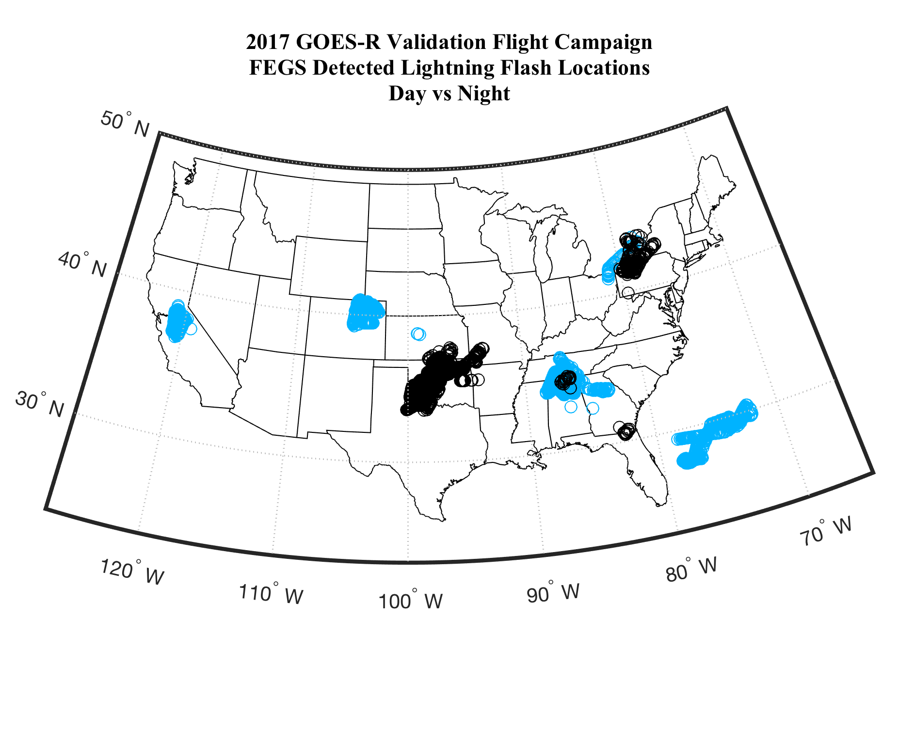
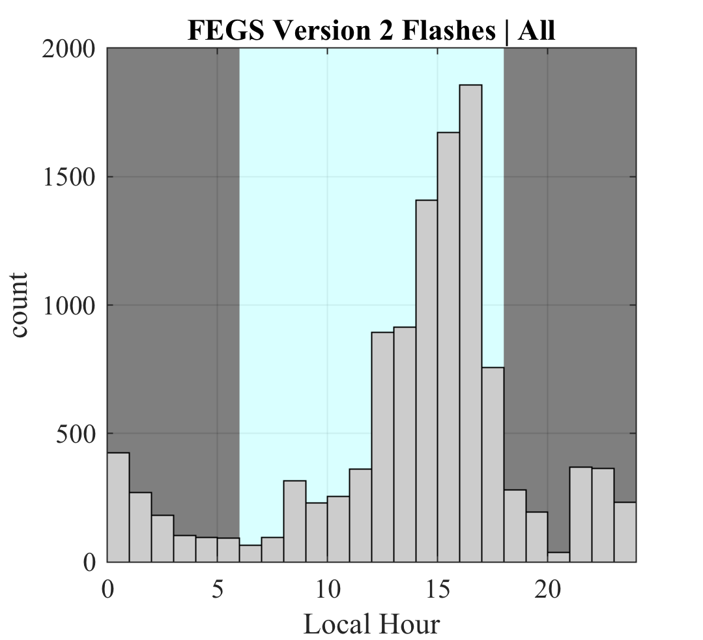
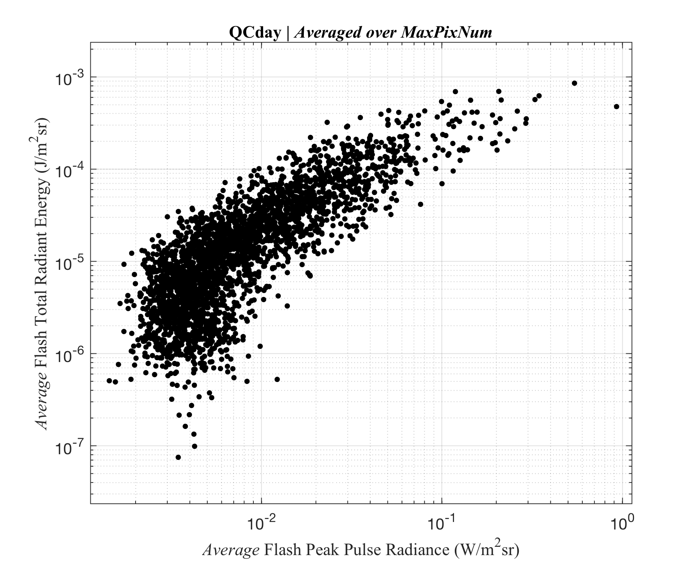
FEGS – GOES-R Validation Flight Campaign
From March to May of 2017, FEGS flew as a primary payload on the ER2 as part of the GOES-R Validation Flight Campaign. Of the 16 flights, 11 were GLM focused and targeted thunderstorms. A variety of thunderstorm phenomenology were observed including oceanic, continental, and coastal storms, convective initiation and supercell storms, during both day and night at locations across the continental United States and Atlantic Ocean. During the 45 flight hours observing thunderstorms, over 10,000 lightning flashes were observed; a factor of 10 increase over datasets collected in previous airborne lightning campaigns. These measurements were taken in conjunction with ground based observation networks such as LMAs, radar, and long range lightning detection networks.

Slide 4
U2 Flights (1980s)
1300 Pulses
79 flashes
Altus Cumulus Electrification Study (2002)
5256 pulses
587 flashes

Slide 5
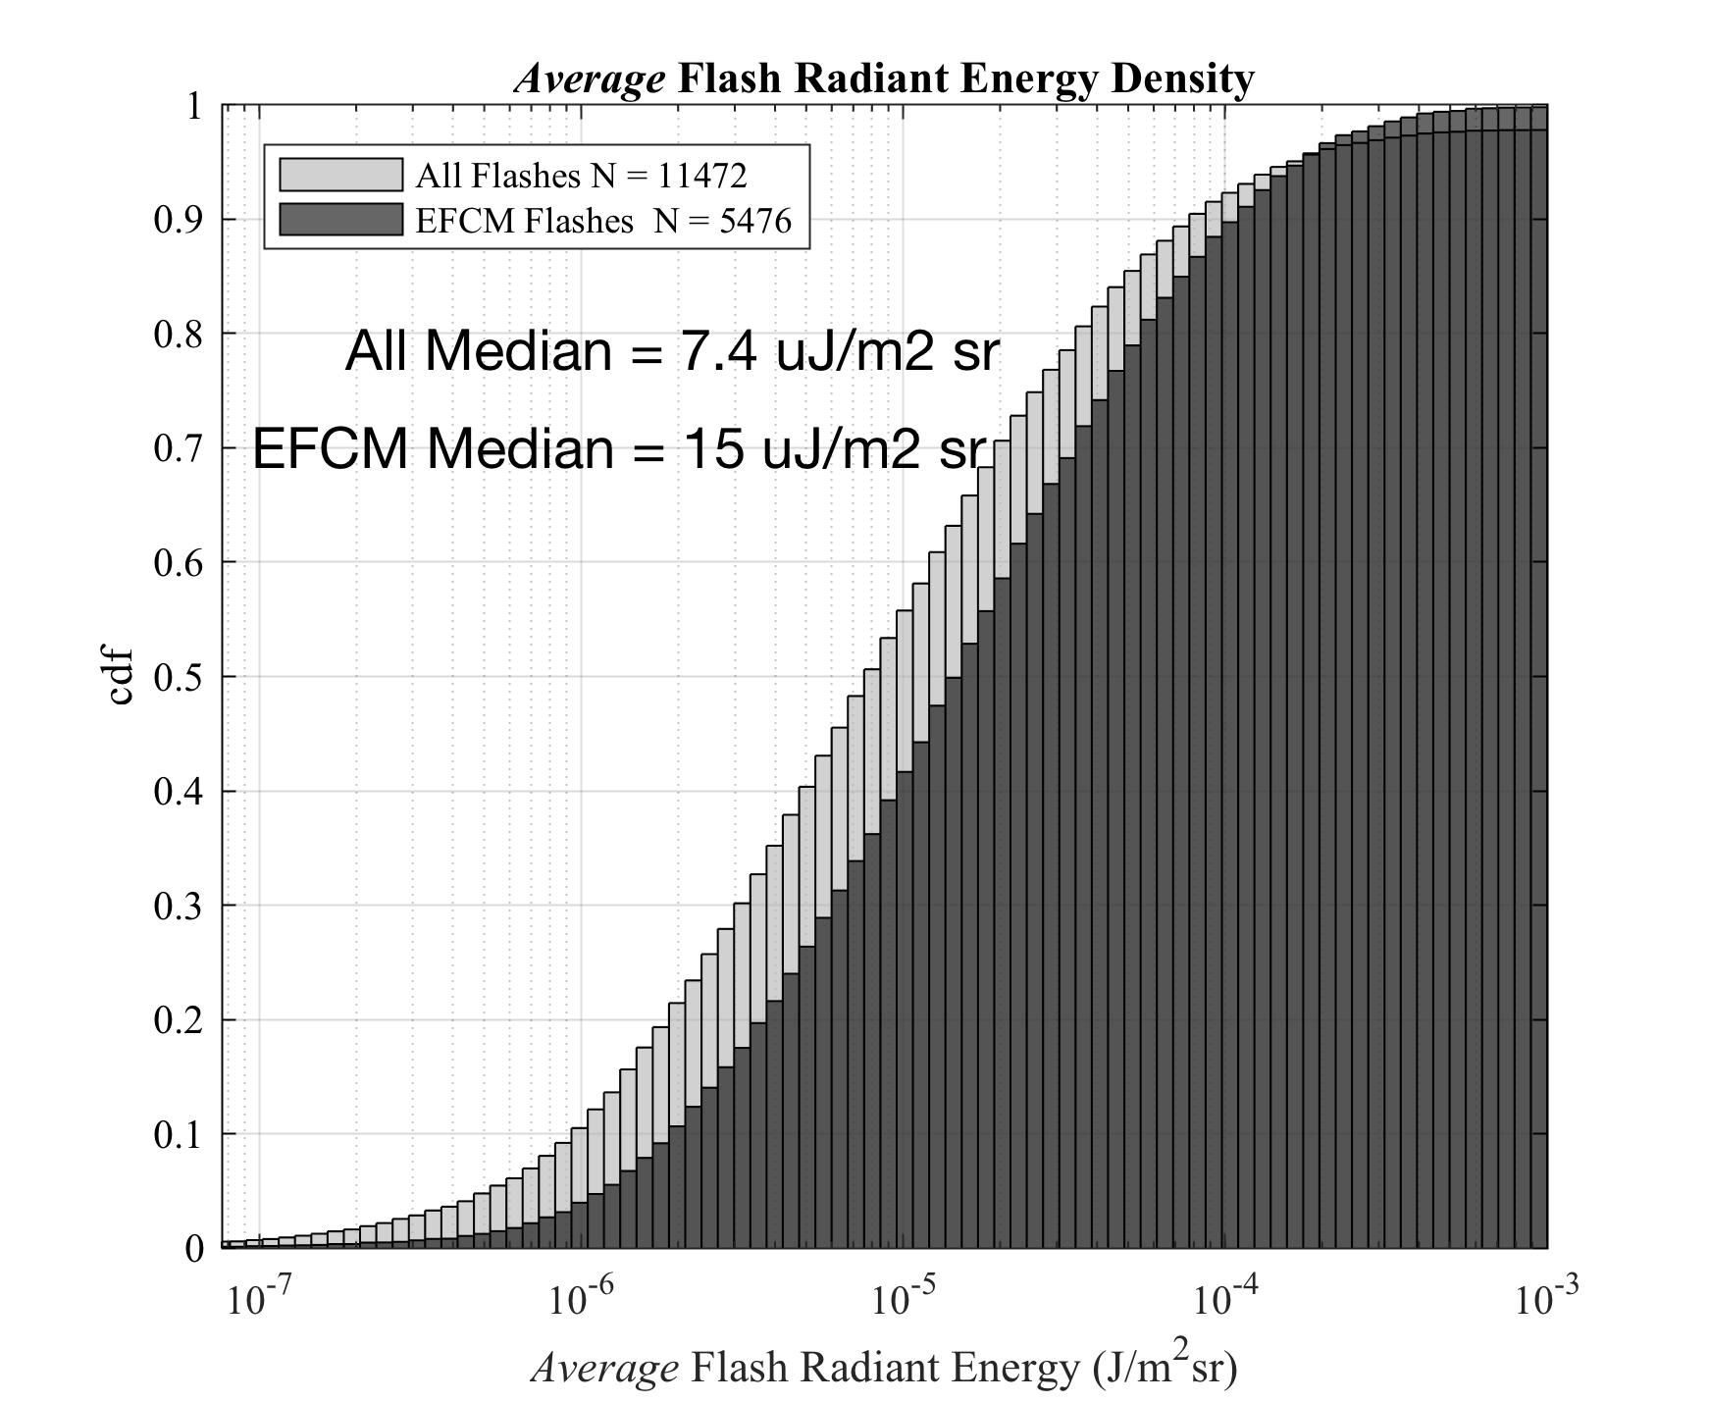
FEGS – GLM DE - flashes
All FEGS Detected Flashes (11472)
Date | DE % | Flash Count
03/21 | 51 | 2289
04/16 | 87 | 390
04/18 | 41 | 348
04/20 | 81 | 394
04/22 | 73 | 2654
04/27 | 54 | 39
04/29 | 94 | 1064
05/08 | 54 | 2454
05/14 | 38 | 1234
05/17 | 73 | 606
Date | DE % | Flash Count | % pass
03/21 | 71 | 567 | 25
04/16 | 93 | 88 | 23
04/18 | 75 | 88 | 25
04/20 | 93 | 248 | 63
04/22 | 79 | 1961 | 74
04/27 | 88 | 24 | 62
04/29 | 94 | 1049 | 99
05/08 | 58 | 470 | 19
05/14 | 82 | 386 | 31
05/17 | 74 | 595 | 98
FEGS Flashes with EFCM Trigger
(5476)
% FEGS flashes detected by GLM
All Flashes: 62%
Day Flashes: 53%
Night Flashes: 85%
% FEGS flashes detected by GLM
All Flashes: 80%
Day Flashes: 78%
Night Flashes: 88%

Slide 6
FEGS – Version 2 Quality Control Filters
Flat wings
EFCM trigger
Non-zero baseline (daytime)
29% of flashes pass all 3 filters (3377 flashes)
40% of pulses pass all 3 filters

Slide 7
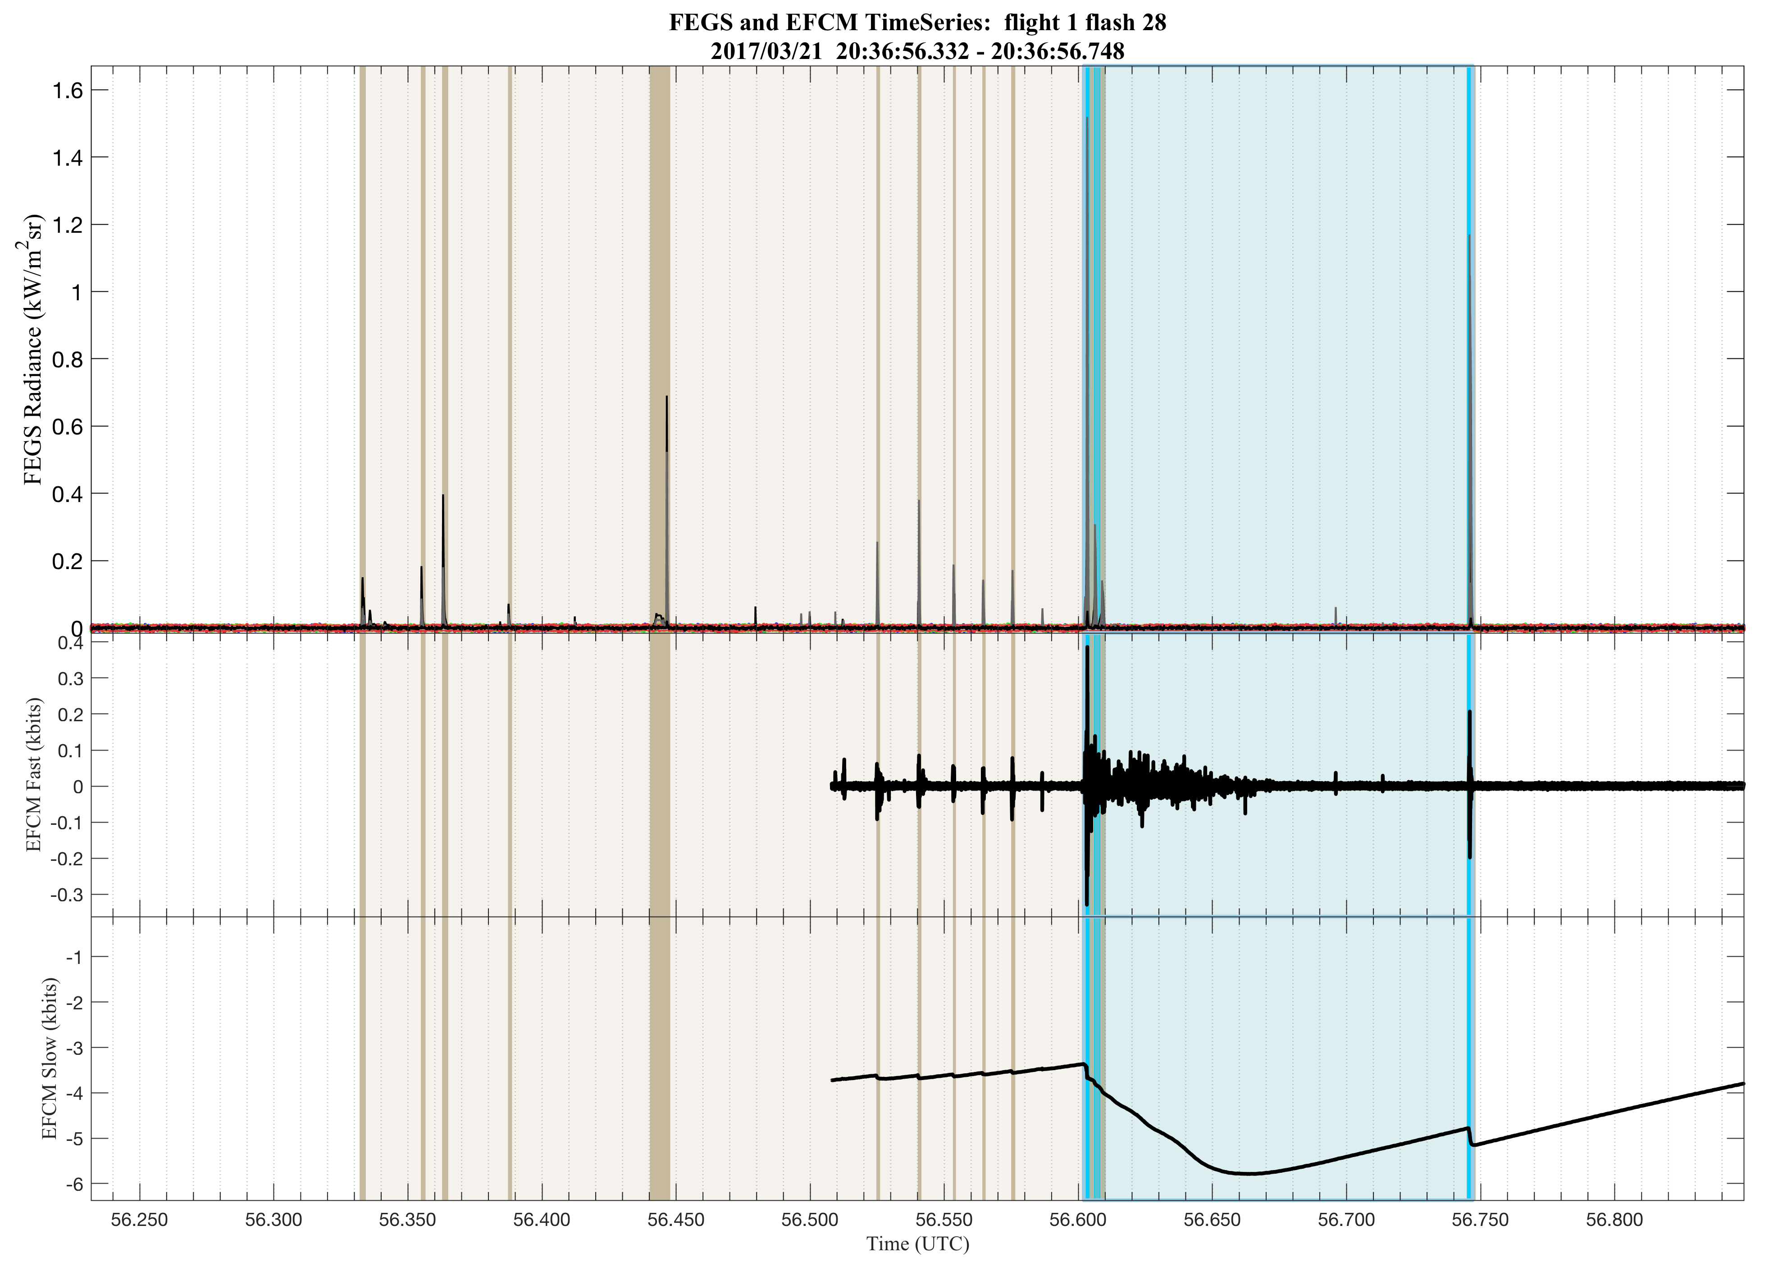
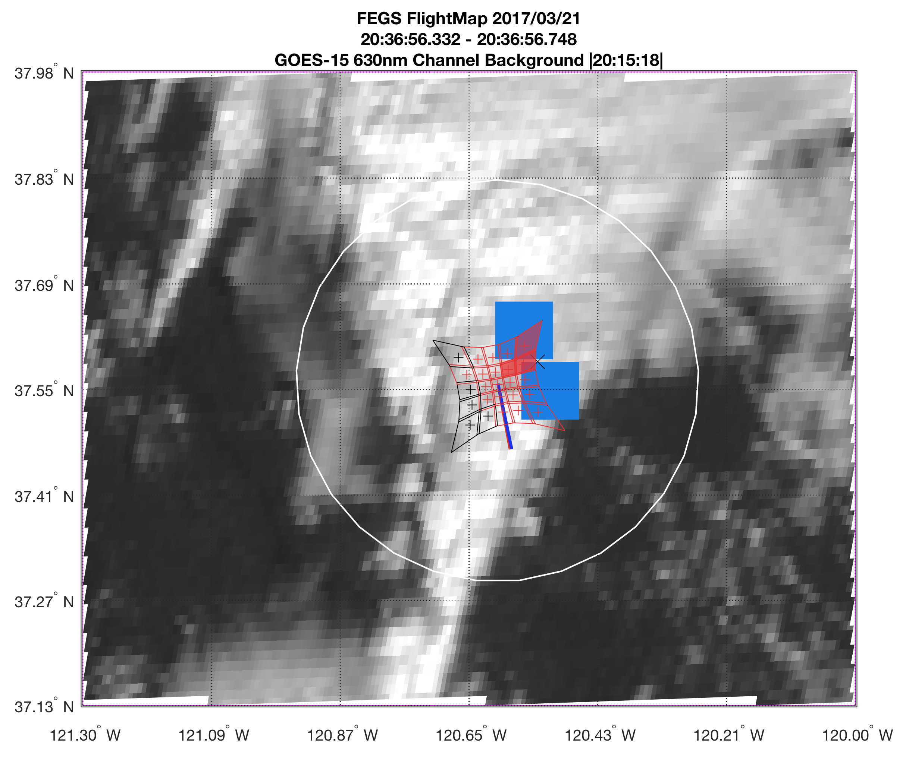
Sub-Flash Features

Slide 8
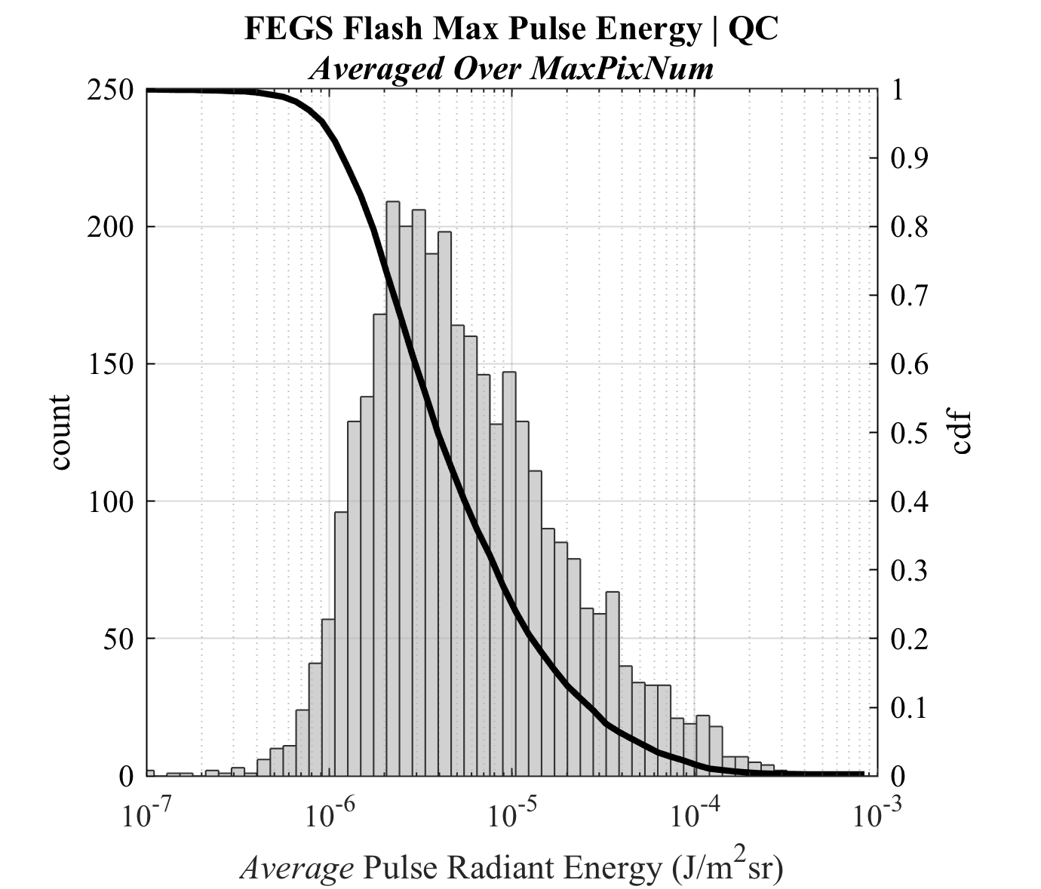
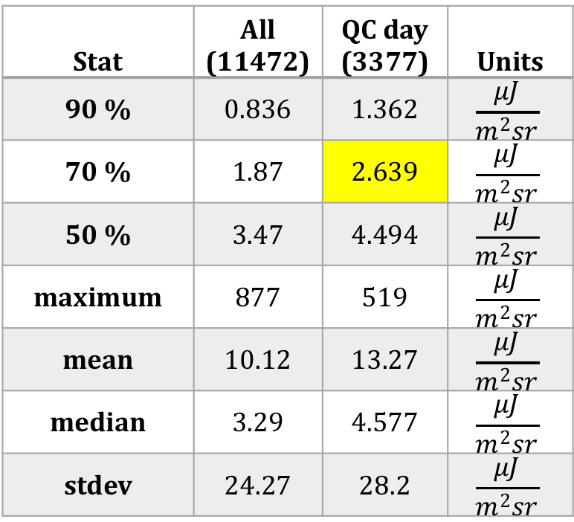
FEGS – GLM DE - pulses
Stat | All (11472) | QC day (3377) | Units
90 % | 0.836 | 1.362 | $$\frac{μJ}{m^{2}sr}$$
70 % | 1.87 | 2.639 | $$\frac{μJ}{m^{2}sr}$$
50 % | 3.47 | 4.494 | $$\frac{μJ}{m^{2}sr}$$
maximum | 877 | 519 | $$\frac{μJ}{m^{2}sr}$$
mean | 10.12 | 13.27 | $$\frac{μJ}{m^{2}sr}$$
median | 3.29 | 4.577 | $$\frac{μJ}{m^{2}sr}$$
stdev | 24.27 | 28.2 | $$\frac{μJ}{m^{2}sr}$$

Slide 9
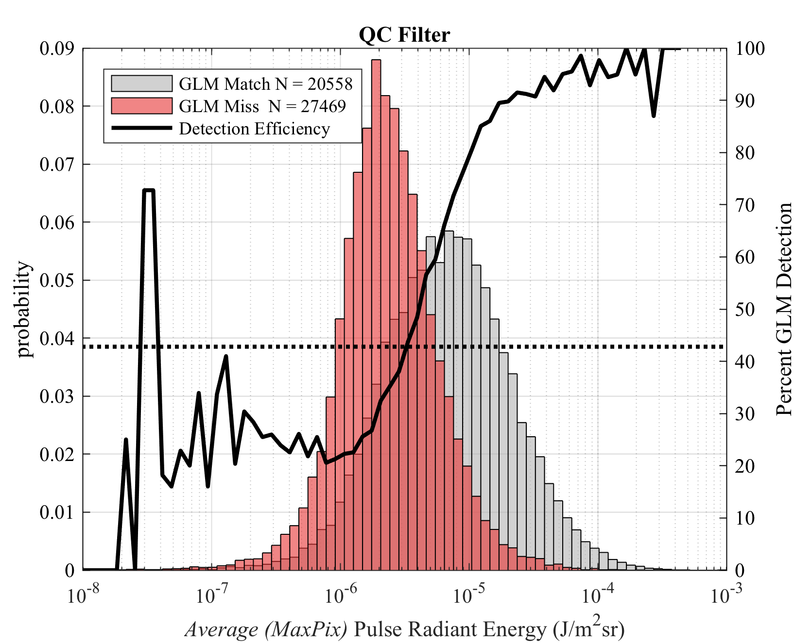
FEGS – GLM DE - pulses
50% DE = 3.94 uJ/m²sr
overall pulse DE of GLM is 43%
Distribution Overlap Caused by…
Dynamic GLM threshold
Radiometric alignment (pixel alignment)
Spatial resolution

Slide 10
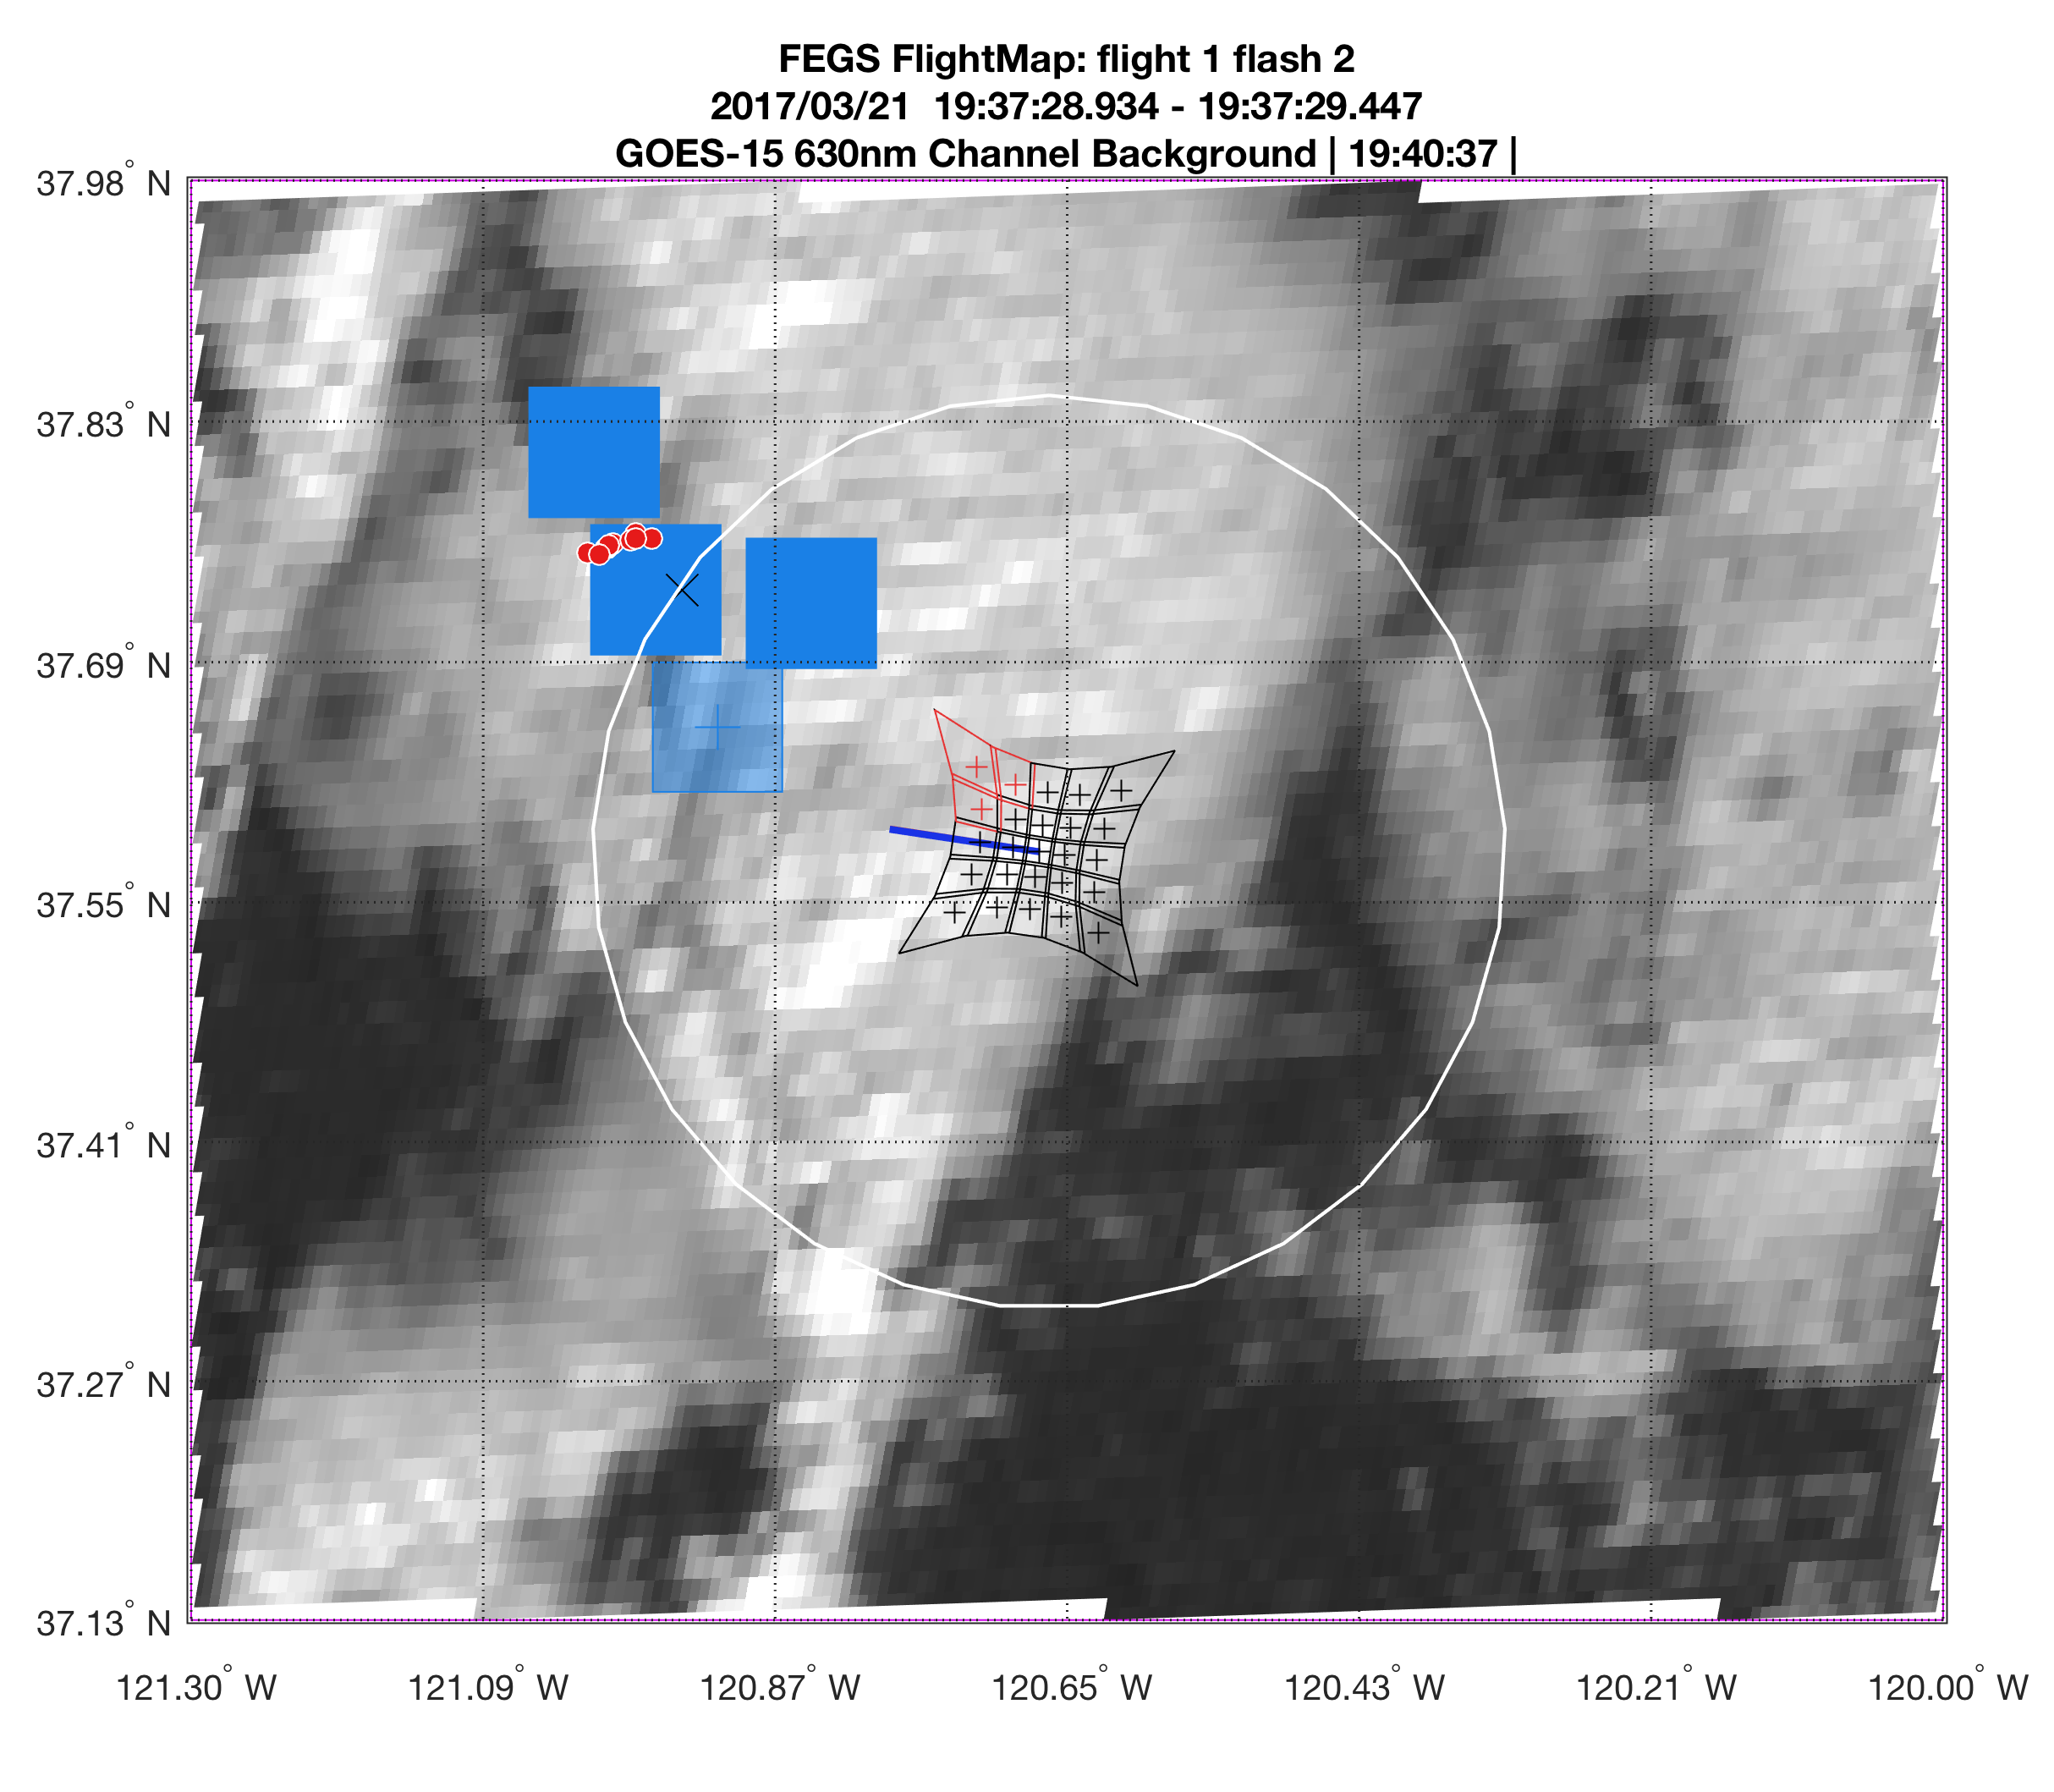
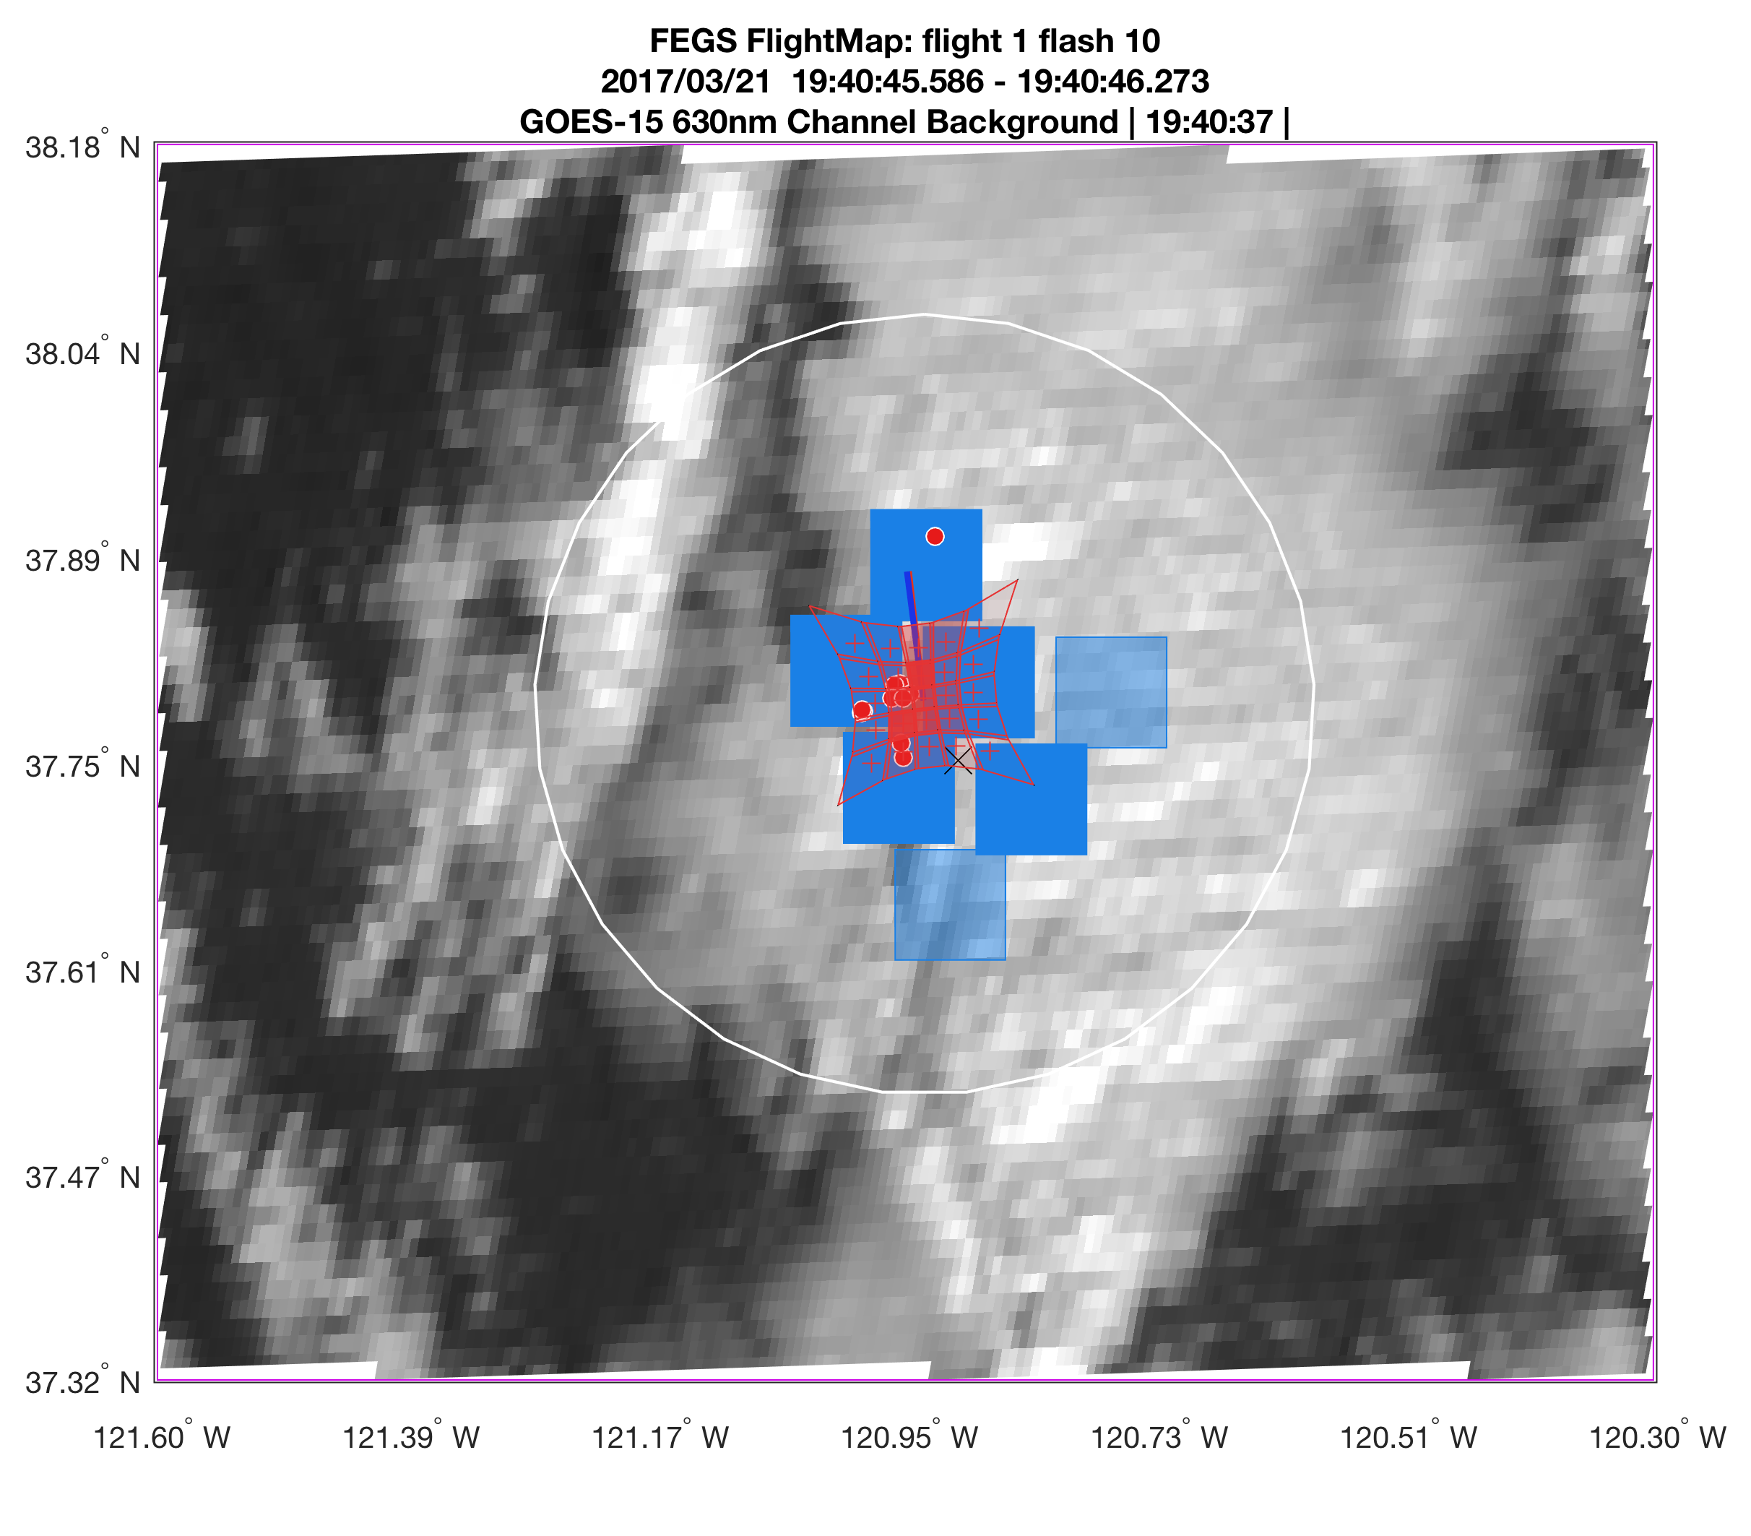
FEGS – pixel alignment

Slide 11
FEGS – GLM Validation
Ongoing Work
Better compare radiometry between FEGS well aligned GLM pixels
Fine tune Quality Control Filters
Intercompare additional datasets (and modeling) to understand
  channel geometry
  optical path
  thunderstorm phenomenology
Categorize DE by discharge process

Slide 12
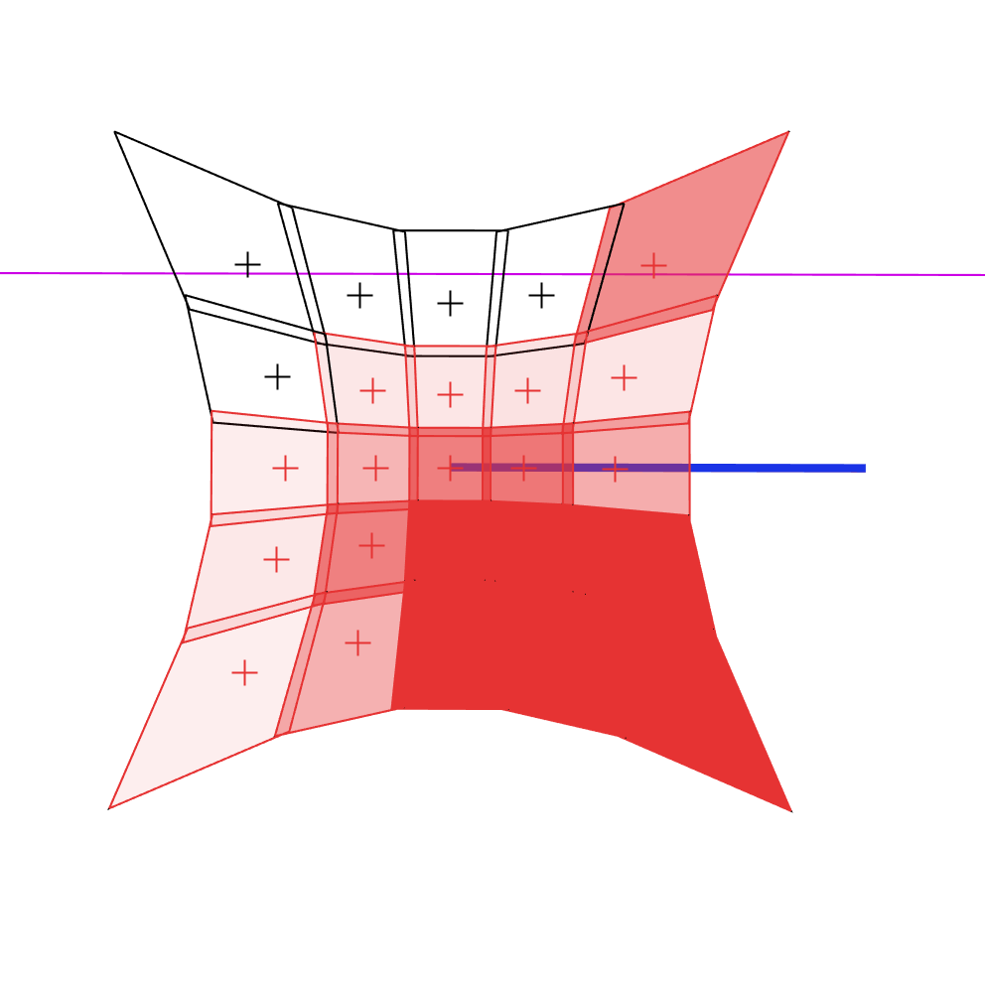
Projected FEGS image with relative radiance shading.

Slide 13
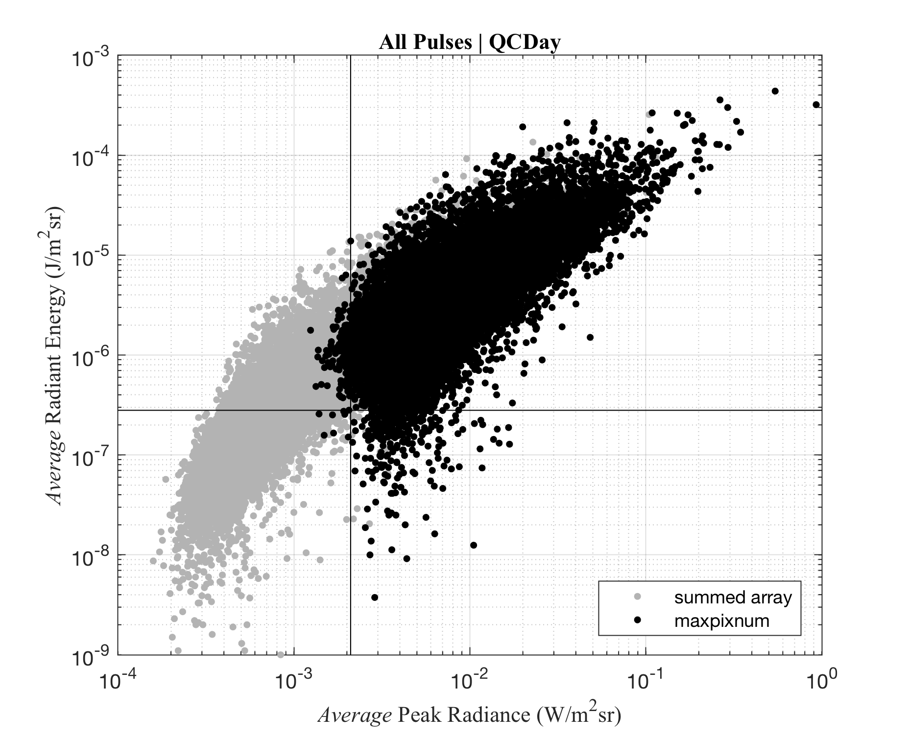
FEGS – Pulse Power and Energy Distributions

Slide 14
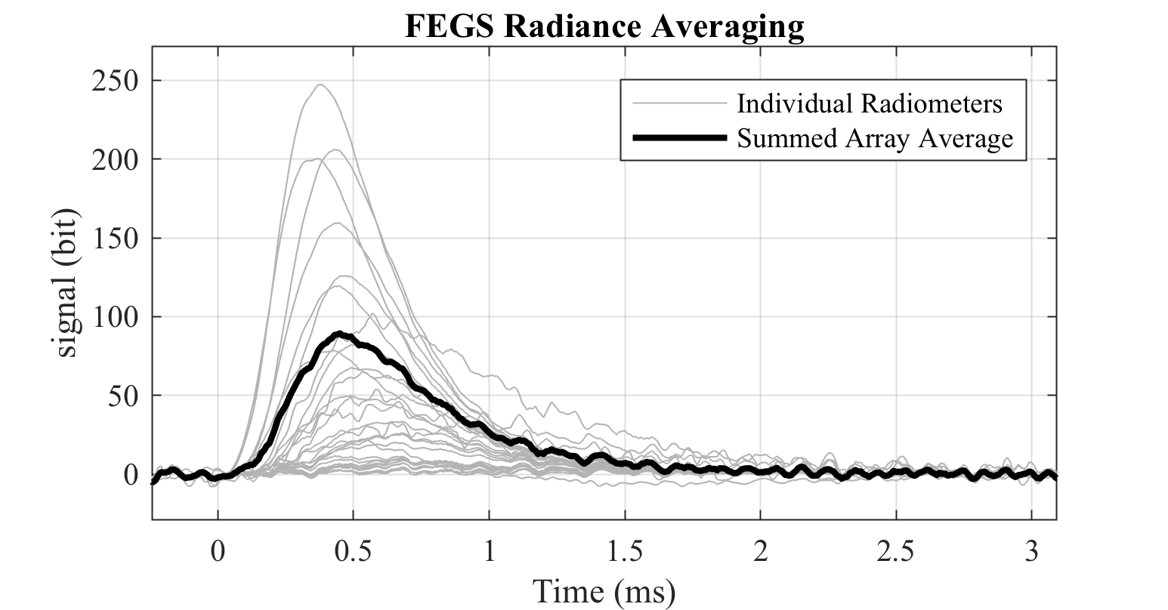
FEGS – Radiance Spatial Averaging

Slide 15
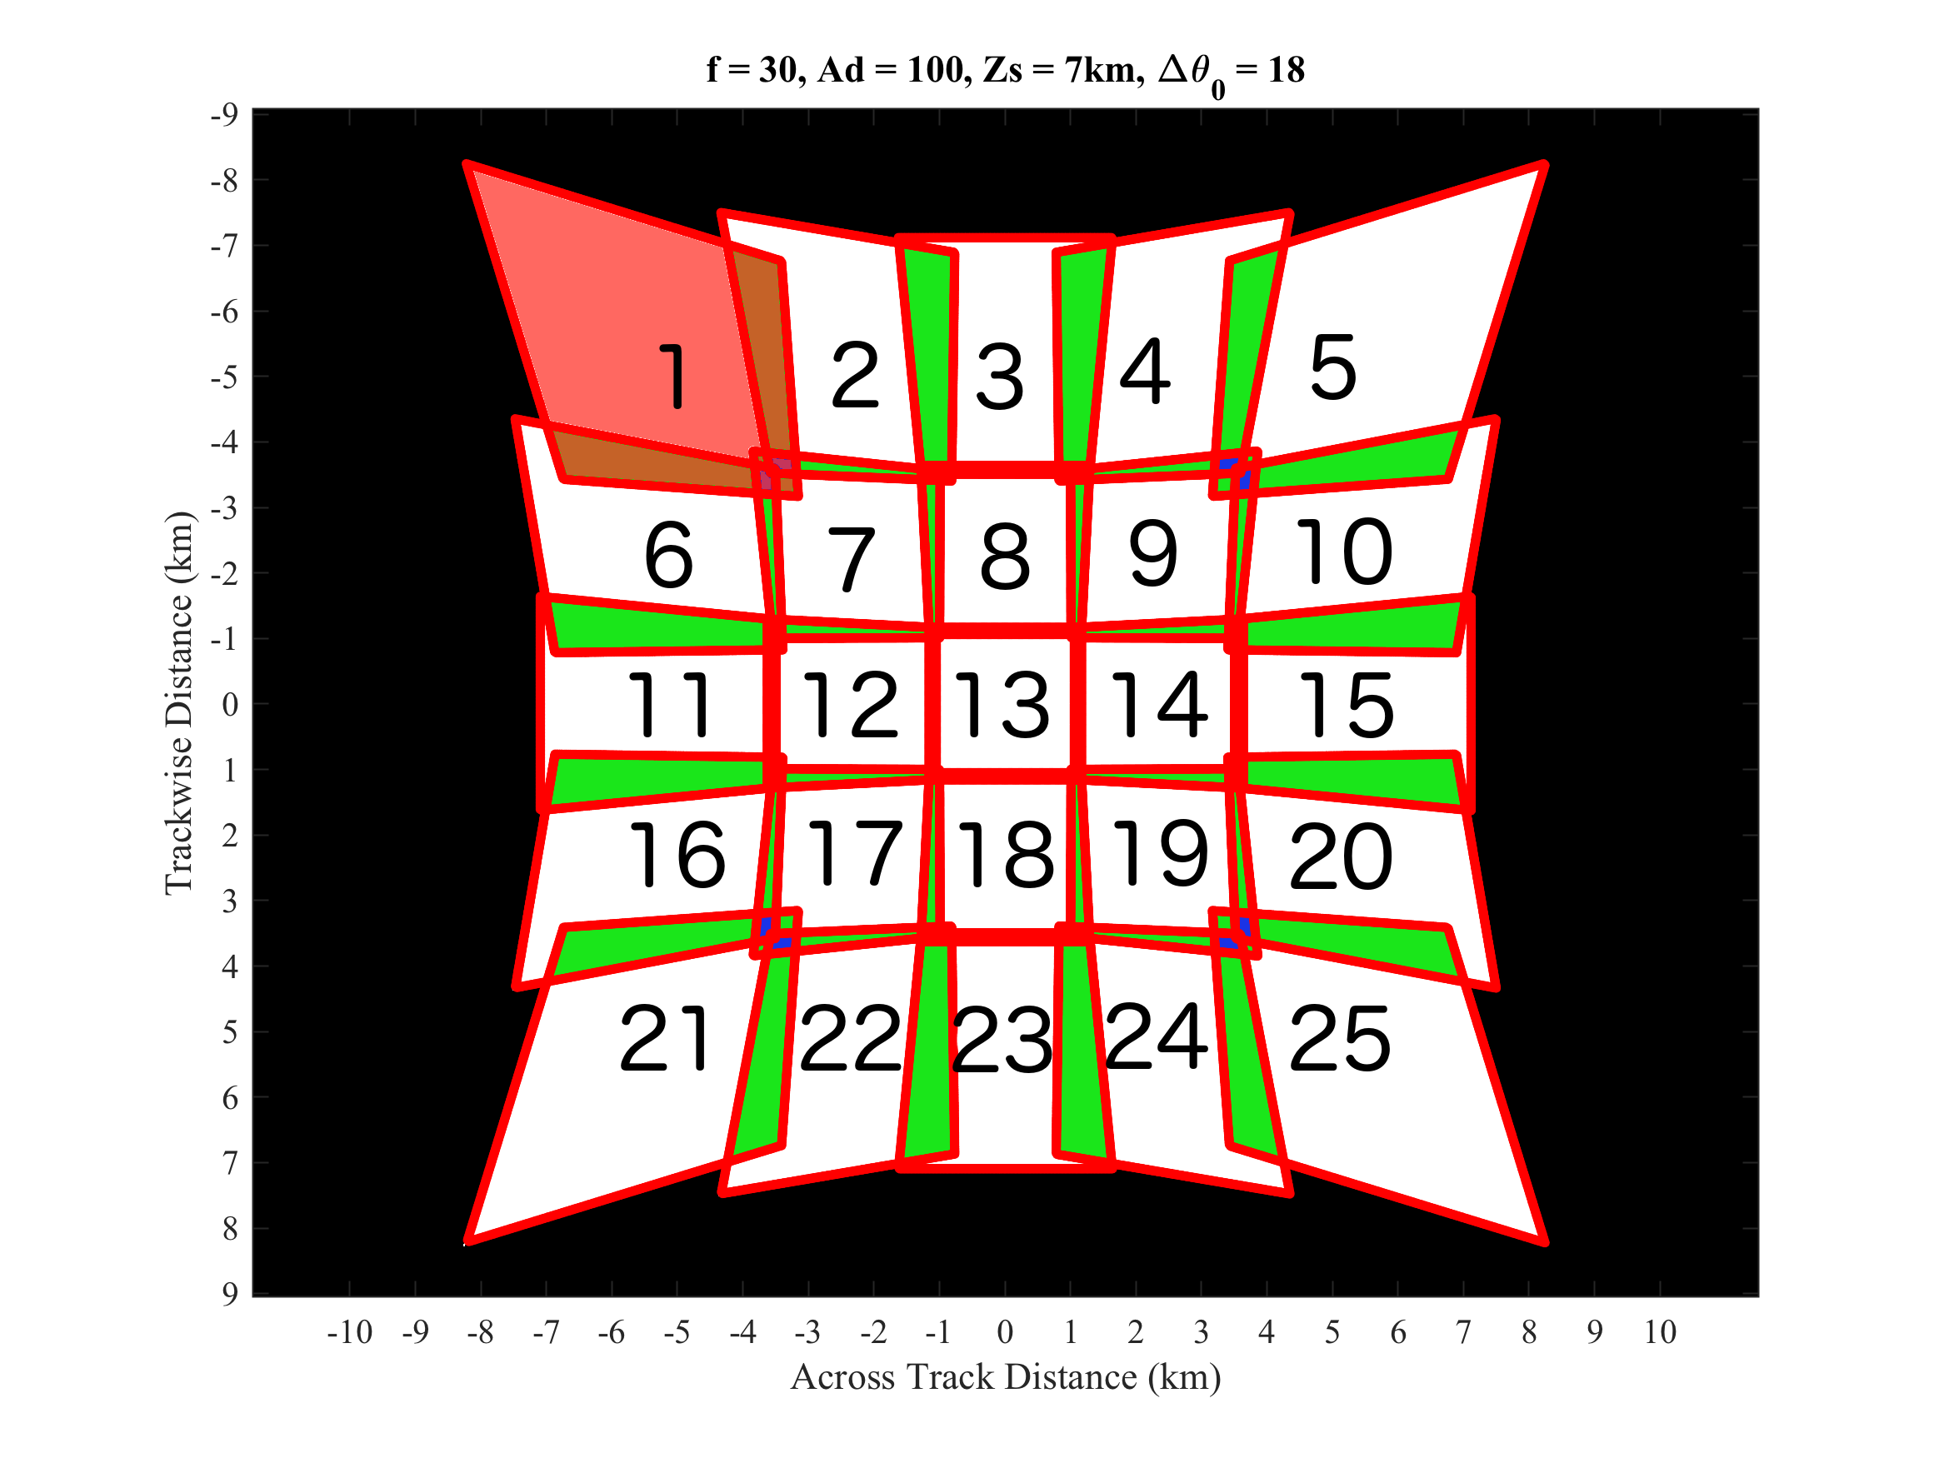
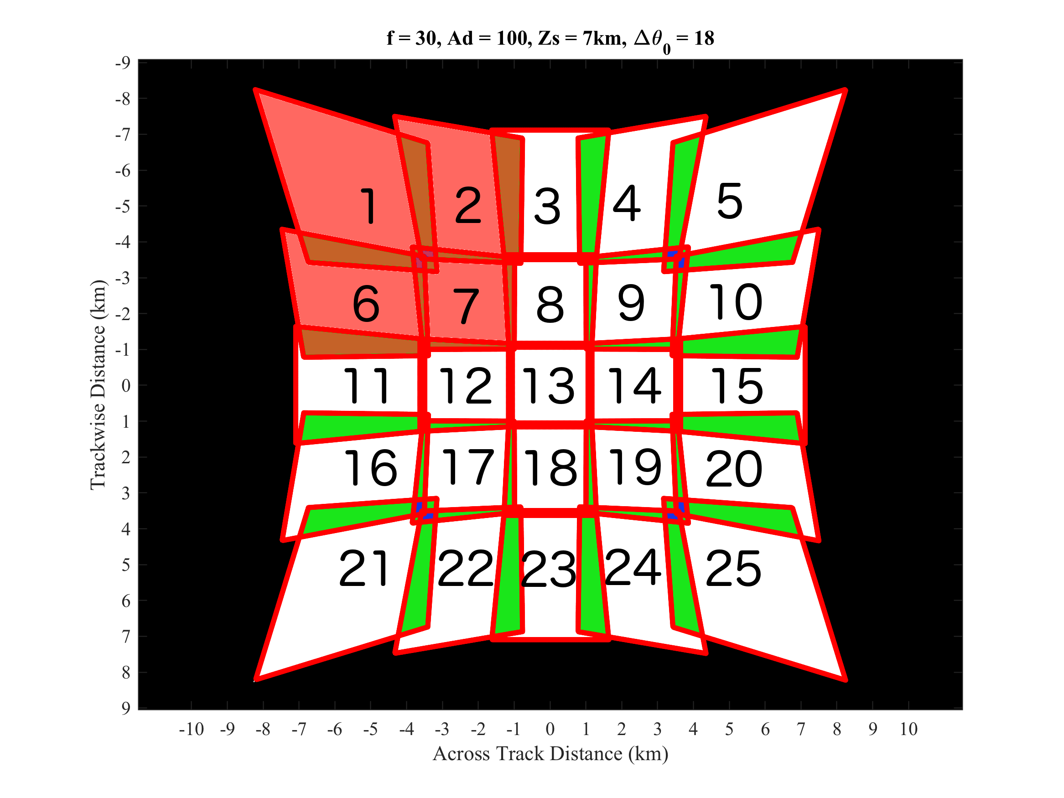
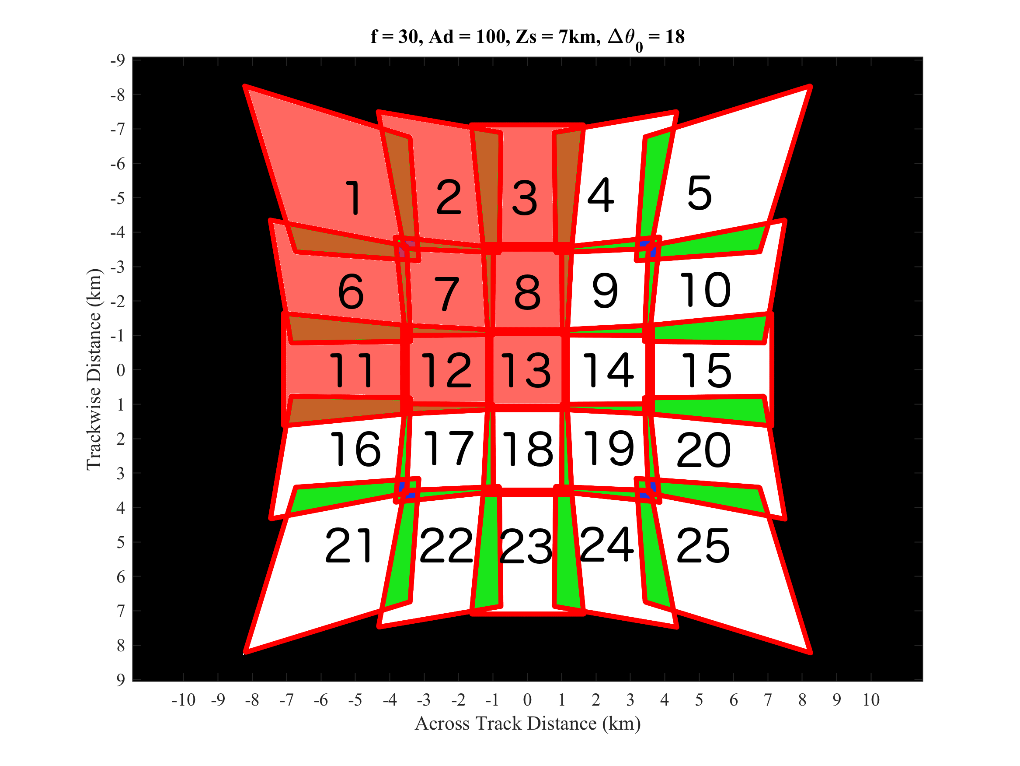
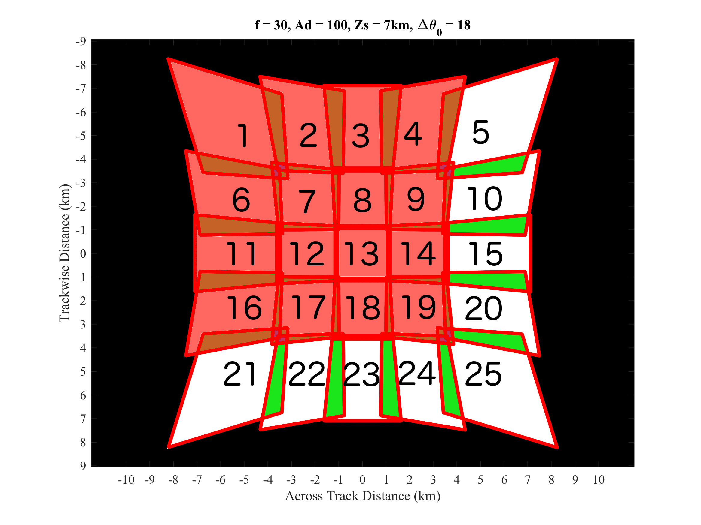
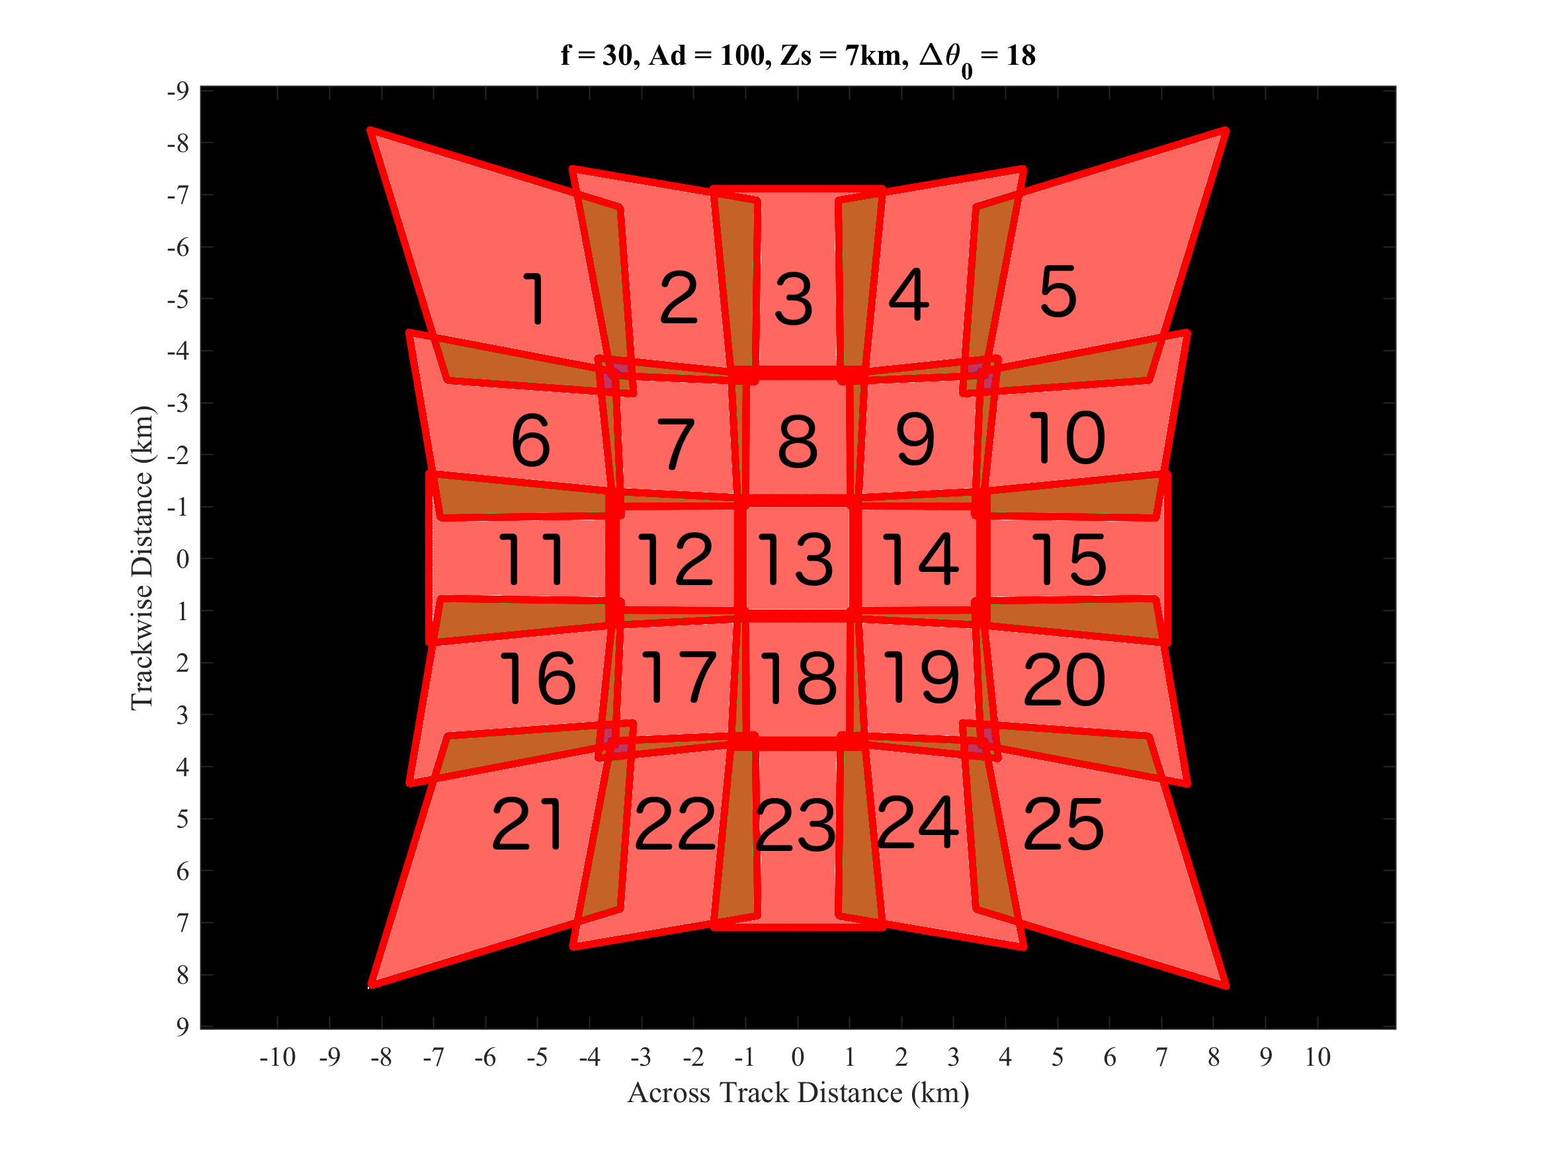
FEGS – Radiance Spatial Averaging

Slide 16
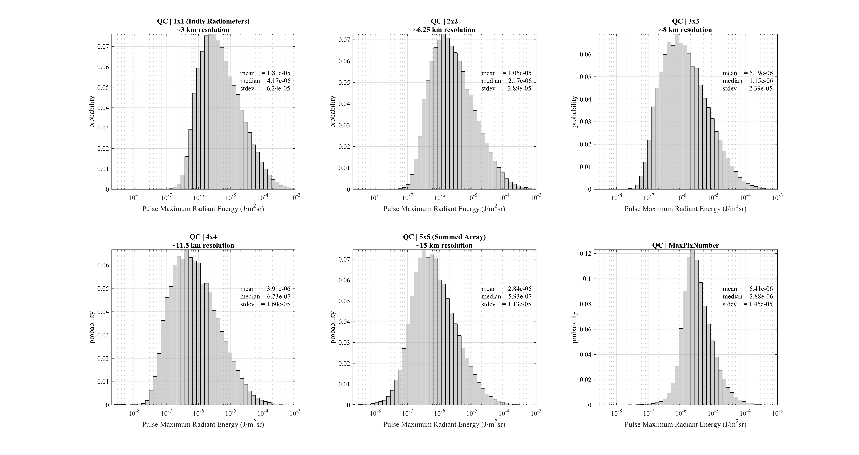
grid | resolution (km) | mean (uJ/m²sr) | median (uJ/m²sr) | stdev (uJ/m²sr) | Percent of 1x1 median
1x1 | 3 | 18.1 | 4.17 | 62.4 | 100
2x2 | 6.25 | 10.5 | 2.17 | 38.9 | 52
3x3 | 8 | 6.19 | 1.15 | 23.9 | 28
4x4 | 11.5 | 3.91 | 0.67 | 16.0 | 16
5x5 | 15 | 2.84 | 0.59 | 11.3 | 14
MaxPixNum | - | 6.41 | 2.88 | 14.5 | 69

Slide 17
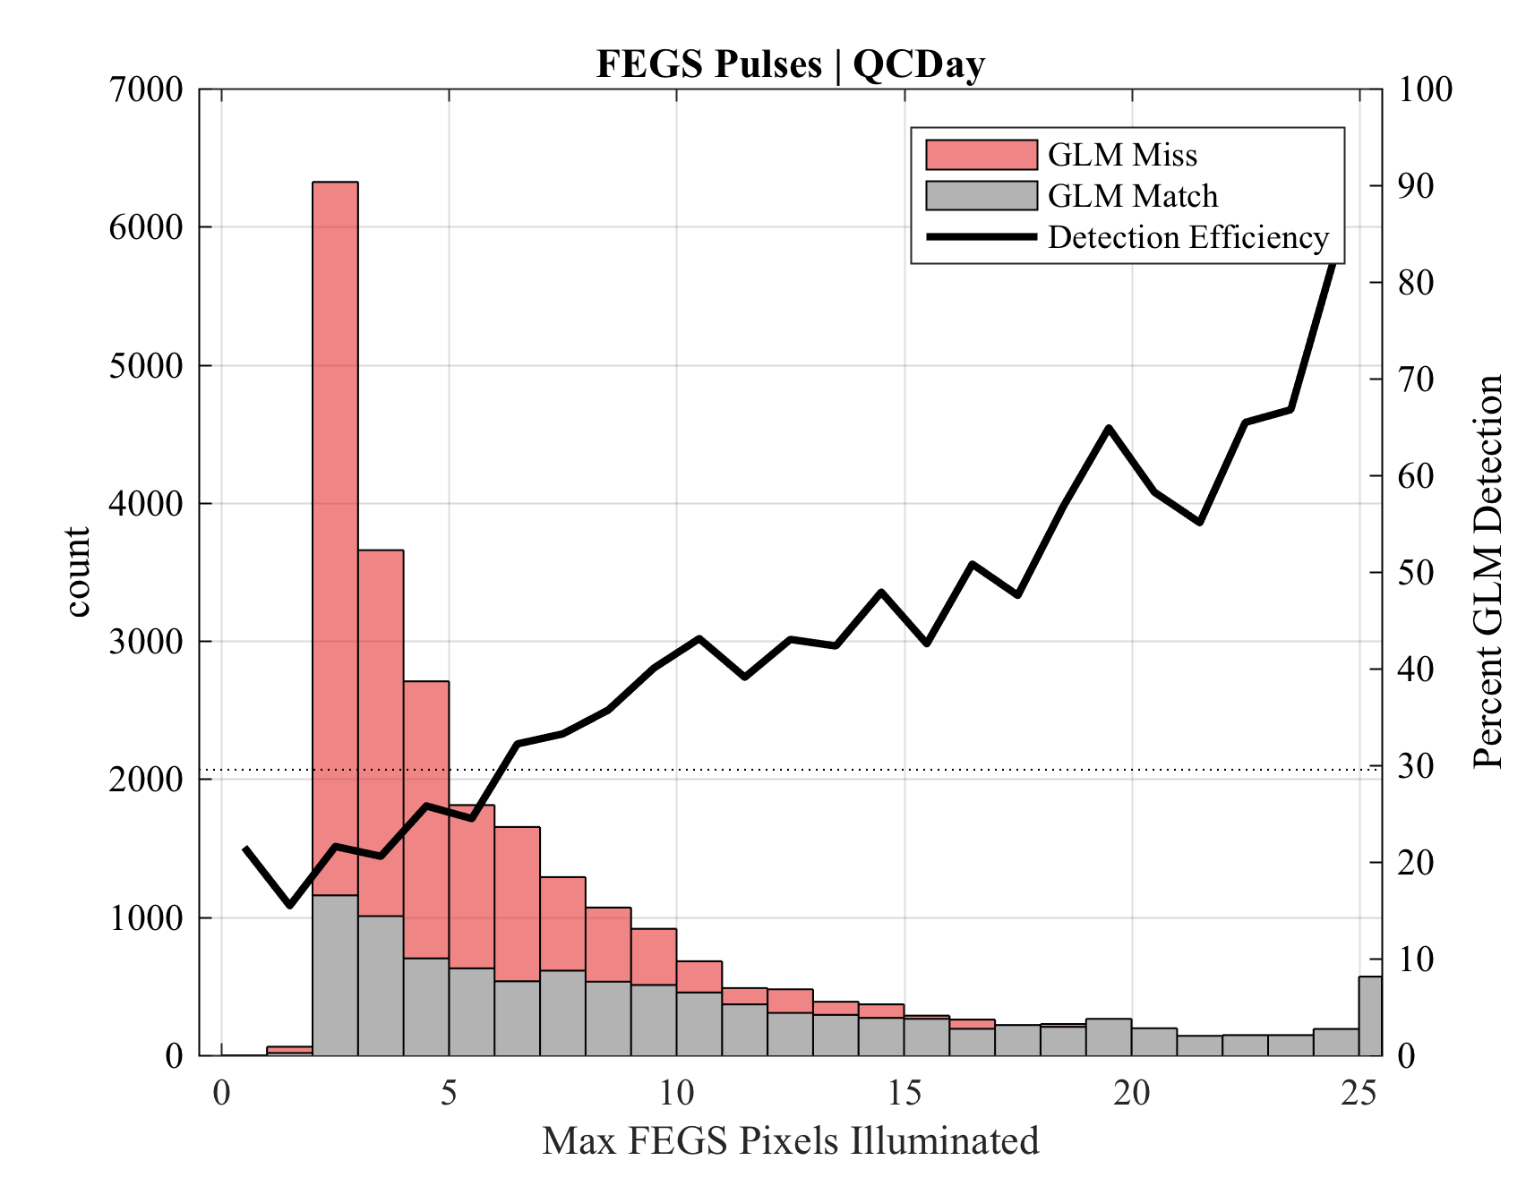
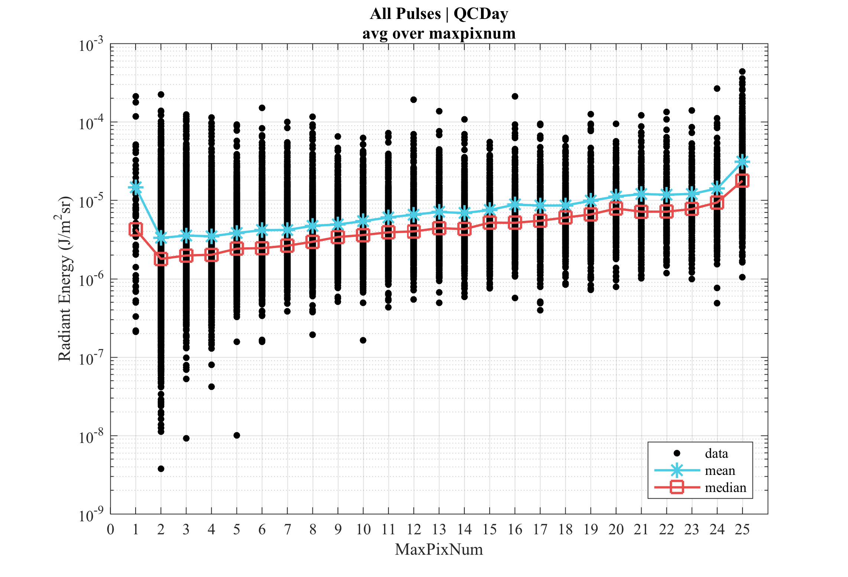
FEGS – Radiance Spatial Averaging

Slide 18
QUESTIONS

Slide 19
FEGS - Version 2 dataset analysis
Performed on individual radiometer channels
HF noise reduction
Background signal estimate
Pulse detection and measurement
Flash clustering
Quality Control

Slide 20
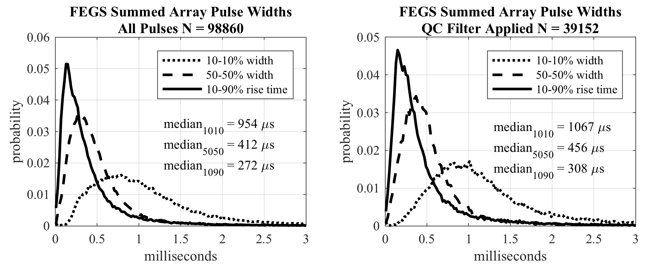
FEGS – Pulse Temporal Characteristics

Slide 21
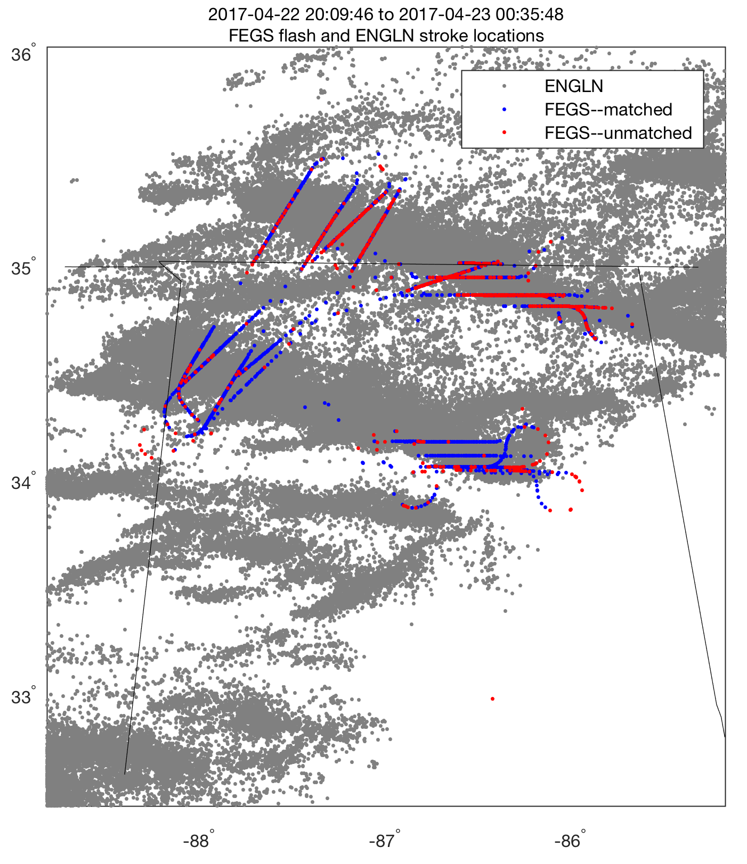
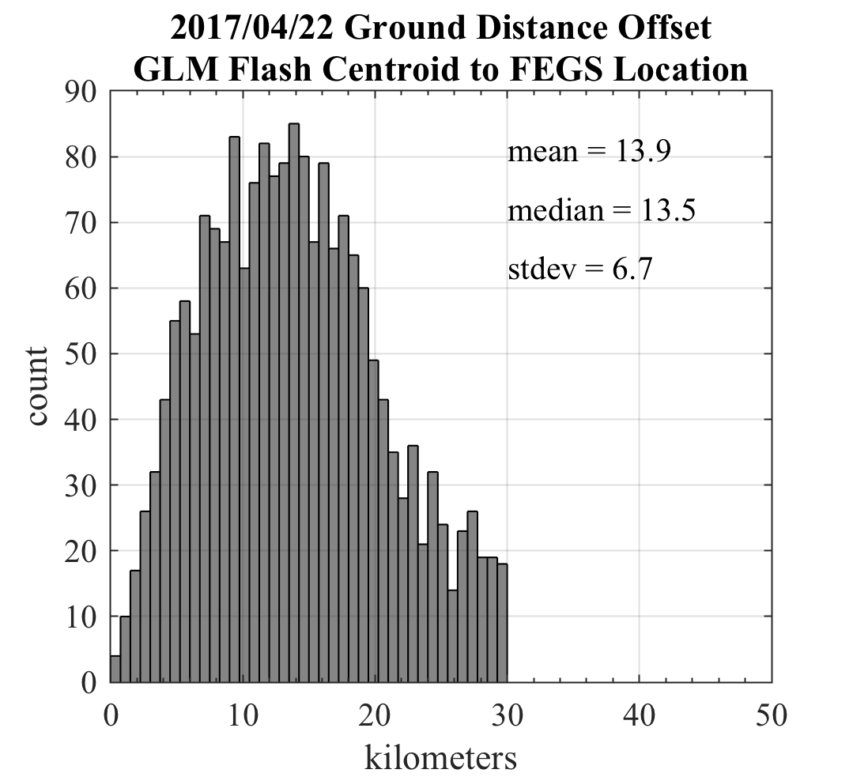
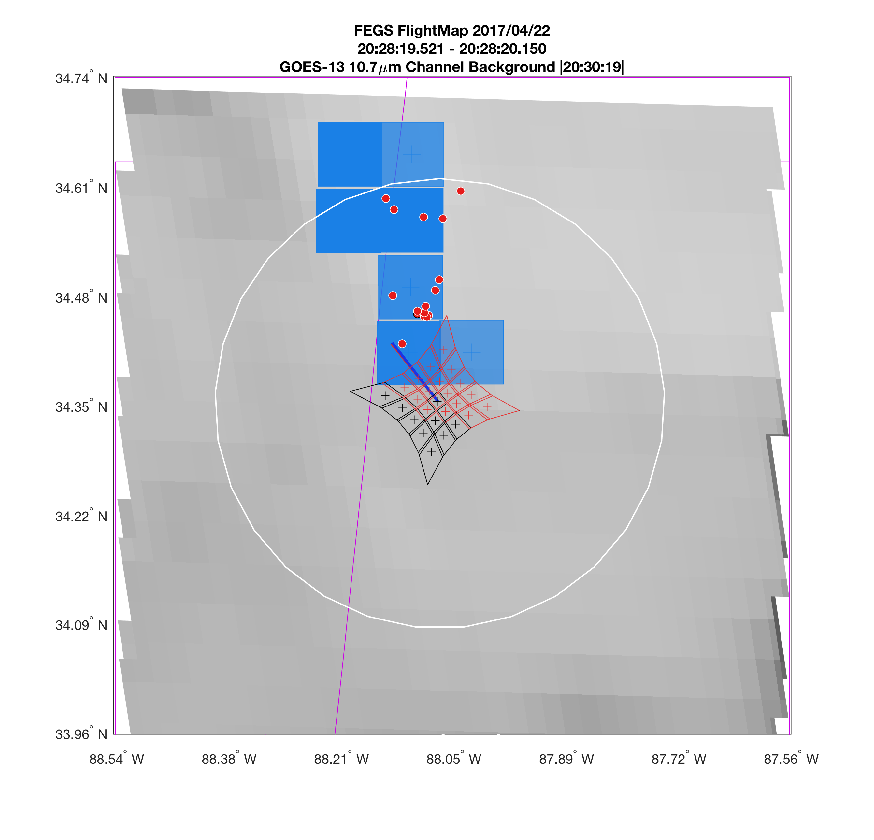
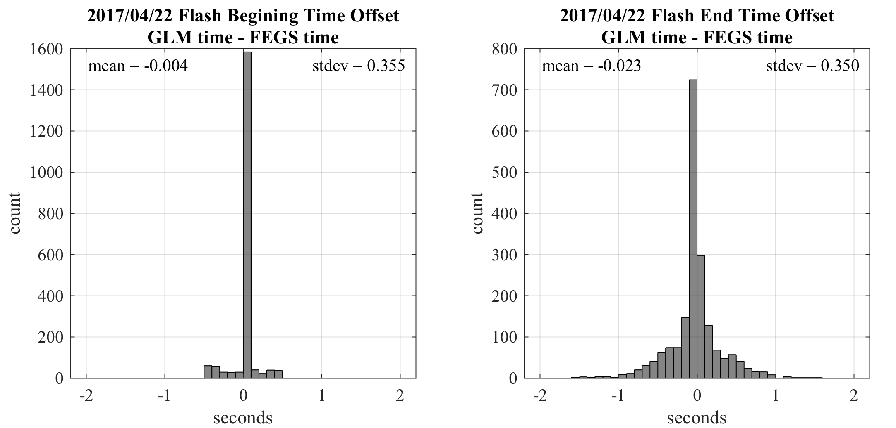
FEGS – GLM DE - flashes
analysis by: Katrina Virts

Slide 22
FEGS – DC gain
(settings during GOES-R campaign)
Negative offset causes dark scenes to drop below the lowest quantization level of the ADC converter

Slide 23
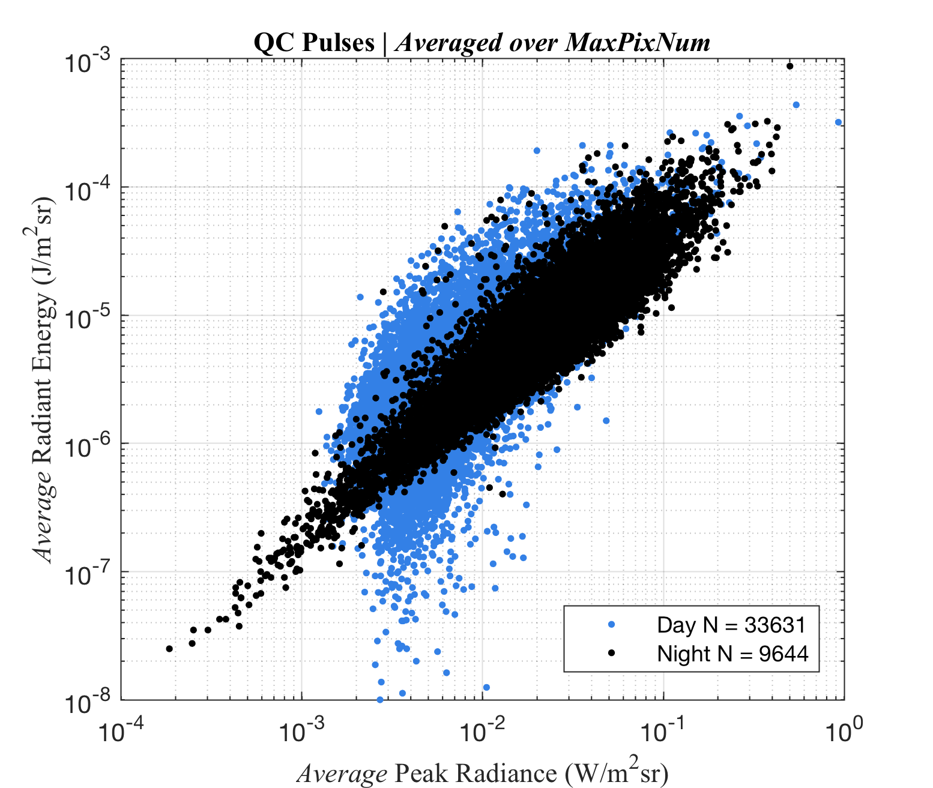
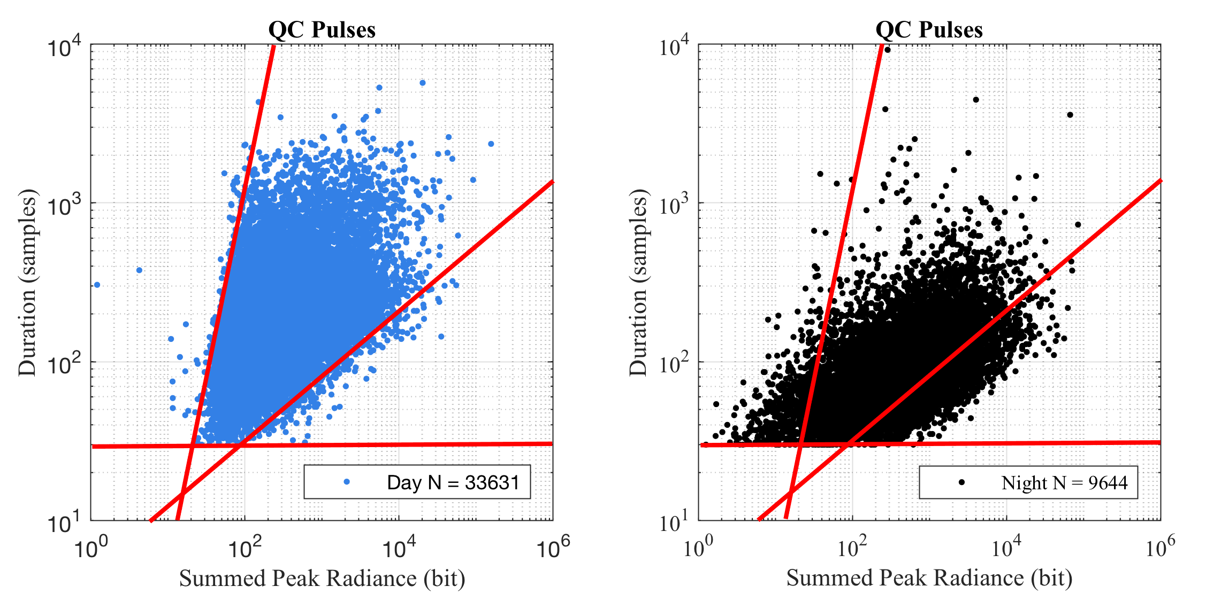
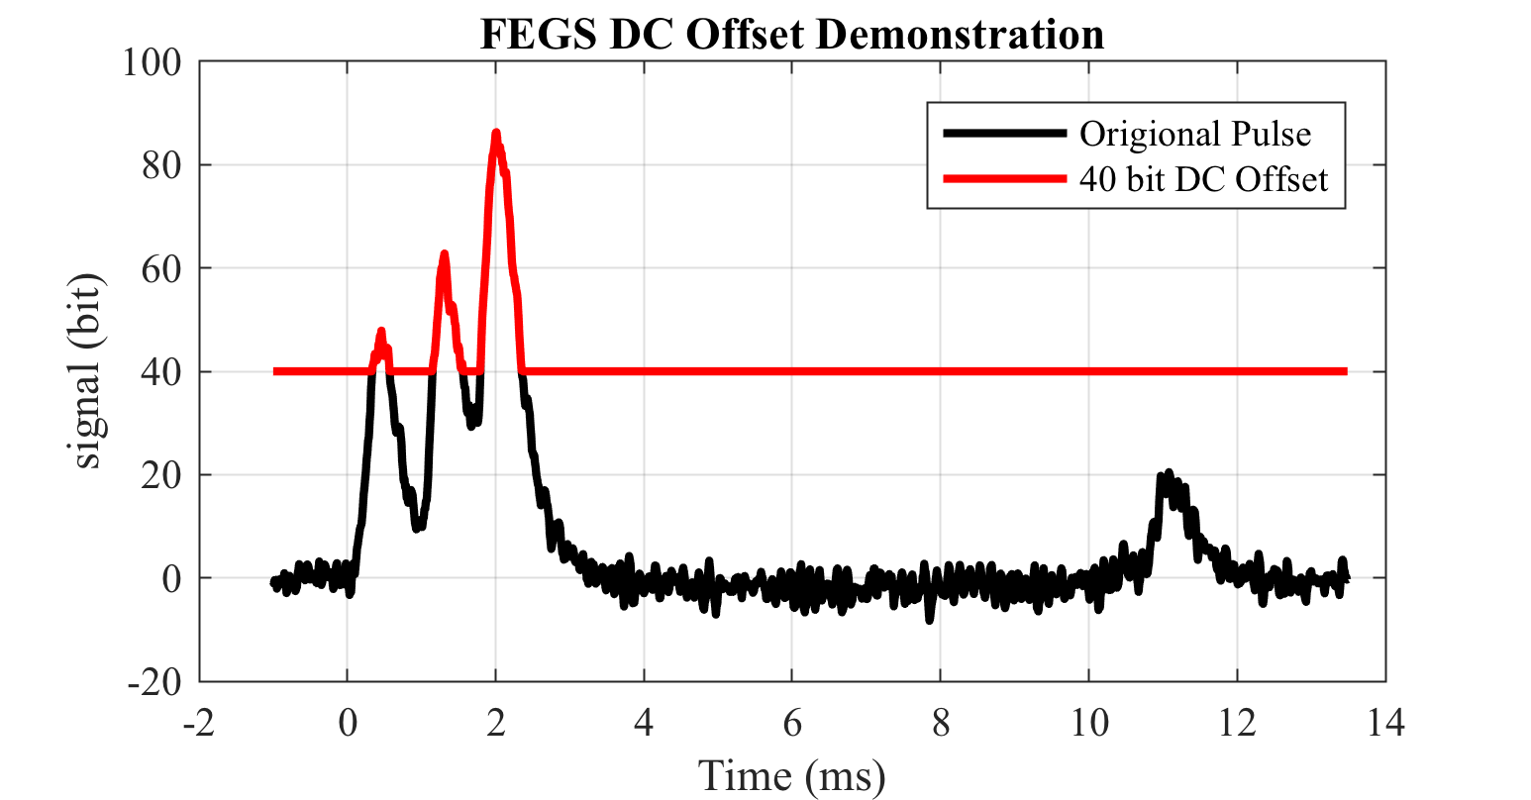
FEGS – negative DC offset at TIA output

Slide 24
