Slide 1
GLM / NLDN / GLD360: A case study
2018 GLM Science Team Meeting
Huntsville, AL
Ryan Said
Martin Murphy

Slide 2
Introduction
Field of View → Storm → Flash level analysis
This talk: Storm level analysis
Limitations:
Only analyze one storm in Colorado, for 6 hours
Only use flash, group data
Questions:
How does spatial / temporal distribution of each LLS differ?
GLM group vs flash rate vs ground-based LLS

Slide 3
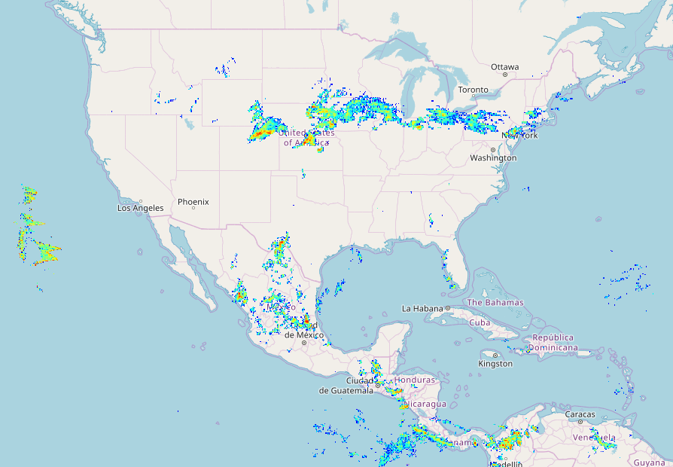
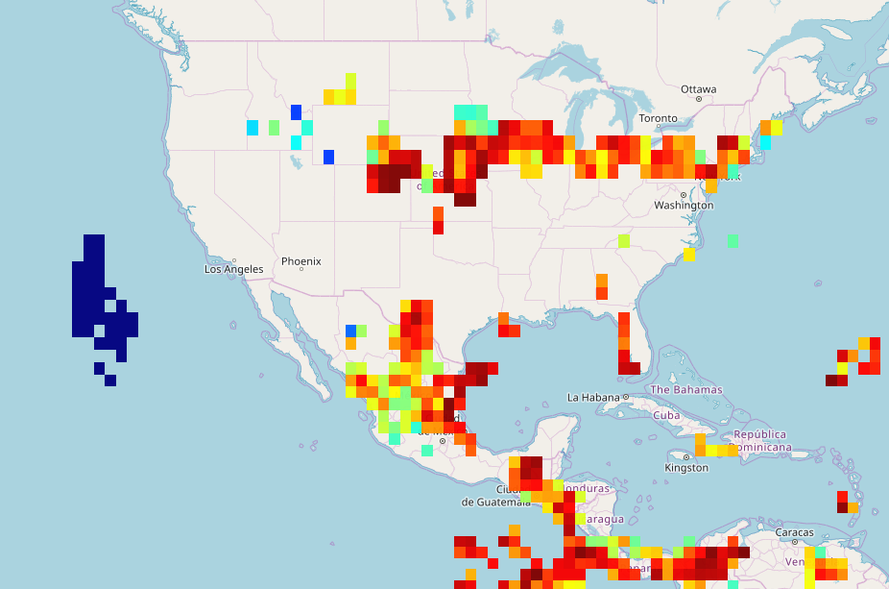
2018-06-19 00:00 – 06:00 UTC
GLM Flash Density
GLD360 Flash RDE
100
50
Blooming
artifact
0

Slide 4
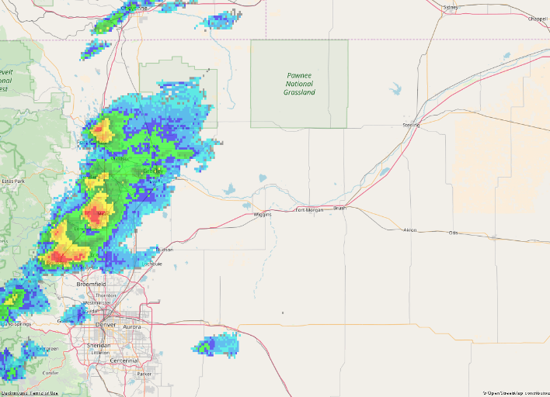
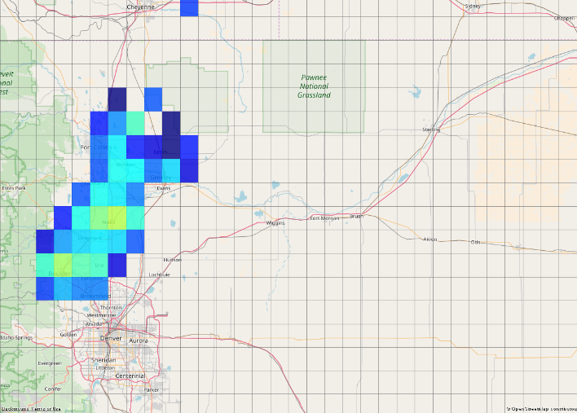
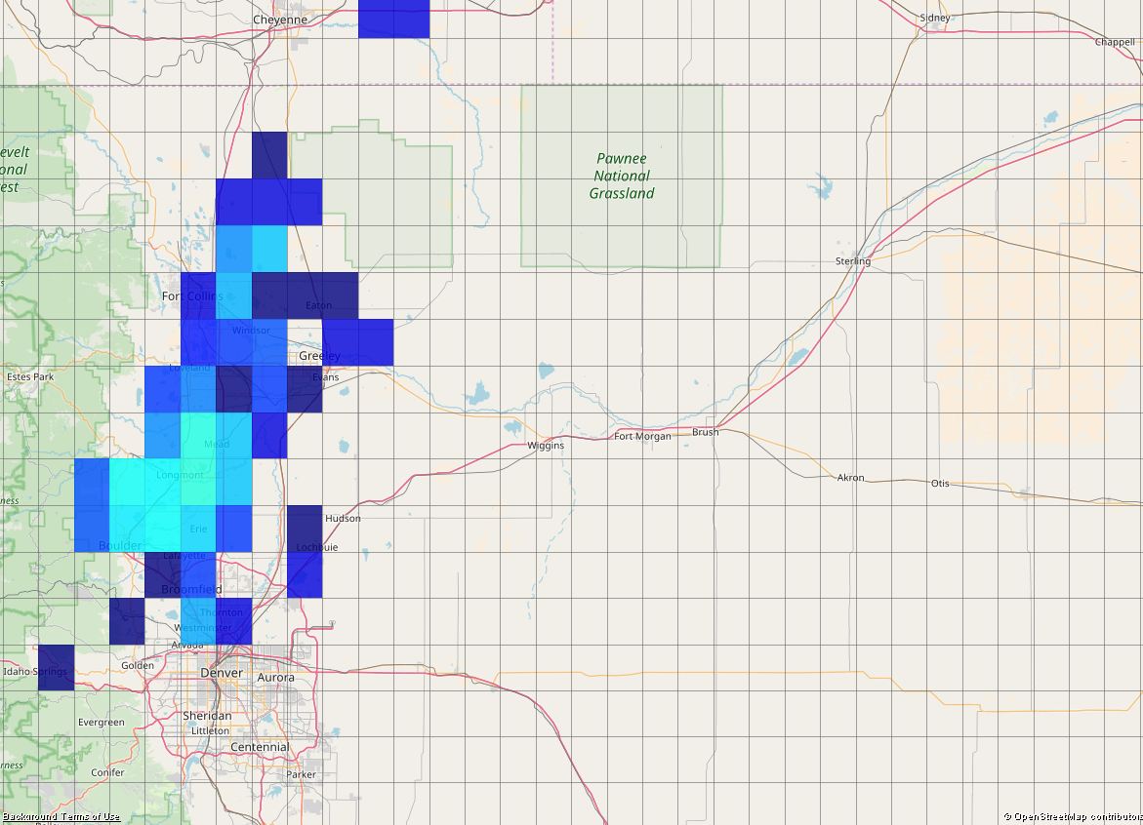
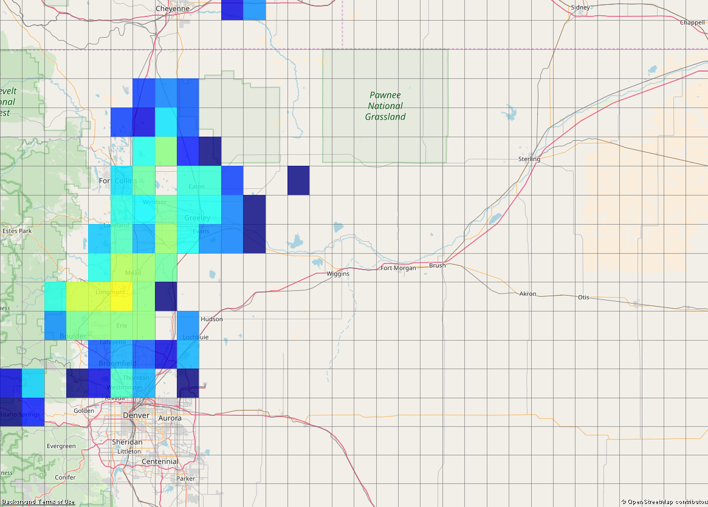
00:10
Use 0.1 deg grid for all datasets
Single snapshot of reflectivity at 0 °C (MRMS)
20 minutes of LLS centered on indicated time
dBZ
Log10(# counts)
MRMS
NLDN Strokes
GLM Flashes
(Centroids)
GLM Groups
(Centroids)

Slide 5
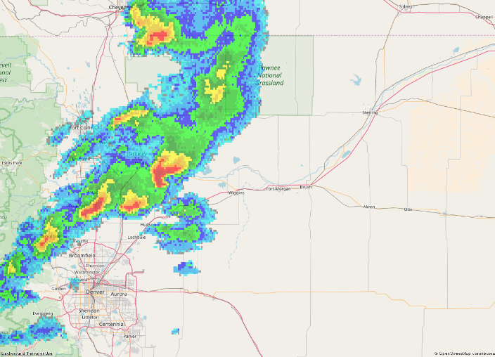
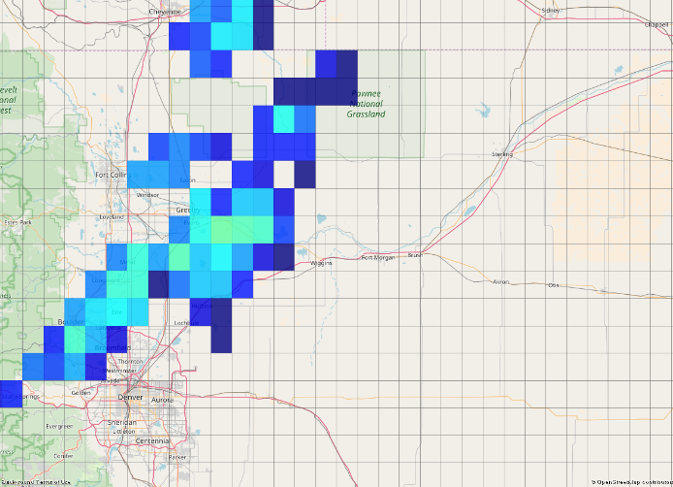
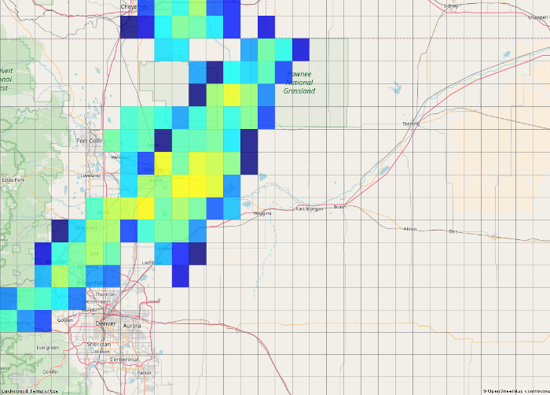
01:10

Slide 6
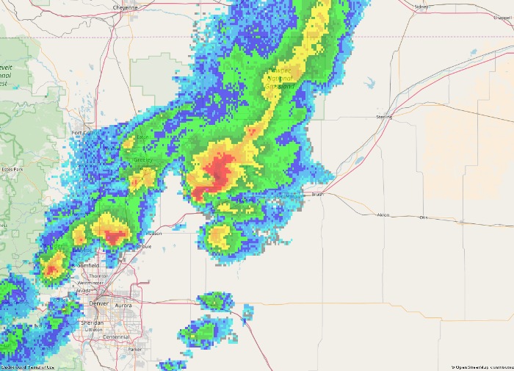
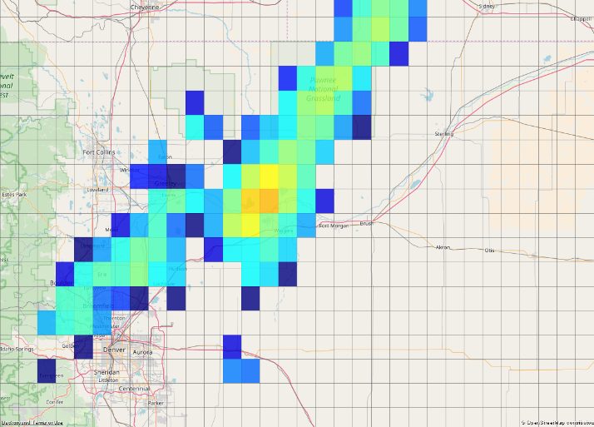
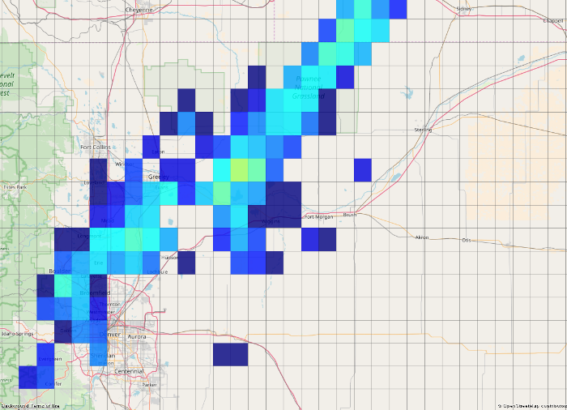
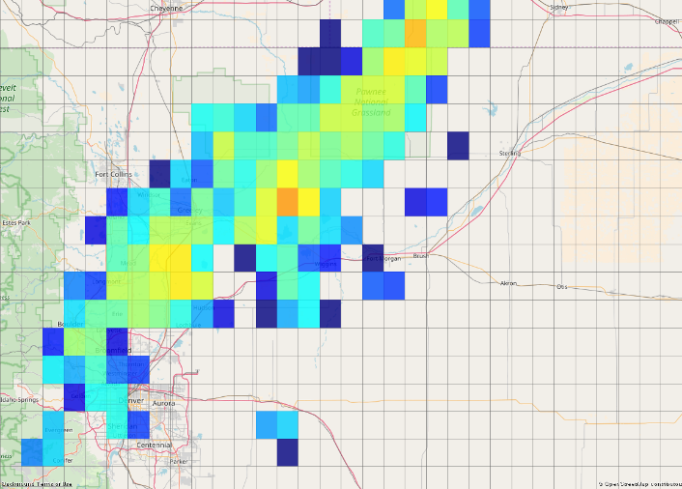
02:10

Slide 7
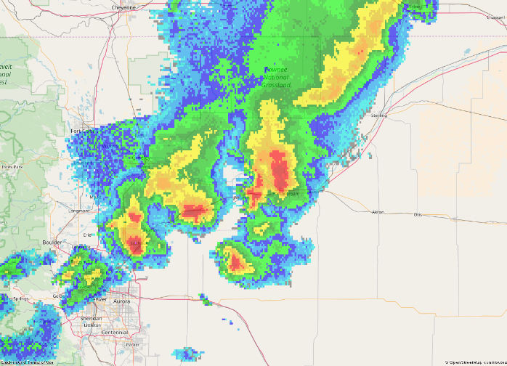
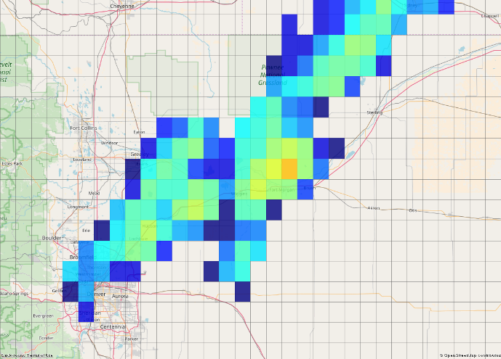
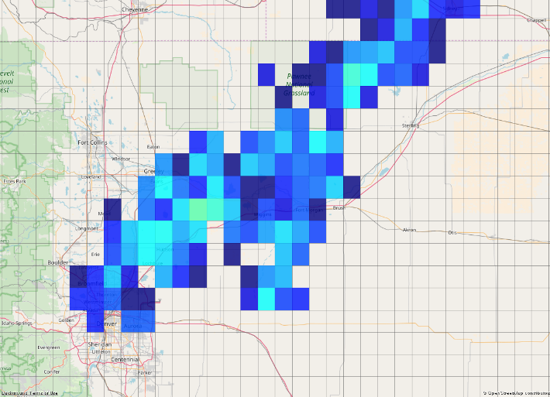
03:10

Slide 8
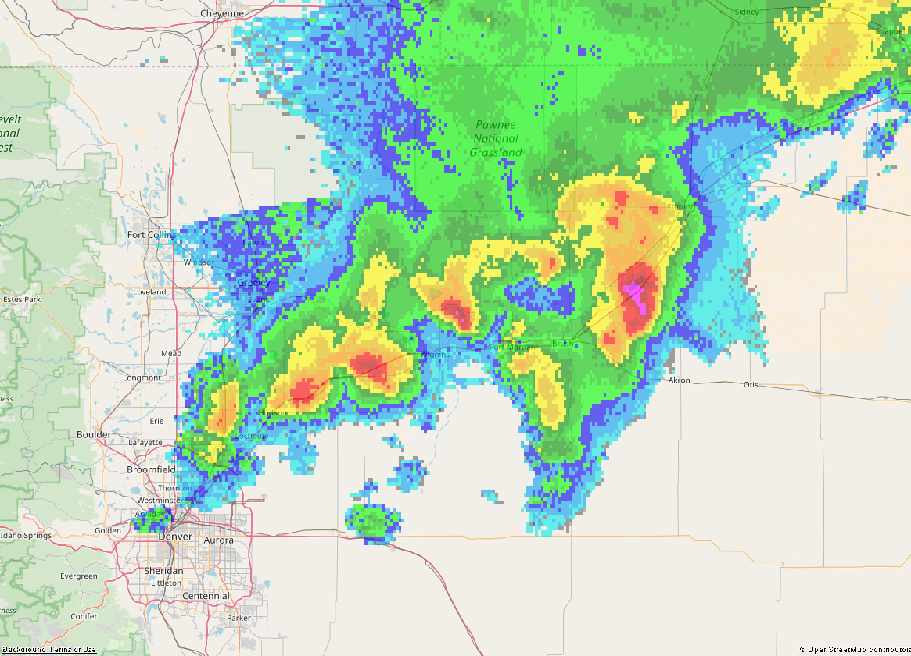
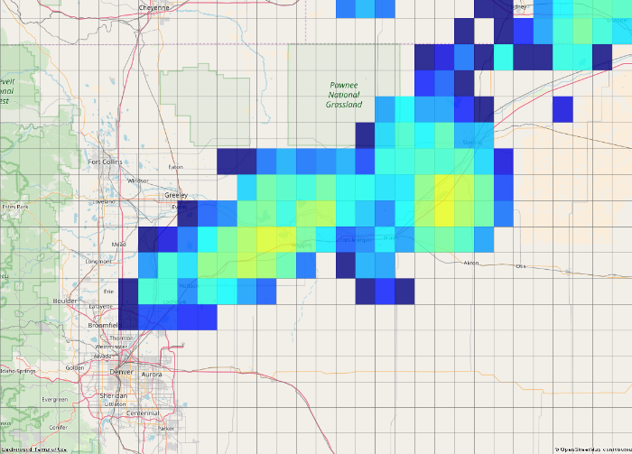
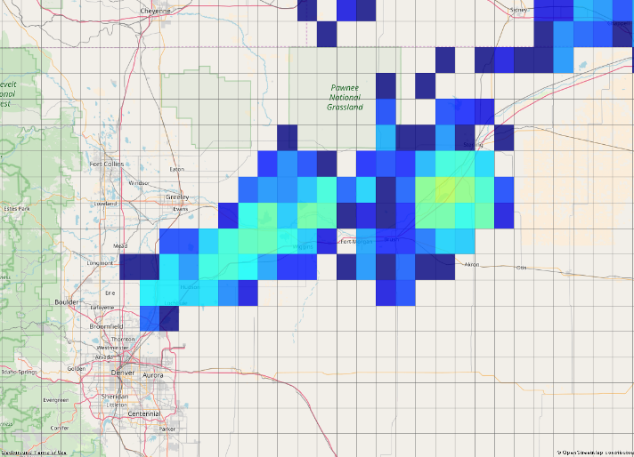
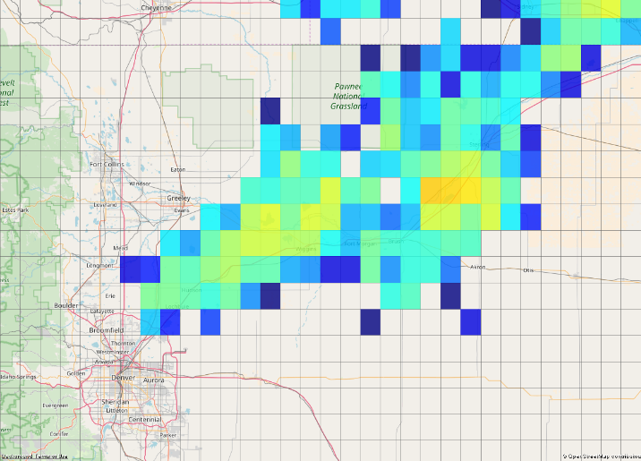
04:10

Slide 9
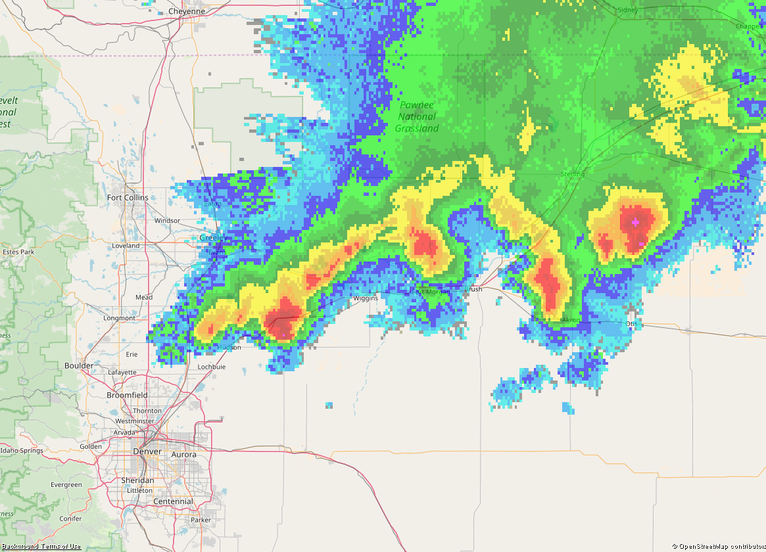
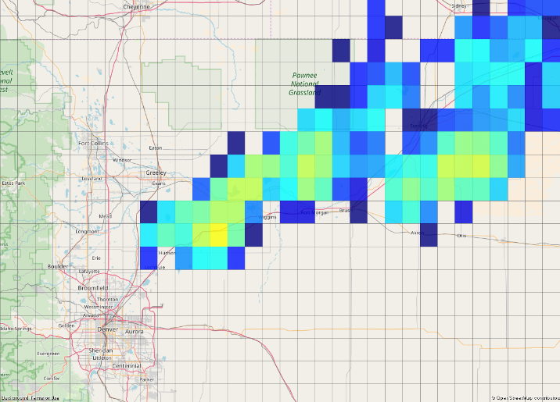
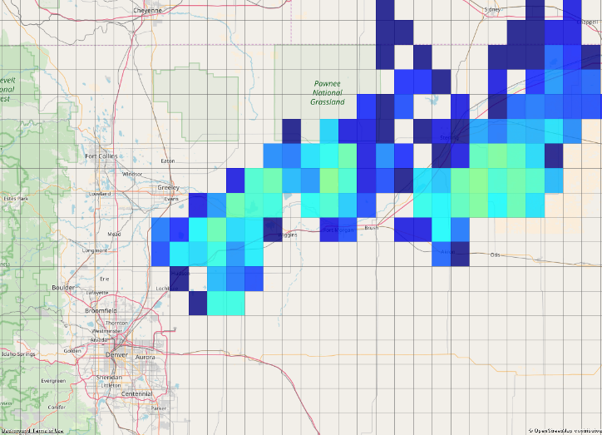
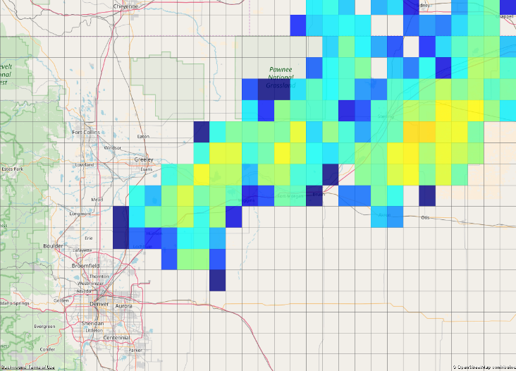
05:10

Slide 10
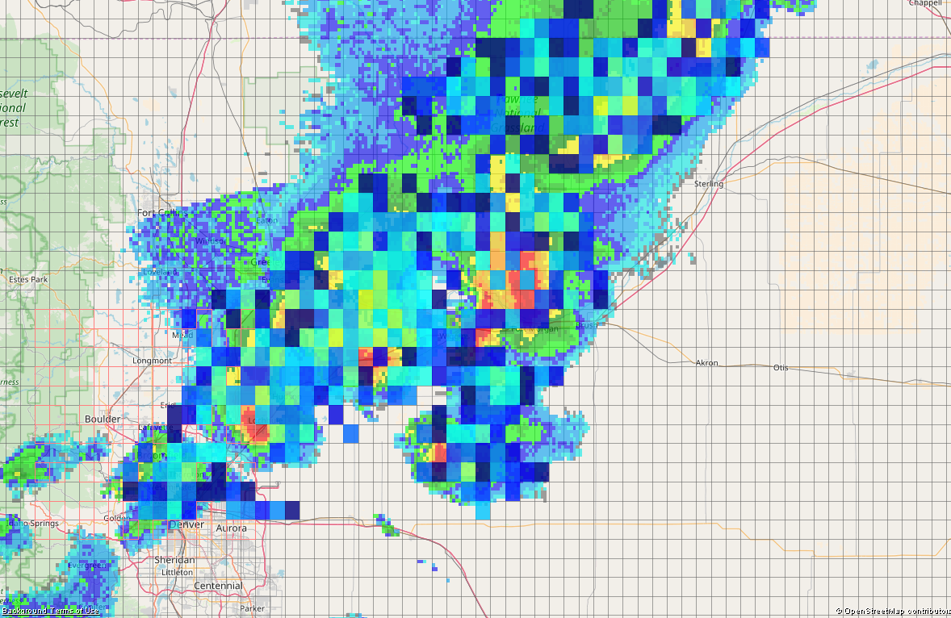
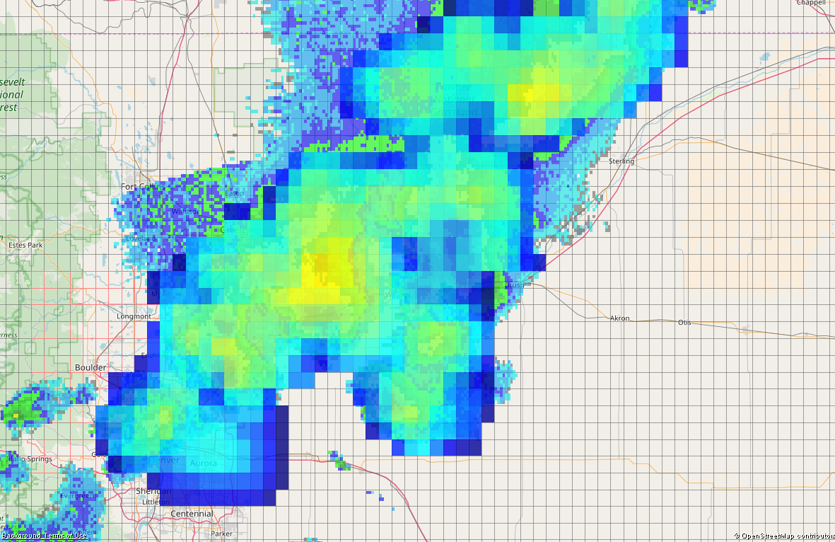
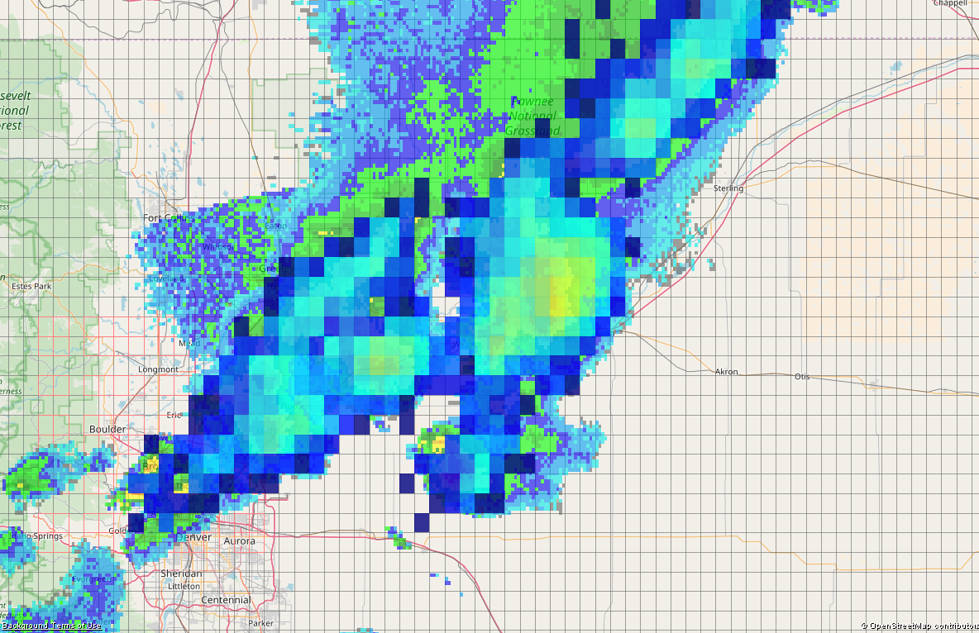
Finer resolution: 0.05° grid at 03:10
MRMS
GLM Group centroids
NLDN Strokes
0.5
1.0
Grp Area
GLD360 Strokes
GLM Grp Density
Grid

Slide 11
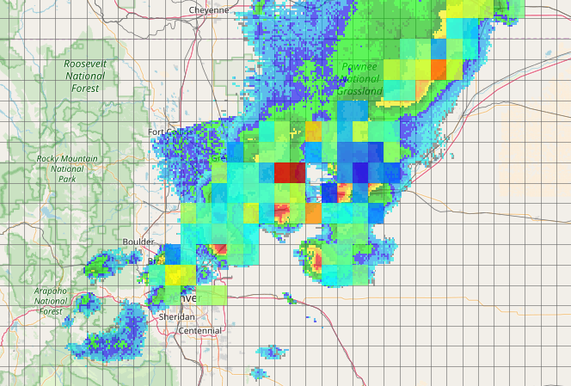
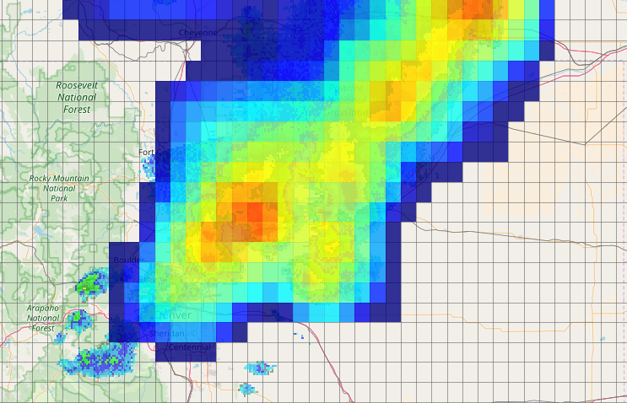
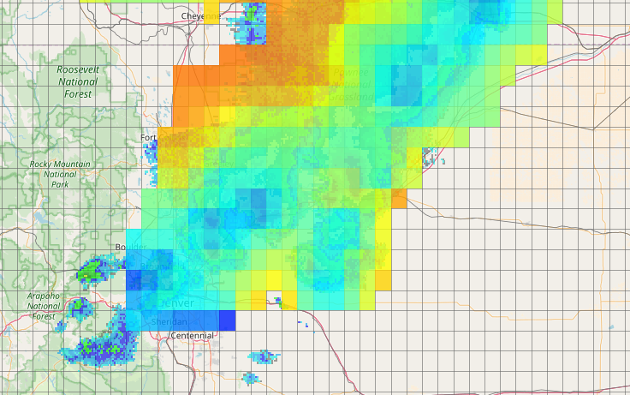
Flash Area. 0.1° grid, 03:10
GLM Flash density
GLM Mean flash area
log10(km^2)
Flash centroids
Area Integrated

Slide 12
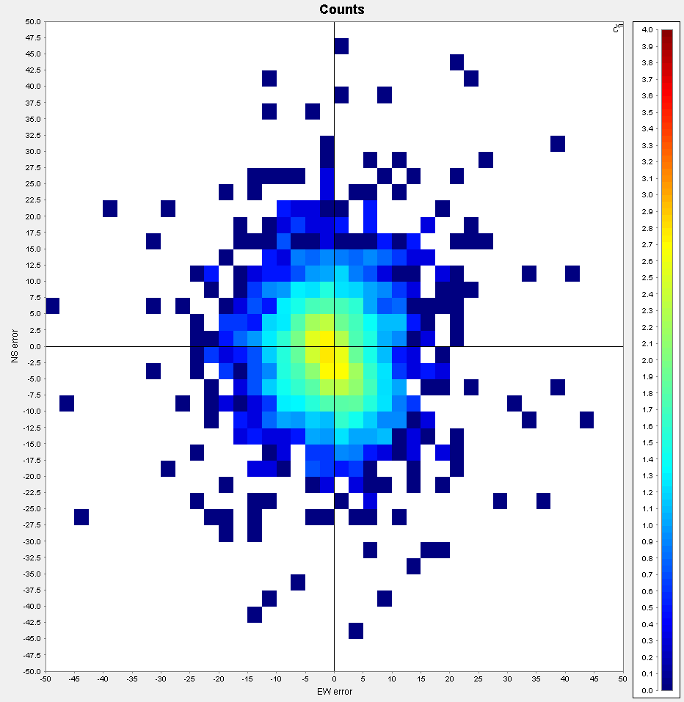
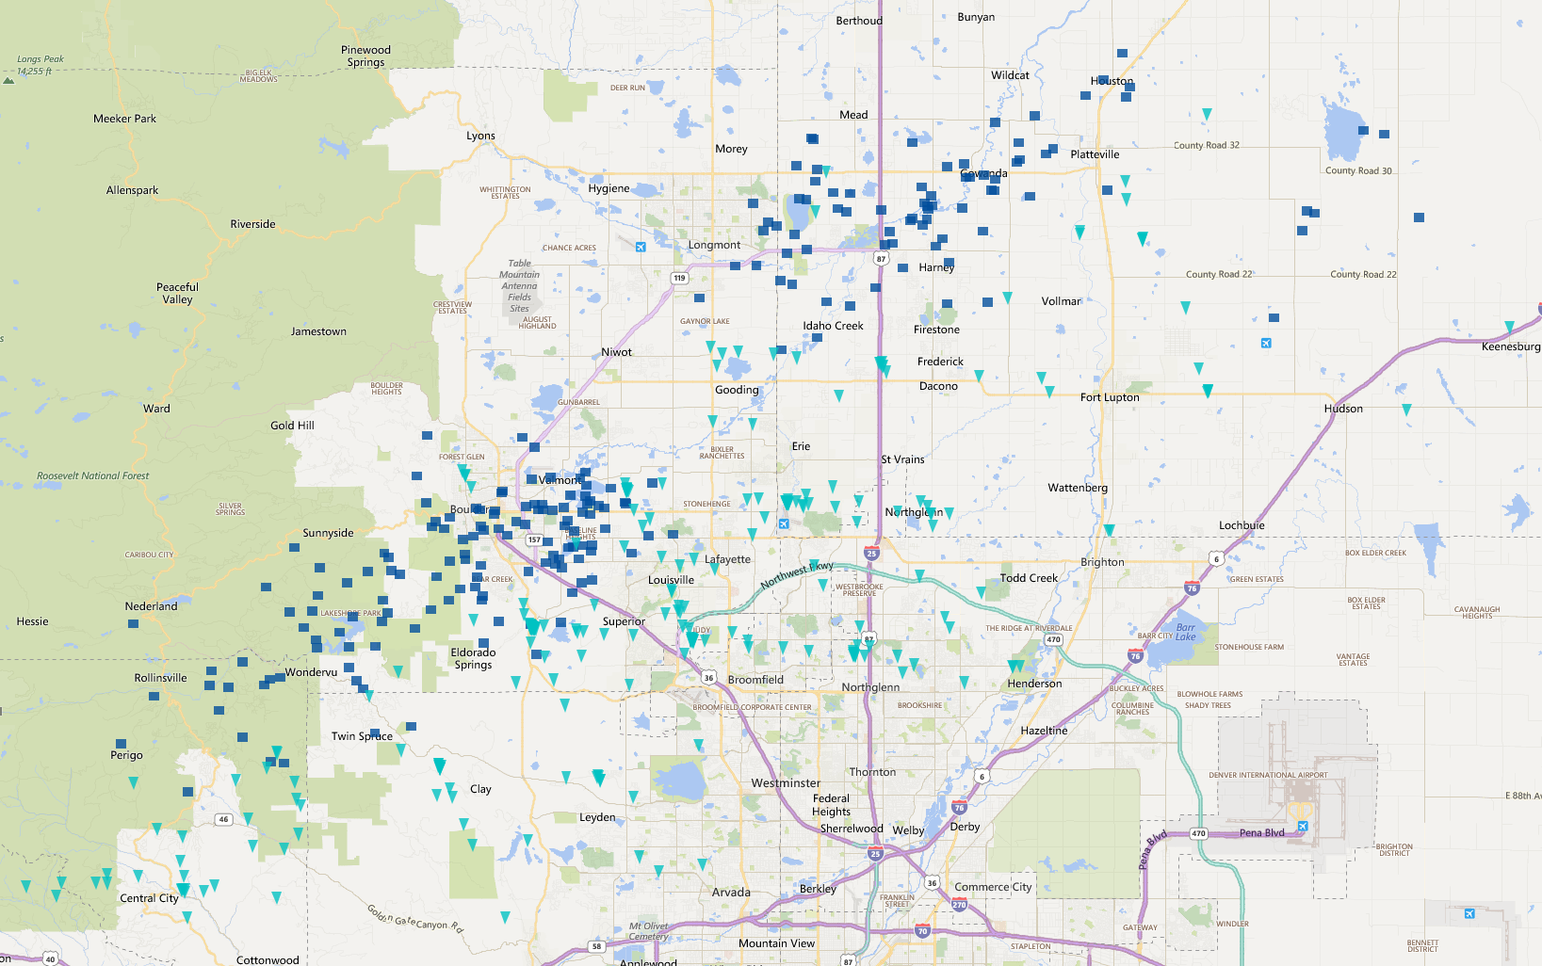
Note on GLM pixelation
NLDN
GLM
Group location difference to NLDN
NLDN and GLM storm tracks (Flash data): Many GLM locations still “snap to grid”

Slide 13
Observations
Hot spots for NLDN / GLD generally coincide with high reflectivity regions
Spatial coverage between NLDN / GLD about the same
GLM shows broader spatial area (especially groups), but activity hot spots do not always coincide with ground-based LLS or radar reflectivity
Possible explanation:
DE lower in higher optical depth region (ice water path)

Slide 14
Temporal flash / stroke / group counts
GLD360 stroke density for 6 hours

Slide 15
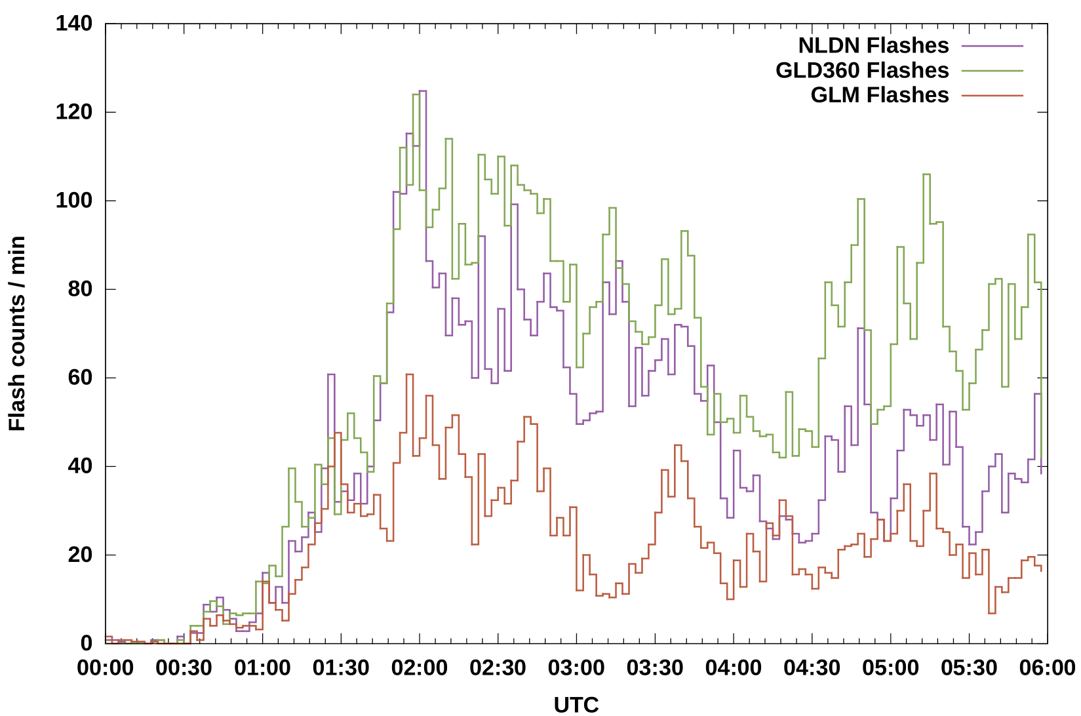
Flash Rate vs Time

Slide 16
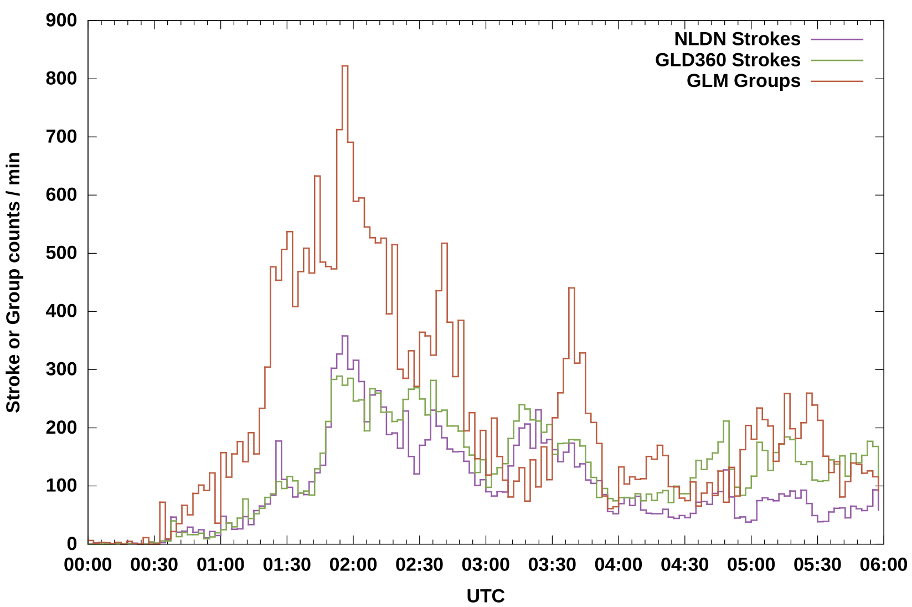
Stroke, Group Rate vs Time

Slide 17
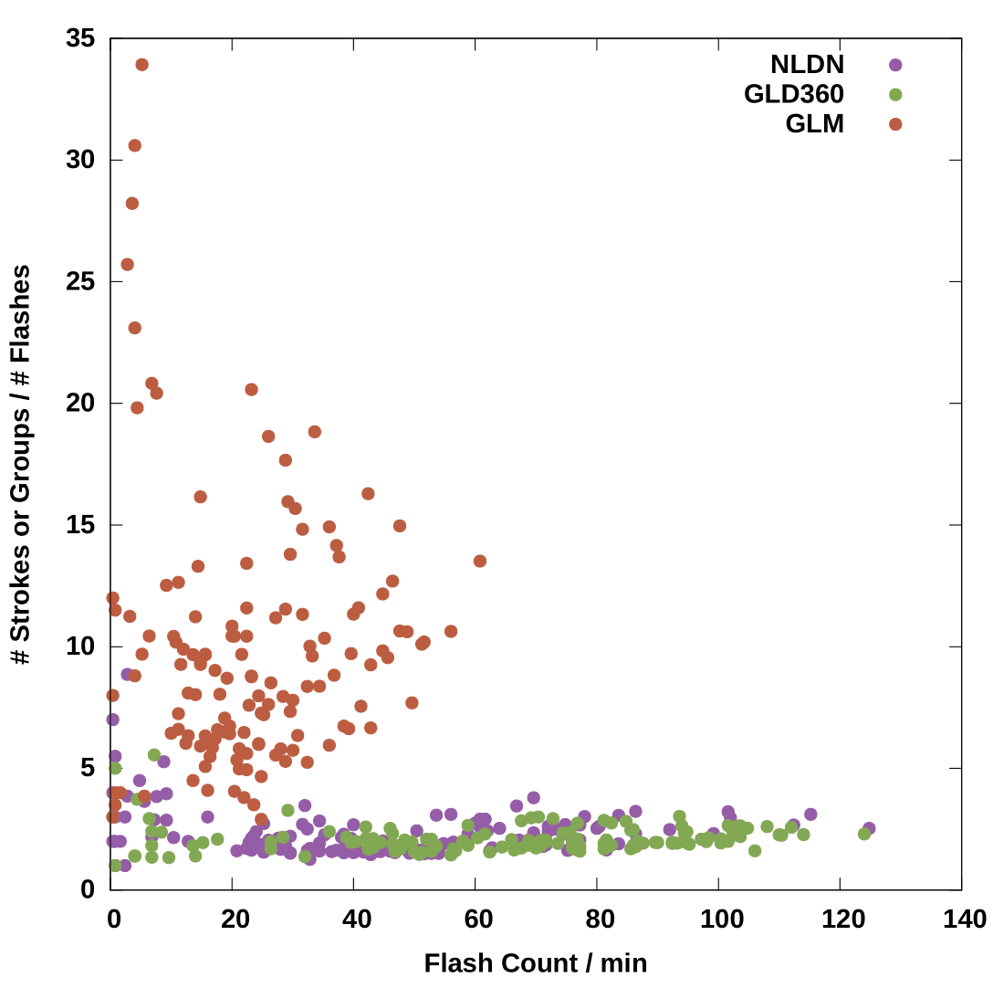
Stroke, Group Rate vs Flash Rate

Slide 18
Summary
Numbers of flashes agree in early stage; spikes in flash count not always correlated
Possibly same symptom seen in spatial maps: better DE with shallower optical depth?
Another possibility: once flash rate is sufficiently high, it’s too difficult to tell what a “flash” is
GLM group counts more variable compared to flash counts from any dataset
Spatially / temporally extensive flashes with large area in well developed thunderstorm cells / stratiform regions?
GLD360 seems to have better relative detection in later part of the storm (perhaps better detection of horizontal channels?)
Very little spatial difference flash/stroke density vs. NLDN
Future work: analyze individual flashes to test these hypotheses

