Slide 1
GLM validation over southern Canada using CLDN and SOLMA: - “Final” Results -
2018 GLM Annual Science Team Meeting
Huntsville, AL
David Sills, Hong Lin, Brian Greaves, Helen Yang
S&T / MSC, ECCC
12 Sep 2018

Slide 2
Outline
Canadian Context
Data sources
GLM validation strategy
Limitations
Methods
‘Deep dives’ in four domains
Choice of matching thresholds
Results
DE results relative to CLDN / SOLMA
Case studies by domain
Summary
Acknowledgments

Slide 3
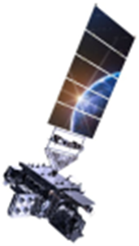
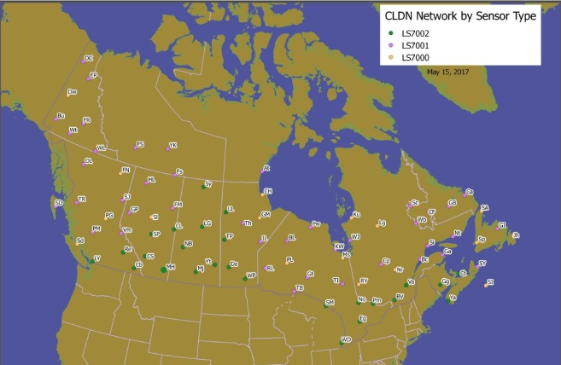
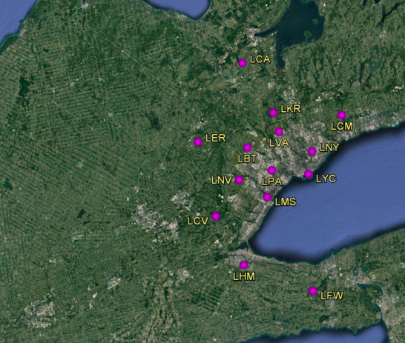
Data Sources
GLM
GOES-16 (2018)
CLDN (NALDN)
84-station network (ECCC/Vaisala)
CG and IC data
SOLMA
14-station array (ECCC)
Toronto area
ECCC Radar
Echo top data

Slide 4
GLM Validation at ECCC
NOAA–ECCC MOU re GLM collaboration:
Leads Steve Goodman / Dave Sills
Task 1: GLM on-orbit validation and product characterization over Canada
Provide SOLMA ‘supersite’ data to cal/val team
ECCC GLM Validation Project to ensure GLM data are reliable, high-quality, need to answer the following questions:
What are the limitations to the use of GLM data in the Canadian context?
How accurate are GLM observations in space and time?
What is the detection efficiency over Canada relative to CLDN and SOLMA?

Slide 5
GLM – Canadian Context
Limitations over Canada:
Resolution – 8 km at nadir but coverage over Canada has ~9-14 km resolution, with most areas near ~10 km resolution

Slide 6
GLM – Canadian Context
Limitations over Canada:
Resolution – 8 km at nadir but coverage over Canada has ~9-14 km resolution, with most areas near ~10 km resolution
Parallax issues
Storm view increasingly side versus top as latitude increases, seen as low top
Geo-location uses cloud top height model
GLM
GLM Subpoint

Slide 7
Assuming 45⁰N latitude…
Surface of Earth
12 km cloud top
To GLM satellite
Model location offset for 12 km
GLM
GLM Subpoint

Slide 8
Assuming 45⁰N latitude…
Surface of Earth
15 km cloud top
To GLM satellite
Model location offset for 12 km
GLM
Shifted north
~3 km
GLM Subpoint

Slide 9
Assuming 45⁰N latitude…
Surface of Earth
10 km cloud top
To GLM satellite
Model location offset for 12 km
GLM
Shifted south ~2 km
GLM Subpoint

Slide 10
Assuming 45⁰N latitude…
Surface of Earth
To GLM satellite
Model location offset for 12 km
GLM
6 km cloud side
Shifted south ~6 km
GLM Subpoint

Slide 11
Assuming 45⁰N latitude…
Surface of Earth
To GLM satellite
Model location offset for 12 km
6 km cloud side
Shifted south ~6 km
Great Lakes lake-effect snow (with lightning) has very low cloud tops (4-6 km)

Slide 12
GLM Validation Plan – ‘Deep Dives’
Courtesy NOAA
Spirit River, AB 55.7N, 119.2W
Woodlands, MB 50.2N, 97.8W
Holyrood, NL
47.3N, 53.2W
Toronto, ON 43.7N, 79.6W
(SOLMA)
1 SOLMA + CLDN site with radar coverage – Toronto
3 CLDN-only sites with radar coverage – W, central, E

Slide 13
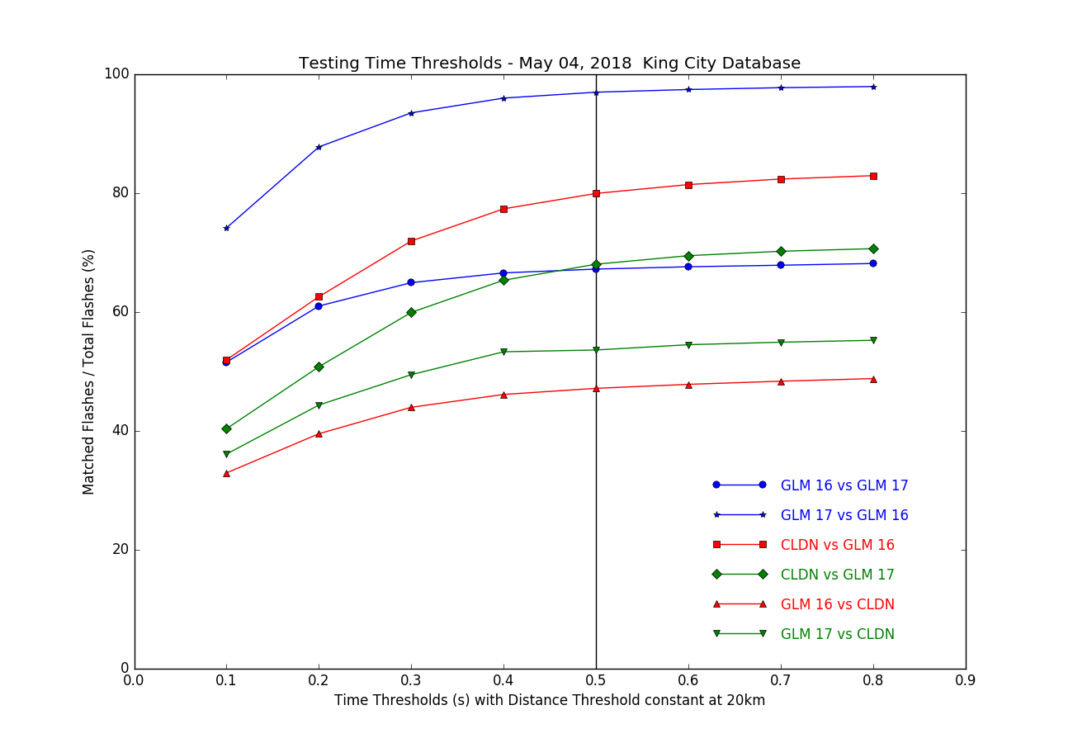
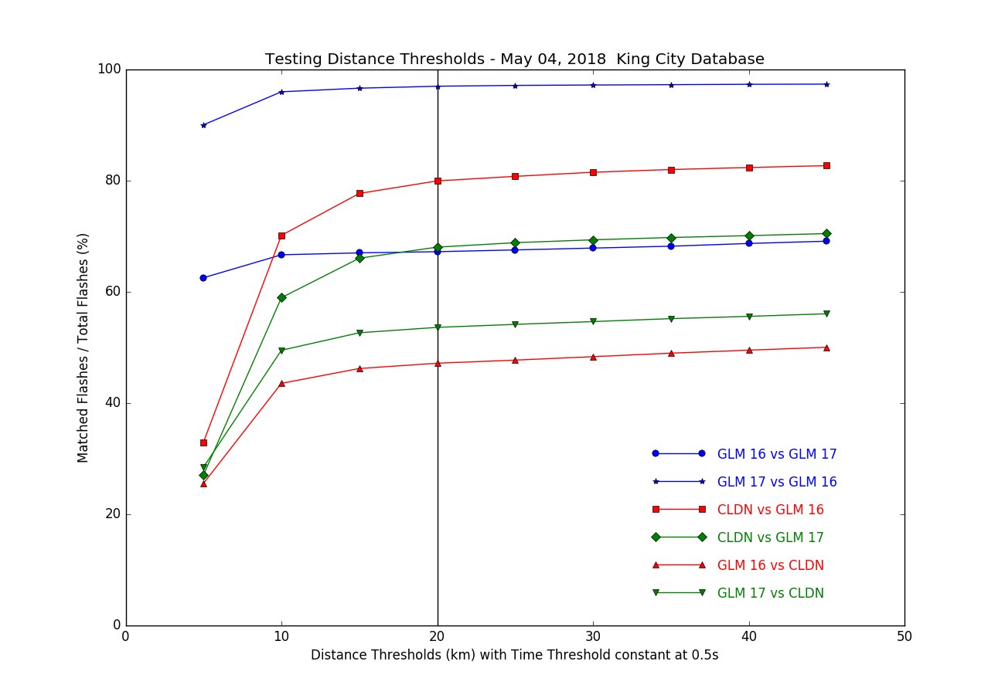
Methods – Matching Thresholds
Relative Detection Efficiencies
Using CLDN and GLM flashes over active 6-hr periods
Increased time and distance thresholds until no significant change in matches
Result: 0.5 s and 20 km radius
0.5 s
20 km
4 May 2018
4 May 2018

Slide 14
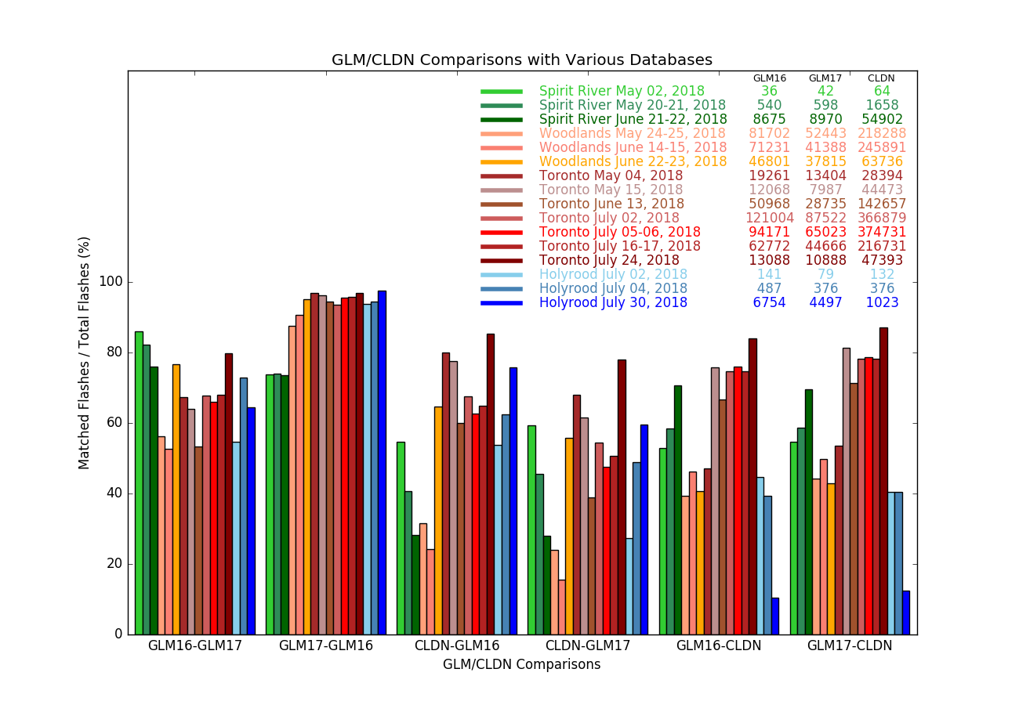
West
Central
16 Cases Total
South
East

Slide 15
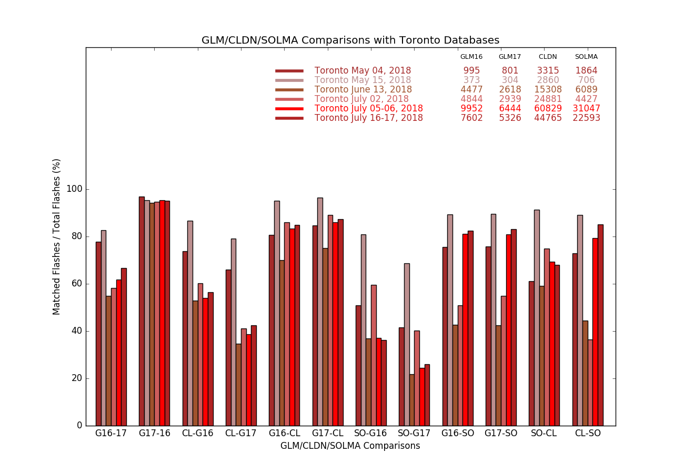
CLDN > SOLMA > GLM-16
CLDN / GLM-16
SOLMA / GLM-16
SOLMA / CLDN

Slide 16
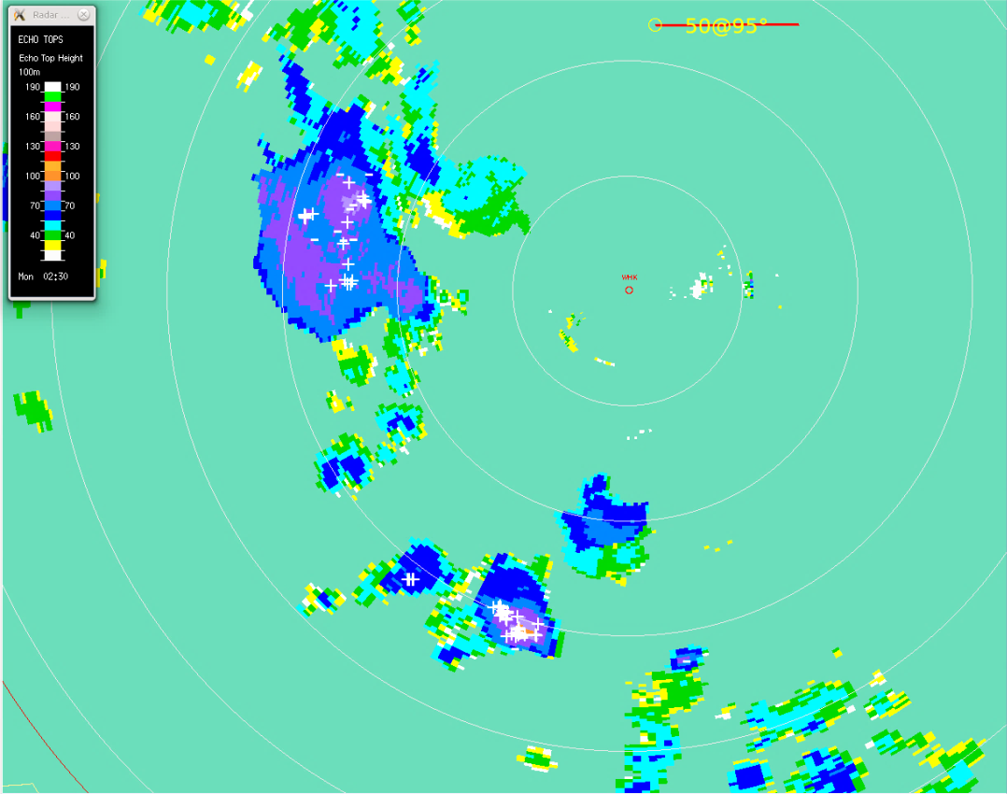
WEST – 20 May 2018 @ Holyrood, NL
50 km
Evening
20:30 LT 0230 UTC
10-min period
Weak storms
Low echo tops 6-8 km
GLM displacement ~10 km towards subpoint (to SE)
GLM >> CLDN

Slide 17
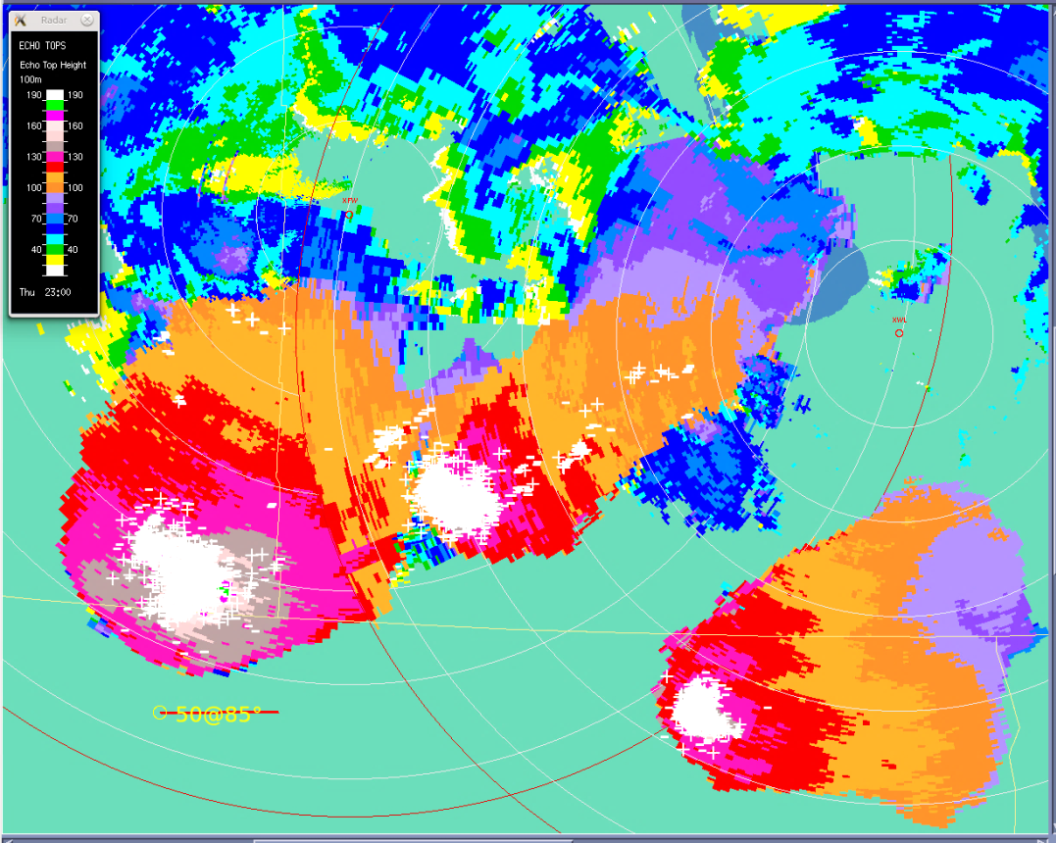
CENTRAL – 14 June 2018 @ Woodlands, MB
Evening 17:00 LT 2300 UTC
10-min period
50 km
Supercells with baseball hail
High echo tops 12-19 km
GLM displacement ~6 km away from subpoint (to NW)
No GLM!
‘optical extension’?

Slide 18
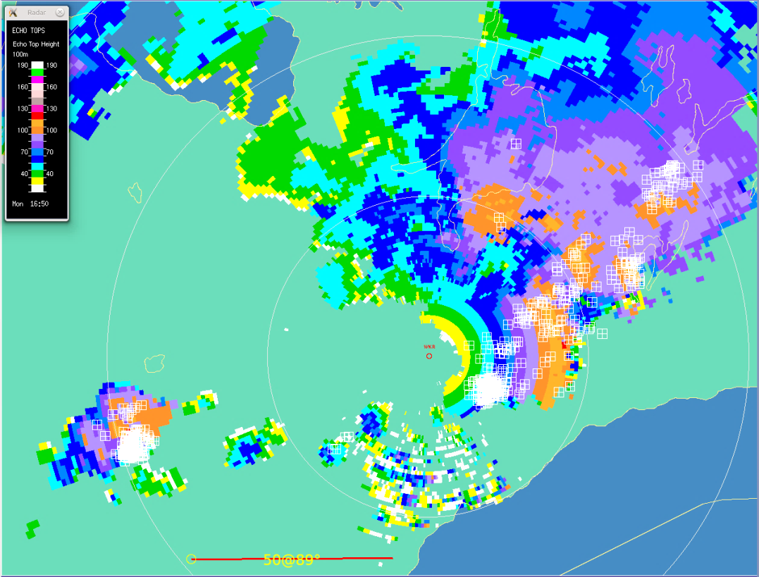
SOUTH – 16 Jul 2018 @ Toronto, ON
Daytime 13:00 LT 1700 UTC
10-min period
50 km
Weak storms
Echo tops 8-12 km
GLM displacement ~1 km toward subpoint (to S)
GLM >> CLDN

Slide 19
SOUTH – 16 Jul 2018 @ Toronto, ON
Daytime 13:00 LT 1700 UTC
10-min period
50 km
Weak storms
Echo tops 8-12 km
GLM displacement ~1 km toward subpoint (to S)
GLM >> CLDN

Slide 20
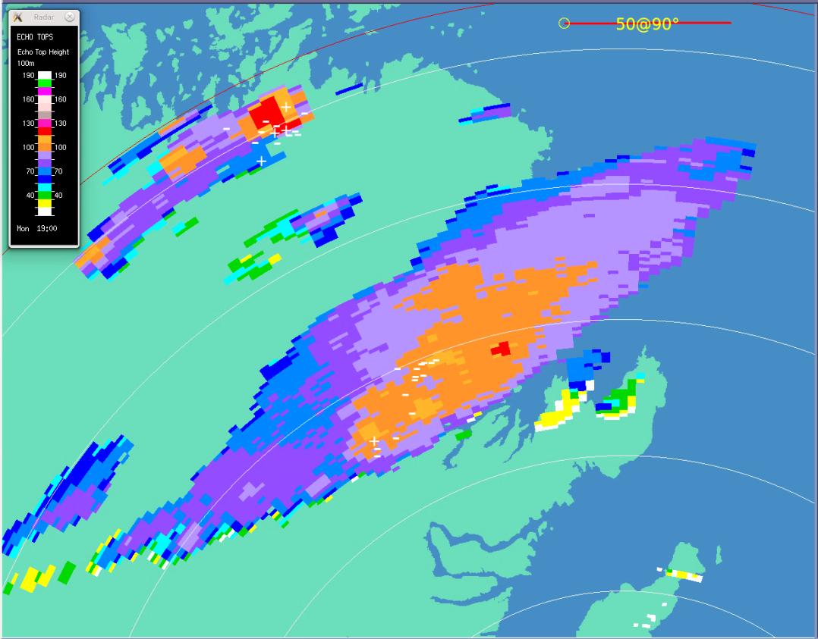
EAST – 30 Jul 2018 @ Holyrood, NL
50 km
Daytime 15:30 LT 1900 UTC
10-min period
Weak storms
Echo tops 10-12 km
GLM displacement ~5 km toward subpoint (to SW)
GLM >> CLDN

Slide 21
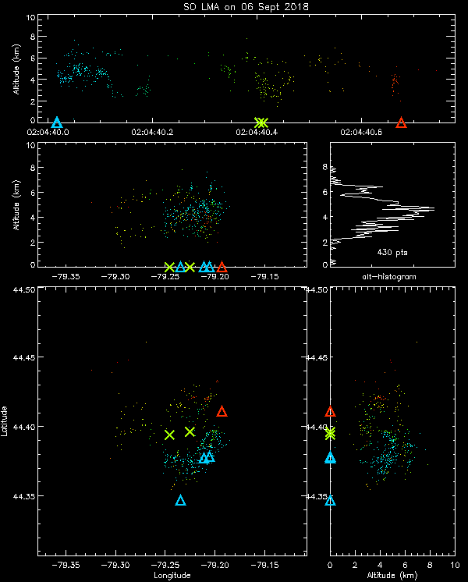
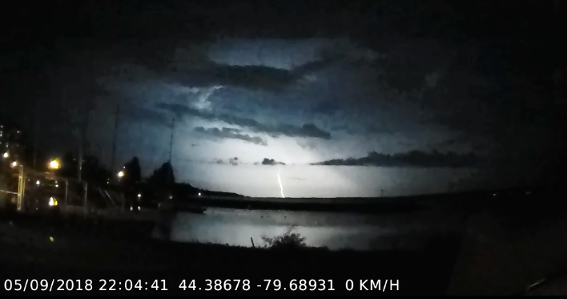
SOUTH - Single Visible CG Flash
6 Sep 2018 N of Toronto
Nighttime (~10 PM local)
Northern edge of LMA
Low echo top ~9 km
SOLMA: one 0.7s flash
CLDN: six single-stroke flashes (-CG, 5 IC)
GLM: one 0.7s flash, 49 groups, 182 events
Time
Vertical
Plan View
Visual CG
Vertical

Slide 22
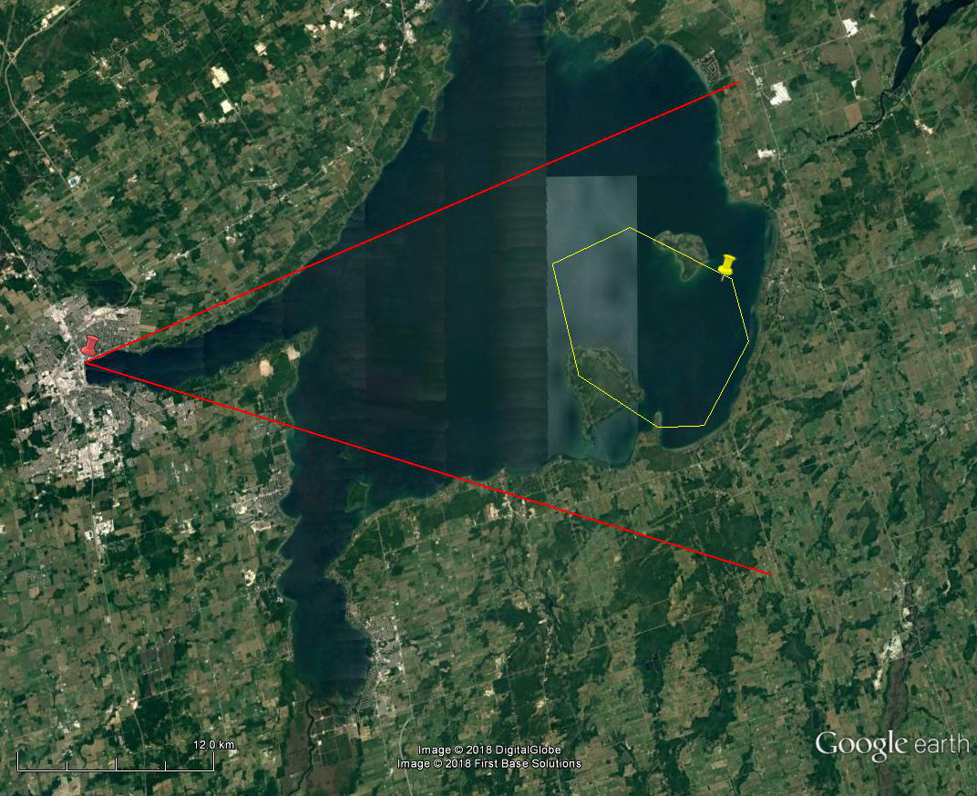
Single Flash – SOLMA
SOLMA CG
Dashcam
SOLMA sources
12 km

Slide 23
Single Flash – CLDN
CLDN -CG
Dashcam
CLDN ICs
12 km

Slide 24
Single Flash – GLM
Dashcam
GLM events
GLM flash
12 km

Slide 25
Single Flash Comparison
SOLMA CG
Dashcam
CLDN -CG
GLM flash
GLM ~11 km to SSW
(part parallax / part side of cloud)
12 km

Slide 26
Summary
ECCC validation plan focused on ‘deep dives’ in four domains across Canada
Results:
GLM DE relative to CLDN varies with location but generally ~70% on average
GLM DE relative to SOLMA lower, ~50% on average (need to investigate further…)
Overly simple cloud height model results in displacements – improvement in works
Side of cloud displacements / ‘optical extension’ / excessive CLDN IC flash artifacts are concerns
Future work:
Compare GOES-17 GLM data

Slide 27
Acknowledgments
GLM: Emma Hung, Aiming Wu, Ron Goodson, Arne Alfheim
SOLMA: Paul Krehbiel, Bill Rison, Dan Rodeheffer, Ron Thomas, Reno Sit, Michael Harwood, Karen Haynes, Rob Reed, Larry Dusolt, Emma Hung, Paul Joe, Diane Johnston, John MacPhee
CLDN: Lyn Mainwaring, Ted Gresiuk

Slide 28
Summary
Thanks! David.Sills@canada.ca
ECCC validation plan focused on ‘deep dives’ in four domains across Canada
Results:
GLM DE relative to CLDN varies with location but generally ~70% on average
GLM DE relative to SOLMA lower, ~50% on average (need to investigate further…)
Overly simple cloud height model results in displacements – improvement in works
Side of cloud displacements / ‘optical extension’ / excessive CLDN IC flash artifacts are concerns
Future work:
Compare GOES-17 GLM data

