Slide 1
Optimal Lightning Emission Height to Improve GLM Location Accuracy
Katrina S. Virts and William J. Koshak NASA/MSFC
2018 GLM Science Team Meeting
11 September 2018

Slide 2
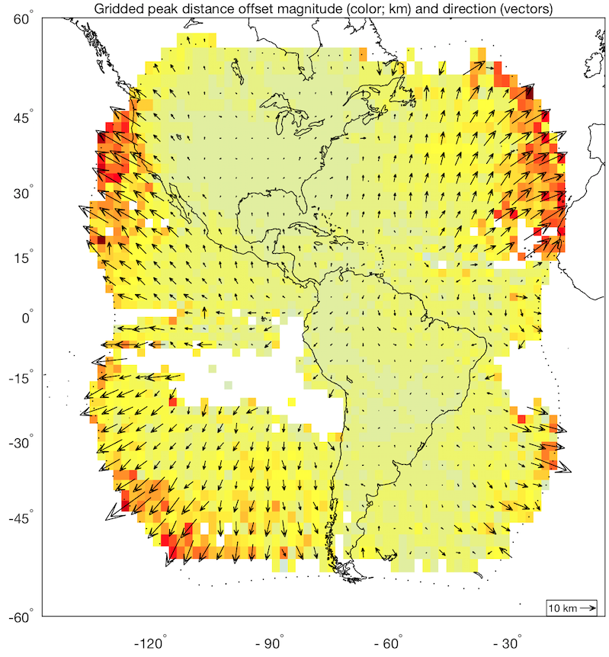
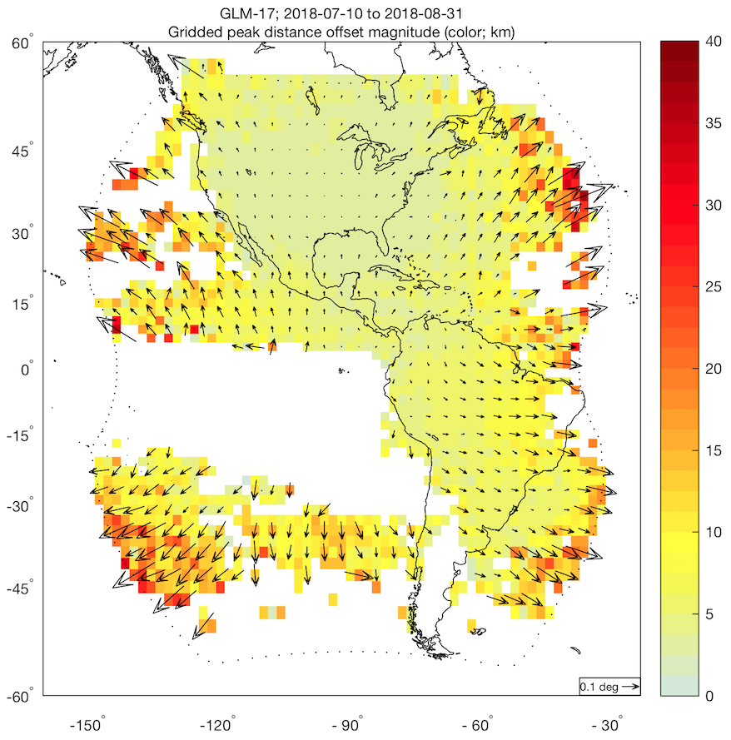
Motivation: Large location errors near GLM limb
GLM-16
GLM-17
Notes:
Comparison of GLM group data with ENGLN and GLD360; 8-month vs. 6-week analysis period

Slide 3
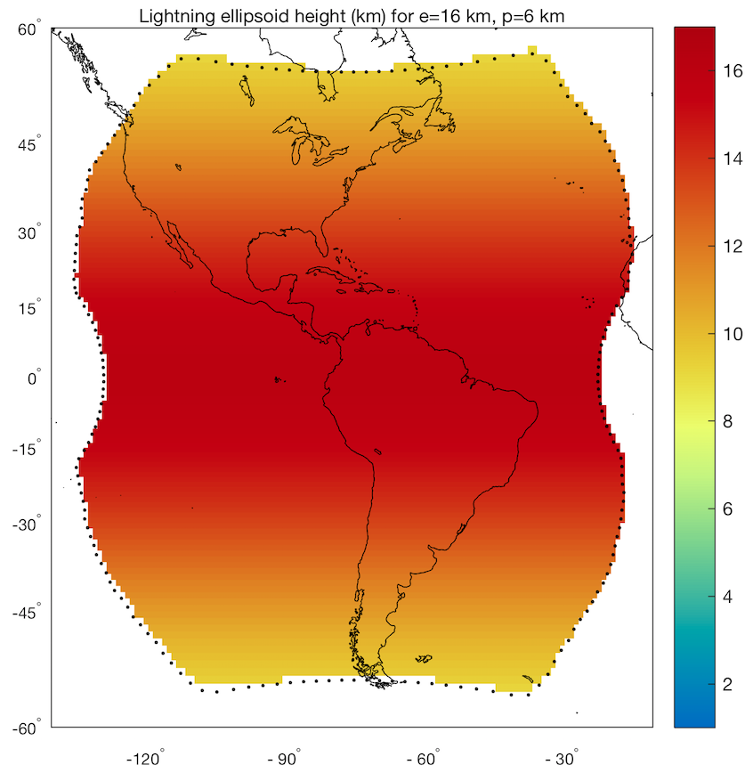
Lightning ellipsoid
Assumes GLM detects illumination at cloud top, approximated as 16 km (equator) and 6 km (poles)
Lowest ellipsoid height in GLM FOV is ~9 km

Slide 4
Lightning ellipsoid
Assumes GLM detects illumination at cloud top, approximated as 16 km (equator) and 6 km (poles)
Lowest ellipsoid height in GLM FOV is ~9 km
Produces location errors if:
Cloud top is below/above the ellipsoid
GLM observes side-cloud illumination or below-cloud lightning flashes
GLM groups currently too close to nadir → ellipsoid is generally too high

Slide 5
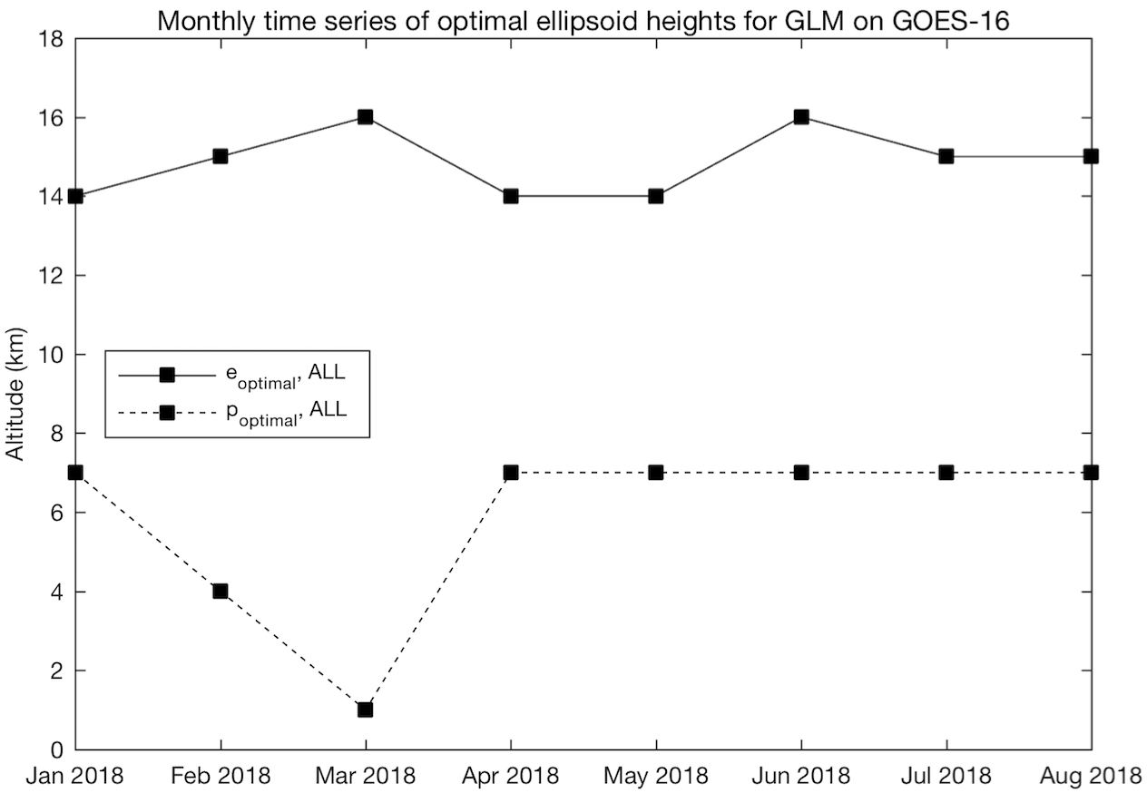
What is the optimal lightning ellipsoid?
Renavigate groups from (lat₁, lon₁) for (e₁, p₁) to (lat₂, lon₂) for (e₂, p₂)
e₂ = 8-17 km, p₂ = 1-7 km
Match renavigated GLM data with reference networks
Identify combination of e₂, p₂ that produces smallest mean error

Slide 6
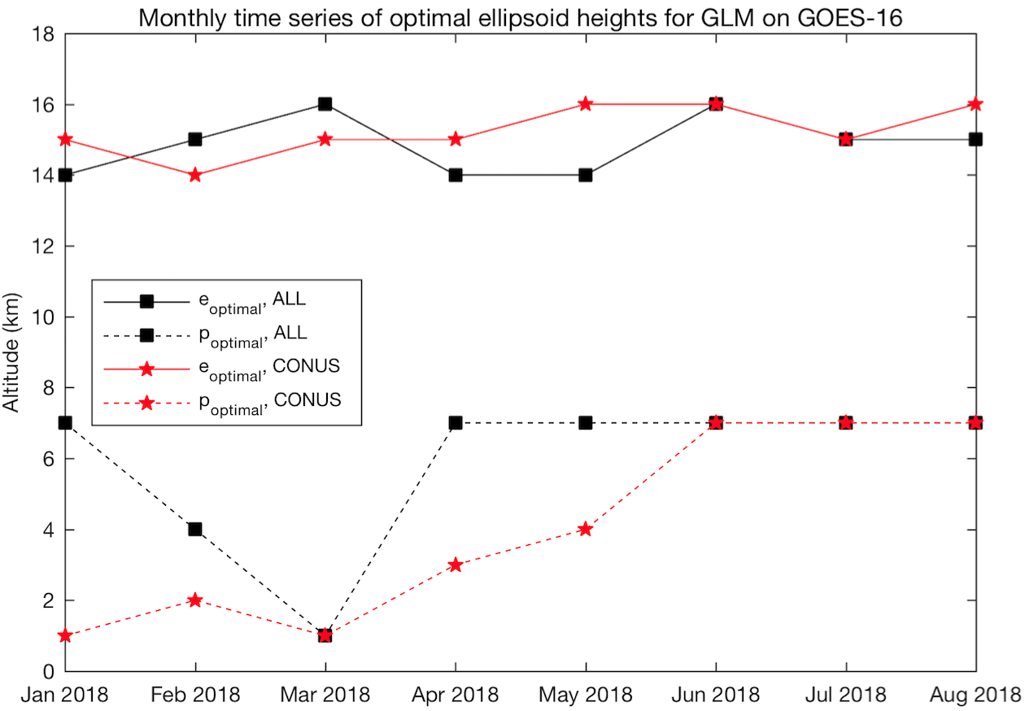
What is the optimal lightning ellipsoid?
Renavigate groups from (lat₁, lon₁) for (e₁, p₁) to (lat₂, lon₂) for (e₂, p₂)
e₂ = 8-17 km, p₂ = 1-7 km
Match renavigated GLM data with reference networks
Identify combination of e₂, p₂ that produces smallest mean error
e₂ = 14 km, p₂ = 6 km
Notes:
Should go into operational environment during October

Slide 7
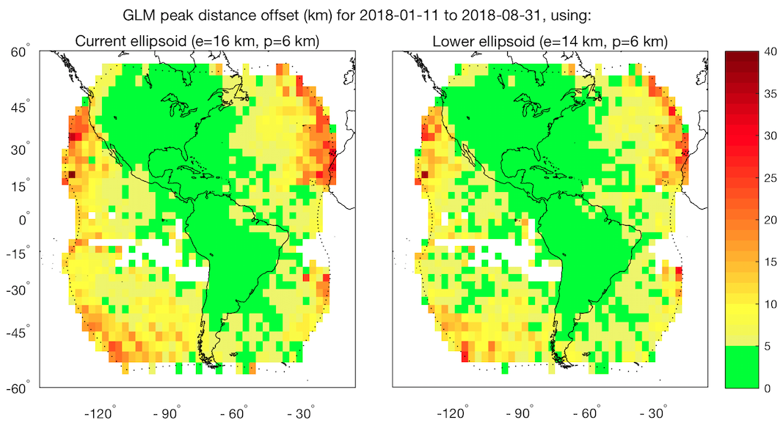
Performance of optimal ellipsoid

Slide 8
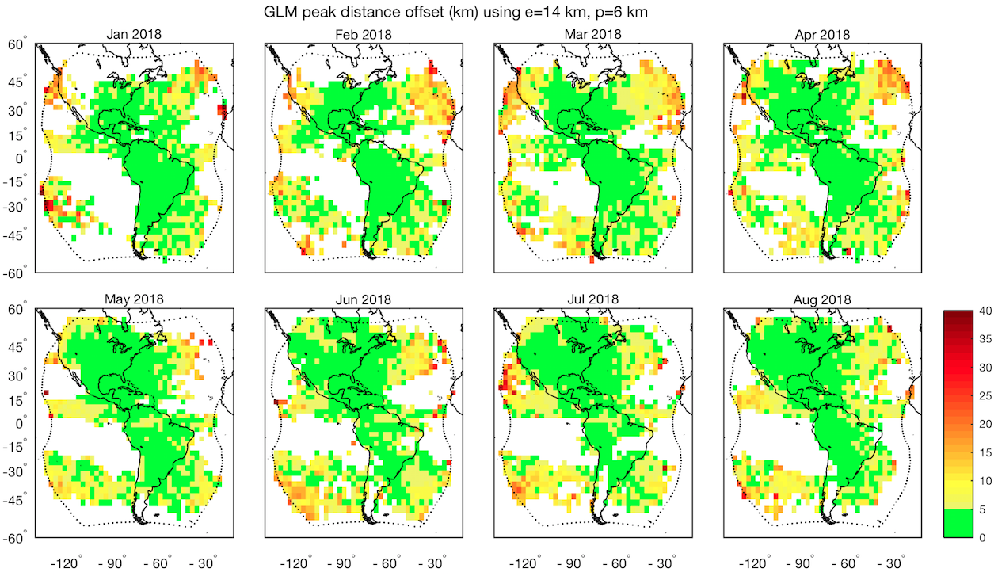
Performance of optimal ellipsoid – monthly

Slide 9
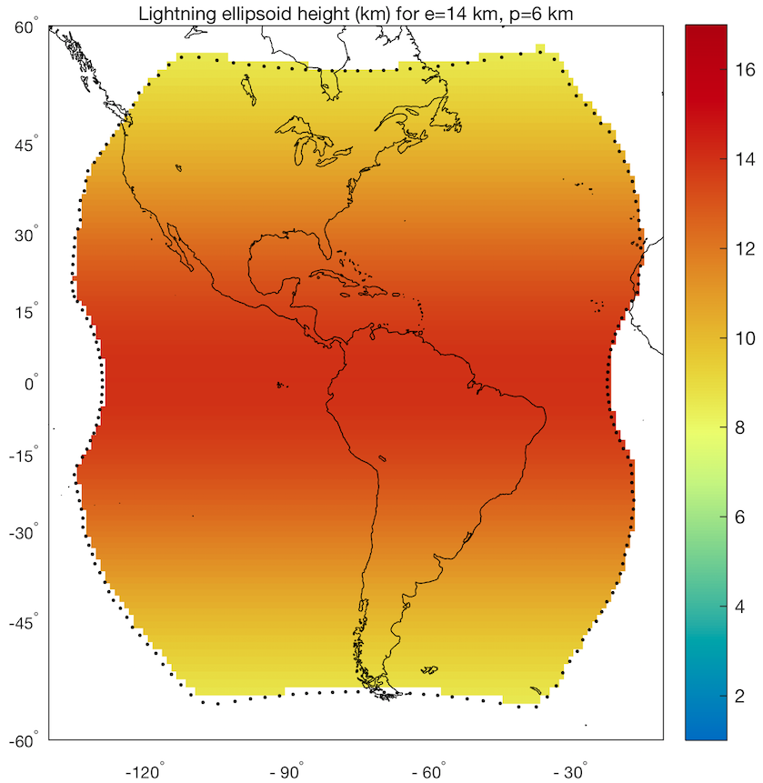
Lightning ellipsoid limitations
Assumes lightning emission height varies only as function of latitude, not as a function of:
Longitude
Season
Time of day
Thunderstorm life cycle
Regional differences including land/ocean

Slide 10
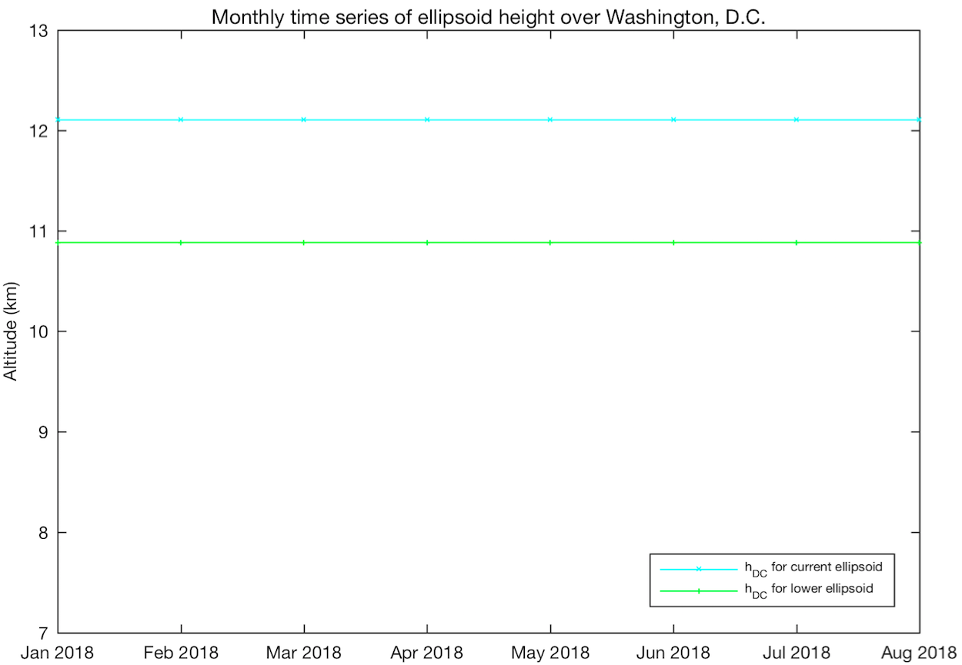
What is the optimal lightning emission height?
Renavigate groups from (lat₁, lon₁) for (e₁, p₁) to (lat₂, lon₂) for (h₂, h₂)
h₂ = 1, 1.5, …, 17 km
Match renavigated GLM data with reference networks
Identify h₂ that produces smallest mean error for each grid box
Notes:
If you don’t limit yourself to an ellipsoid…

Slide 11
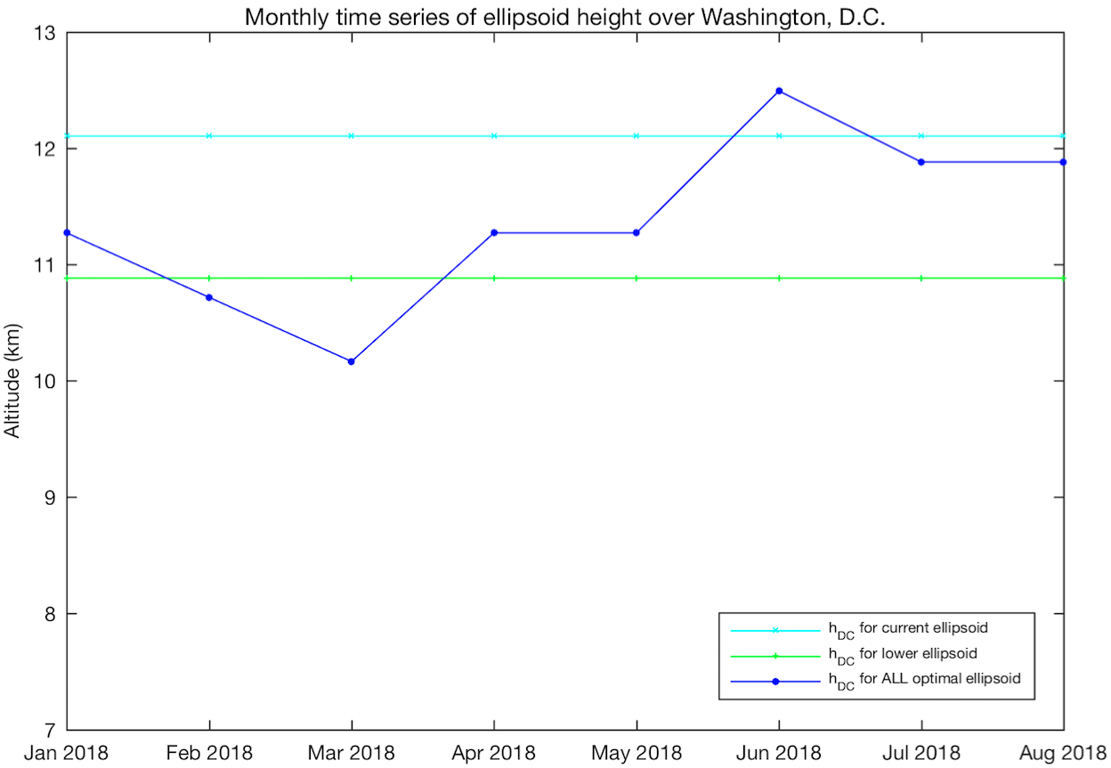
What is the optimal lightning emission height?
Renavigate groups from (lat₁, lon₁) for (e₁, p₁) to (lat₂, lon₂) for (h₂, h₂)
h₂ = 1, 1.5, …, 17 km
Match renavigated GLM data with reference networks
Identify h₂ that produces smallest mean error for each grid box

Slide 12
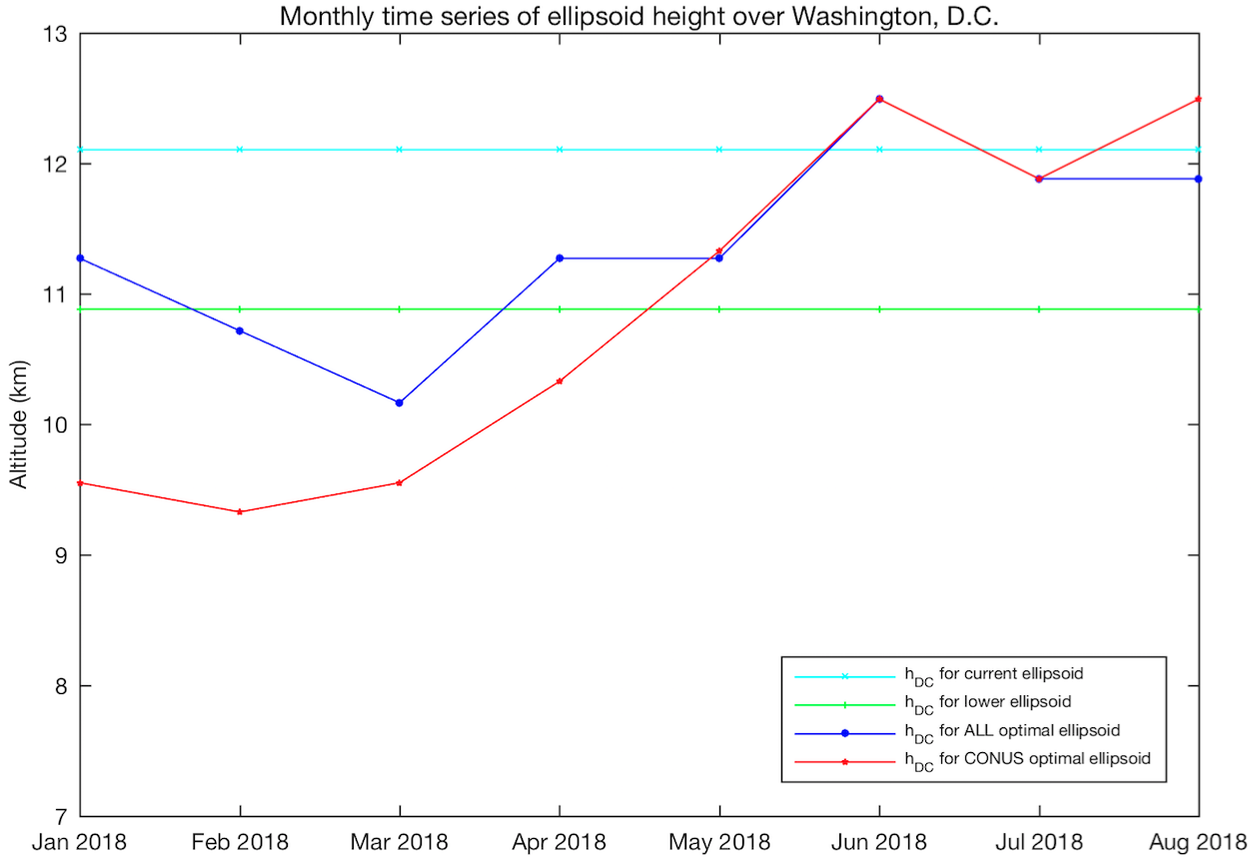
What is the optimal lightning emission height?
Renavigate groups from (lat₁, lon₁) for (e₁, p₁) to (lat₂, lon₂) for (h₂, h₂)
h₂ = 1, 1.5, …, 17 km
Match renavigated GLM data with reference networks
Identify h₂ that produces smallest mean error for each grid box

Slide 13
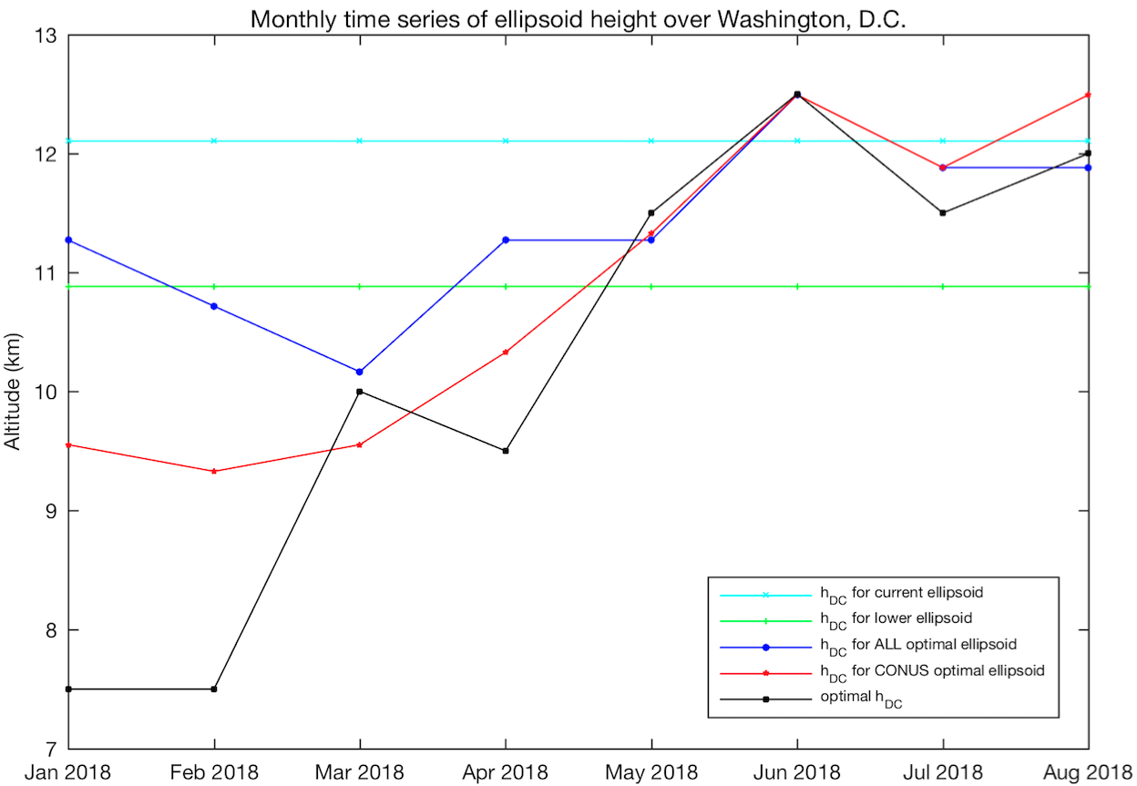
What is the optimal lightning emission height?
Renavigate groups from (lat₁, lon₁) for (e₁, p₁) to (lat₂, lon₂) for (h₂, h₂)
h₂ = 1, 1.5, …, 17 km
Match renavigated GLM data with reference networks
Identify h₂ that produces smallest mean error for each grid box
Notes:
Optimal for this grid box independent of lightning in any other region

Slide 14
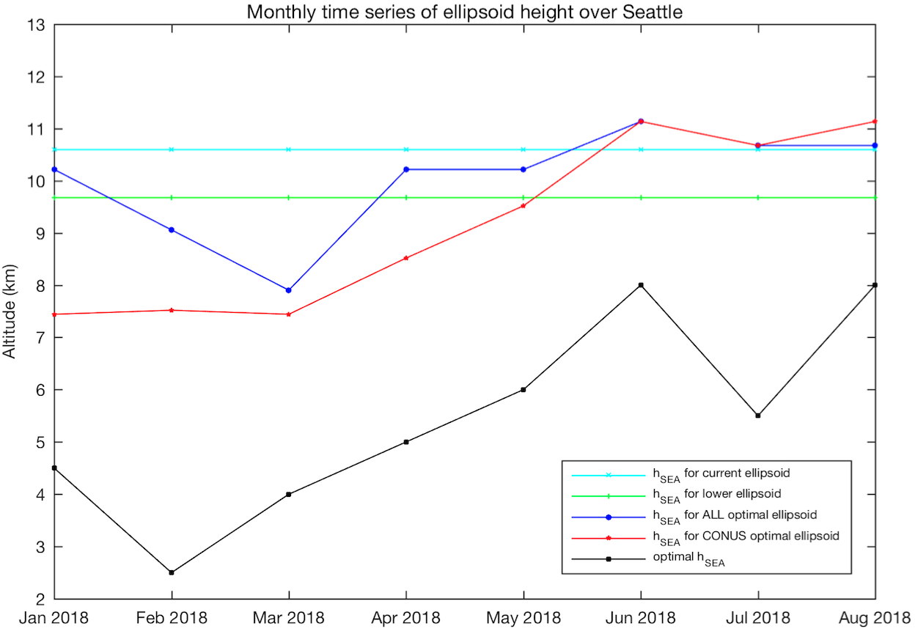
What is the optimal lightning emission height?
Renavigate groups from (lat₁, lon₁) for (e₁, p₁) to (lat₂, lon₂) for (h₂, h₂)
h₂ = 1, 1.5, …, 17 km
Match renavigated GLM data with reference networks
Identify h₂ that produces smallest mean error for each grid box
Notes:
What is location error in km during these months?

Slide 15
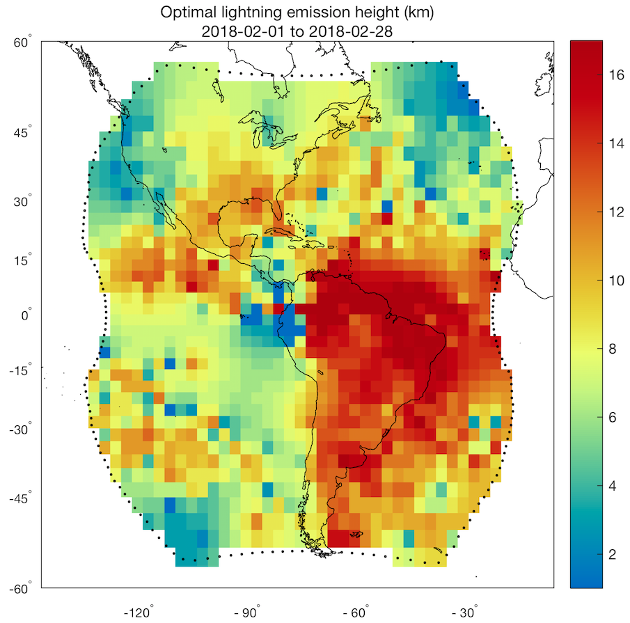
Optimal lightning emission height – February 2018
New ellipsoid
Optimal
Notes:
Address dipole near satellite subpoint

Slide 16
Performance of optimal lightning emission height

Slide 17
Performance of optimal lightning emission height

Slide 18
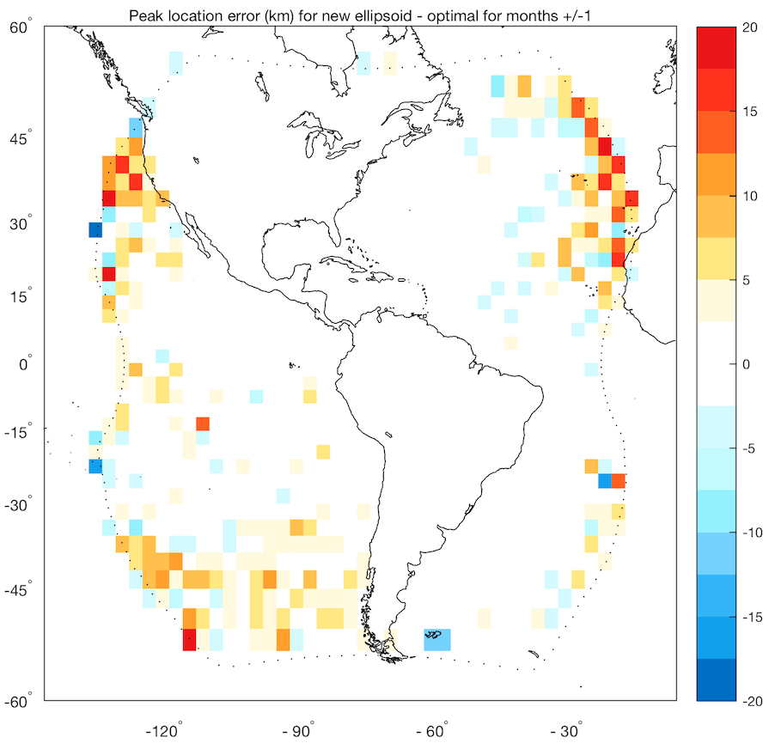
Performance of optimal lightning emission height

Slide 19
Conclusions
Lightning ellipsoid currently used for GLM displaces observations toward nadir; largest location errors near the limb
Lower ellipsoid (e=14 km, p=6 km) will be implemented
Monthly optimal lightning emission height maps are available that significantly improve location accuracy near the limb

Slide 21
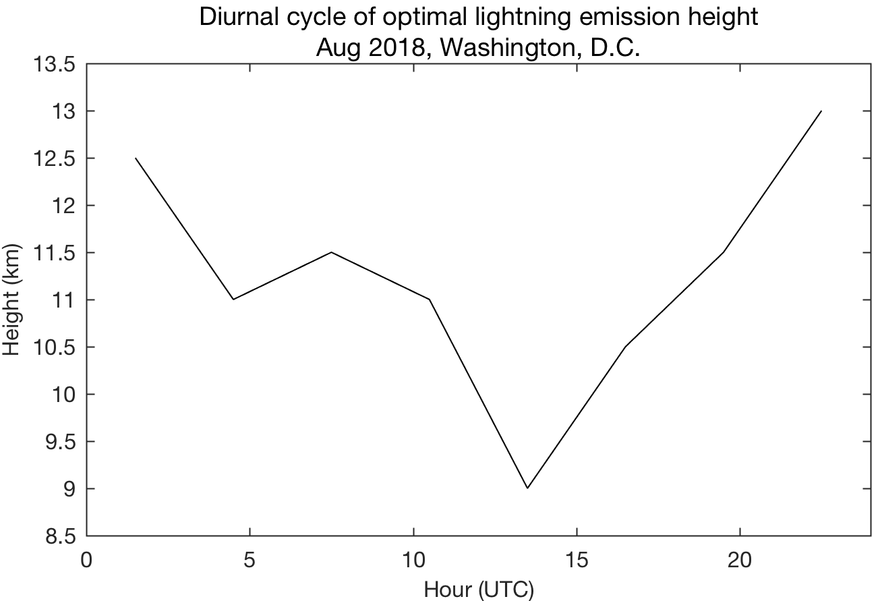
Optimal lightning emission height – diurnal
Notes:
Optimal for full month is 12 km

