Slide 1
RELAMPAGO Lightning Mapping Array Update
Timothy Lang
NASA Marshall Space Flight Center

Slide 2
NASA LMA Deployment Team
Timothy Lang, NASA lead
Rich Blakeslee
Walt Petersen
Brad Zavodsky
Larry Carey, UAH lead
Jeff Burchfield
Matt Wingo
Michael Solomon
Joy Marich
Steve Goodman
Eldo Avila
Acknowledgments
NOAA GOES-R Program
Wiebke Deierling
Steve Nesbitt
Paola Salio
Phil Bitzer
Betsy Goldemen
Carlos De La Vega
Eduardo Serena
Eric Bruning
Vanna Chmielewski
DOE-ARM
NCAR
… and many more!

Slide 3
GLM Science Hypothesis for RELAMPAGO
Argentinian storms produce some of the highest flash rates ever recorded from space
Due to similarity in geographic and atmospheric environments between Argentina and the U.S. High Plains, we hypothesize that many of these storms have anomalous charge structures, with predominantly positive charge in the mid-levels
Thus, most intracloud lightning flashes are smaller, occur at lower altitudes, and occur in more optically thick portions of the cloud
Therefore, we hypothesize that GLM (and LIS) flash rates are biased low in many Argentinian storms, due to reduced optical detection efficiency

Slide 4
LMA Deployment Details
11-station network
Sites already selected
6-month deployment (~October 2018 – April 2019)
Realtime communications via CloudGate + SIMs
Data QC and publishing within 6 months after deployment end

Slide 5
Range Error
km
Azimuth Error
Radians
Altitude Error
km
Source Detection
Efficiency (%)
Simulated error characteristics

Slide 6
Deployment Logistics
Delayed ~2 months due to difficulty in arranging NASA-Argentina agreement
Air shipping arranged by NASA
Customs brokering managed by Serena Group
Site selection major assist by Eldo Avila (ARM-DOE providing one site; sharing of some NCAR sites)
Site survey and installation led by UAH
In-country monitoring during RELAMPAGO EOP (Nov-Dec 2018)
Remote monitoring during rest of deployment (possible maintenance trips to check/reestablish stations)
First results presented at AGU 2018/AMS 2019 if possible

Slide 7
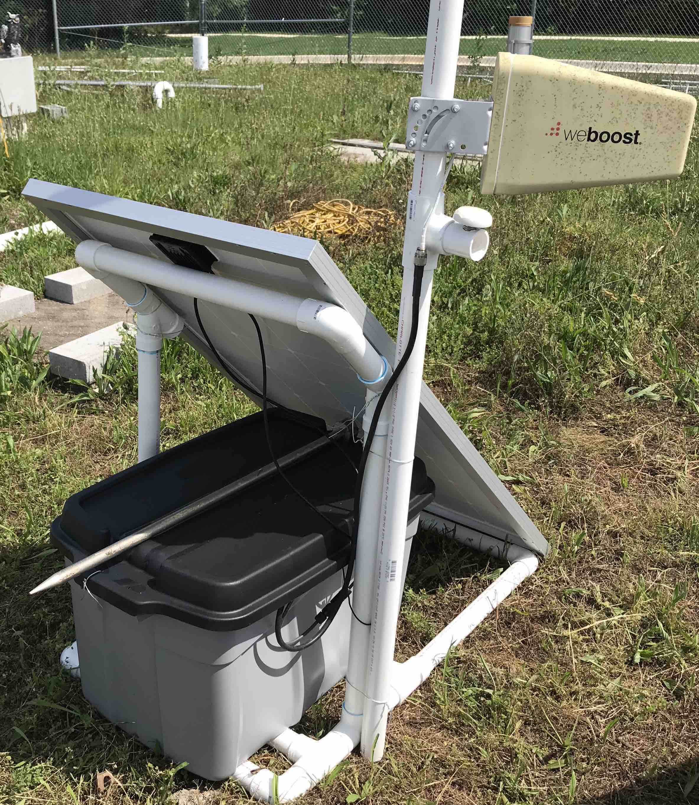
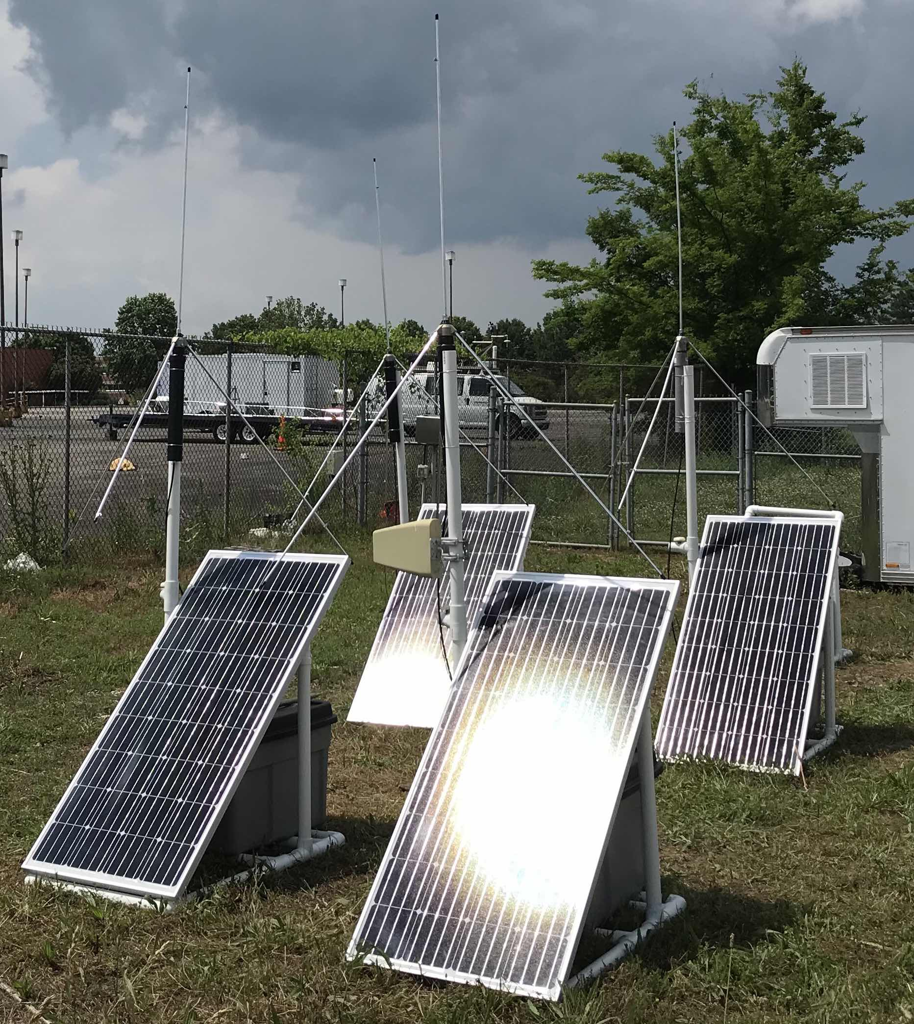

Slide 8
Complementary RELAMPAGO Measurements
GOES-16 ABI/GLM
NASA ISS-LIS
Field Change Meters (UAH)
Electric Field Mills (CU/NCAR)
LF Detectors (CU)
LEONA TLE camera network + Other Brazilian Lightning Sensors (USP/INPE)
C-band polarimetric radars (CSWR, CSU, SMN, ARM-DOE)
Mobile X-band Doppler radars (CSWR)
Soundings
Mobile/deployable near-surface meteorological measurements

Slide 9
Summary
NASA LMA deployment for RELAMPAGO moving forward – shipping in progress now
Aiming for October 2018 – April 2019 ops, inclusive of main RELAMPAGO EOP
Public QC’d data about a year from now

