Slide 1
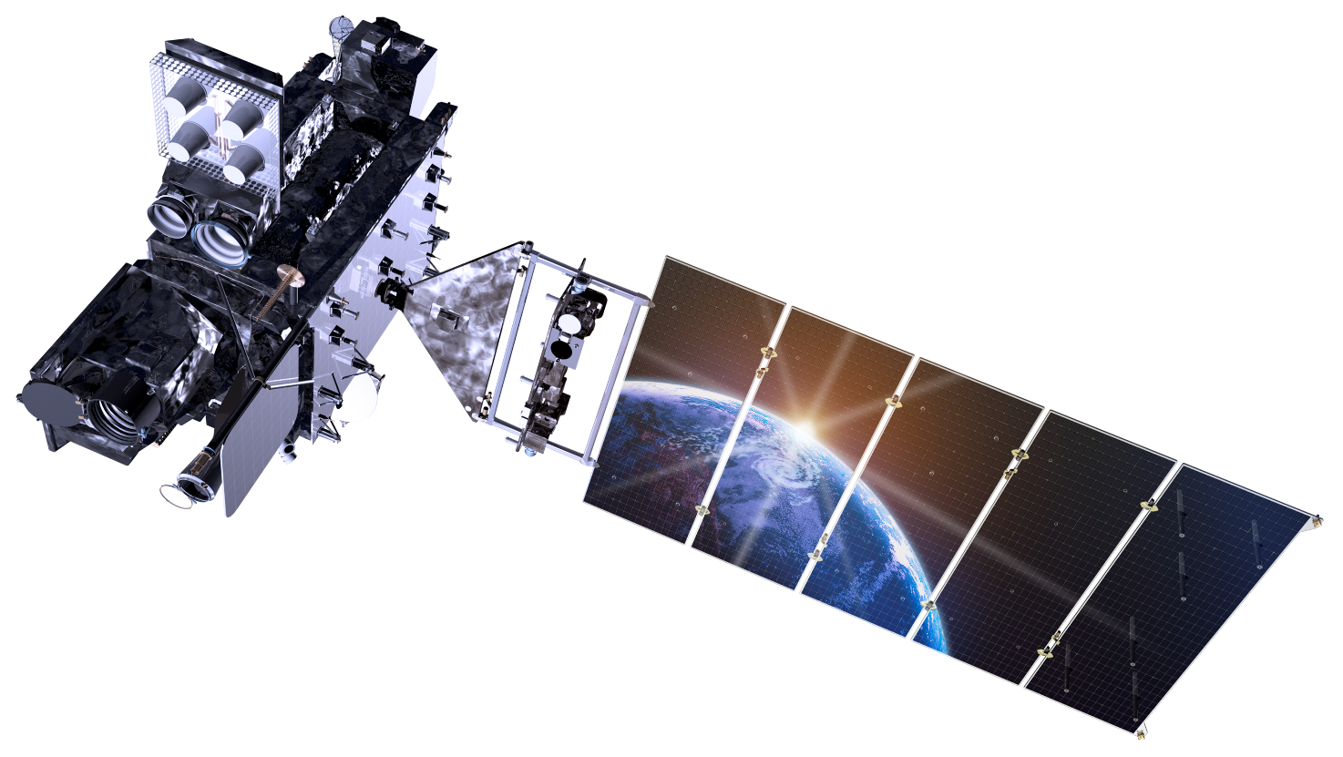
Geostationary Lightning Mapper Training Overview
Presented by Geoffrey Stano
Numerous individuals are part of this effort
GLM Science Meeting, 14 September 2018
Huntsville, Alabama

Slide 2
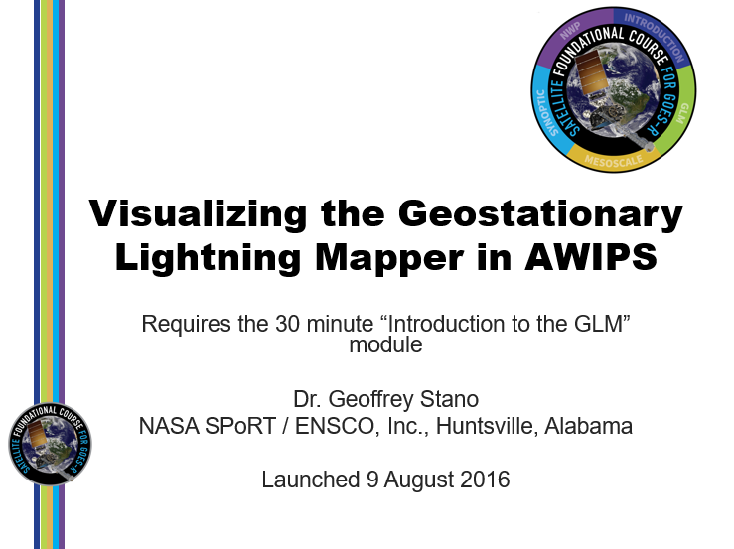
GLM Training: Motivation and Development
(Left) GLM visualizations in the Satellite Foundational Course
(Right) Example using PGLM for the SOO-Prep Course
Satellite Training Advisory Team (STAT): Organize efforts to prepare for GOES-R/S and JPSS
Satellite Liaisons played important role
Early work for GLM and other capabilities included:
Satellite Foundational Course for GOES-R
SOO-DOH Prep Course for GOES-R

Slide 3
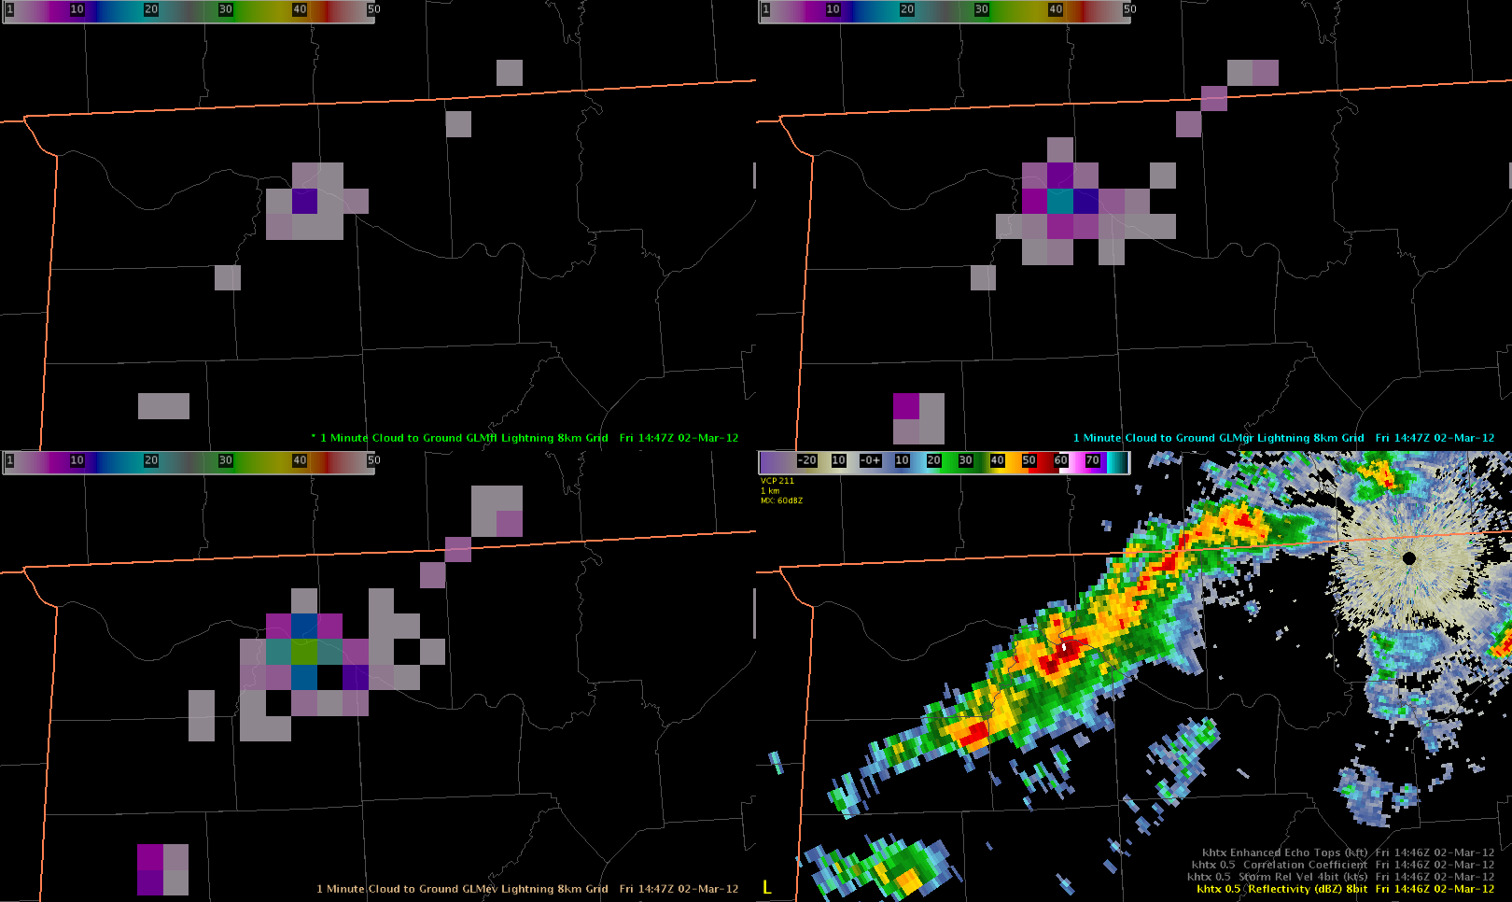
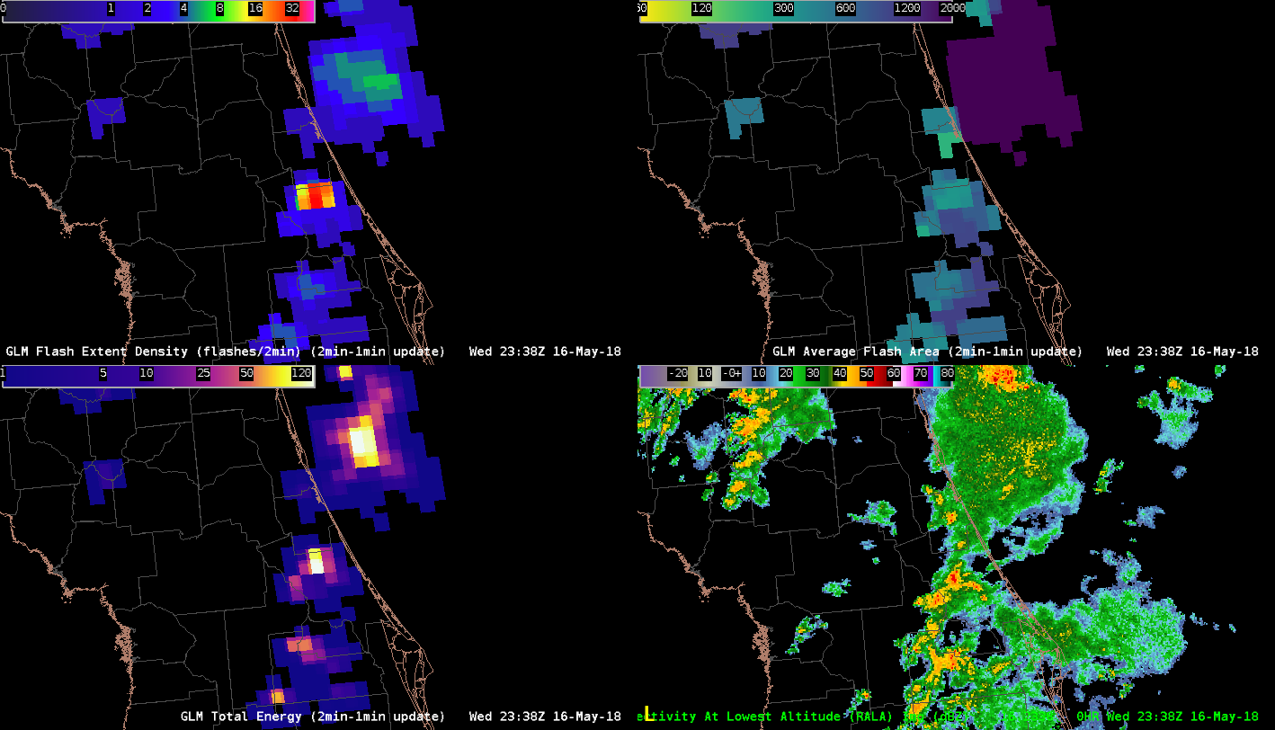
GLM Training: Recent Product Changes
Flashes
Groups
Large issue for GLM: Available data
ABI could use SEVIRI, Himawari, MODIS, and SNPP-VIIRS as demonstrations
GLM had no equivalent beyond the TRMM-Lightning Imaging Sensor
Major changes to proposed GLM products
Initial work: Event, Group, and Flash densities on the GLM grid
Current paradigm: Flash extent density (and others) on the ABI fixed grid (2×2 km)
Had to rework training as initial baselines developed. Thanks HWT!!
Events
Original AWIPS concept
Flash Extent Density
Average Flash Area
Total Optical Energy
Planned operational release

Slide 4
GLM Training: Recent Developments
Current efforts:
Quick Guide: front and back page
Quick Brief: 5-6 min overview
Focus: Basic familiarization
Availability:
AWIPS Integrated Reference (AIR)
STOR and Virtual Lab
NWS Commerce Learning Center
Scope:
Intended as initial piece of training
More to follow

Slide 5
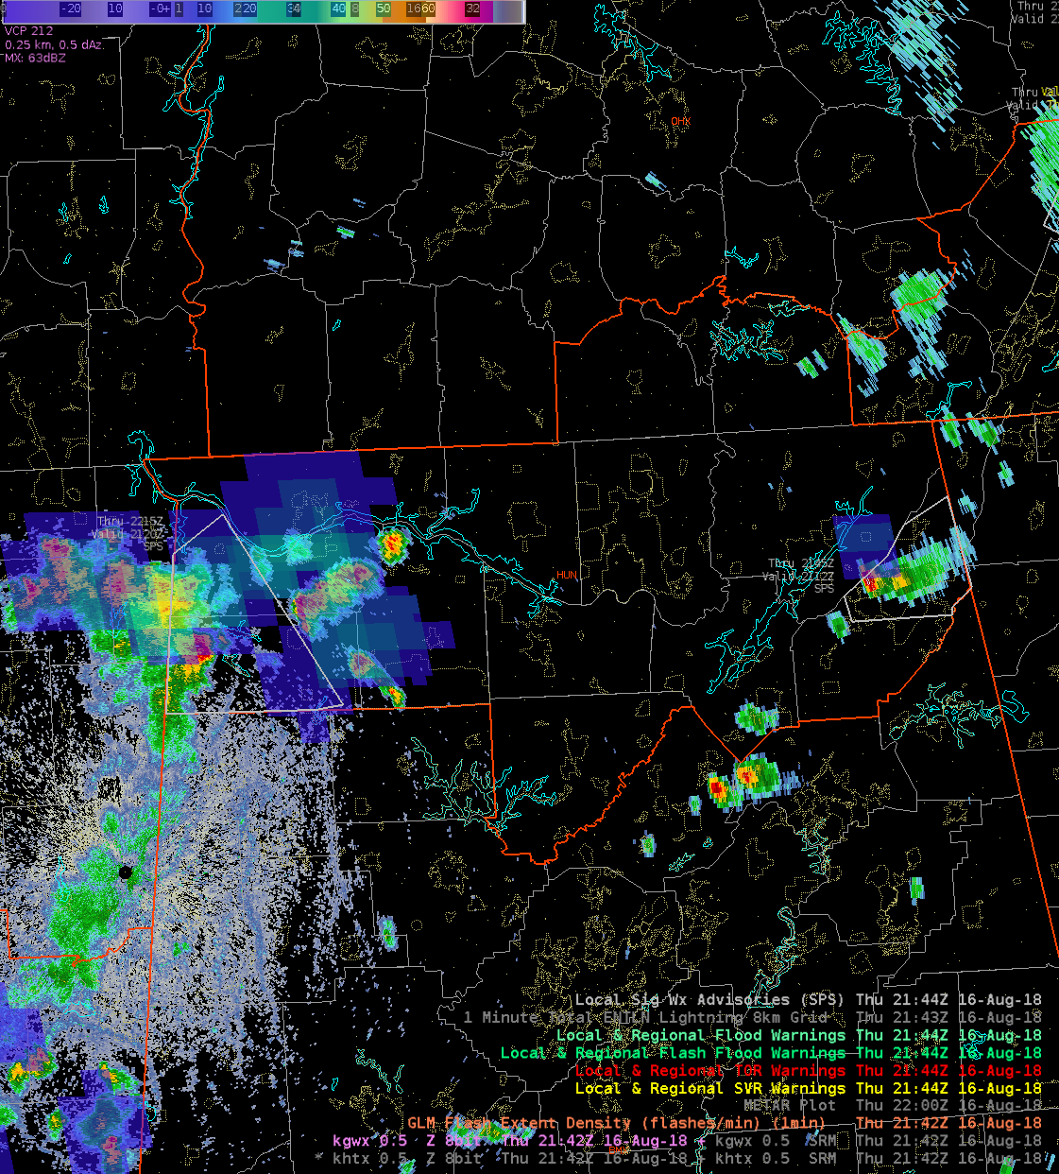
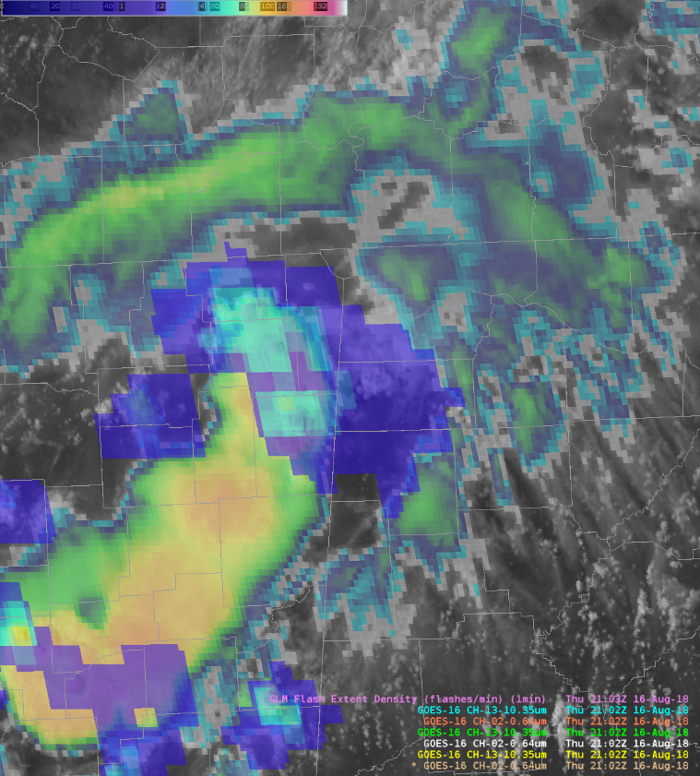
GLM Training: Importance of Assessments
Training is being strongly influenced by assessment feedback
Hazardous Weather Testbed provided initial foundation
Implement average flash area and total optical energy
Pre-operational assessment
Highlighting “clear-air” discharges
Cases where storms have low GLM flash counts
Feedback demonstrating gaps that subsequent training must address
“Clear-air” discharges
Include image from Scott’s training
Include CHS example

Slide 6
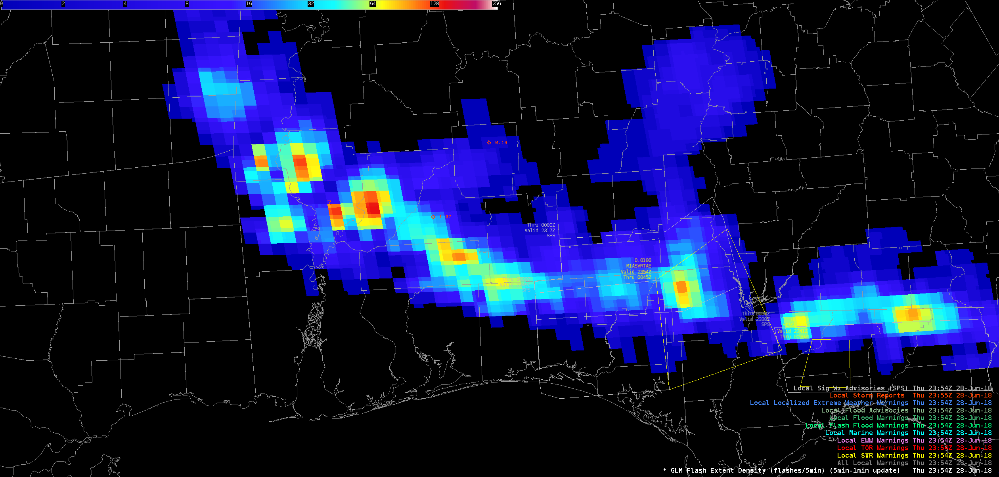
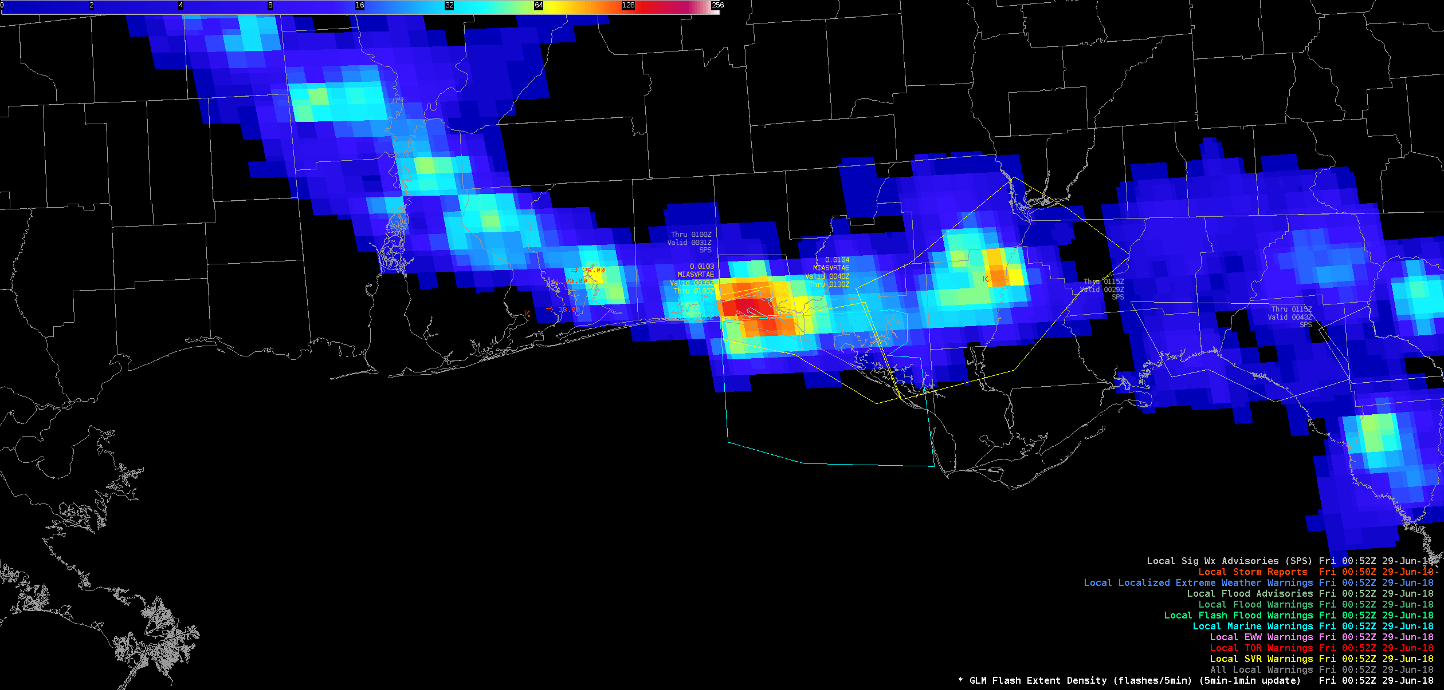
GLM Training: Looking Forward
Current training is just the first step
Update the Foundational Course
Recommendations from the field
Traditional Warning Event Simulation case
Common baseline knowledge (some of this material likely exists now)
More operational examples – Applications Library

Slide 7
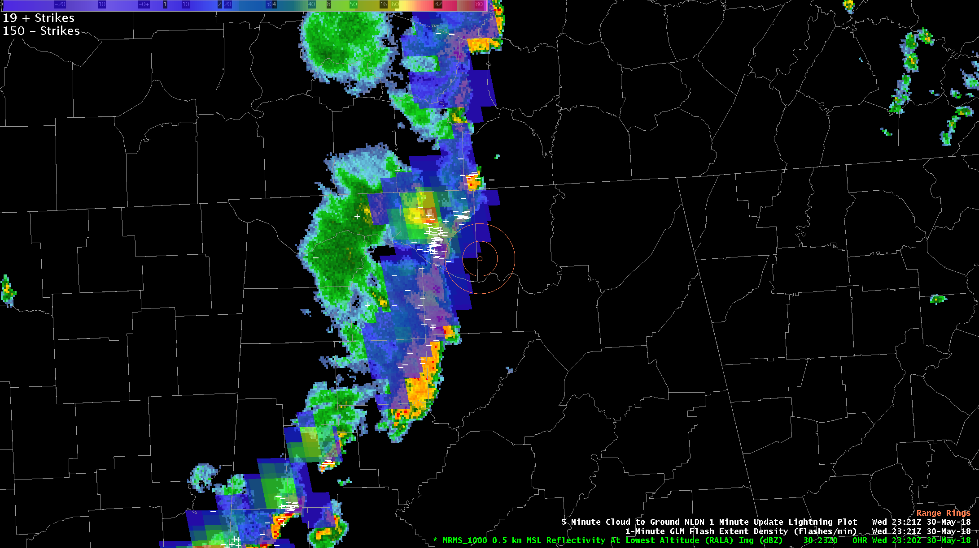
Initiating the Airport Weather Warning
Storms approaching Huntsville International Airport
GLM flash extent density overlaid on MRMS Reflectivity at Lowest Altitude with NLDN cloud-to-ground flashes (white).
Yellow rings are 5 and 10 nm from airport.
Airport Weather Warning based on lightning within 10 and 5 nm (yellow rings)
NLDN showing active lightning approaching the airport
GLM provided insight, but NLDN was primary lightning data used
2321 UTC
Notes:
Initially at 2321 UTC, there was a line of storms approaching the Huntsville International Airport. Forecasters were monitoring storms to determine if an airport weather warning would be necessary with lightning occurring within 5 and 10 nautical miles of the airport. The traditional NLDN cloud-to-ground observations indicated the line was electrically active and that an airport weather warning was needed. At this time, the GLM simply reinforced what the NLDN data provided.

Slide 8
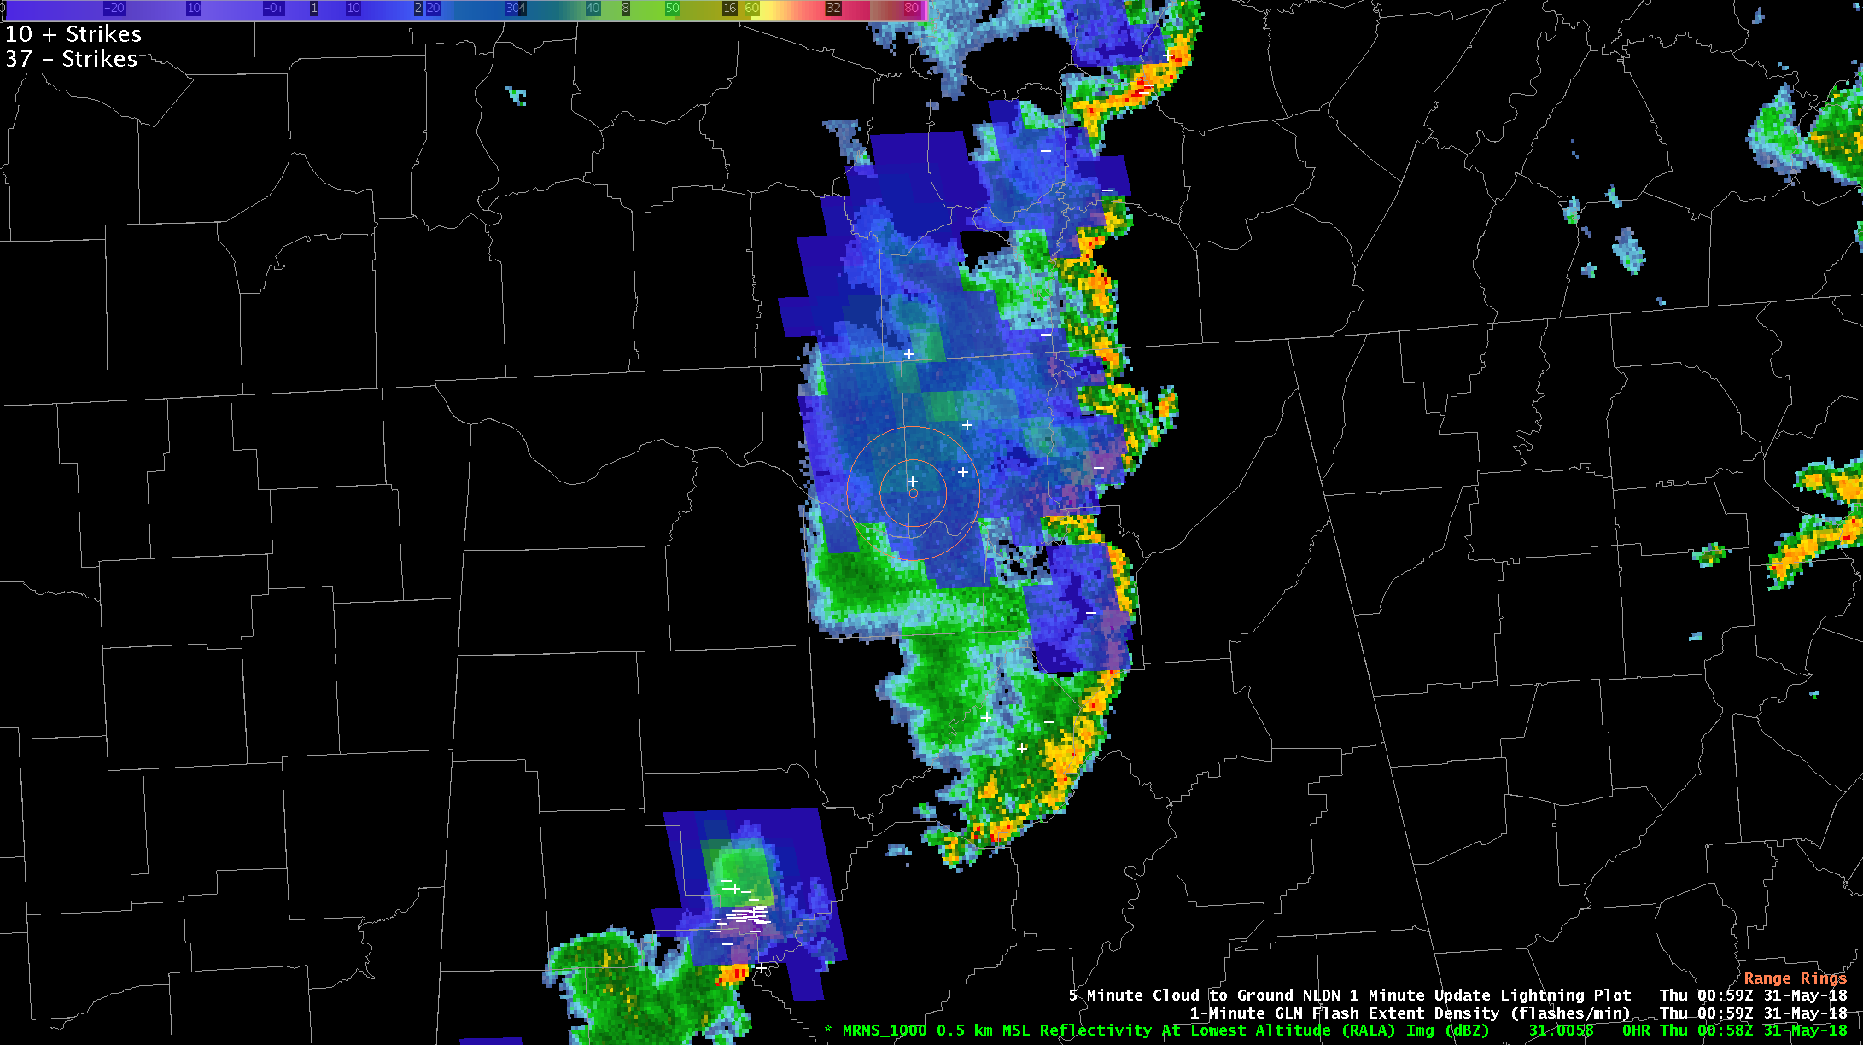
Continuing the Airport Weather Warning
GLM flash extent density far more useful later in the event
GLM flash extent density overlaid on MRMS Reflectivity at Lowest Altitude with NLDN cloud-to-ground flashes (white).
Yellow rings are 5 and 10 nm from airport.
Storms had pushed well east of airport
Convection weakening and overall lightning activity decreased
However, GLM played significant role in identifying long flashes in trailing stratiform region
GLM showed lightning continuing over the airport
GLM illustrated the threat simply and effectively
0059 UTC
Notes:
The GLM flash extent density data were far more useful later in the event. By 0059 UTC on May 31, the storms had pushed well to the east of the Huntsville airport and metro area. Additionally, the convection was weakening with a corresponding decrease in lightning activity. It was at this time, however, that the GLM played a significant role. The GLM flash extent density was identifying numerous flashes propagating westward into the stratiform region. This showed active lightning activity over the airport and confirmed the need to maintain the airport weather warning. Although not used in this specific case, the 5 minute GLM summation would have provided similar information by showing the areal coverage for the past five minutes. In this case, the GLM illustrated the threat posed by lightning simply and effectively.

Slide 9
Questions?

