Slide 1
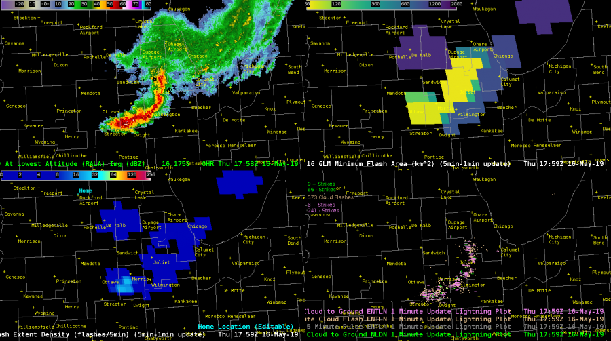
Geostationary Lightning Mapper:
Minimum Flash Area
Quick Guide
MFA Background
Minimum Flash Area (MFA) reports the minimum size of any GLM flash spatially coincident with each 2×2 km grid cell during a specified time period
MFA values range from a minimum of 1 GLM pixel (~64 km²) to thousands of km²
MFA portrays several features of interest:
Strengthening storm cores often produce smaller, more frequent flashes; using MFA alongside Flash Extent Density (FED) helps identify this
MFA indicates the spatial extent of large flashes and helps differentiate anvil/stratiform flashes from embedded, newly-developing convection
MFA helps monitor the development, growth, and displacement of the stratiform region (i.e., lead, side, trailing), providing insights into system evolution and the primary convective mode/hazard
Hazardous Weather Testbed Cases
“From an IDSS standpoint, MFA and FED proved it’s necessary to look at both GLM products and ground based lightning products to see the “total” picture.”
“GLM products captured a larger flash that extended out into the stratiform area behind the main line that is not seen in the ENTLN and NLDN products. This information can be especially important for Airport Weather Warnings and/or outdoor venues. You can easily see that the flash extends almost back to the Rockford Airport, while the main line and most of the flashes are ~80 miles away.”
“Storms are trending sub-severe across most of our CWA at this hour, but one cell behind the initial line started getting its act together.”
“The large FED and MFA bullseye imply the updraft is intensifying on this storm. This proved to be a useful proxy because this was the result 8 min later:”
“This suite of products has a lot of utility for pulse severe events and IDSS on-site weather events.”
Minimum Flash Area (MFA)
Flash Extent Density (FED)
* Rockford Airport
~80 miles
National Lightning Detection Network (NLDN) Earth Networks Total Lightning Network (ENTLN)
Primary MFA Applications
Detect/Monitor Thunderstorm Growth – MFA color map accentuates small flashes to highlight the earliest lightning, then MFA provides a visual cue to help quantify subsequent storm growth
Monitor Convective Mode and Storm Evolution –MFA trends are indicative of storm life cycles [e.g., frequent small flashes within the most intense convection (< 300 km²) and a tendency for larger flashes as storms weaken (> 600 km²)]
Monitor the Lightning Areal Extent – Extensive anvil and stratiform flashes result in large MFA values; regions with large MFA are important due to their less obvious risk of cloud-to-ground (CG) lightning, an important consideration during IDSS operations
Time 1
FED
MFA
Cell of interest
Suggests strengthening
0.5° Z
Time 2
FED
MFA
Potential new pulse storm
Stronger reflectivity
0.5° Z
Authors: Joseph Patton, CISESS/UMD
Scott Rudlosky, NOAA/NESDIS/STAR Version 1 – December 7, 2020

Slide 2
Geostationary Lightning Mapper:
Minimum Flash Area
Quick Guide
Yellow/Green MFA Reveals:
Smaller flashes occurring in newly developing (isolated or embedded) or strengthening convection (can suggest growing severe weather potential)
Blue/Purple MFA Reveals:
Larger flashes occurring in the anvil / stratiform regions of mature storms and in the cores of decaying storms
Extensive stratiform flashes often break the 30/30 lightning safety rule, and are important for public safety via aviation and IDSS applications
Flashes connecting distant storm cores, also indicative of CG lightning threat (see below)
B
B
A
A
A
B
B
B
C
A
A
18:06 Z
0.5° Z
18:11 Z
C
18:16 Z
18:21 Z
C
Messy radar scene
5 min intervals are shown, but the GLM provides new insights every minute!
FED
Little FED contrast
Unknown whether GLM factored into this warning decision, but it could have
MFA
C
MFA provides new context on flash size variability!
C

