Slide 1
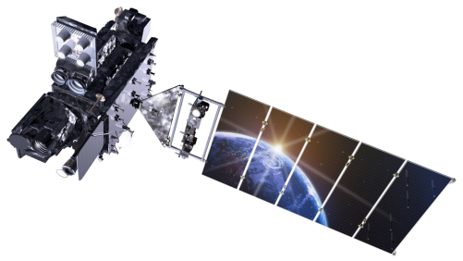
Geostationary Lightning Mapper (GLM) Quick Brief: GLM Data Quality

Slide 2
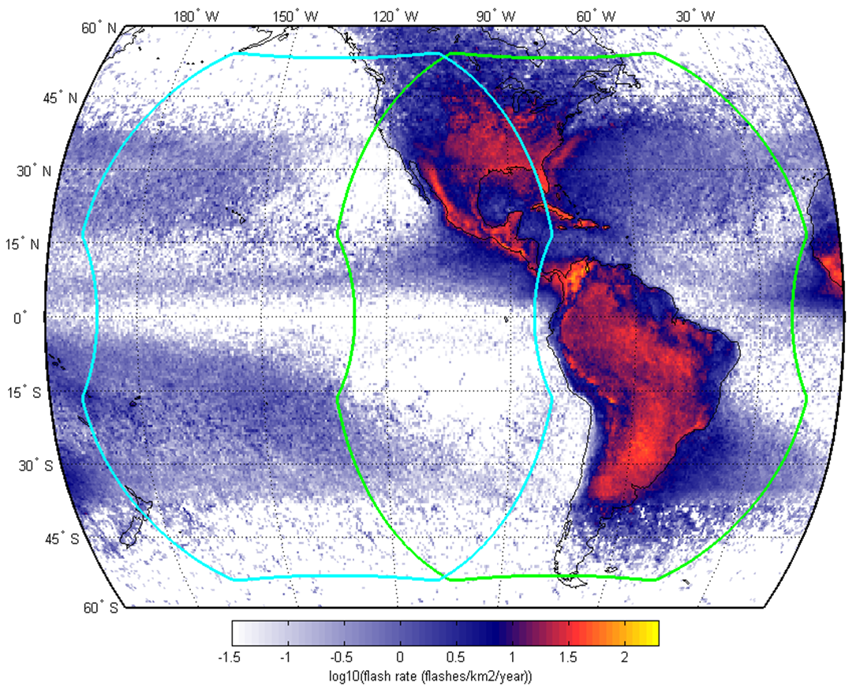
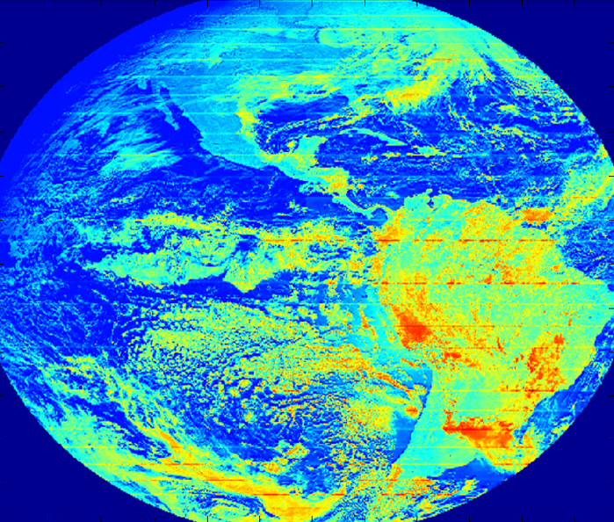
Geostationary Lightning Mapper
The GLM is a new instrument undergoing extensive calibration and validation
The GOES team worked alongside the instrument vendor to reach beta (June 2017) and provisional (January 2018) maturity status
All known issues are being worked in preparation for the full validation review
Performance Requirements
Full disk coverage
Detection efficiency > 70%, averaged over full disk and 24 h
Flash false alarm rate shall be less than 5%, averaged over 24 hours
Navigation error within ±112 microradians (~1/2 pixel or ~4 km)
Dynamic range greater than 100 at all times everywhere in FOV
All four GLM flight models will go through the same maturity review process

Slide 3
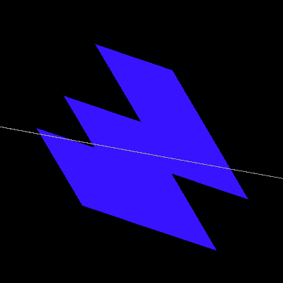
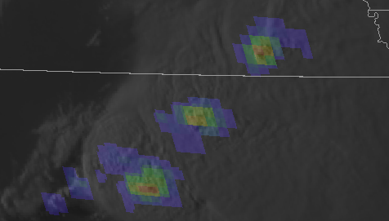
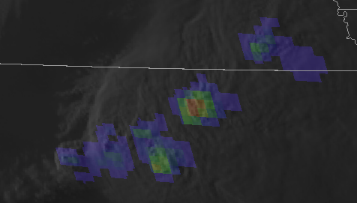
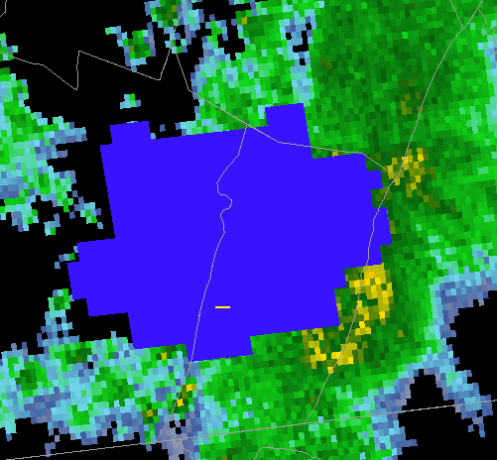
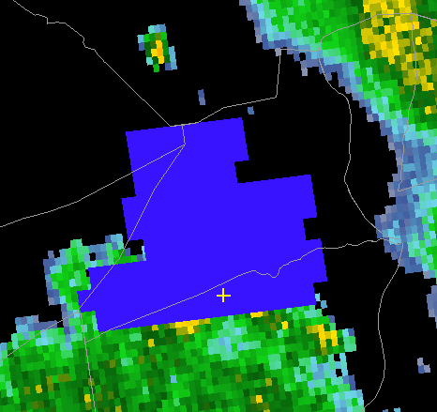
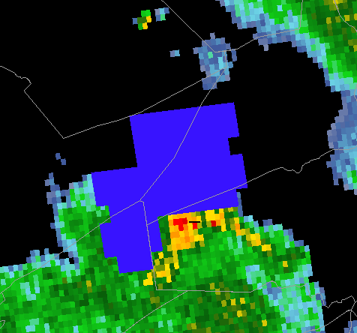
Pixel Geometry / Location Accuracy
GLM is a variable pitch CCD array with 56 sub arrays and 1372 x 1300 pixels
Variable pitch reduces the growth of GLM pixel footprints away from nadir, but the pixel size, shape, and orientation still vary
Gridded GLM products have a similar parallax effect to the ABI
Parallax results in the gridded GLM products appearing shifted away from nadir
Near the limbs, where the parallax is most pronounced, GLM observations of side-cloud illumination partially counteract the parallax by shifting the GLM towards nadir
Five GLM pixels south of Cuba
Five GLM pixels on the boarder of Montana and Canada
GLM well matched with ABI
GLM, NLDN, and base reflectivity over Pennsylvania

Slide 4
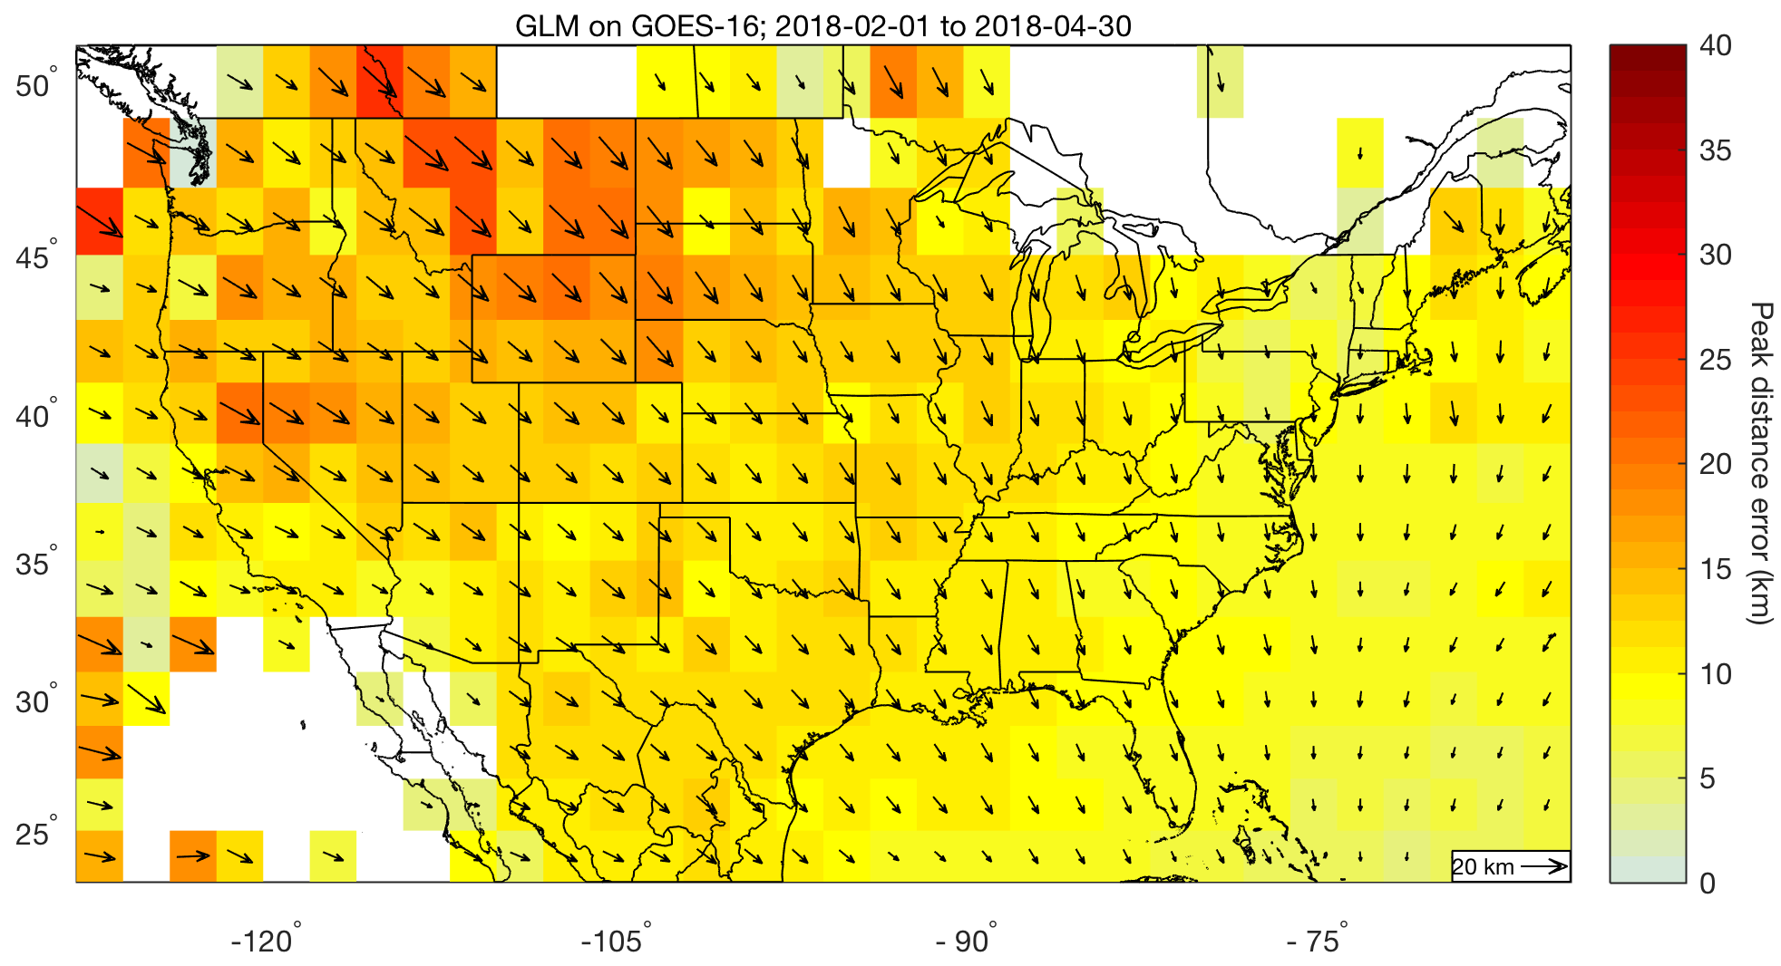
Geospatial Considerations
Parallax results in the gridded GLM products appearing shifted away from nadir
Plot depicts the direction vector and peak distance offset that must be applied for the GLM to match the ground-based networks

Slide 5
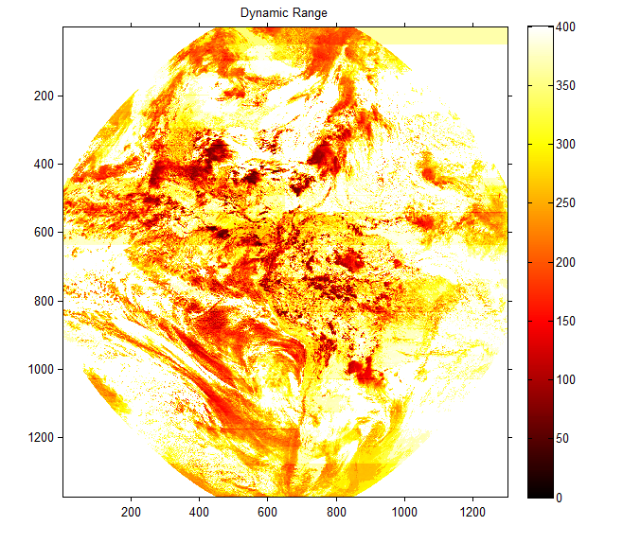
GLM Sensitivity and False Events
GLM seeks to maximize detection efficiency while minimizing the false alarm rate
False alarm rate is the number of false flash detections divided by the average true flash rate
Each subarray is independently tuned to optimize the dynamic range and sensitivity
Real Time Event Processors (RTEPS) are like lawn mowers
Blade too high = low sensitivity to dim lightning
Blade too low = flood downlink with false events
56 channels * 32 BG levels = 1792 thresholds
GLM is a variable pitch CCD array with 56 sub arrays and 1372 x 1300 pixels

Slide 6
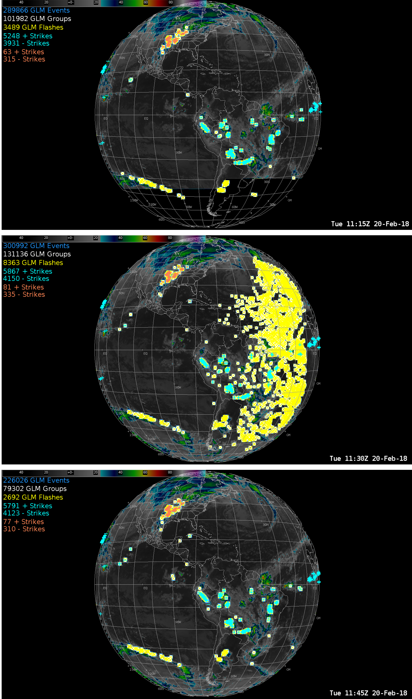
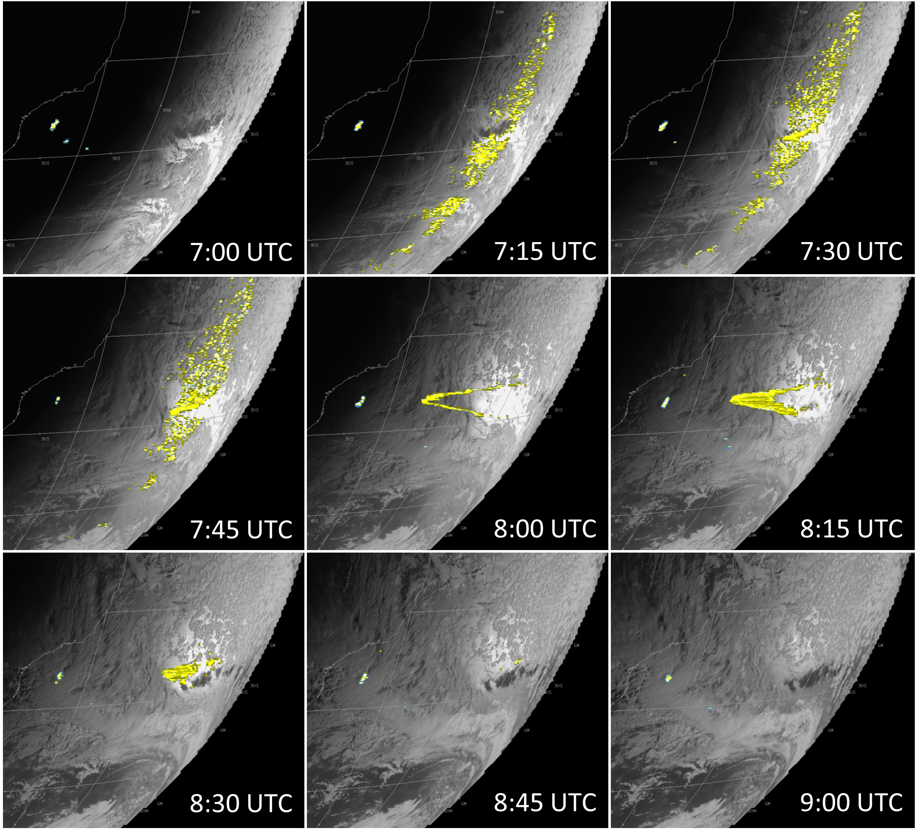
False Events
Platform disturbances from momentum adjust maneuvers and instrument calibration scans
River/Lake/Ocean Glint – Calm body of water and proper sun angle (results in blooming artifact)
5 May 2018
15-16 UTC
16-17 UTC
17-18 UTC
Columbia
Venezuela

Slide 7
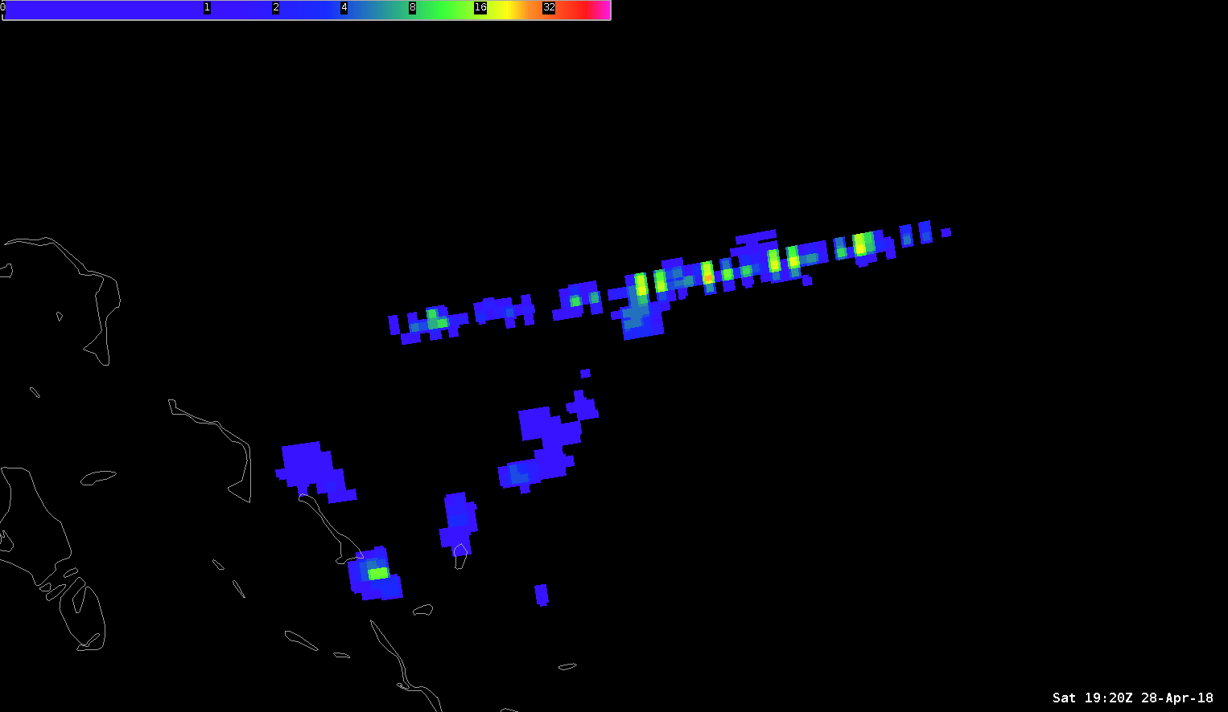
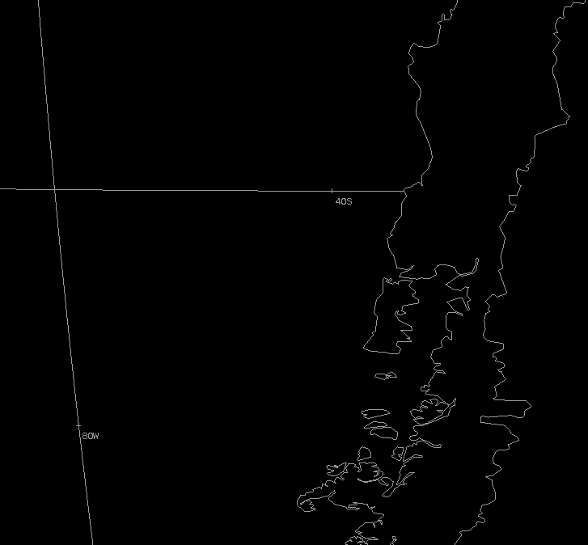
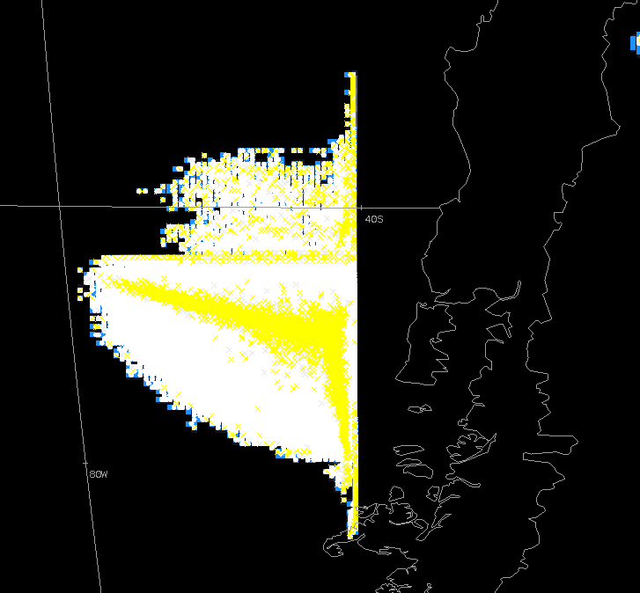
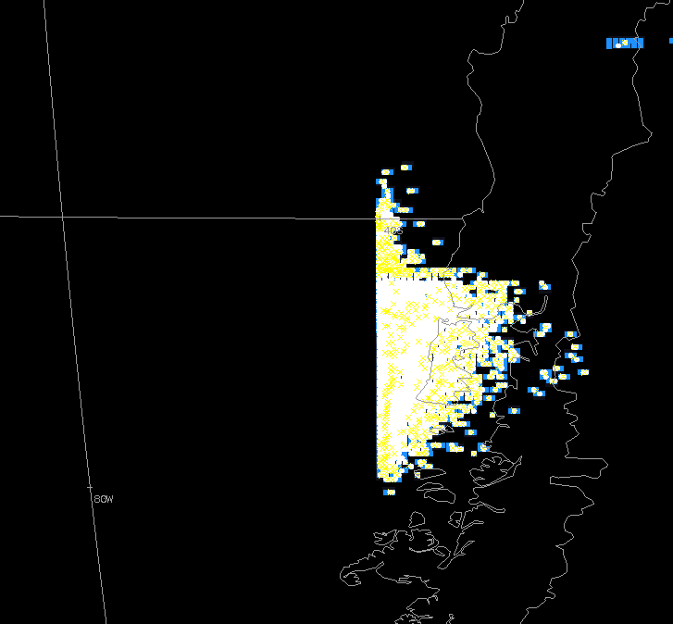
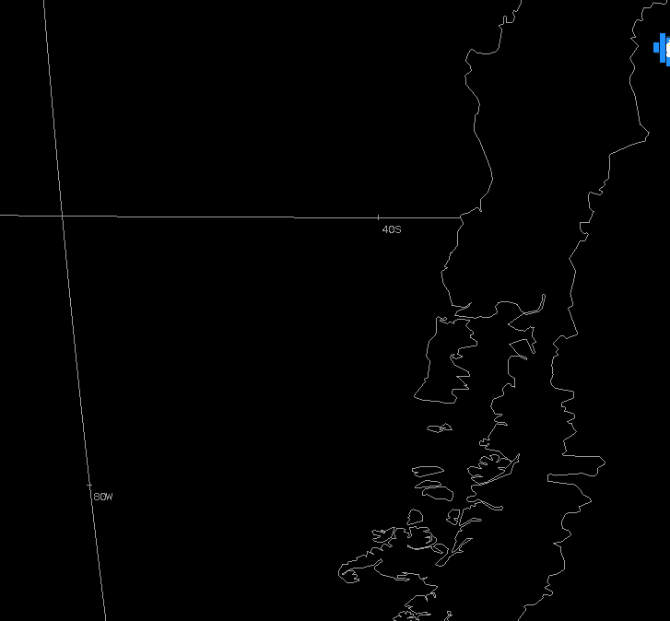
False Events
False events at the edge of subarrays
Overshoot at RTEP boundaries
Threshold to noise ratio drops (sensitivity increases) when bright clouds persist over RTEP boundaries
Solar intrusion during eclipse season
Blooming filter awaiting implementation
Bahamas
This example will be improved in the near term by updating RTEP thresholds (early fall 2018)
The GLM is susceptible to brief outages driven by bursts of false events (short term fix planned for early fall 2018)
5:00 UTC
5:15 UTC
5:30 UTC
5:45 UTC
20 February 2018
40° S
80° W
Many sources of false events (and related data outages) will be mitigated in the longer term by implementing a blooming filter and data quality product

Slide 8
Mitigation Efforts
The GOES ground system (GS) produces the Level 2 GLM data, GS updates are provided as periodic software patches
Two most notable planned updates are the blooming filter and the L1b overshoot & second level threshold adjustments
The blooming filter quenches the rapid growth of artifacts associated with both sun glint and eclipse effects
The GOES team is working towards deploying a data quality product and gridded products from the GS
The gridded GLM products are being produced and provided via experimental channels (reliability/support will improve beginning fall 2018)

Slide 9
Summary
All known issues are being worked in preparation for full validation
Similar parallax effect as the ABI, lessening location accuracy near limbs
Sources of false events (will be addressed by ground system updates)
False events at the edge of subarrays
River/Marsh/Ocean Glint
Space craft maneuvers – momentum adjust and instrument calibration
Solar intrusion during eclipse seasons (spring and fall)
Working to optimize the efficiency and accuracy of the gridded products
Additional Information:
GLM VLab Page (https://vlab.ncep.noaa.gov/web/geostationary-lightning-mapper/home)
Short Course (https://www.meted.ucar.edu/satmet/goesr_faculty_recordings/glm_lightning)
UMD Website (http://lightning.umd.edu/)
NASA SPoRT (https://weather.msfc.nasa.gov/sport/)

