Slide 1
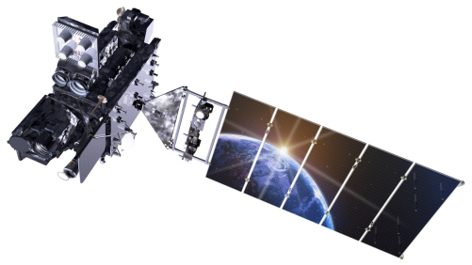
Geostationary Lightning Mapper (GLM) Quick Brief: Flash Extent Density

Slide 2
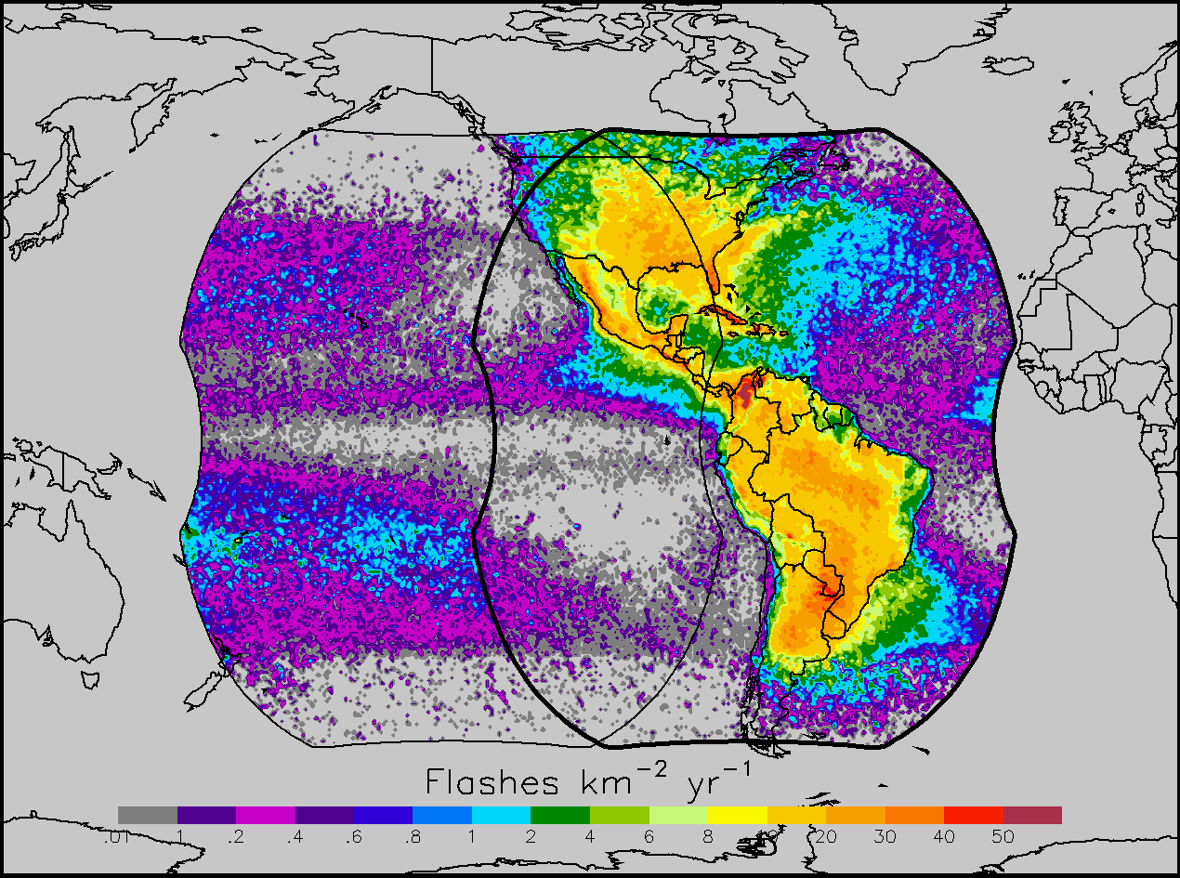
Geostationary Lightning Mapper
Provides continuous, full disk total lightning measurements, with coverage to 54° N/S
Detects >70% of all flashes (24 hour average)
Detects electrically active storms and the areal lightning extent
Track embedded convective cells, identify strengthening and
weakening storms, monitor convective mode and storm evolution, characterize storms as they transition offshore, provide insights into tropical cyclone intensity changes

Slide 3
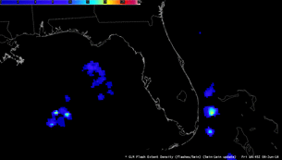
GLM Gridded Products
GLM Level 2 data (events, groups, and flashes) are produced as points, resulting in a loss of information concerning the spatial extent
New gridded GLM product restores and disseminates the
spatial footprint information while greatly reducing file size
Gridded GLM products involve re-navigating the GLM event latitude / longitude to the 2×2 km Advanced Baseline Imager (ABI) fixed grid
Flash extent density (FED), the number of flashes that occur within a grid cell over a given period of time, is the first NWS product

Slide 4
GLM Gridded Products
A corner point lookup table is used to re-create event polygons from the L2 points
Parent-child relationships are used to combine the event polygons into group and flash polygons
Subset of GLM FOV
These polygons then are subdivided at the flash, group, and event levels by slicing them with the ABI fixed grid
The next step accumulates and weights the sliced polygons at the flash, group, and event levels to create the gridded products
FED values are rounded arithmetically to the nearest integer
Group 1
GLM L2 Event Locations
ABI
Fixed
Grid
One Flash
Group 2
FED = 1
0 < FED < 1
This slide includes animations designed for PowerPoint

Slide 5
GLM Gridded Products
Many years of research and operational LMA demonstrations have shown the flash extent density (FED) to be the preferred total lightning product
FED best portrays, in a single product, the quantity/extent of GLM flashes/events
The initial plan is for the 1-min and 5-min window FED grids to reach AWIPS within ~1 minute
FED is the only product in the initial AWIPS deployment

Slide 6
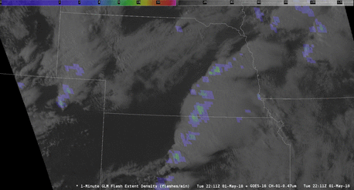
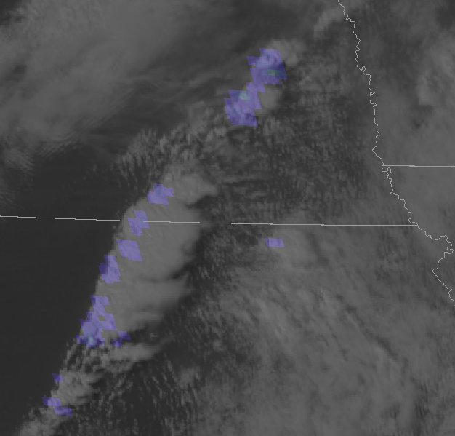
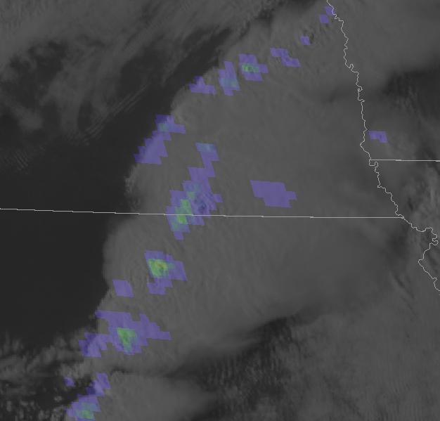
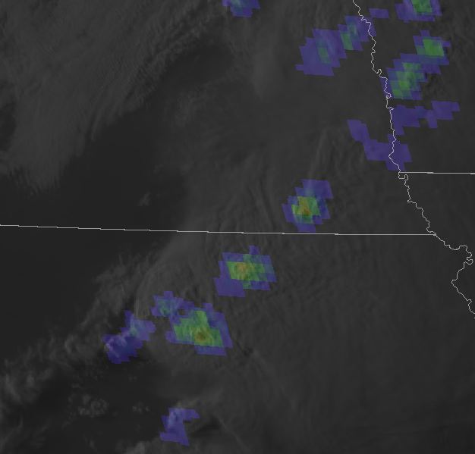
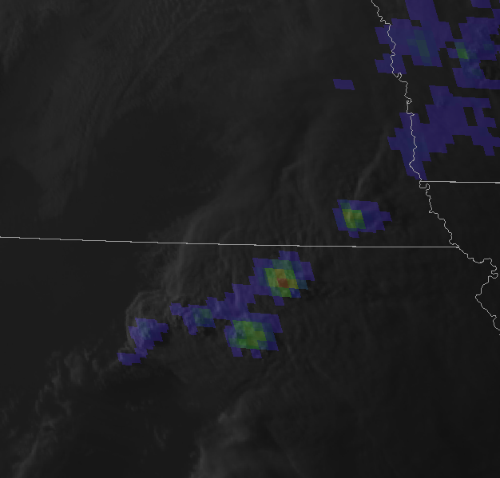
Example AWIPS Imagery
1-min GLM FED with 1-min mesoscale ABI visible imagery
Illustrates convective processes on a variety of scales

Slide 7
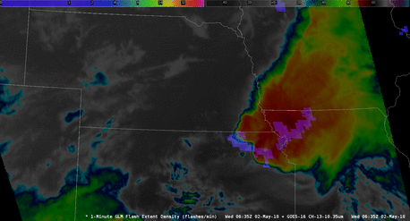
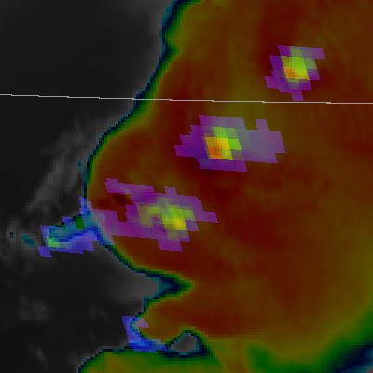
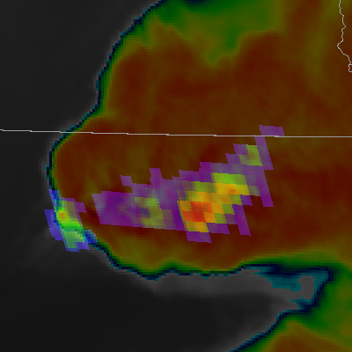
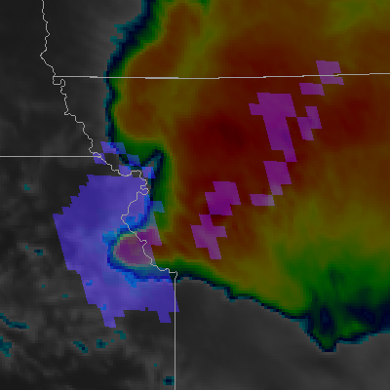
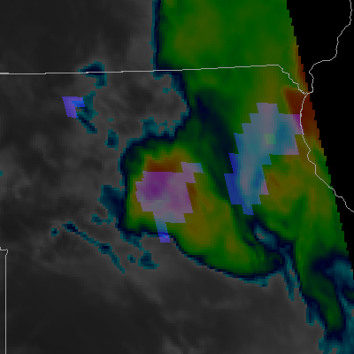
Example AWIPS Imagery
1-min GLM FED combined with 1-min ABI IR brightness temperatures
At night, flashes are easier to detect and appear larger
Low cloud illumination

Slide 8
Additional Gridded Products
Additional gridded GLM products are being evaluated for future AWIPS deployment
Average flash area (AFA) and total optical energy (TOE) complement FED to maximize the insights provided by the GLM
AFA and TOE also help diagnose the GLM data quality and illustrate the subtleties of space-based optical lightning observations
FED
AFA
TOE

Slide 9
Summary
GLM provides continuous, full disk total lightning measurements
New gridded FED product rolling out during Spring/Summer 2018
Restores and disseminates the spatial footprint information
The FED (flash count per grid cell) is the first NWS product
The GLM is re-navigated the 2×2 km ABI fixed grid
Corner point lookup table and parent-child relationships are used
Sliced polygons accumulated/weighed to create gridded products
FED best portrays the quantity / extent of GLM flashes / events
Additional Information:
GLM VLab Page (https://vlab.ncep.noaa.gov/web/geostationary-lightning-mapper/home)
Short Course (https://www.meted.ucar.edu/satmet/goesr_faculty_recordings/glm_lightning)
UMD Website (http://lightning.umd.edu/)
NASA SPoRT (https://weather.msfc.nasa.gov/sport/)

