Slide 1
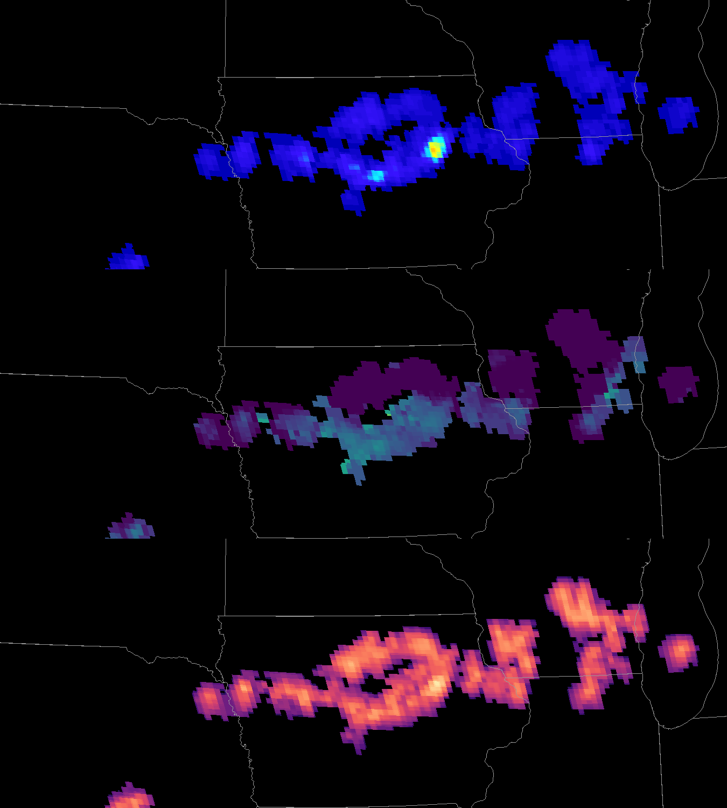
Geostationary Lightning Mapper:
Gridded Products: AFA and TOE
Quick Guide
AFA and TOE Background
Average flash area (AFA) is the average area of all GLM flashes spatially coincident with each 2×2 km grid cell during a specified time period
AFA has units of km², with values ranging from a minimum of 1 pixel or ~64 km² to several thousand km² for regions with extensive stratiform flashes
Total optical energy (TOE) is the sum of all optical energy that the GLM observes within each grid cell during a specified time period
TOE has units of femtojoules (fJ; 10⁻¹⁵ J), with values on the order of decimals for the dimmest flashes to over 1000 fJ for regions with many bright flashes
AFA and TOE complement flash extent density (FED) to maximize the insights provided by the GLM
AFA and TOE also provide context for understanding GLM data quality and the subtleties of space-based optical lightning observations
Flash Extent Density
Average Flash Area
Total Optical Energy
Primary TOE Applications
TOE directly depicts optical lightning observations – provides the most intuitive GLM portrayal
Identify strengthening and weakening storms – forecasters have likened the use of TOE to watching a light bulb brighten/dim as the storms grow/decay
Characterize convective scenes – the TOE helps make inferences regarding the surrounding cloud scene [e.g., the TOE helps distinguish between deep convection and the dimmer low level clouds it often illuminates (most common at night)]
Analyze the cloud-to-ground lightning threat - TOE indicates lightning channel locations within extensive stratiform flashes, along which these flashes commonly strike ground [e.g., FED often illuminates large cloud areas (especially at night), TOE illustrates the actual lightning channel extent
Primary AFA Applications
Detect/Monitor Thunderstorm Growth – the AFA color map accentuates small flashes to highlight the earliest flashes, AFA also provides a visual que to help quantify subsequent storm growth
Observe the areal lightning extent – the AFA indicates the occurrence of large/long flashes and helps differentiate anvil/stratiform flashes from embedded, newly-developing convection
Monitor convective mode and storm evolution – the AFA trends are indicative of storm life cycles [e.g., frequent small flashes within the most intense convection (< 300 km²) and a tendency for larger flashes as storms weaken (> 600 km²)]
Author: Scott Rudlosky, Ph.D.
NOAA/NESDIS/STAR (CICS-MD) Version 1 – August 7, 2018

Slide 2
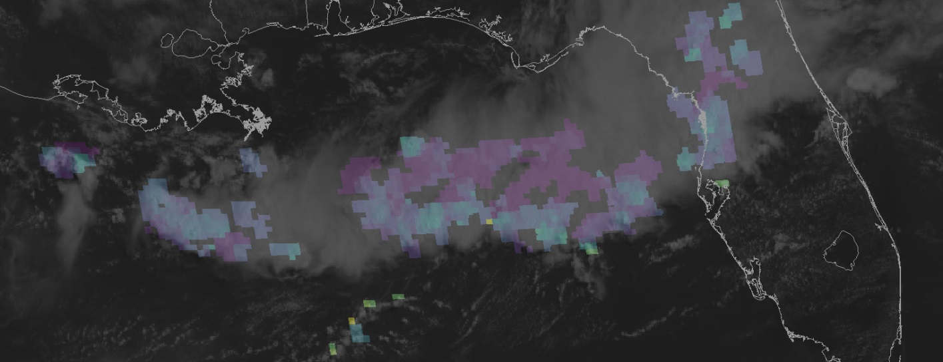
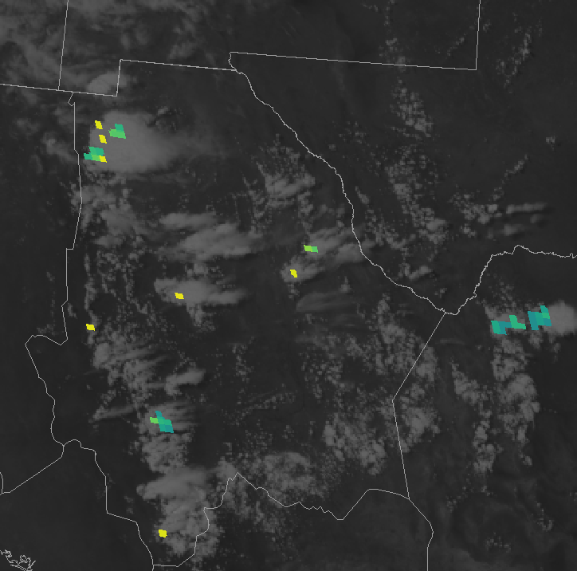
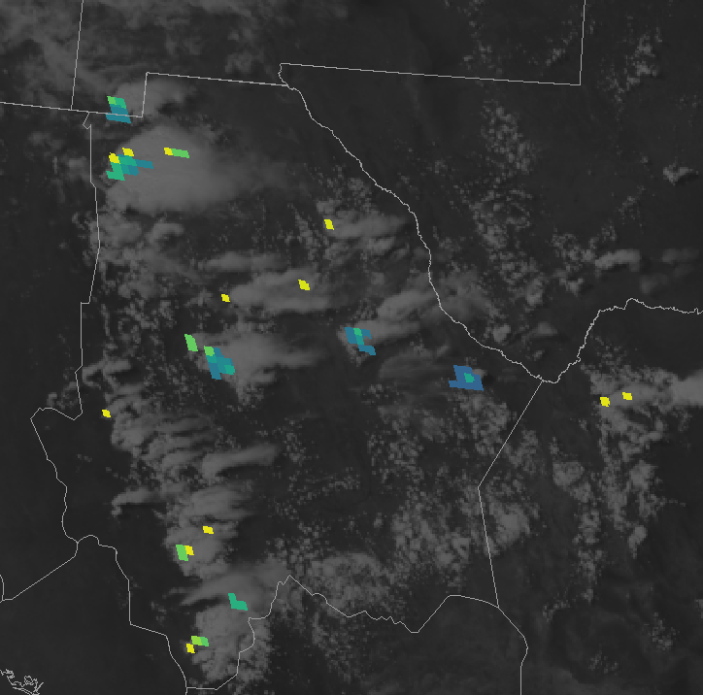
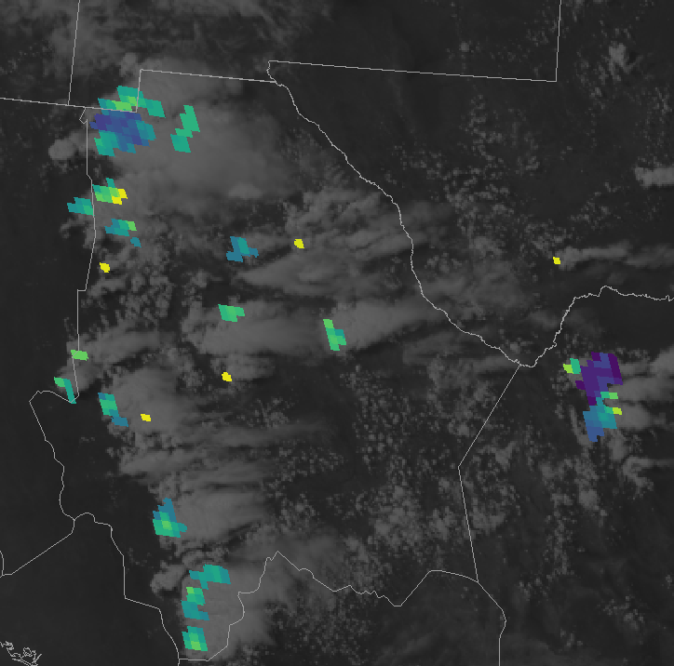
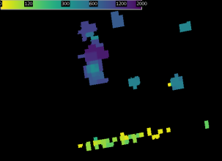
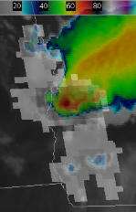
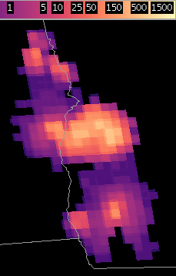
Geostationary Lightning Mapper:
Gridded Products (FED)
Quick Guide
Bright TOE regions indicate
The most energetic convective cores
Lightning channels within extensive flashes
AFA reveals
Large flashes in the stratiform / anvil regions and decaying storms
Small flashes in new convection (see below) and along the leading line
Distinct convective cores
1
1
2
2
Extensive stratiform flash = CG threat
Trailing stratiform region
3
3
4
4
Leading convective line
New Convection
Detect and Monitor Storm Growth
AFA accentuates small flashes to highlight earliest convection, also provides a visual que to help quantify storm growth
5
1953 UTC
2018 UTC
2112 UTC
5
AFA
Understanding Optical Observations
AFA and TOE help understand how the optical lightning signals interact with the convective scene
AFA makes false events along subarray boundaries very apparent (issue should be fixed during 2018)
TOE helps confirms when dim areas in nocturnal scenes represent illuminated low-level clouds rather than lightning channels ahead of the storm
Additional Resources
GLM VLab Community: https://go.usa.gov/xU5MF
GLM Faculty Virtual Course
NESDIS/STAR - CICS-MD
NASA SPoRT Home Page
Hyperlinks not available when viewing material in AIR Tool

