Slide 1
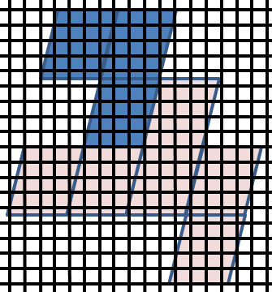
Geostationary Lightning Mapper:
Gridded Products (FED)
Quick Guide
Gridded GLM Products
GLM Level 2 data (events, groups, and flashes) are produced as points, resulting in a loss of information concerning the spatial extent
Gridded GLM product restores and disseminates the spatial footprint information while greatly reducing the file size
Gridded GLM products involve re-navigating the GLM event latitude / longitude to the 2×2 km Advanced Baseline Imager (ABI) fixed grid
Flash extent density (FED), the number of flashes that occur within a grid cell over a given period of time, is the first NWS product
Gridding Procedures
A corner point lookup table is used to re-create event polygons from the L2 points
Parent-child relationships are used to combine the event polygons into group and flash polygons
These polygons are then subdivided at the flash, group, and event levels by slicing them with the ABI fixed grid
The next step accumulates and weights the sliced polygons at the flash, group, and event levels to create the gridded products
FED values are rounded to the nearest integer
(1) Re-create event, group, and flash polygons from L2 points
(2) Slice GLM polygons with the ABI fixed grid
(3) Accumulate/weight sliced polygons to create FED product
FED = 1
Motivation for Gridded Products
Many years of research and operational LMA demonstrations have shown the FED to be the preferred total lightning product
FED best portrays, in a single product, the quantity/extent of GLM flashes/events
The initial plan is for 1-min and 5-min window FED grids to reach AWIPS within ~1 minute
More gridded products will be incorporated later
Primary GLM Applications
Detect electrically active storms
Observe the areal lightning extent
Track embedded convective cells
Identify strengthening and weakening storms
Monitor convective mode and storm evolution,
Characterize storms as they transition offshore,
Provide insights into TC intensity changes
Author: Dr. Scott Rudlosky
NOAA/NESDIS/STAR (CICS-MD) Version 2 – June 11, 2018

Slide 2
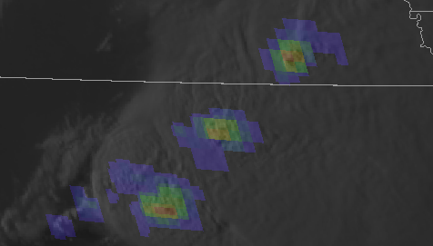
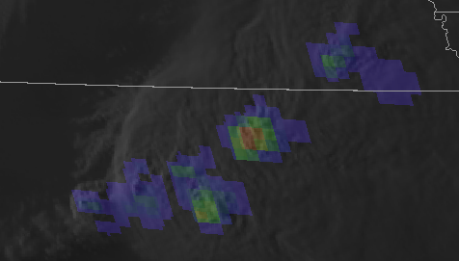
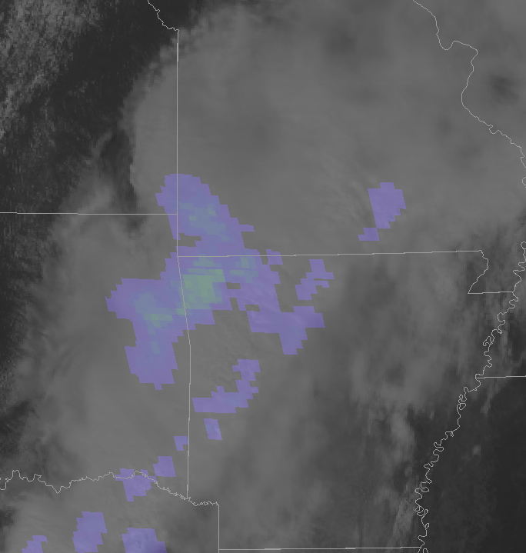
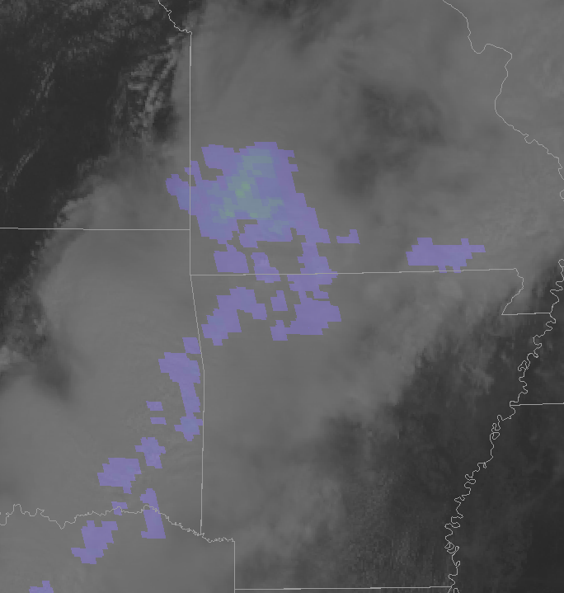
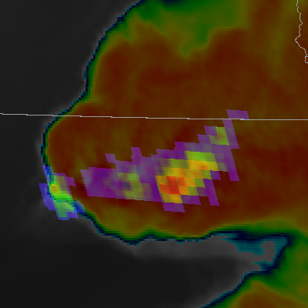
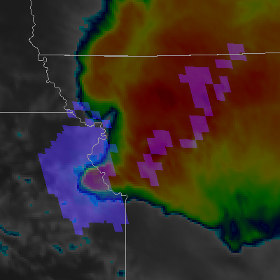
Geostationary Lightning Mapper:
Gridded Products (FED)
Quick Guide
GLM FED with visible imagery from an ABI mesoscale sector
Collocation of greatest flash rates and tallest storms
Distinct convective cores
Extensive stratiform flashes
Flash Extent Density
GLM gridding technique produces other gridded products under evaluation for potential AWIPS integration
Average flash area
GLM FED with ABI IR
Low-cloud illumination
Total optical energy
Nocturnal effects:
The increased sensitivity induced by the nighttime background makes nocturnal flashes appear larger than identical flashes during the day
Some of this signal also relates to the tendency for nocturnal storms to produce larger flashes as they grow upscale into mesoscale convective systems or weaken into messier convective scenes
Another important nocturnal feature is the illumination of low clouds by nearby deep convection
Optical GLM observations provide a new perspective on lightning activity
Additional Resources
Virtual Lab for the GLM
GLM Faculty Virtual Course
NESDIS/STAR - CICS-MD
NASA SPoRT Home Page
Hyperlinks not available when viewing material in AIR Tool

