Slide 1


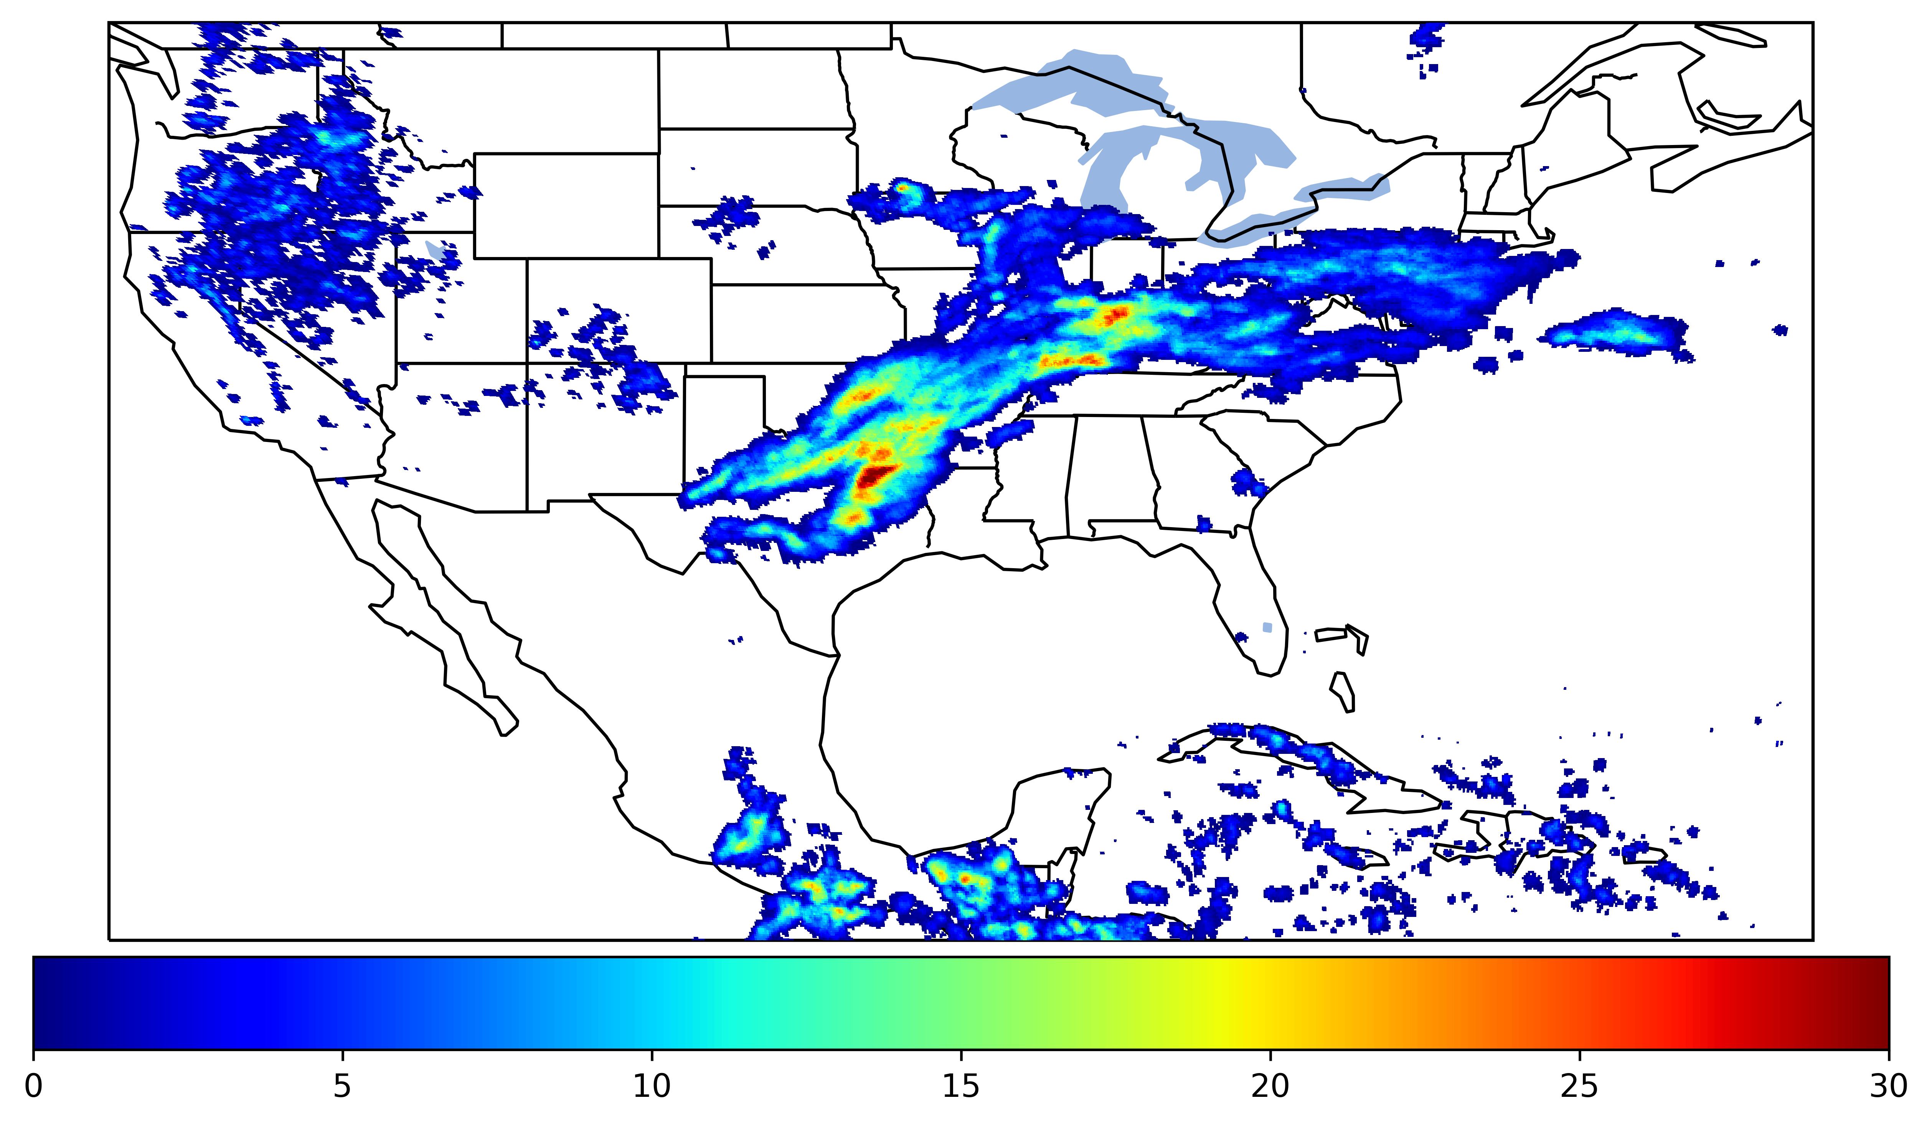
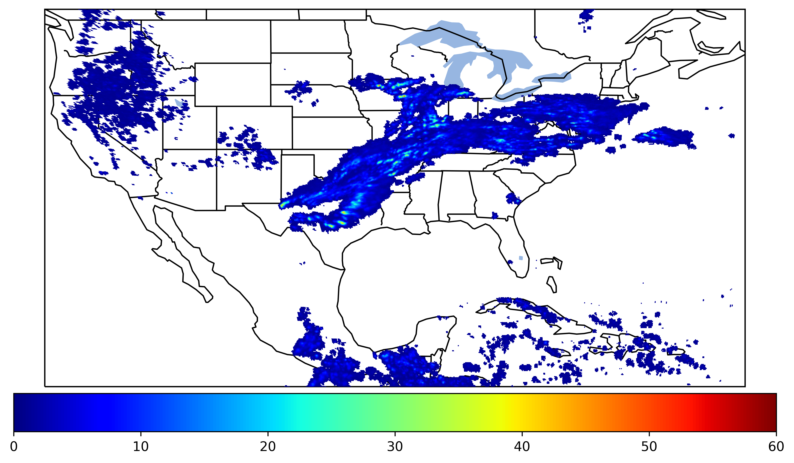
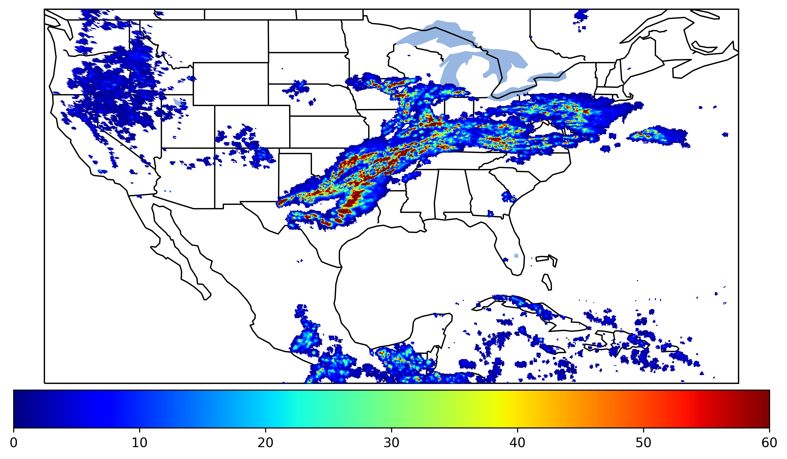
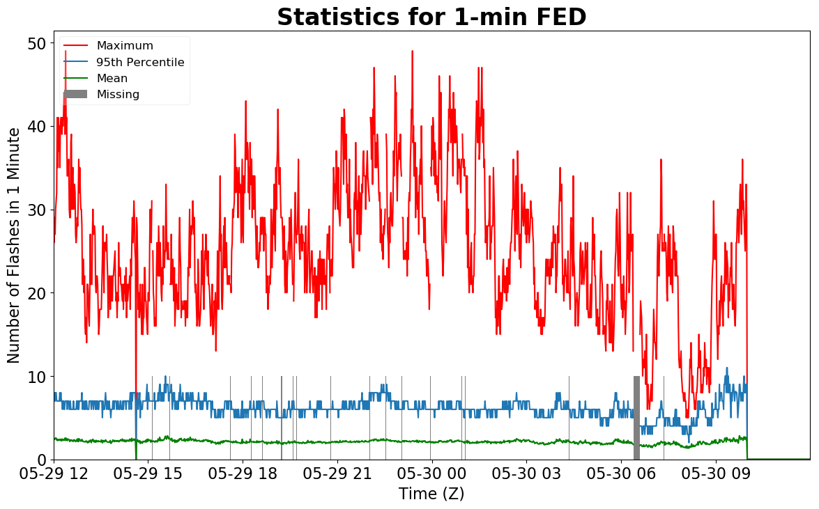
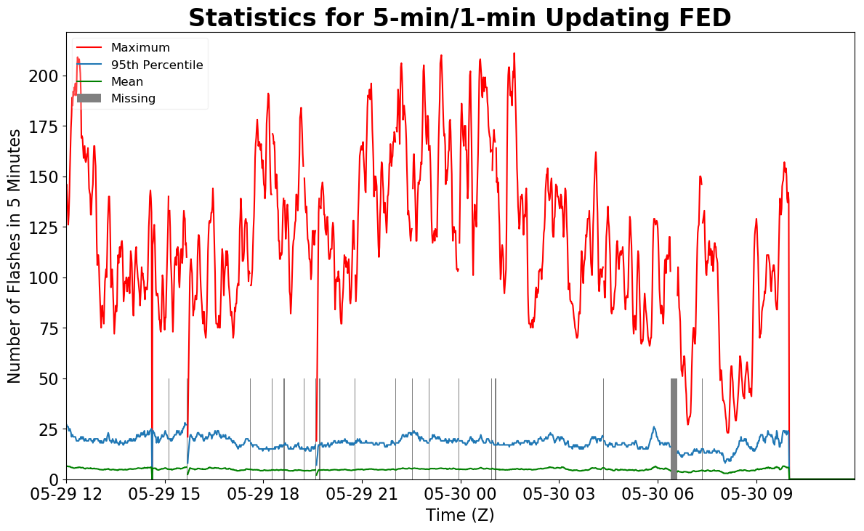
Geostationary Lightning Mapper Gridded Products Daily Summary
Overall Summary Statistics for 1200Z-1200Z ending on
05/30/2019
of grid cells detected lightning –
Duration of GLM outage(s):
14.3%
93.7%
91 minute(s)
of the day had GLM coverage –
Fraction of the Day With Lightning (%)
Mean 5-min FED
Max 5-min FED
FED Summary Statistics
1-min FED
Max 1-min FED:
Max min-to-min increase:
49 flashes/min
19 flashes
5-min/1-min Updating FED
Max 5-min FED:
Max min-to-min increase:
211 flashes/5min
75 flashes
Total Optical Energy and Average Flash Area Summary Statistics
5-min/1-min Updating TOE
5-min/1-min Updating AFA
194.3 fJ
9273.0 km^2
Max 5-min TOE:
Max min-to-min increase:
Max 5-min AFA:
Max min-to-min increase:
177.6 fJ
7834.0 km^2

