Slide 1


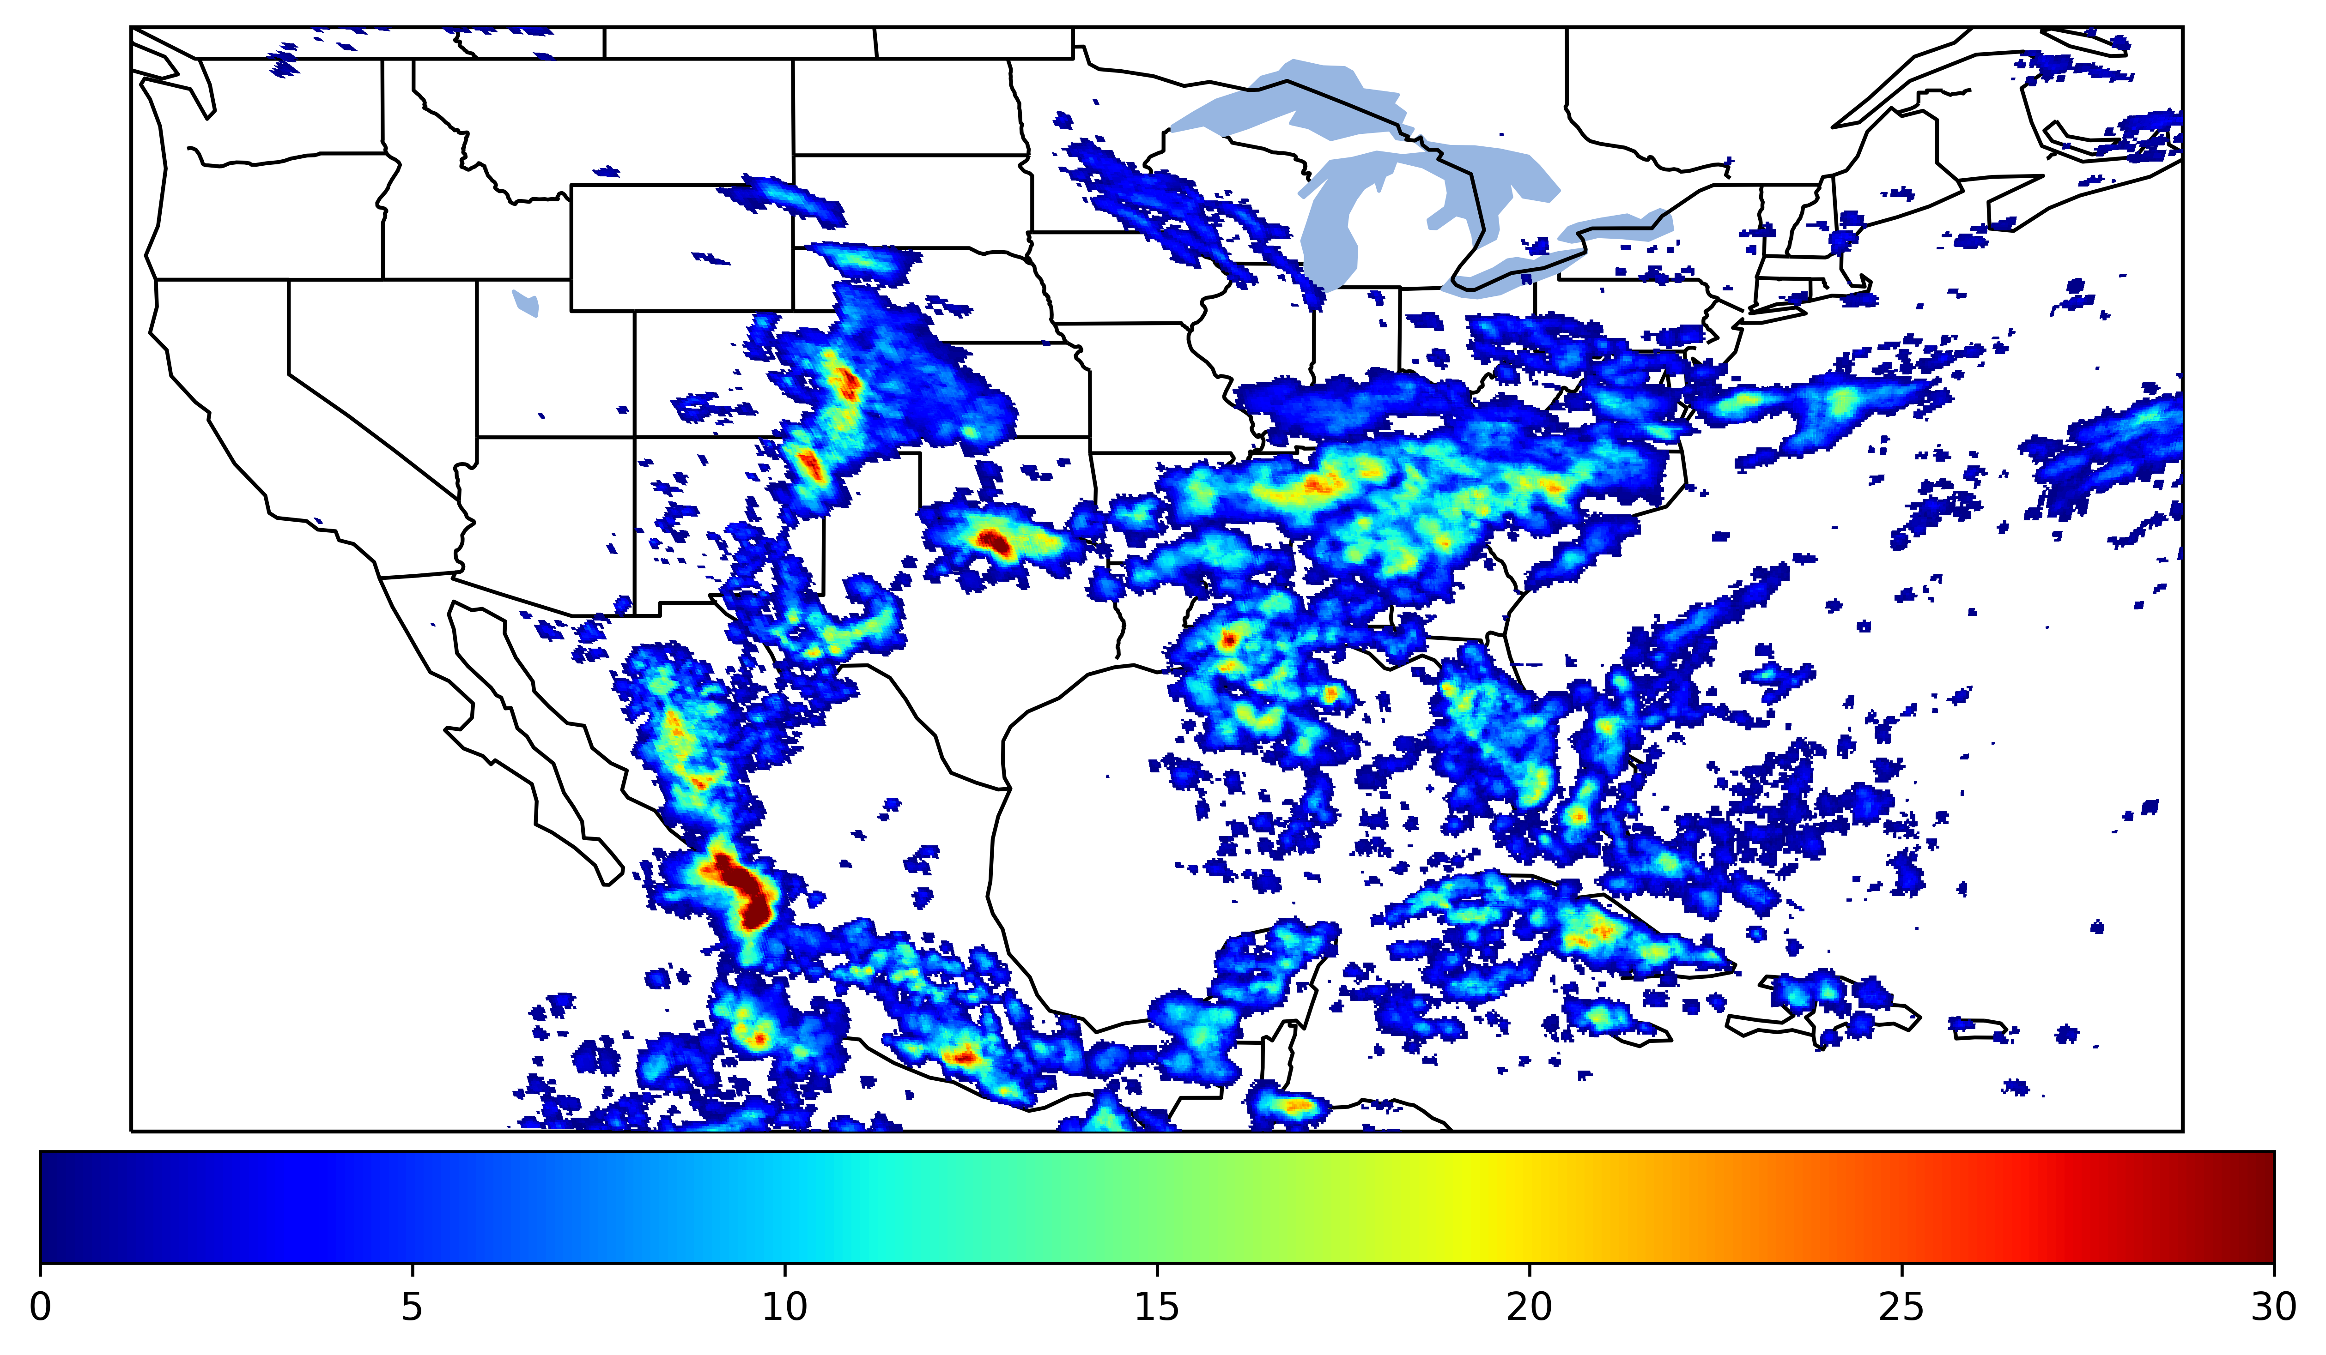
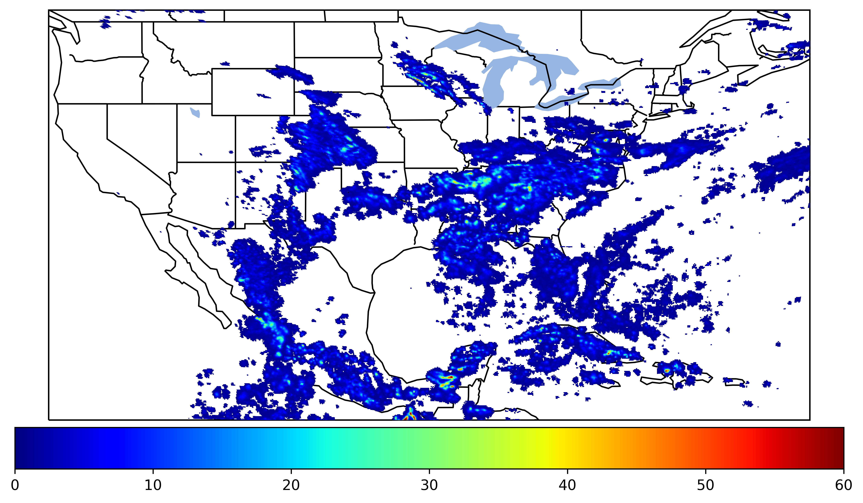
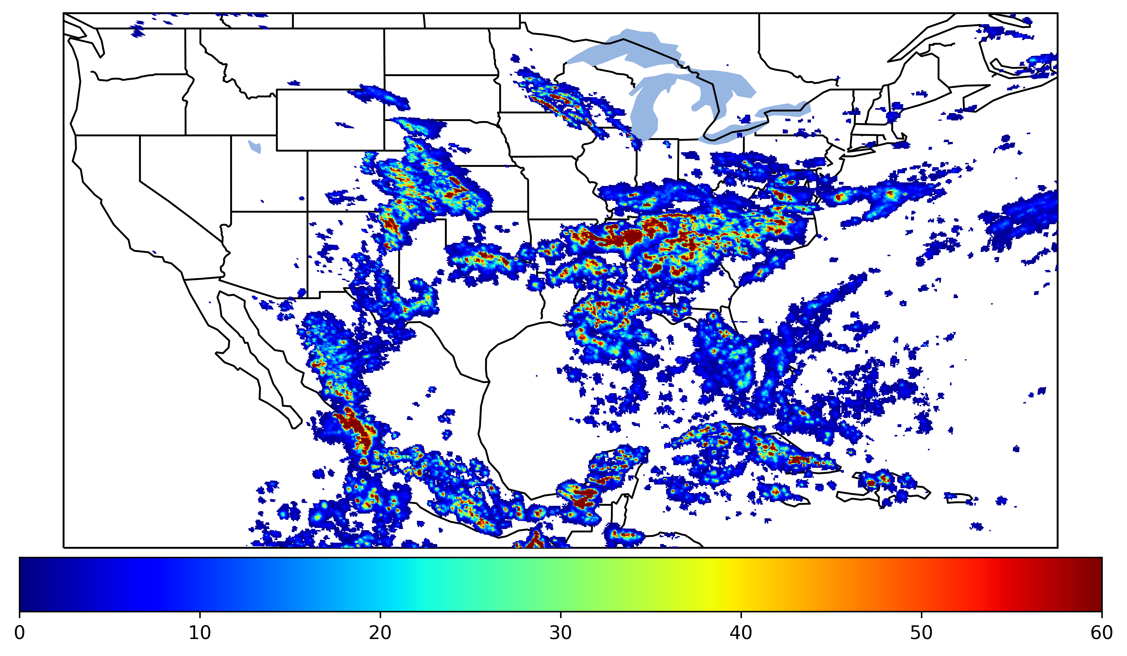
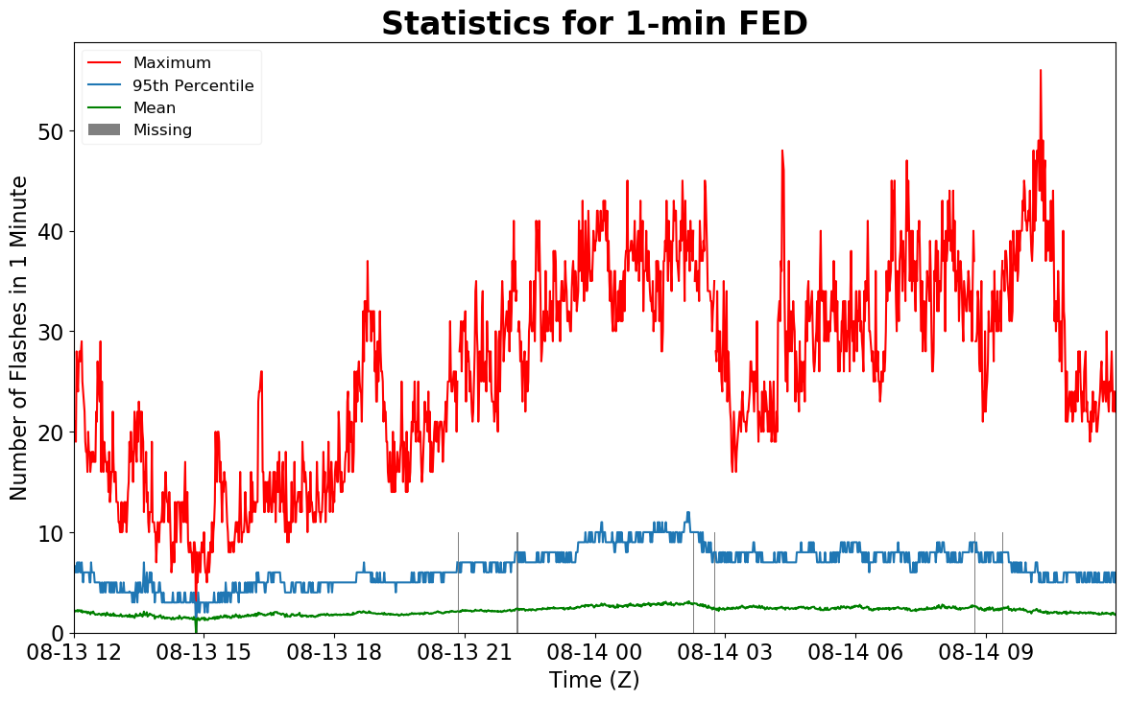
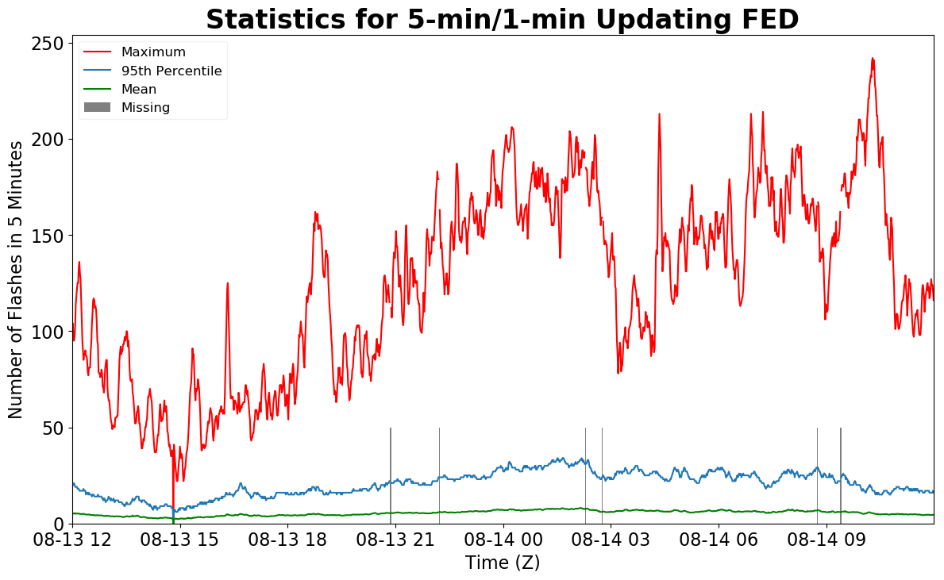
Geostationary Lightning Mapper Gridded Products Daily Summary
Overall Summary Statistics for 1200Z-1200Z ending on
08/14/2019
of grid cells detected lightning –
Duration of GLM outage(s):
26.2%
99.4%
8 minute(s)
of the day had GLM coverage –
Fraction of the Day With Lightning (%)
Mean 5-min FED
Max 5-min FED
FED Summary Statistics
1-min FED
Max 1-min FED:
Max min-to-min increase:
56 flashes/min
17 flashes
5-min/1-min Updating FED
Max 5-min FED:
Max min-to-min increase:
242 flashes/5min
36 flashes
Total Optical Energy and Average Flash Area Summary Statistics
5-min/1-min Updating TOE
5-min/1-min Updating AFA
196.4 fJ
9890.0 km^2
Max 5-min TOE:
Max min-to-min increase:
Max 5-min AFA:
Max min-to-min increase:
193.4 fJ
7192.0 km^2

