Slide 1


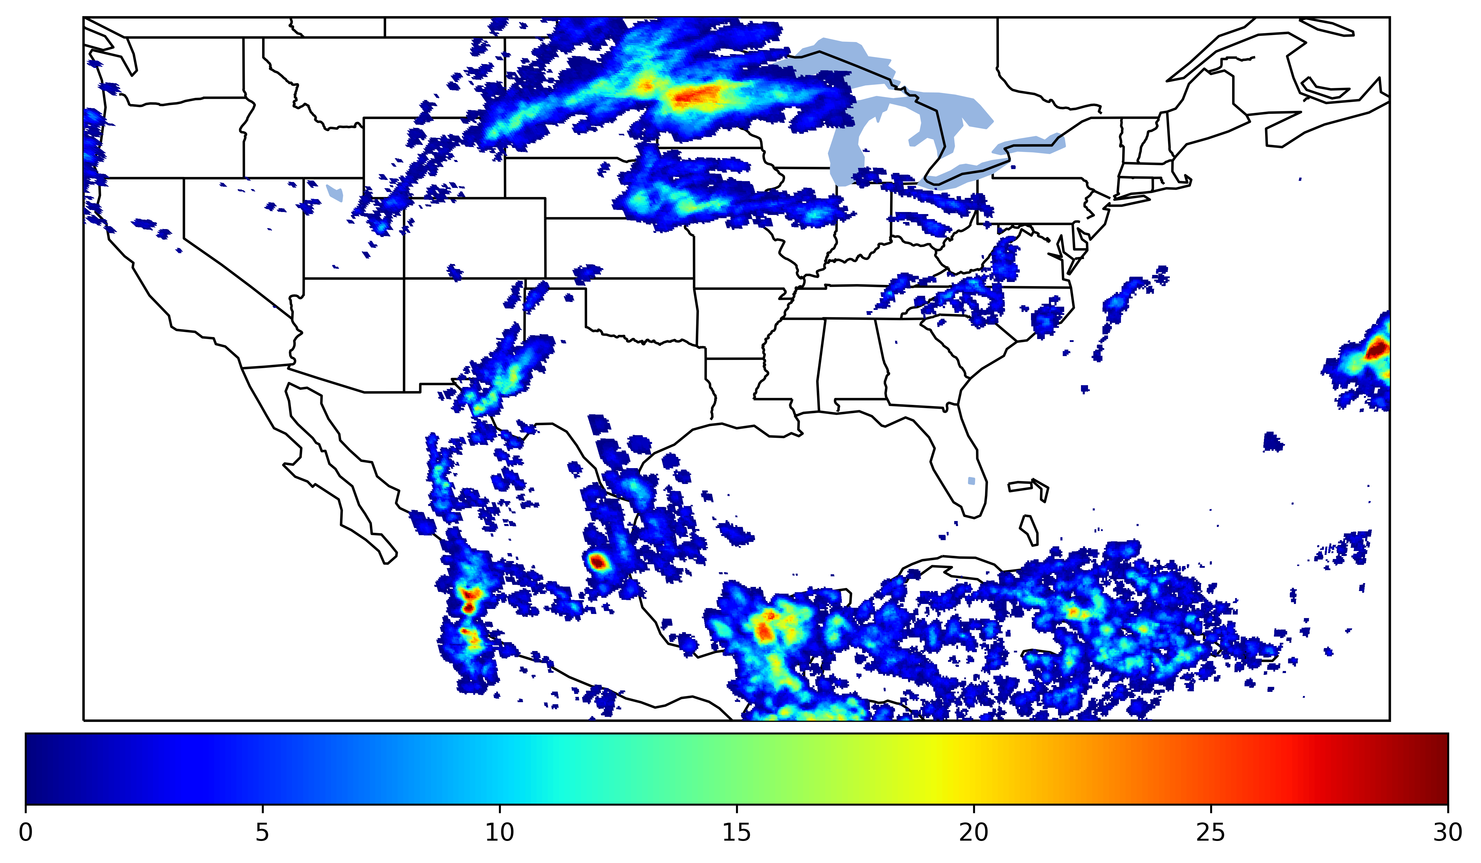
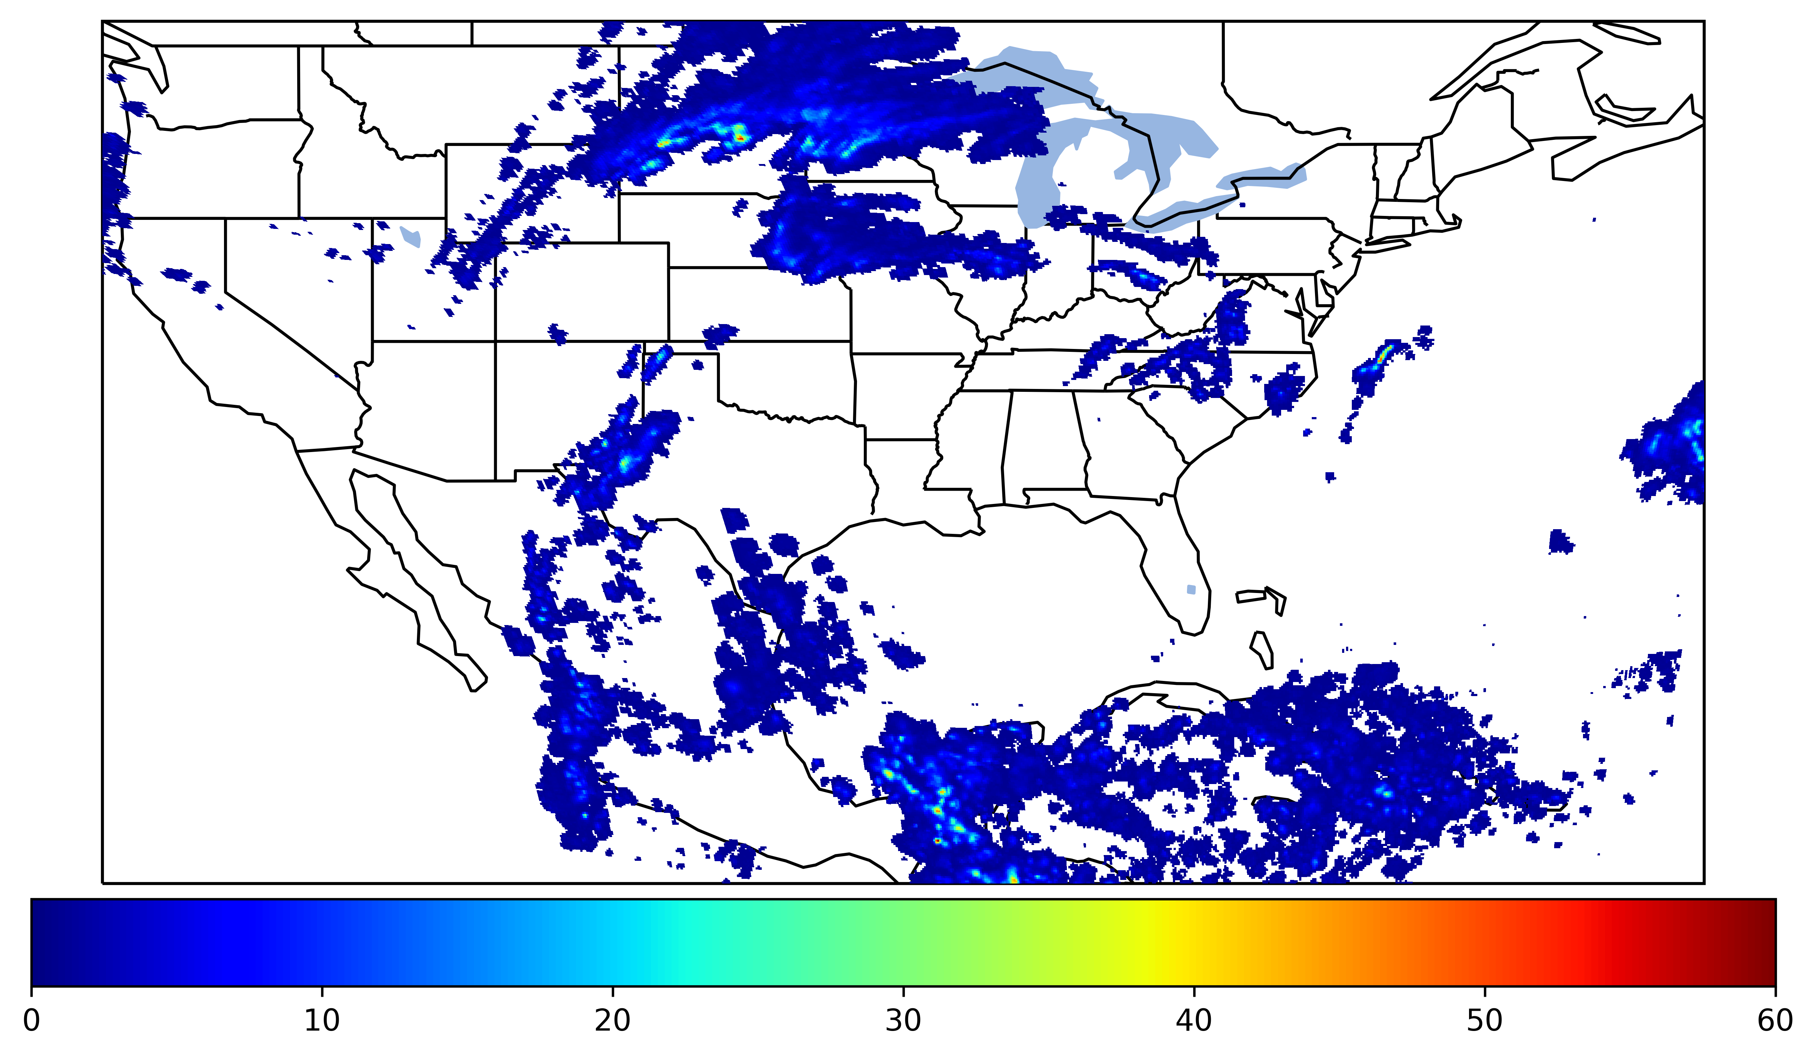
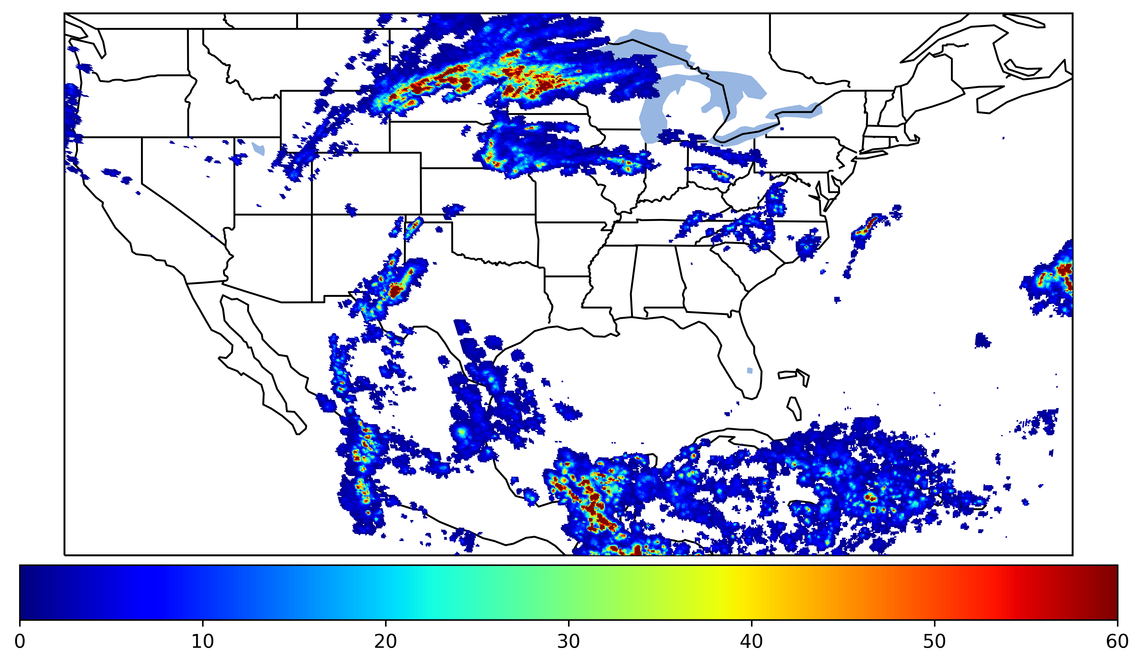
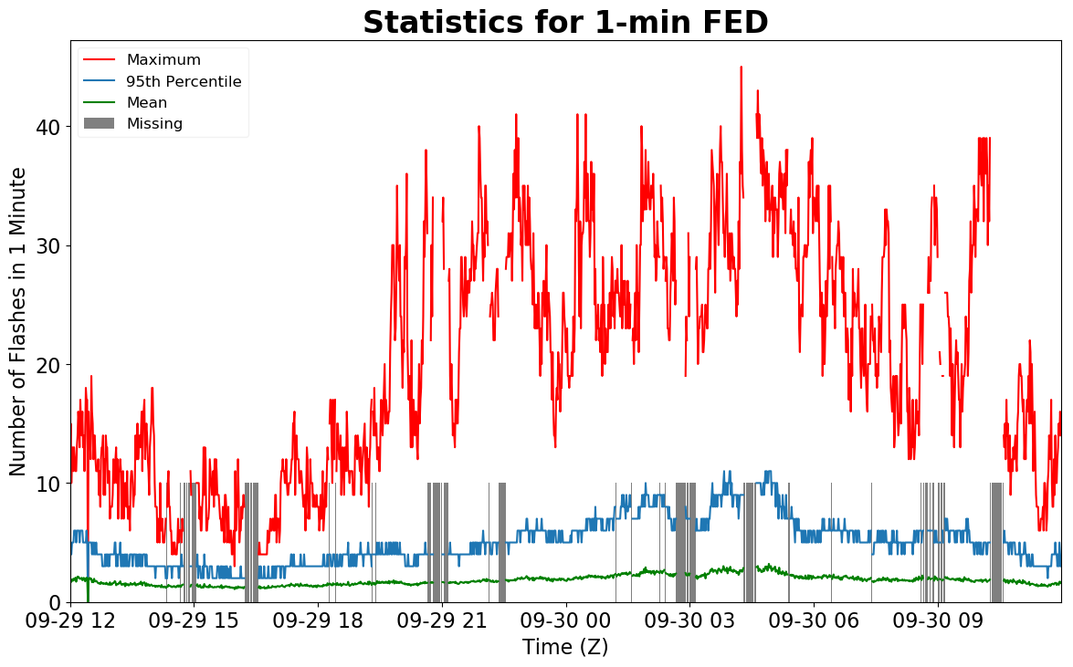
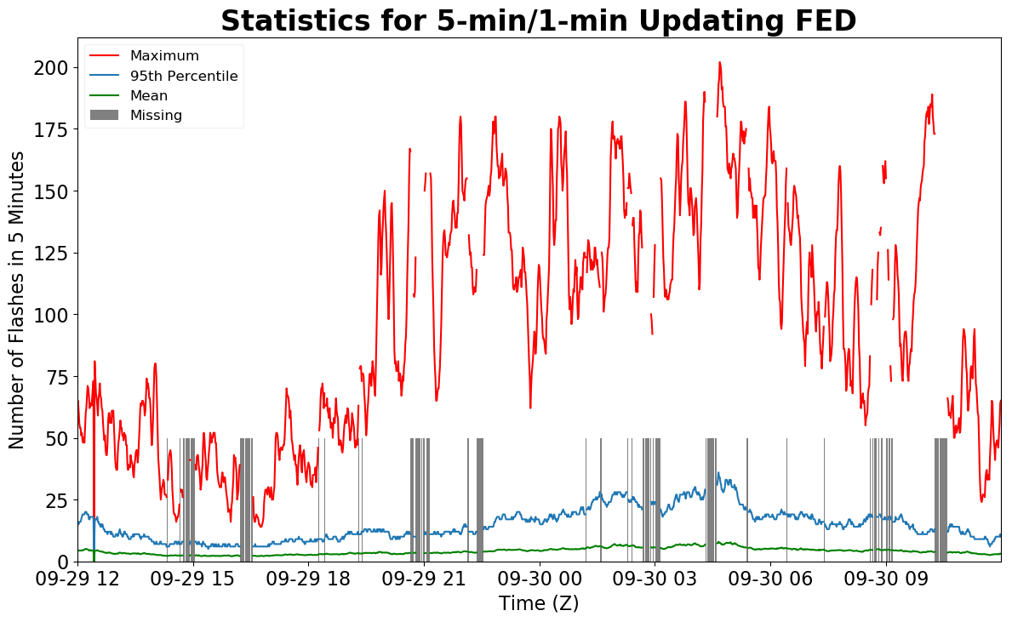
Geostationary Lightning Mapper Gridded Products Daily Summary
Overall Summary Statistics for 1200Z-1200Z ending on
09/30/2019
of grid cells detected lightning –
Duration of GLM outage(s):
19.6%
90.1%
143 minute(s)
of the day had GLM coverage –
Fraction of the Day With Lightning (%)
Mean 5-min FED
Max 5-min FED
FED Summary Statistics
1-min FED
Max 1-min FED:
Max min-to-min increase:
45 flashes/min
29 flashes
5-min/1-min Updating FED
Max 5-min FED:
Max min-to-min increase:
202 flashes/5min
102 flashes
Total Optical Energy and Average Flash Area Summary Statistics
5-min/1-min Updating TOE
5-min/1-min Updating AFA
196.6 fJ
9777.0 km^2
Max 5-min TOE:
Max min-to-min increase:
Max 5-min AFA:
Max min-to-min increase:
194.6 fJ
9078.0 km^2

