Slide 1


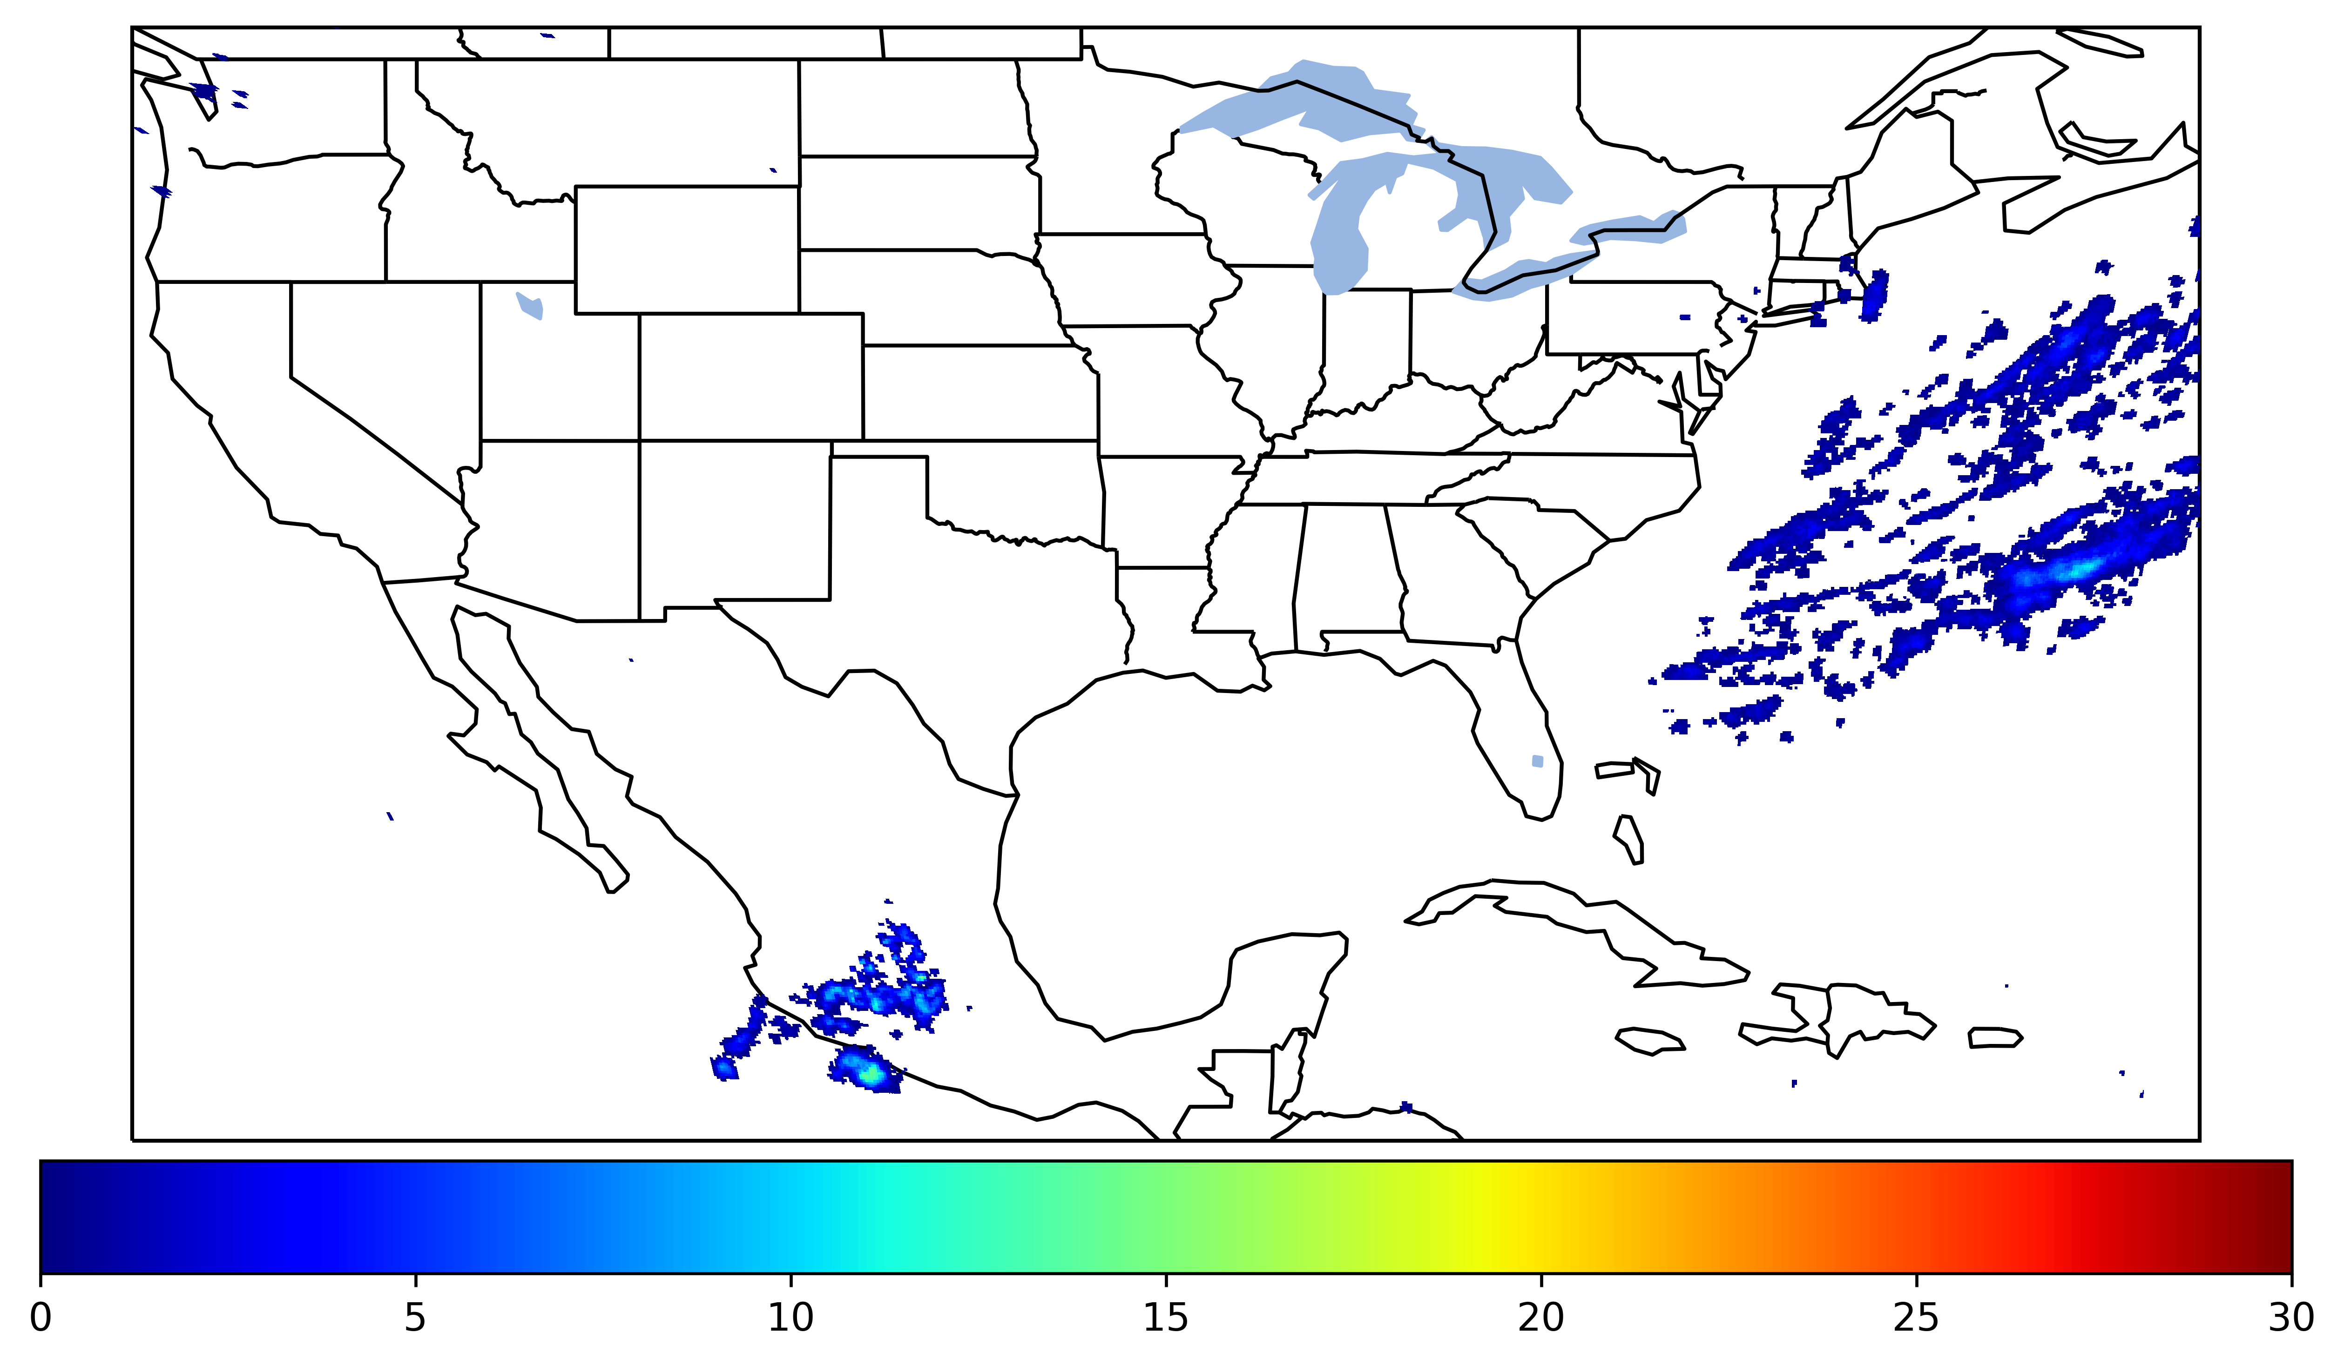


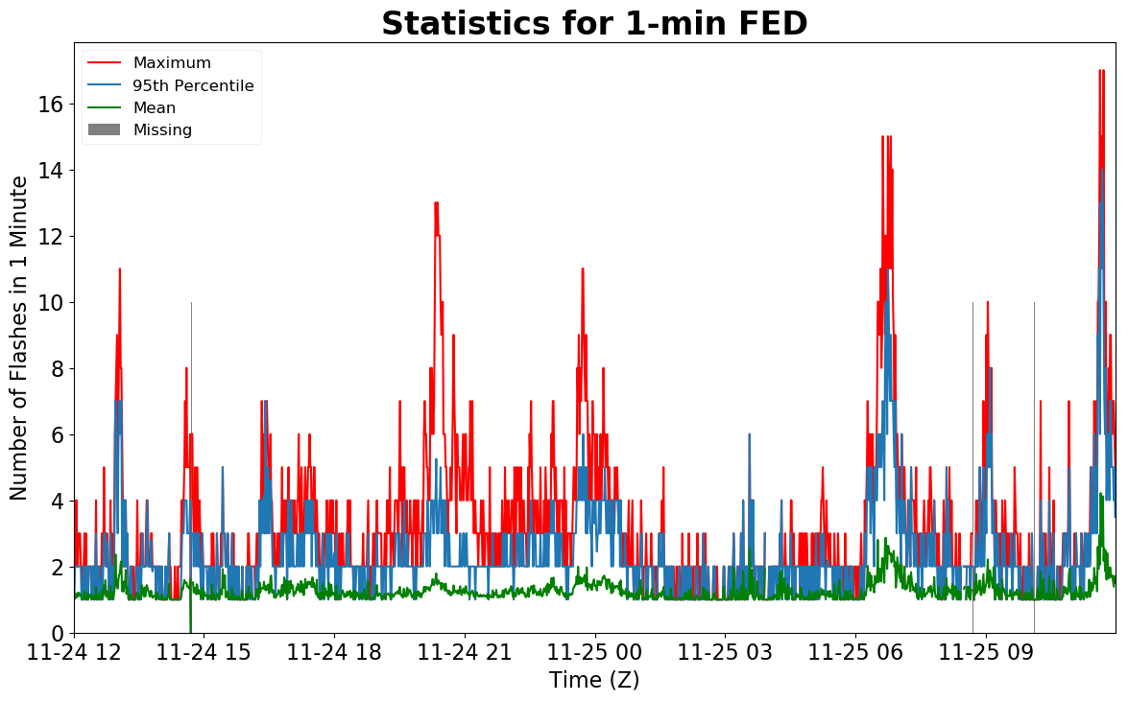
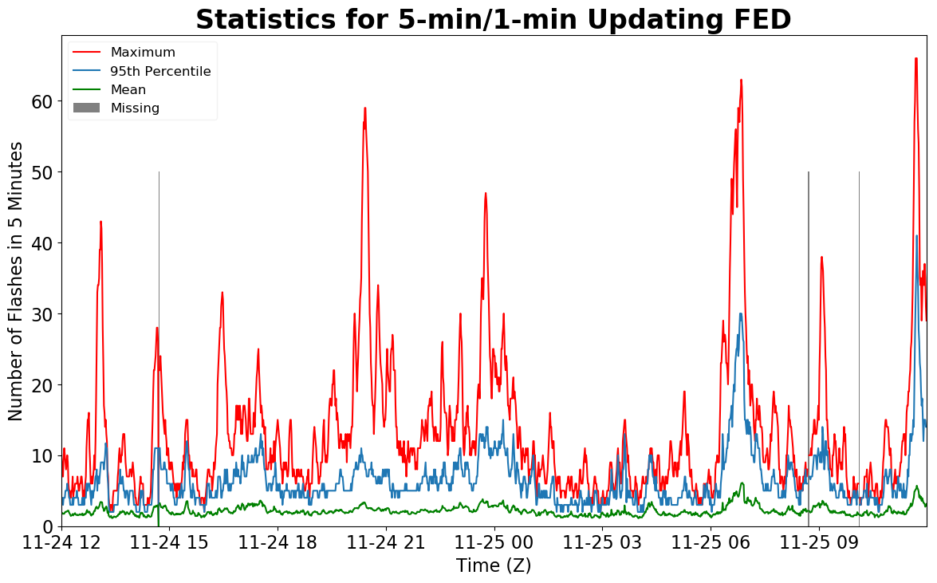
Geostationary Lightning Mapper Gridded Products Daily Summary
Overall Summary Statistics for 1200Z-1200Z ending on
11/25/2019
of grid cells detected lightning –
Duration of GLM outage(s):
3.9%
99.7%
5 minute(s)
of the day had GLM coverage –
Fraction of the Day With Lightning (%)
Mean 5-min FED
Max 5-min FED
FED Summary Statistics
1-min FED
Max 1-min FED:
Max min-to-min increase:
17 flashes/min
8 flashes
5-min/1-min Updating FED
Max 5-min FED:
Max min-to-min increase:
66 flashes/5min
13 flashes
Total Optical Energy and Average Flash Area Summary Statistics
5-min/1-min Updating TOE
5-min/1-min Updating AFA
108.7 fJ
8196.0 km^2
Max 5-min TOE:
Max min-to-min increase:
Max 5-min AFA:
Max min-to-min increase:
32.4 fJ
5865.0 km^2

