Slide 1


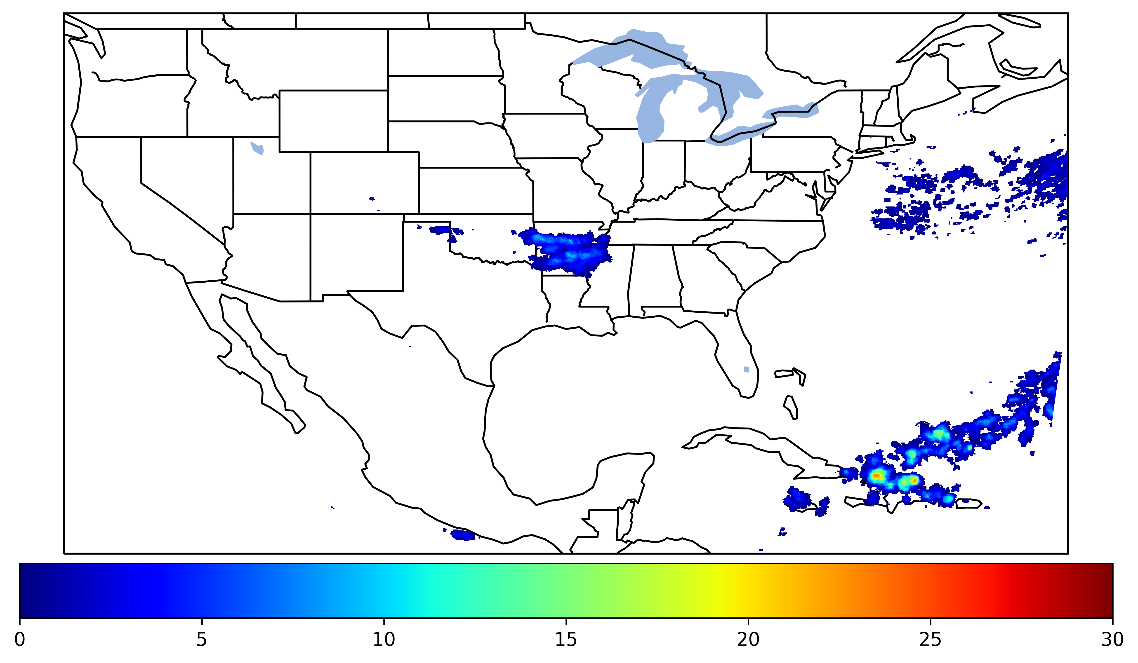
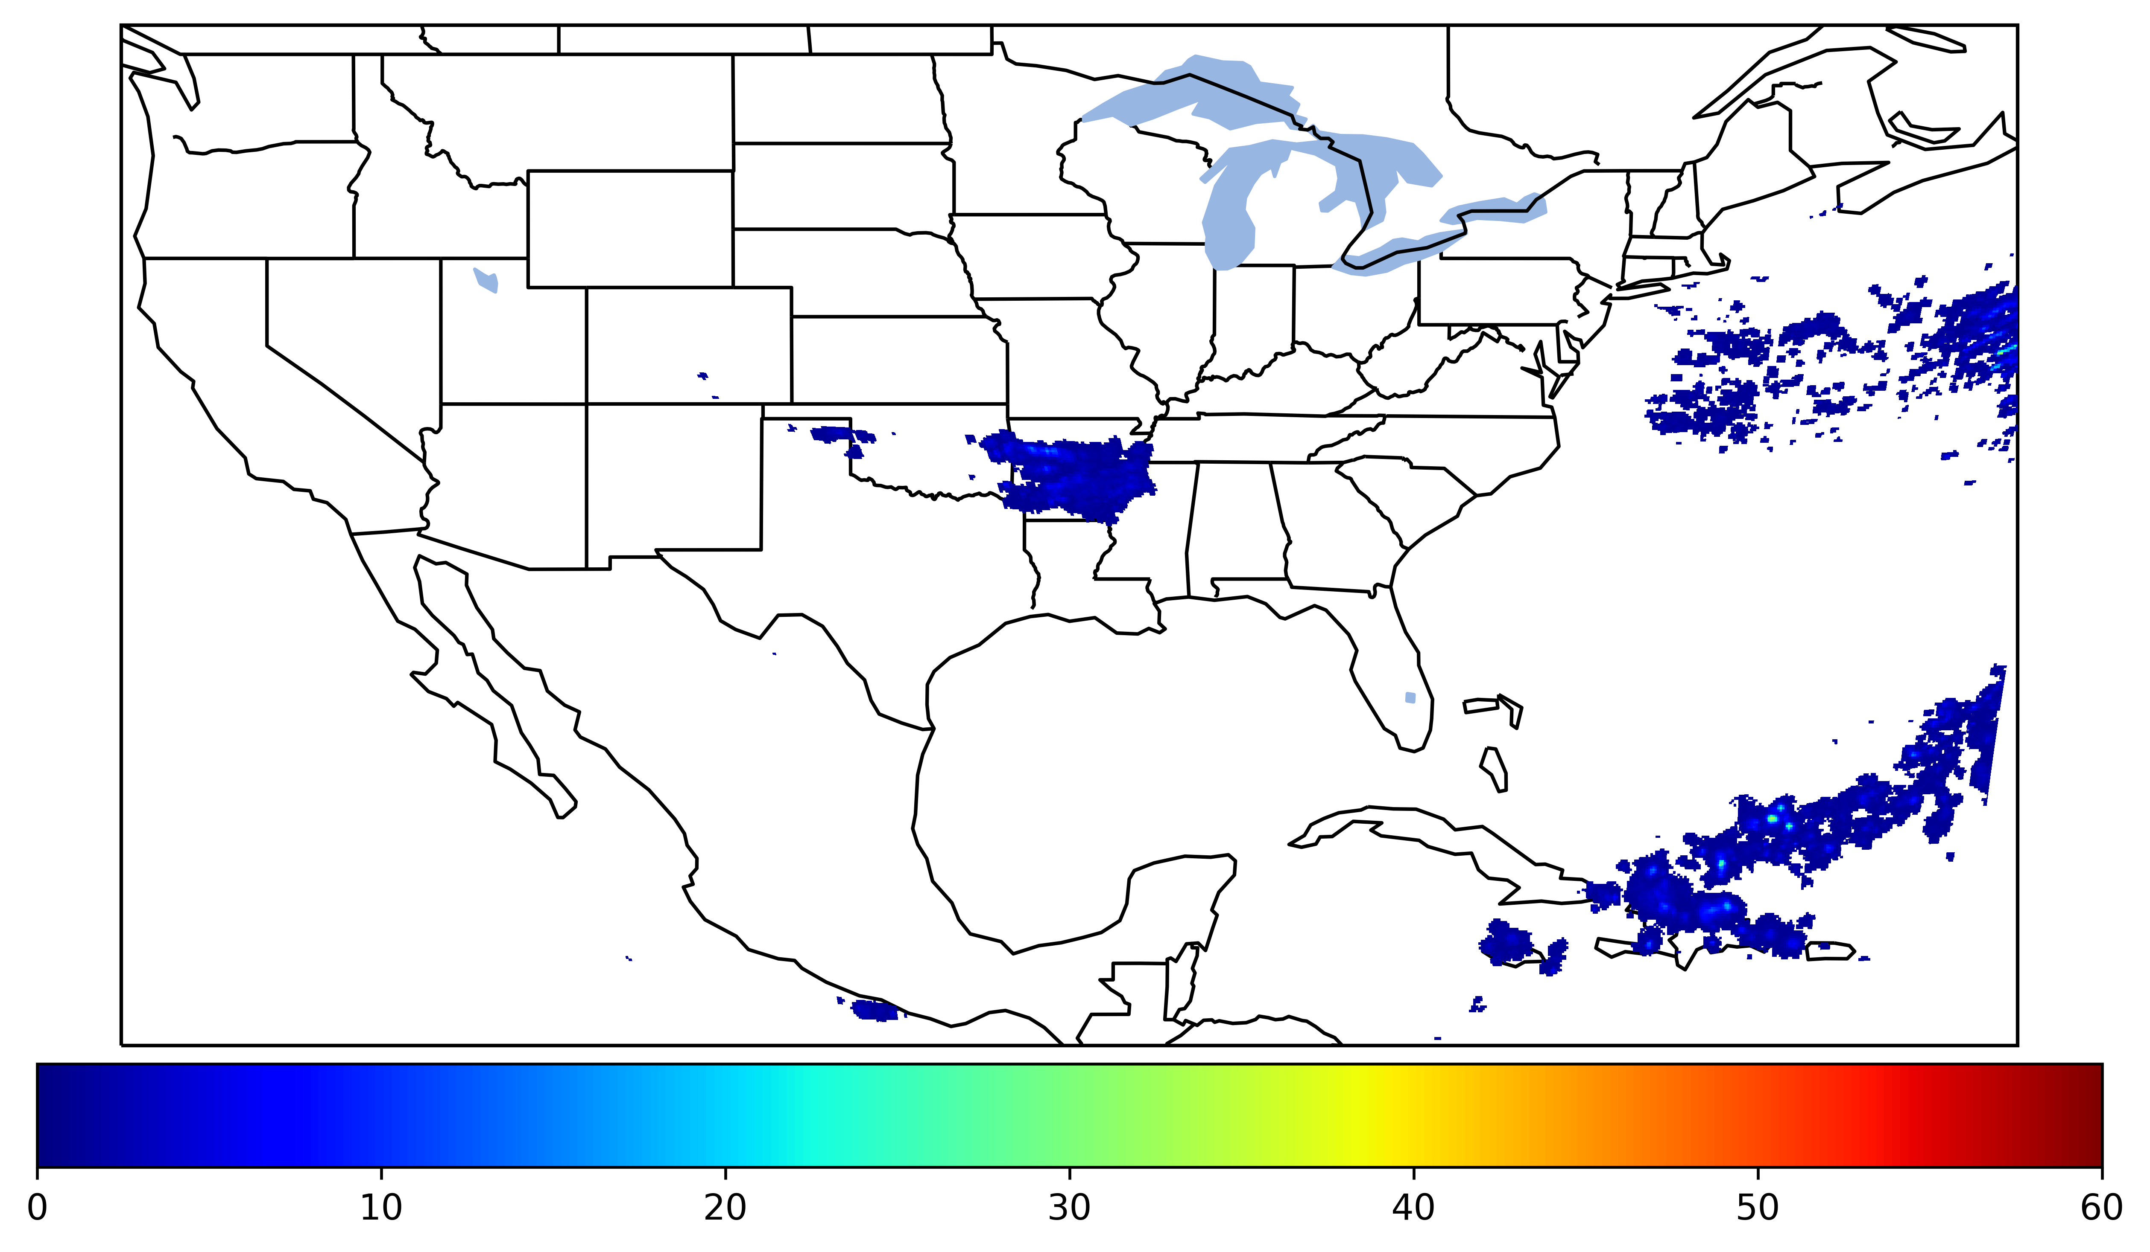

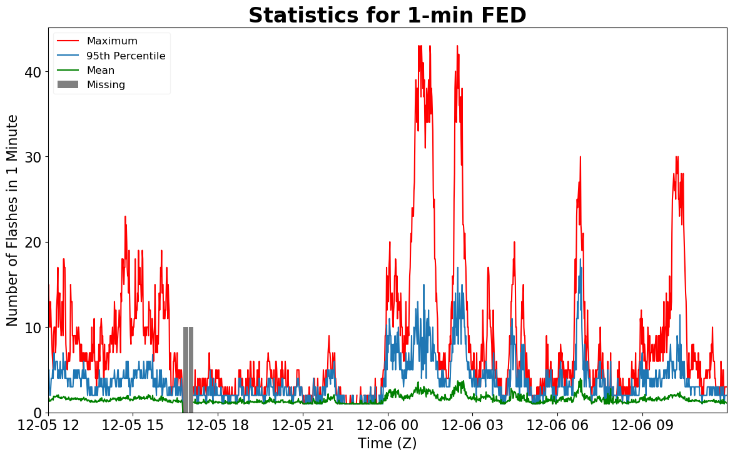
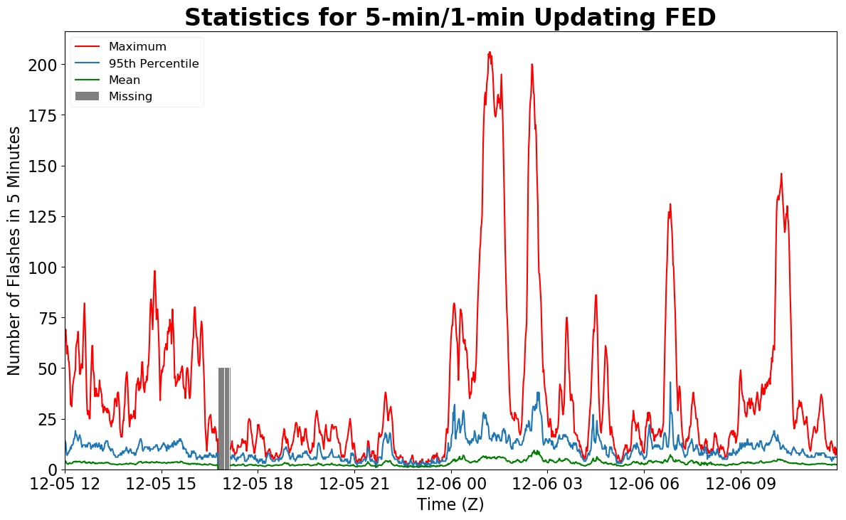
Geostationary Lightning Mapper Gridded Products Daily Summary
Overall Summary Statistics for 1200Z-1200Z ending on
12/06/2019
of grid cells detected lightning –
Duration of GLM outage(s):
4.5%
98.5%
21 minute(s)
of the day had GLM coverage –
Fraction of the Day With Lightning (%)
Mean 5-min FED
Max 5-min FED
FED Summary Statistics
1-min FED
Max 1-min FED:
Max min-to-min increase:
43 flashes/min
15 flashes
5-min/1-min Updating FED
Max 5-min FED:
Max min-to-min increase:
206 flashes/5min
30 flashes
Total Optical Energy and Average Flash Area Summary Statistics
5-min/1-min Updating TOE
5-min/1-min Updating AFA
188.7 fJ
9524.0 km^2
Max 5-min TOE:
Max min-to-min increase:
Max 5-min AFA:
Max min-to-min increase:
184.5 fJ
7745.0 km^2

